Slide 1
6. Design: Design Patterns
Choi, Kwanghoon
Chonnam National University

Slide 2
Table of Contents
Design Pattern

Slide 3
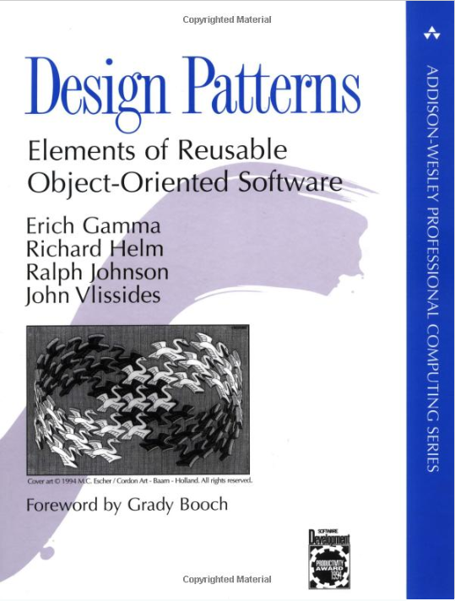
6.5 Design Patterns
A description of problem and the essence of its solution reusable in different settings
Design Patterns: Elements of Reusable Object-Oriented Software by GoF (Gang of Four)
23 Design Patterns in 3 types:
Creational Pattern types
Structural Pattern types
Behavioral Pattern types
http://www.uml.org.cn/c++/pdf/DesignPatterns.pdf

Slide 4
Design Pattern Types
Creational patterns
Creation and composition of objects, mechanism to instantiate objects easier, and constraints on the type and number of objects
Structural patterns
How classes and objects are organized and integrated to build a larger structure
Behavioral patterns
The assignment of responsibility between objects and the manner in which communication is effected between objects

Slide 5
23 Design Patterns
Creational Patterns | Structural Patterns | Behavioral Patterns
Abstract Factory Factory method Builder Prototype Singleton | Adapter Bridge Composite Decorator Façade Flyweight Proxy | Chain of Responsibility Command Interpreter Iterator Mediator Memento Observer State Strategy Template Method Visitor

Slide 6
Creational Patterns
Abstract factory pattern groups object factories that have a common theme. Factory method pattern creates an object without specifying the exact class to create. Builder pattern constructs complex objects by separating construction and representation. Prototype pattern creates objects by cloning an existing object. Singleton pattern restricts object creation for a class to only one instance.

Slide 7
Structural Patterns
Adapter pattern allows classes with incompatible interfaces to work together by wrapping its own interface around that of an already existing class. Bridge pattern decouples an abstraction from its implementation so that the two can vary independently. Composite pattern composes zero-or-more similar objects so that they can be manipulated as one object. Decorator pattern dynamically adds/overrides behavior in an existing method of an object. Façade pattern provides a simplified interface to a large bod of code. Flyweight pattern reduces the cost of creating and manipulating a large number of similar objects. Proxy pattern provides a placeholder for another object to control access, reduce cost, and reduce complexity.

Slide 8
Behavioral Patterns
Chain of Responsibility pattern delegates commands to a chain of processing objects. Command pattern creates objects which encapsulate actions and parameters. Interpreter pattern implements a specialized language. Iterator pattern accesses the elements of an object sequentially without exposing its underlying representation. Mediator pattern allows loose coupling between classes by being the only class that has detailed knowledge of their methods. Memento pattern provides the ability to restore an object to its previous state (undo). Observer pattern is a publish/subscribe pattern which allows a number of observer objects to see an event. State pattern allows an object to alter its behavior when its internal state changes. Strategy pattern allows one of a family of algorithms to be selected on-the-fly at runtime. Template Method pattern defines the skeleton of an algorithm as an abstract class, allowing its subclasses to provide concrete behavior. Visitor pattern separates an algorithm from an object structure by moving the hierarchy of methods into one object.

Slide 9
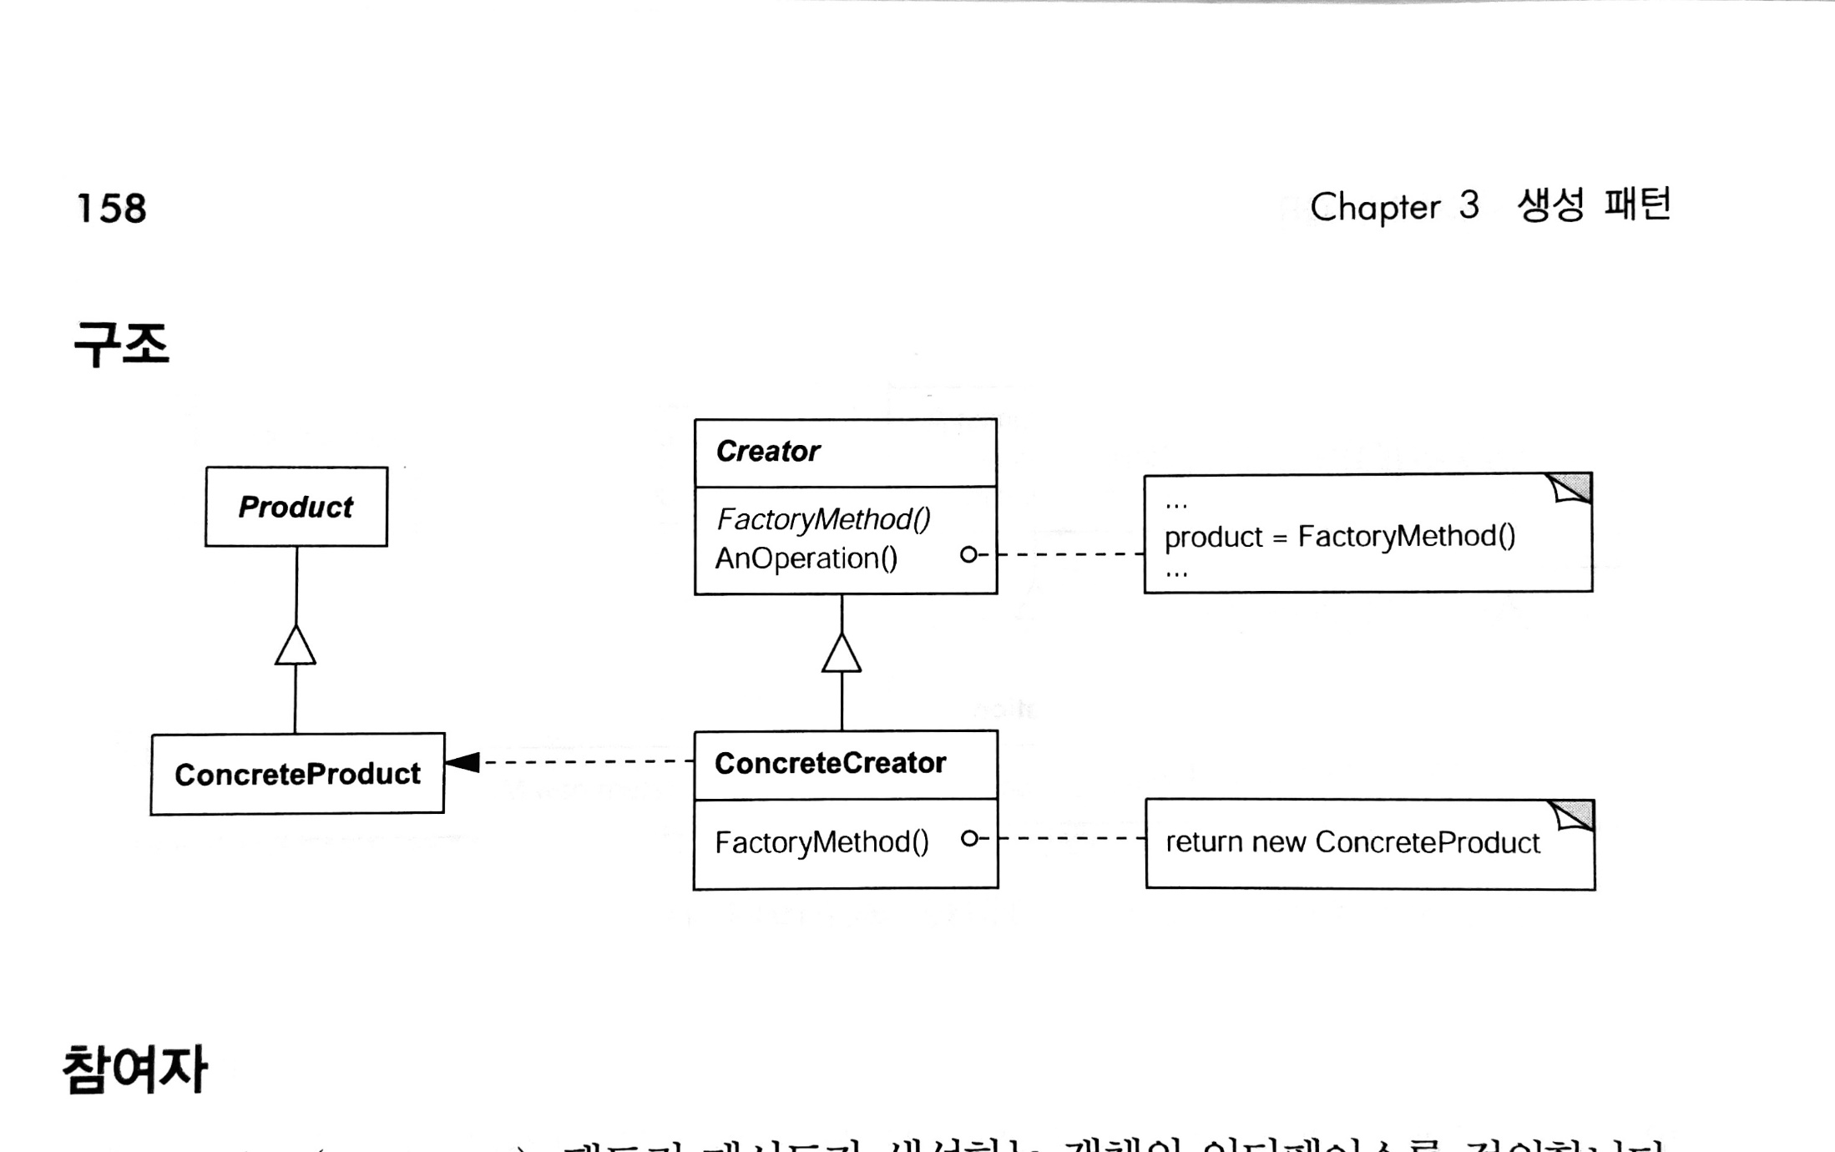
Factory Method Pattern
Creates an object without specifying the exact class (name) to create
참고) GoF 디자인 패턴

Slide 10
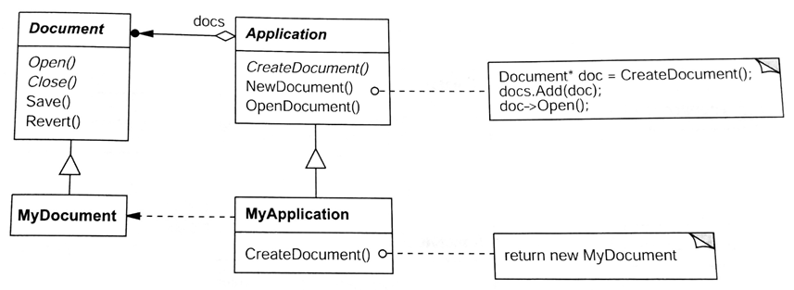
Factory Method Pattern
Creates an object without specifying the exact class to create
Example) CreateDocument()
참고) GoF 디자인 패턴

Slide 11
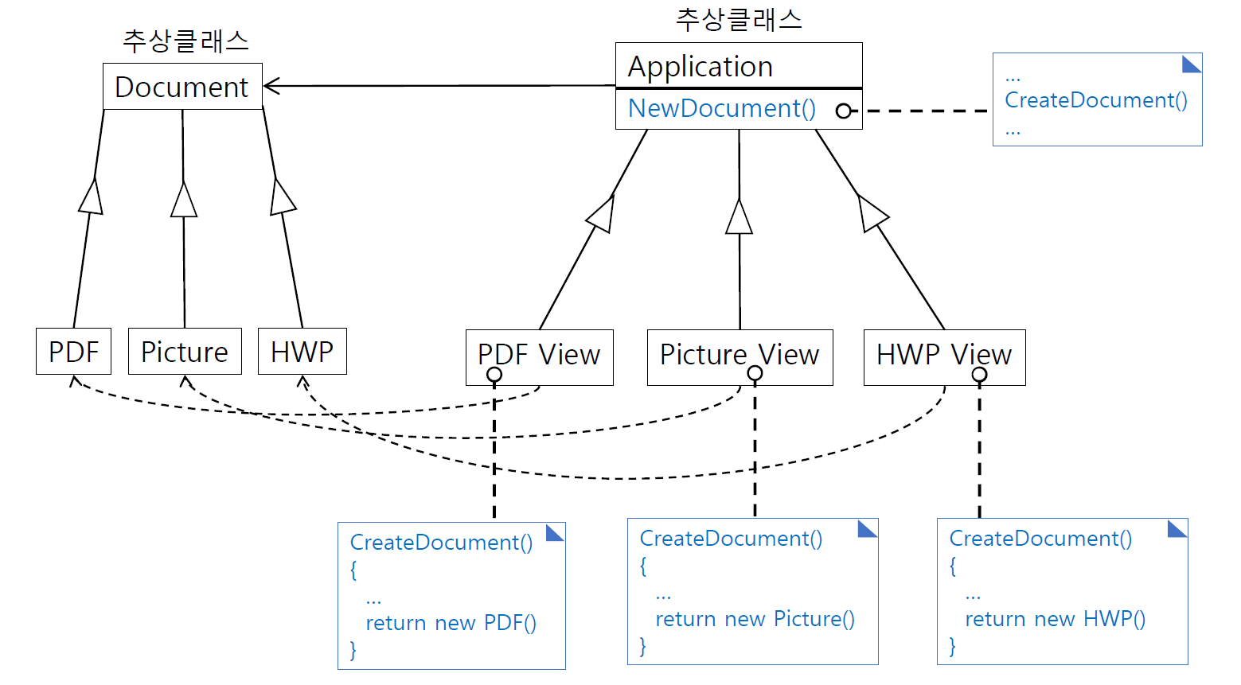
Application(추상클래스)
CreateDocument() NewDocument()
PDF Viewer
Picture Viewer
HWP Viewer

Slide 12
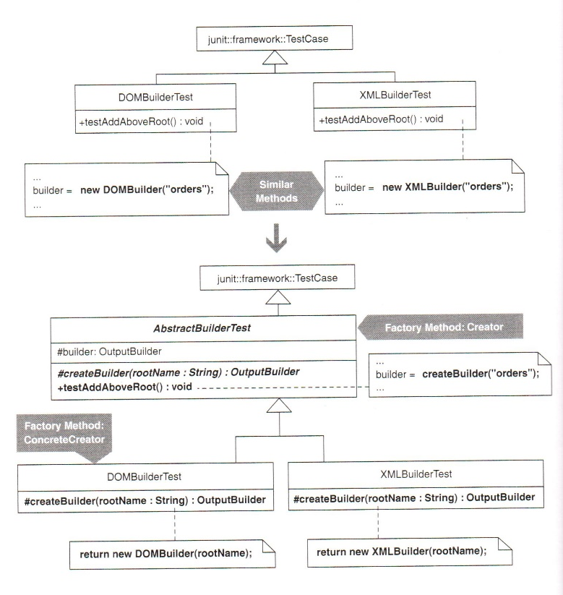
factory method pattern을 사용하도록
리팩토링(refactoring)
참고) Joshua Kerievsky, Refactoring to design patterns

Slide 13
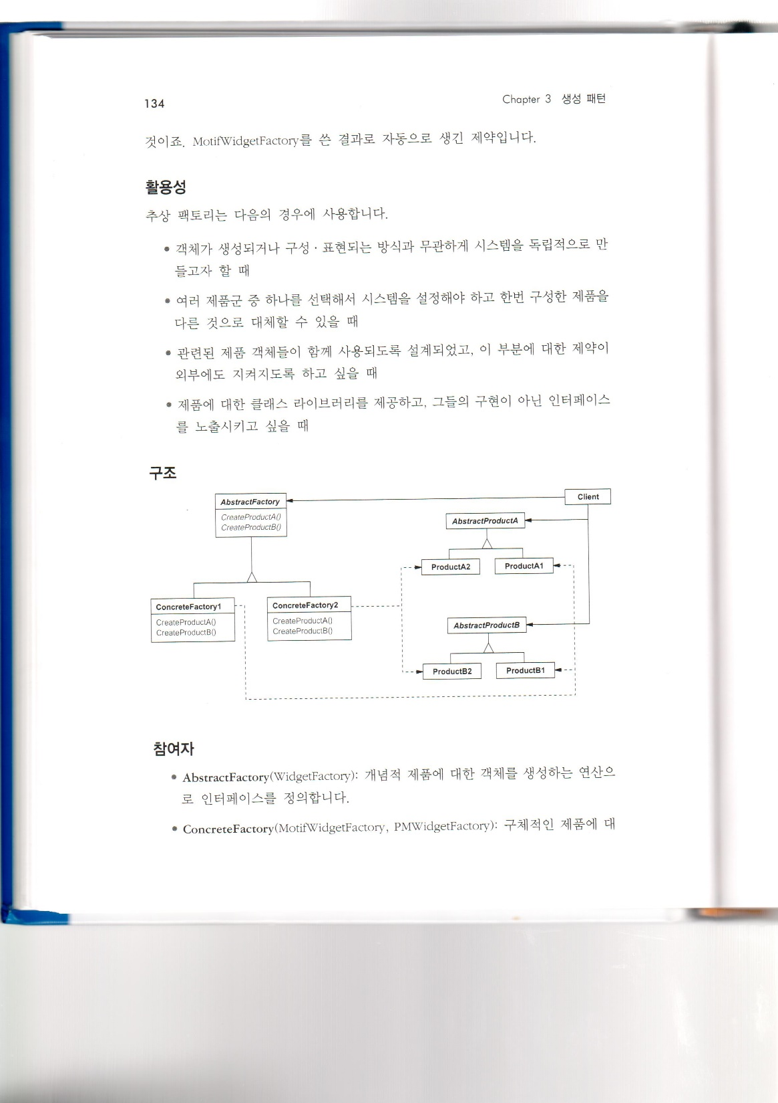
Abstract Factory Pattern
groups object factories that have a common theme
참고) GoF 디자인 패턴

Slide 14
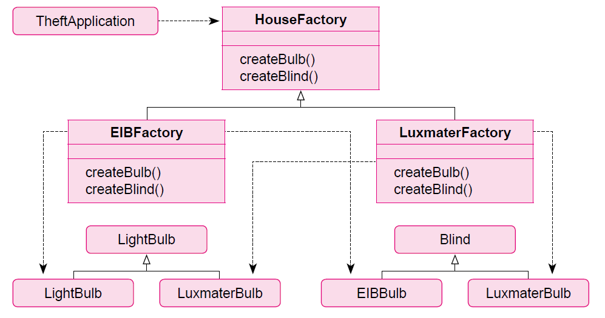
Abstract Factory Pattern
groups object factories that have a common theme
EIBBulb
EIBBlind
LuxmaterBlind
참고) 최은만 교재

Slide 15
Abstract Factory Pattern
Q. Draw a class diagram for the following Java programs
DesignPatternExamples/src/com/example/designpattern/abstractfactory
Q. Explain the role of FactoryFactory
The ElevatorFactoryFactory class

Slide 16
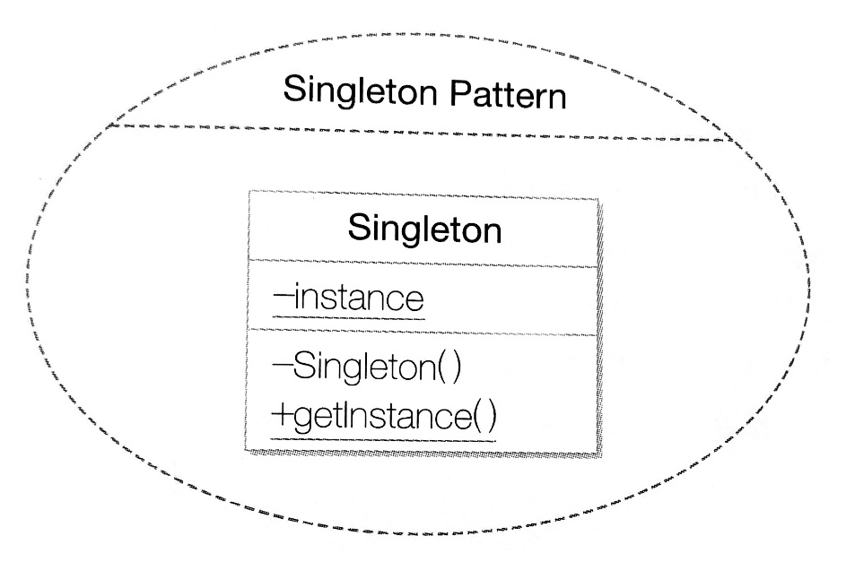
Singleton Pattern
restricts object creation for a class to only one instance.
public class Singleton {
private static Singleton instance = null;
private Singleton() { … }
public static Singleton getInstance() {
if (instance == null)
instance = new Singleton();
return instance;
}
public void doSomething() {
…
}
}
참고) 정인상, 채흥석, Java로 배우는 디자인패턴

Slide 17
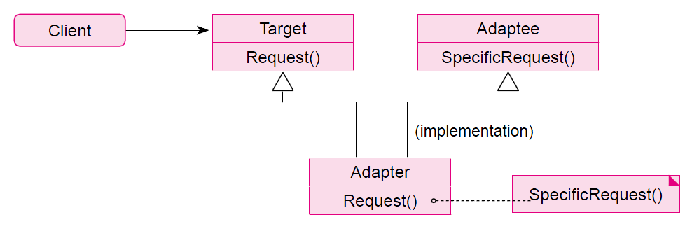
Adapter Pattern
allows classes with incompatible interfaces to work together by wrapping its own interface around a legacy system.
[Problem]
참고) 최은만 교재

Slide 18
Adapter Pattern
allows classes with incompatible interfaces to work together by wrapping its own interface around a legacy system.
[Solution]
참고) 최은만 교재

Slide 19
Adapter Pattern
Q. Draw a class diagram for the following Java programs
DesignPatternExamples/src/com/example/designpattern/adapter
Explain how Client can call specificRequest() in ClassB.
Q. How is it different from the class diagram in the previous slide?
Explain each role of the two inheritance relationships in the previous slide. (Target <- Adapter, Adaptee <- Adapter)
Draw a new class diagram for the adapter pattern based on the answer to the second question.

Slide 20
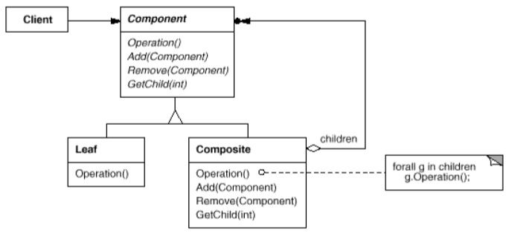
Composite Pattern
composes zero-or-more similar objects so that they can be manipulated as one object.
참고) GoF 디자인 패턴

Slide 21
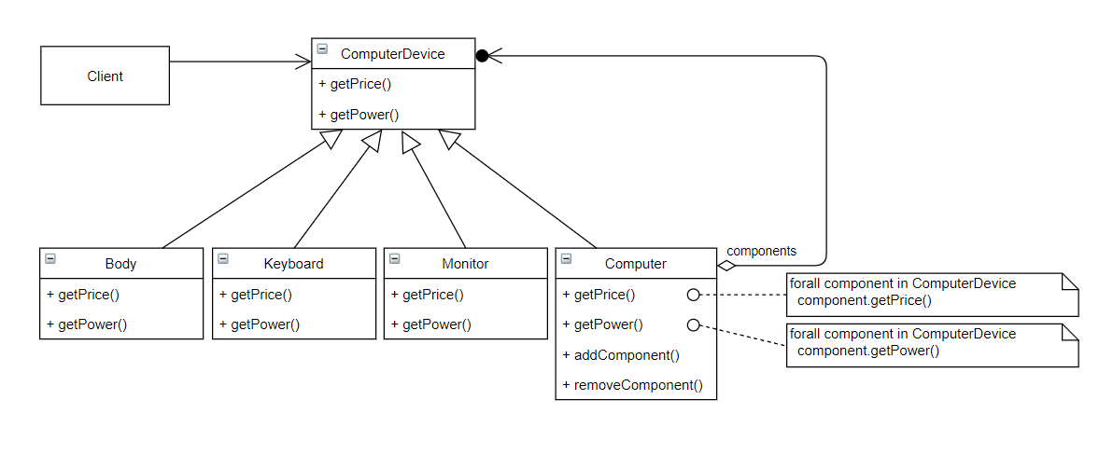
Composite Pattern
Draw a class diagram for Computer, ComputerDevice, Client, etc. using this pattern
참고) 정인상, 채흥석, Java로 배우는 디자인패턴

Slide 22
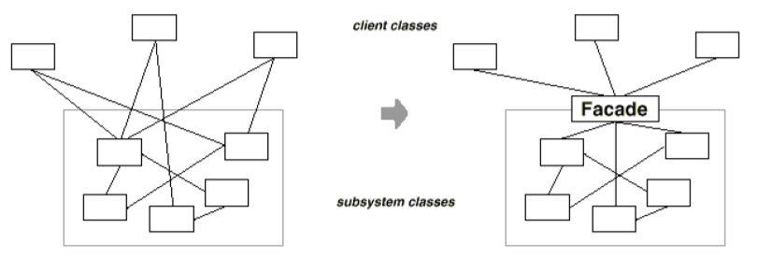
Façade Pattern
provides a simplified interface to a large body of code.
참고) 최은만 교재

Slide 23
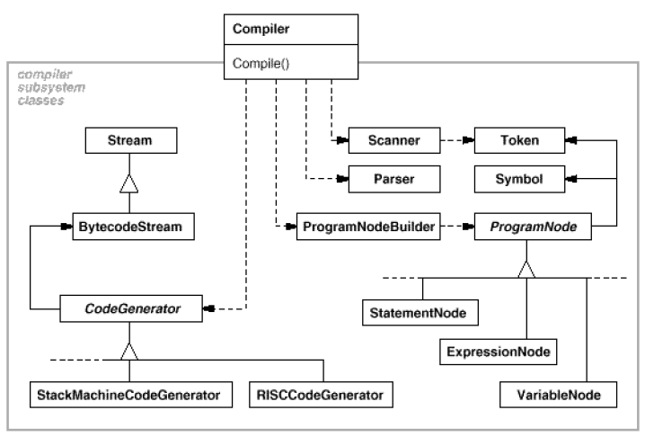
Façade Pattern
Compiler subsystem classes
참고) GoF 디자인 패턴

Slide 24
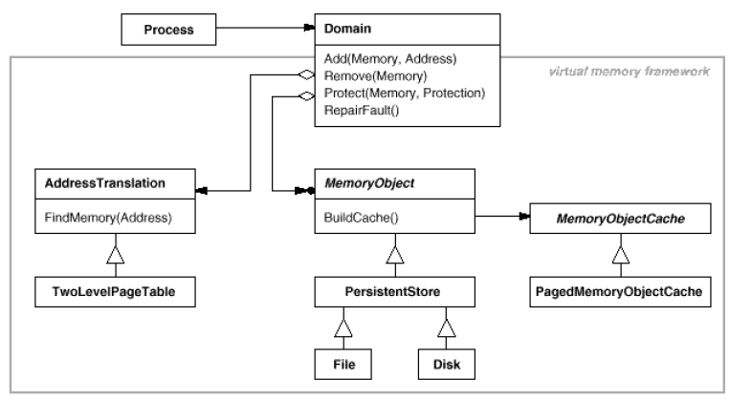
Façade Pattern
Virtual memory framework
참고) GoF 디자인 패턴

Slide 25
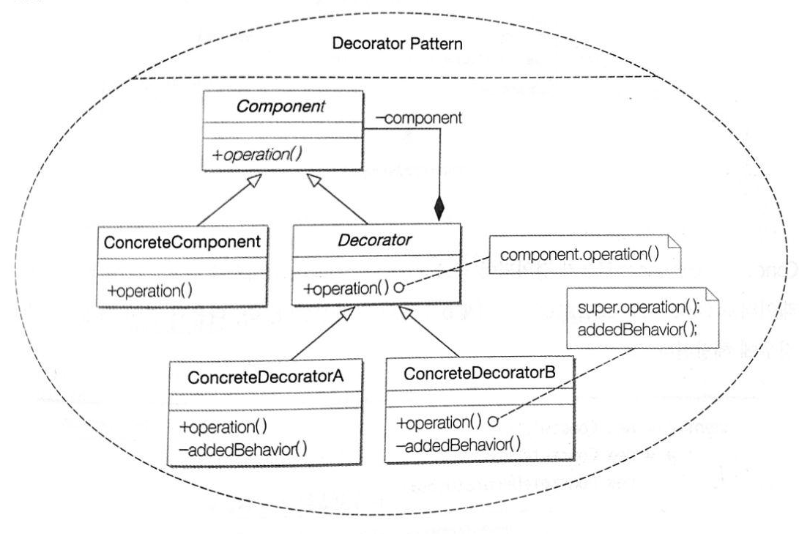
Decorator Pattern
dynamically adds/overrides behavior in an existing method of an object.

Slide 26
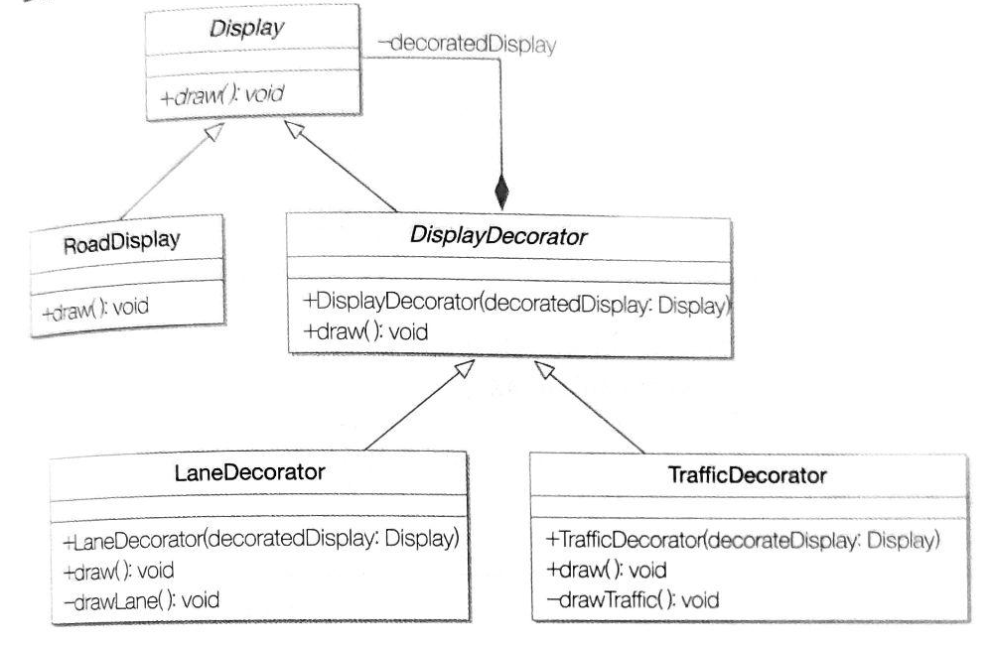
Decorator Pattern
Various combinations of road displays
new RoadyDisplay().draw()
// 기본 도로 표시
new LaneDecorator(new RoadDisplay()).draw()
// 기본 도로 표시 + 차선 표시
new TrafficDecorator(new RoadDisplay()).draw()
// 기본 도로 표시 + 교통량 표시
new TrafficDecorator(new LaneDecorator(new RoadDisplay())).draw()
// 기본 도로 표시 + 차선 표시 + 교통량 표시

Slide 27
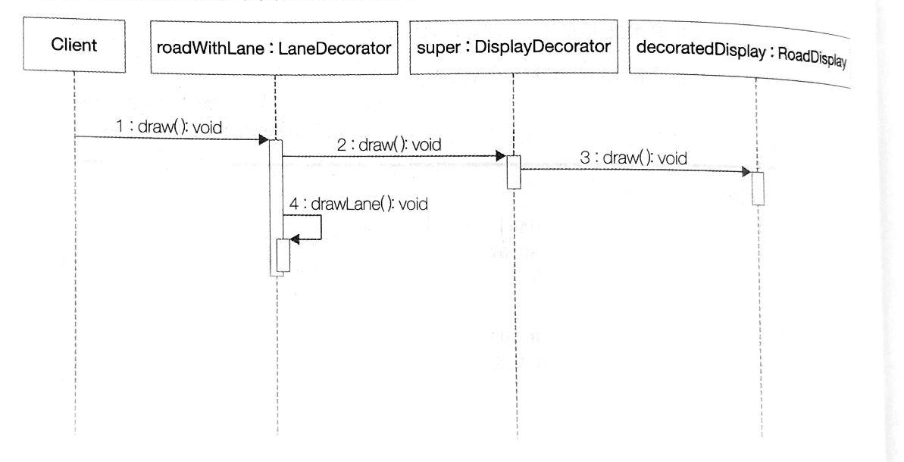
Decorator Pattern
Sequence diagram (roadWithLane.draw)

Slide 28
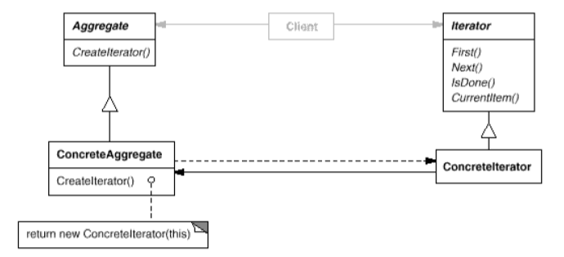
Iterator Pattern
accesses the elements of an object sequentially without exposing its underlying representation.
cf. Iterator, Iterable, for each statement in Java
java.lang.Iterator<E>
java.util.Iterable<E>
참고) GoF 디자인 패턴

Slide 29
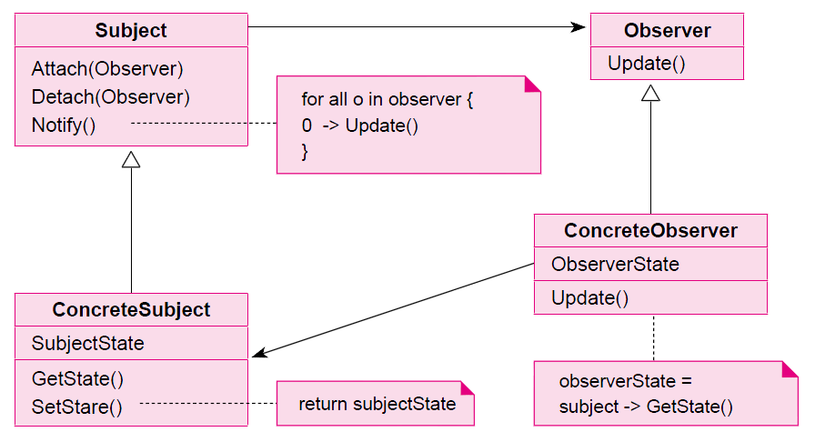
Observer Pattern
a publish/subscribe pattern which allows a number of observer objects to see an event.
참고) 최은만 교재

Slide 30
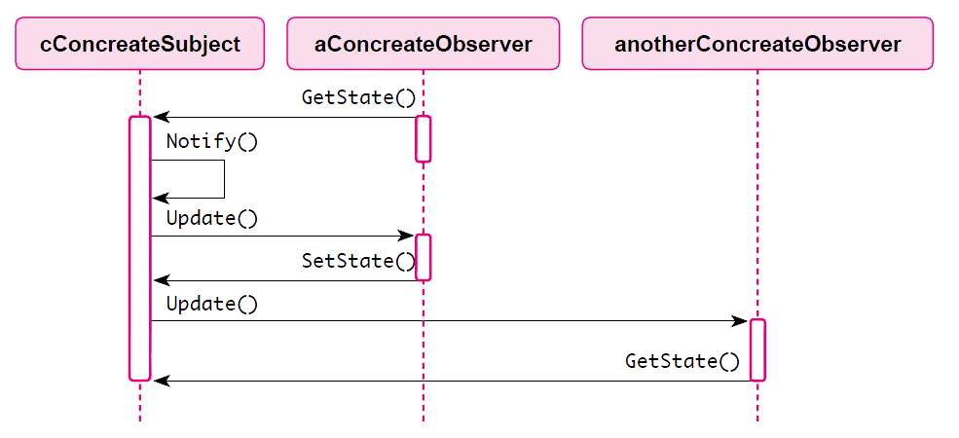
Observer Pattern
a publish/subscribe pattern which allows a number of observer objects to see an event.
참고) 최은만 교재

Slide 31
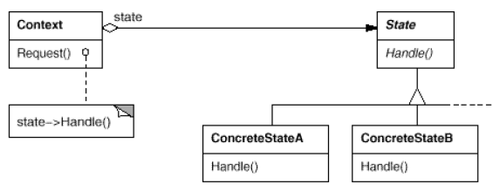
State Pattern
allows an object to alter its behavior when its internal state changes (a.k.a. objects for states)
참고) GoF 디자인 패턴

Slide 32
State Pattern
Light
[The initial design]
[A new design]
on button
on button
OFF
ON
OFF
ON
off button
off button
on button
on button
off button
on button
off button
off button
SLEEP
참고) 정인상, 채흥석, Java로 배우는 디자인패턴

Slide 33
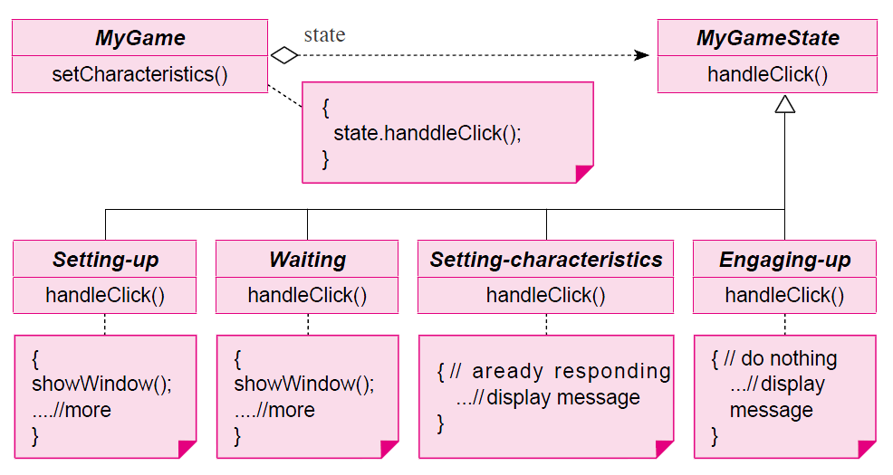
State Pattern
allows an object to alter its behavior when its internal state changes (a.k.a. objects for states)
참고) 최은만 교재

Slide 34
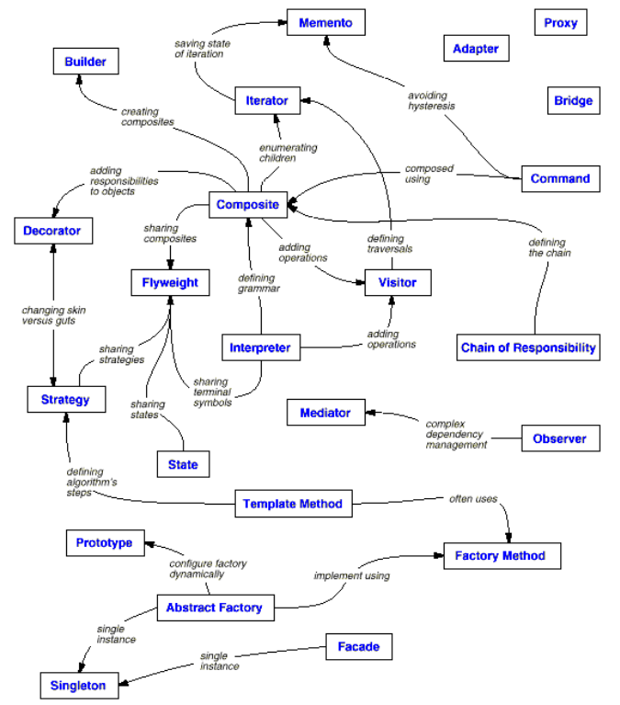
참고) GoF 디자인 패턴

