Slide 1


AIoT-Based Smart Climate-Aware Greenhouse System for Sustainable Agriculture
Muhammad Maaz
Muhammad Ibad Khan
Muhammad Talha Khan
Department of Computer Systems Engineering
University of Engineering & Technology Peshawar
1/19

Slide 2
Introduction
The challenge in traditional plant care is inconsistency and delayed intervention. Environmental factors need constant, precise management. Our system addresses this by providing real-time, data-driven control and medicinal plants.
Our primary objective was to build an Internet of Things (IoT) hardware platform capable of sensing the environment and automatically controlling devices like pumps and fans, and to train a Machine Learning model that dictates these control actions intelligently.
2/19

Slide 3
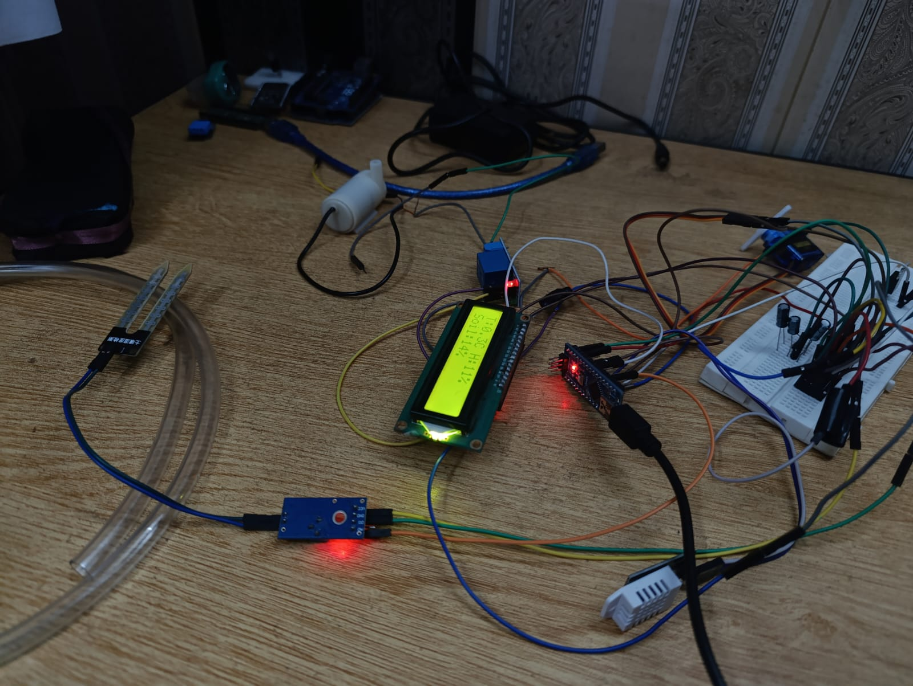
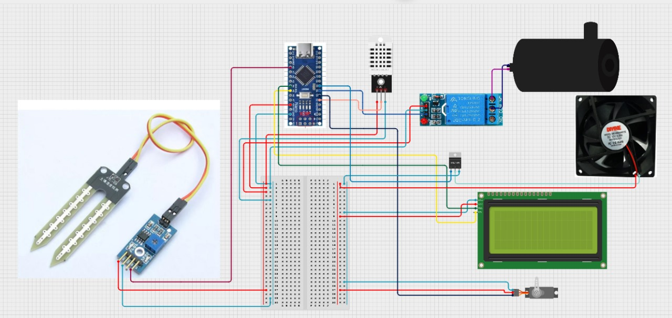
Automation System
3/19

Slide 4
Automation System
We’re using a soil moisture sensor to check the moisture level in the soil.
When it drops, the motor turns on and activates the irrigation system.
The DHT22 handles temperature, so the servo motor and fan turn on when the temperature gets high. The fan speed adjusts automatically, and all readings show up on the screen.
4/19

Slide 5
Automation System
For wireless communication, we’re using NRF modules.
One connects to the Raspberry Pi, and the other sends the data wirelessly.
The same setup can be expanded to multiple greenhouses. A single Raspberry Pi can manage data from several NRF nodes, whether it’s one greenhouse or two and different nodes.
5/19

Slide 6
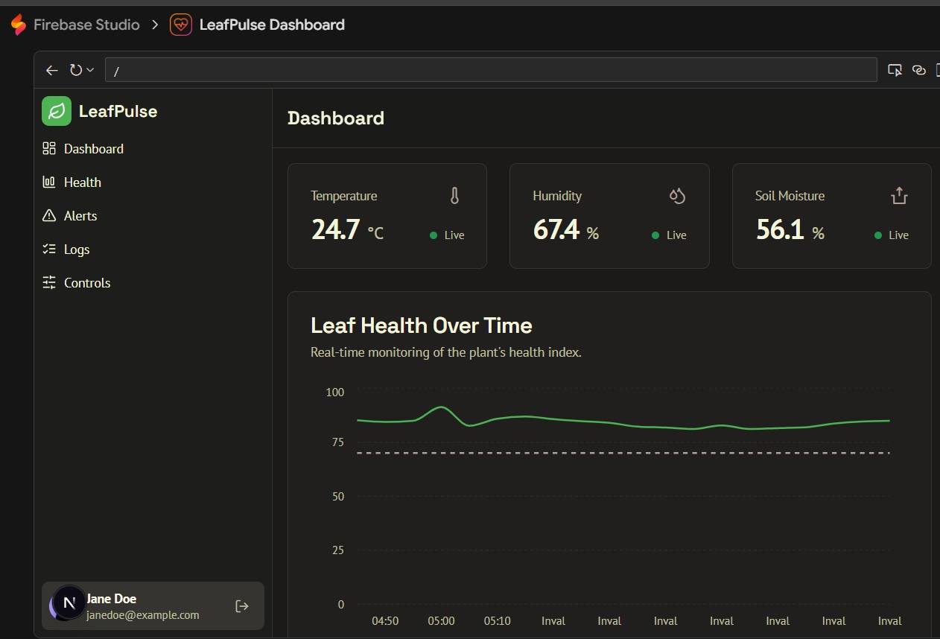
Firebase Dashboard
6/1
6/19

Slide 7
Firebase Dashboard
A real-time cloud-based monitoring interface for the Smart Plant Monitoring System, likely using Firebase Studio.
Navigation: The panel on the left provides quick access to the main sections: Dashboard (Overview), Health, Alerts, Logs, and Controls (for manual intervention).
Real-Time Data (KPIs): The dashboard displays the current, live environmental conditions:
Temperature: 24.7°C
Humidity: 67.4%
Soil Moisture: 56.1%
Leaf Health Over Time: A key feature is the chart tracking the plant's calculated health index in real-time. This provides an aggregated score of the plant's well-being based on all sensor and model data.
7/19

Slide 8
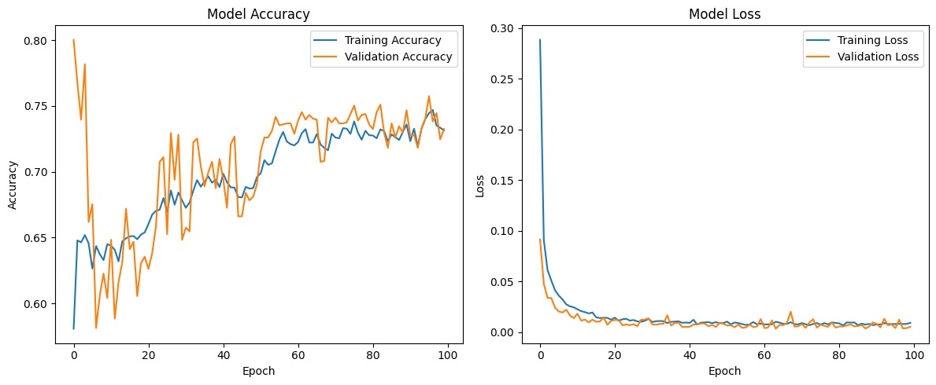
Model Accuracy
8/19

Slide 9
Module Accuracy
The plots suggest that the model has been trained successfully.
The accuracy stabilized around 74%, and the loss minimized very quickly.
There is no evidence of catastrophic overfitting, as the validation metrics closely mirror the training metrics.
The model is well-trained for its current task (likely the control decisions for the pump, fan, and ventilation).
9/19

Slide 10
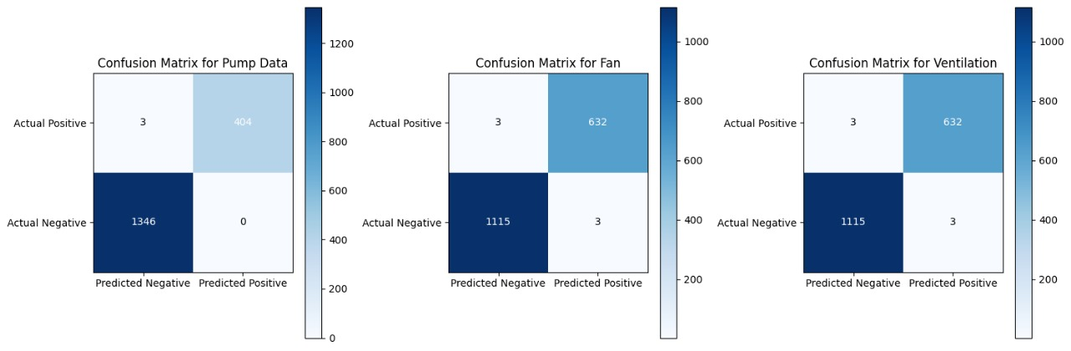
Confusion Matrix
10/19

Slide 11
Confusion Matrix
The Confusion Matrices demonstrate that the machine learning model achieved extremely high accuracy and low error rates for all three control systems (Pump, Fan, Ventilation). The high counts in the True Negative (TN) and True Positive (TP) cells, coupled with the near-zero counts in the False Positive (FP) and False Negative (FN) cells, indicate a highly reliable and effective control system.
11/19

Slide 12
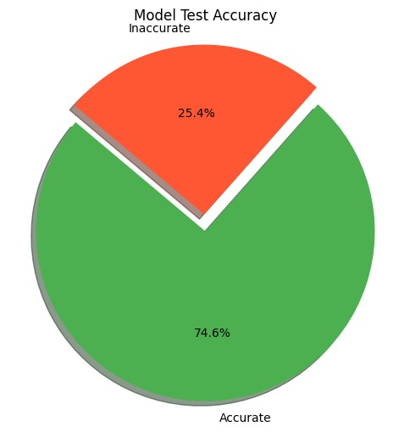
Accuracy
12/19

Slide 13
Accuracy
The chart provides a clear, high-level metric for the model's reliability. An overall test accuracy of 74.6% is a solid result for a real-world system, indicating that the model successfully generalizes the learned control logic to new, unseen environmental conditions most of the time. This confirms the model is a viable component for the intelligent control system.
13/19

Slide 14
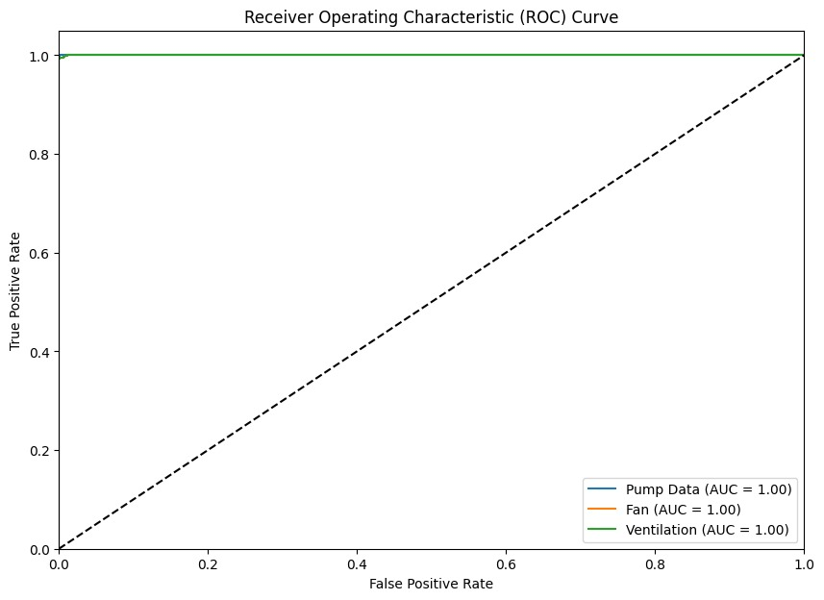
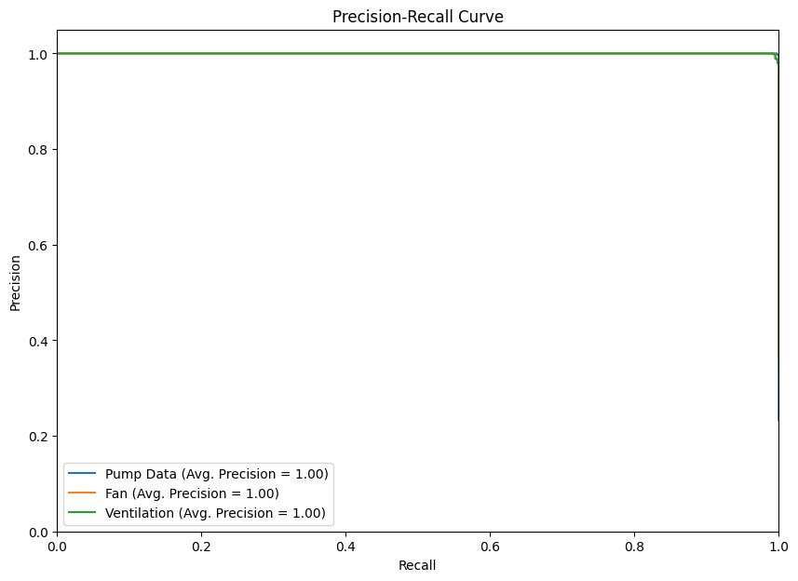
ROC Curve and Precision-Recall curve
14/19

Slide 15
ROC Curve and Precision-Recall curve
Dashboard
Both plots confirm the extremely high, virtually perfect performance of your machine learning model in its current state. The AUC = 1.00 and Average Precision = 1.00 scores indicate that the model is making the correct control decisions (ON/OFF) based on the input sensor data with 100% accuracy on the test set.
15/19

Slide 16
Real time image Classification on RaspberryPi
Dashboard
Component | Library/Tool | Role in Real-Time Classification
Edge Hardware | Raspberry Pi | The resource-constrained host, performing all processing on-device (Edge AI).
Video Input | OpenCV (cv2) | Handles the real-time camera stream, performs pre-processing (e.g., resizing the captured frame to $224 \times 224$ pixels), and displays the results.
Model Runtime | TensorFlow Lite (tflite_runtime) | The lightweight core library for executing the optimized machine learning model on the Pi's ARM CPU.
Language | Python | The primary scripting environment tying the hardware, camera, and model runtime together.
16/19

Slide 17
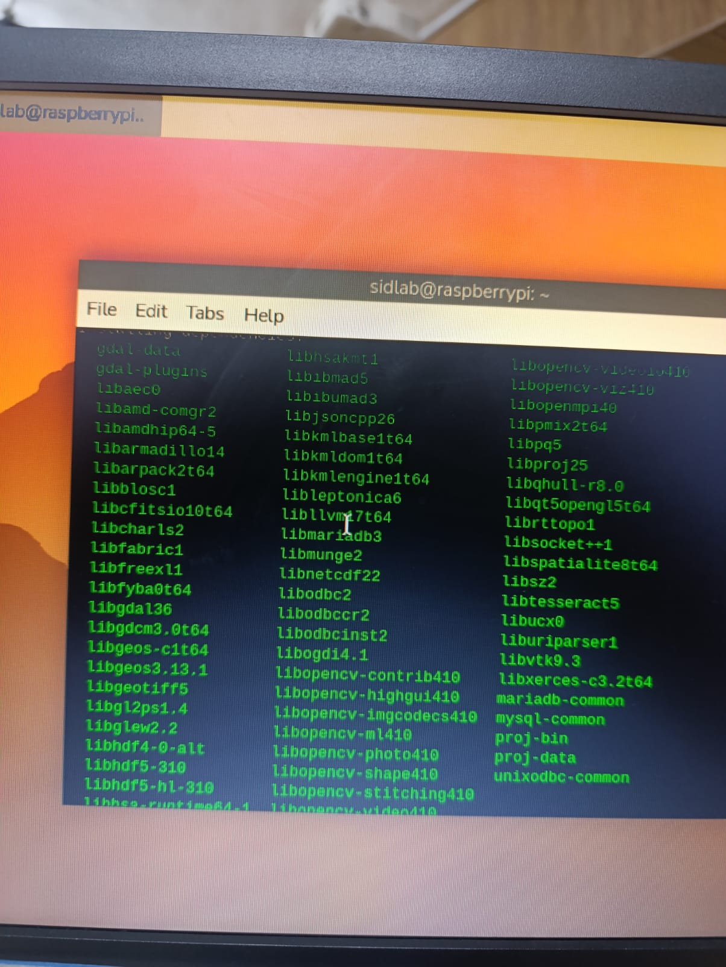
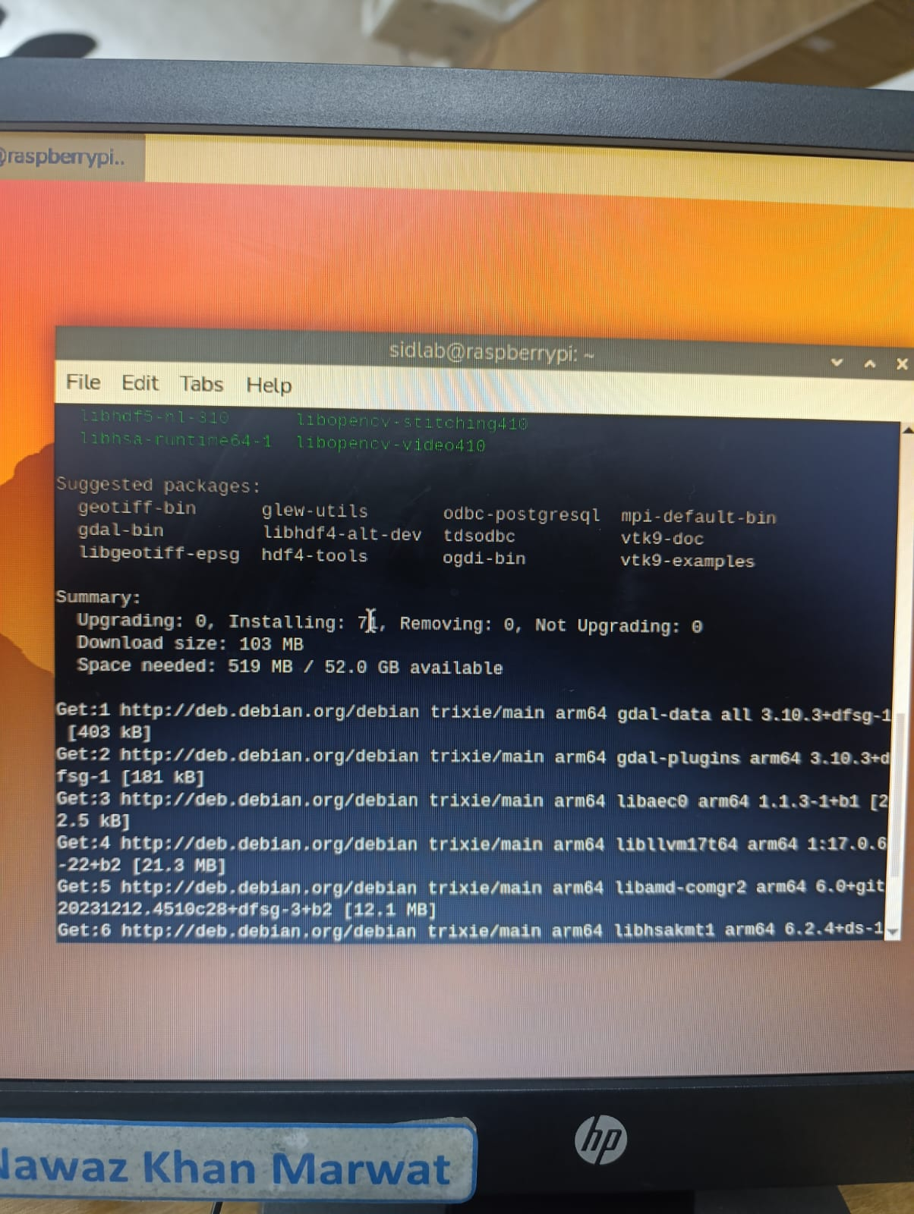
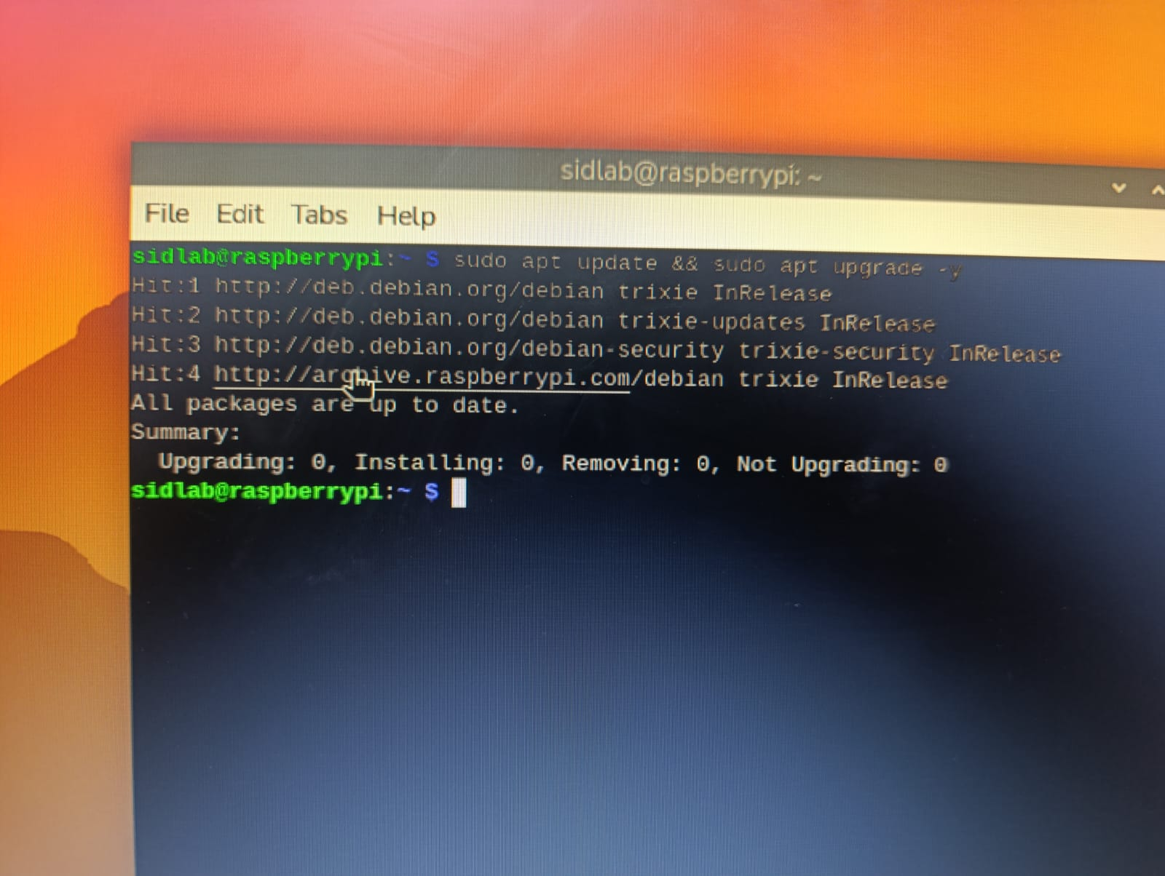
Real time image Classification on RaspberryPi
Dashboard
1/19

Slide 18
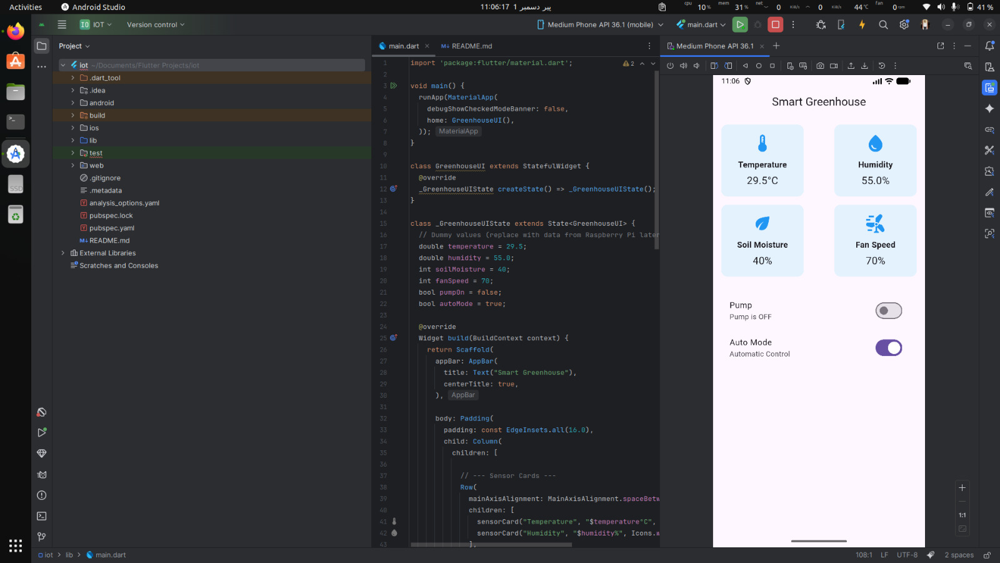
App Dashboard
User Interface (UI)
Cross-Platform Interface (Flutter):
1) The system uses Flutter to build a modern, intuitive Smart Greenhouse application. This allows the same codebase to run on both Android and iOS, providing wide accessibility for monitoring.
2) Real-Time Data Visualization: The mobile app displays key sensor metrics in real-time, including Temperature, Humidity, Soil Moisture, and Fan Speed. This gives the user immediate visibility into the greenhouse environment.
3) Remote Control and Automation: The application includes toggle controls (switches) for activating components like the Pump and setting the system to Auto Mode (Automatic Control), allowing users to remotely manage the greenhouse conditions.
18/19

Slide 19
Thank You
19/19

