Slide 1
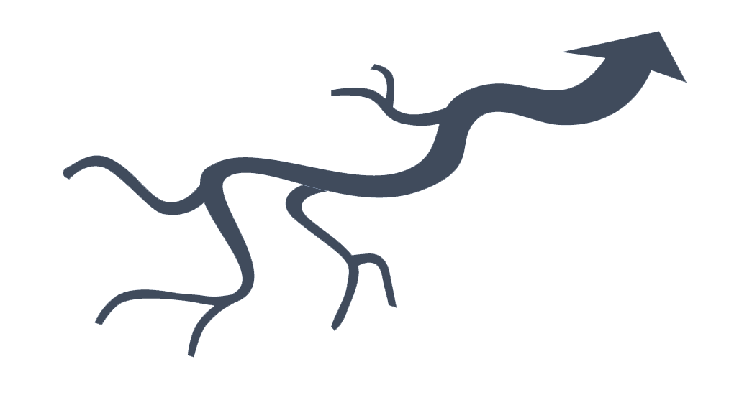

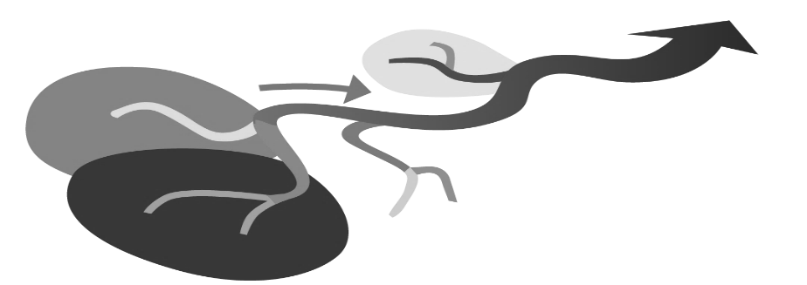
Fragmentation affects…
Dispersal dynamics at
network scale
β−among tributaries
Regional pool
(a) Hypothesis 1
Stoichiometry
filters at
tributary scale
Homogenization affects…
(c) Hypothesis 3
Hydrodynamical sorting at
microhabitat scale
Niche opportunities
habitat heterogeneity
disturbance frequency
low β
β−habitat
β−habitat
Biotic control
Physical control
(b) Hypothesis 2
Nutrient balance
… regional functioning
upstream functioning
downstream functioning

