Slide 1

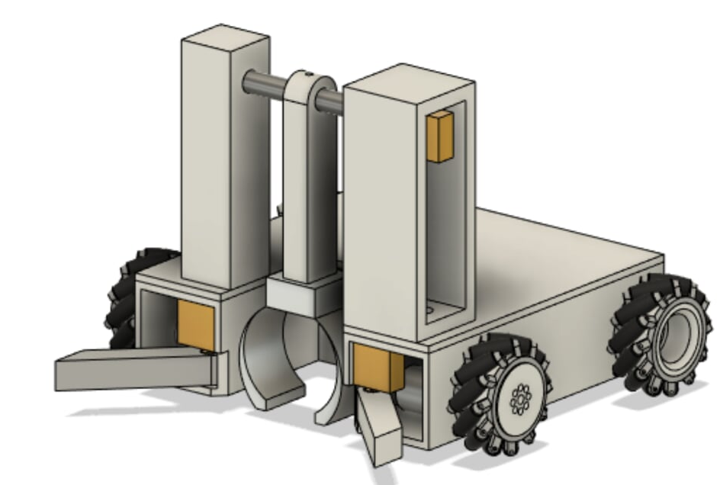
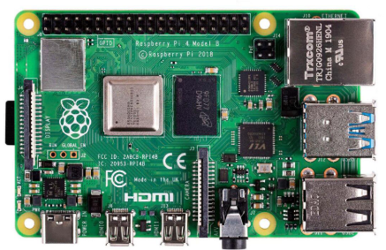
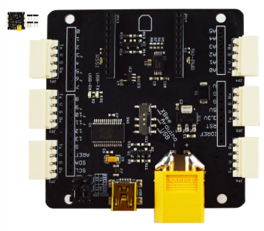
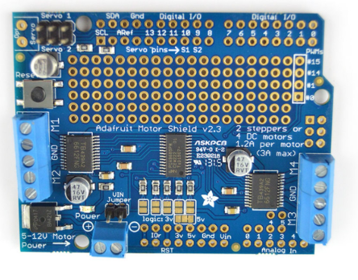
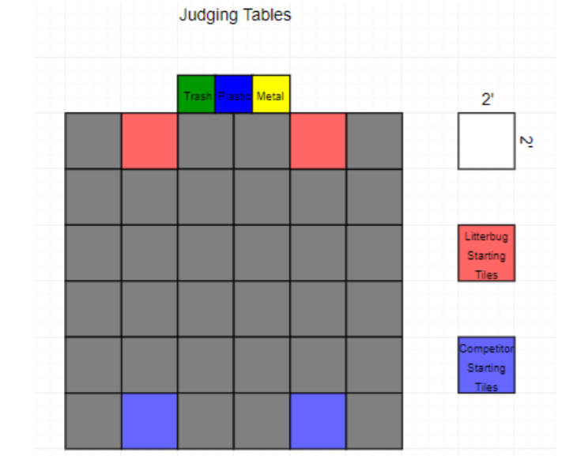
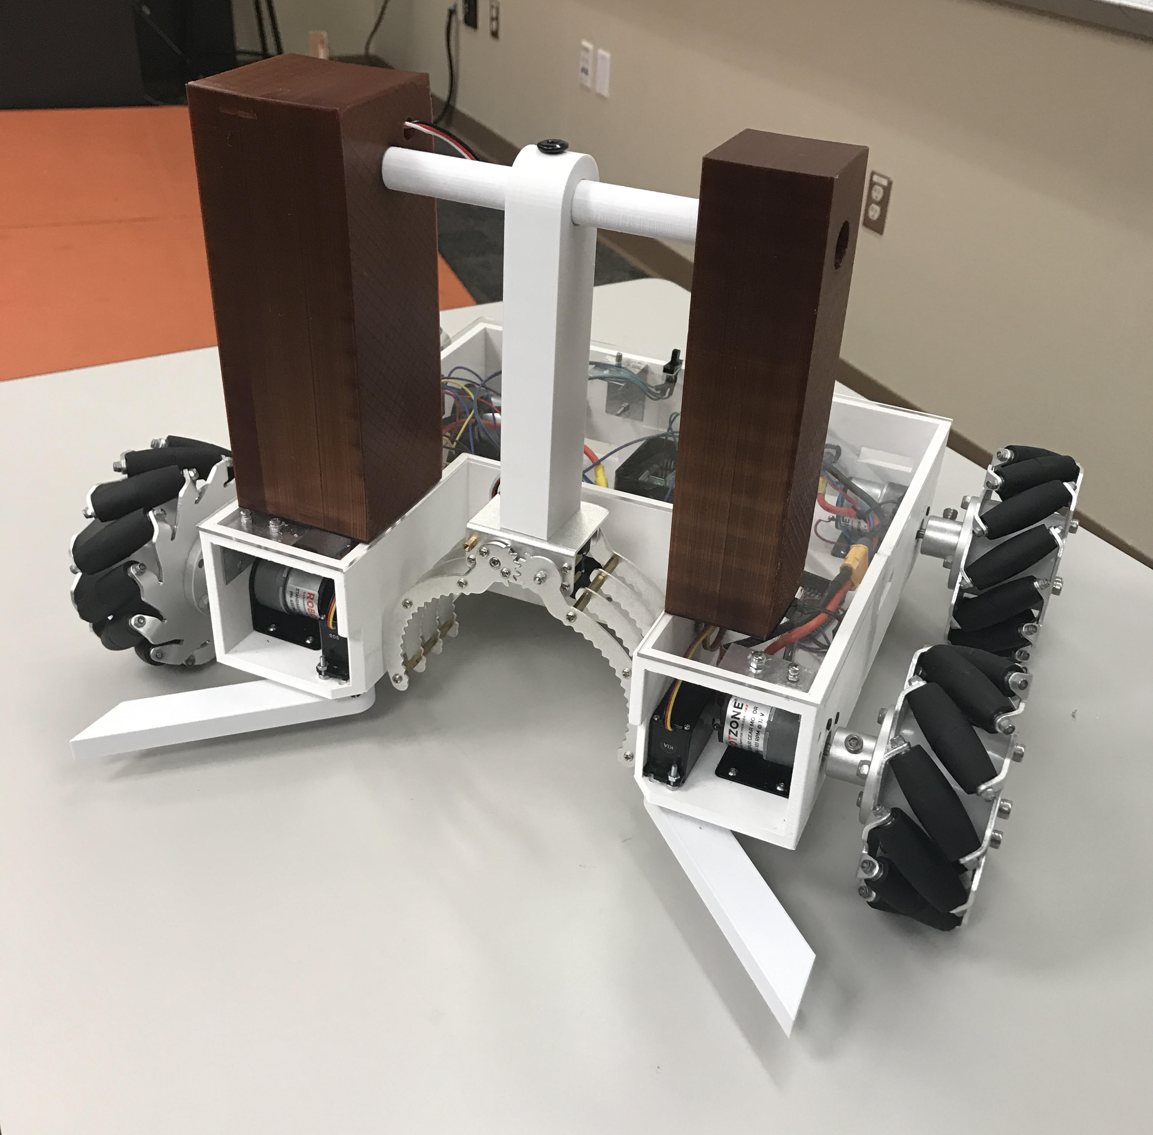
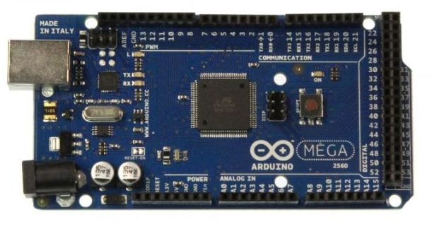
IEEE Robotics Competition
TYL 9: ROBOTECH
Members: Richard Sij, Joshua Luker​, Michelle Tamdjo​, Wyatt Snare​, and Josue Rios​
Sponsor: University of Texas at Tyler Department of Electrical Engineering
Advisor Dr. Prabha Sundaravadivel
Introduction
Mechanical Design
Hardware Design
The IEEE Region 5 organizes an annual robotics competition open to schools in the region. The overall goal is to design and build an autonomous robot that has the ability to identify and pick up objects to place them into their respective bins. Objects placed in the correct bins within the two-minute time limit will score points and the team with the most point wins the competition.
The list below are rules and design constraints that must be followed:
Robot must be within 24"x24"x24"
Must have a start and button
Must weigh less than 25lbs
Must not separate into multiple parts
No hazardous materials
Our design was created with a single servo-based arm and servo-actuated claw to minimize movement of trash items to a single axis and ensure precise item capture.
Other mechanical components consist of:
Four drive wheels
Four drive motors
Two servo actuated flippers
The brain of this design relies on a Raspberry Pi and borrows the processing power of two Arduino Mega boards. Each Arduino board serves a specific purpose: one is responsible for processing movement, and the other is responsible for processing all servo-based operations. The Arduino responsible for movement is connected via I2C to a driver shield while the Arduino responsible for servo-based operations is connected via I2C to an LSS smart servo adapter.
Other hardware items connected to the Raspberry Pi and Arduinos:
LSS Smart Servo
Raspberry Pi Camera
Two power switches
Code initializer switch
Adafruit Feather 32u4 RFM96 LoRa Radio
The Playing Field
The field will be 12' X 12' square with an 11" high border wall around the arena. The arena will be made up of 20 grey tiles, 2 red tiles, and 2 blue tiles. The bins are placed outside the area which will be green, blue, and yellow. Each robot must start on a blue tile opposite of a red tile with Litterbug, which is a competition owned robot that will dispense different objects throughout the round and must be stopped by sending different RF signals using FSK, GFSK, and MSK modulation schemes.
The types of objects on the field will be:
Aluminum soft drink cans
Clear plastic water bottles
Paper trays (commonly used for serving concession food)
Snack size chip bags
Raspberry Pi 4
LSS Smart Servo Adapter
Arduino Mega 2560
Adafruit motor shield V2
Conclusions
All of our designs came together to create a functioning robot. However, due to unforeseen current events, we were not able to attend and compete.

