Slide 1
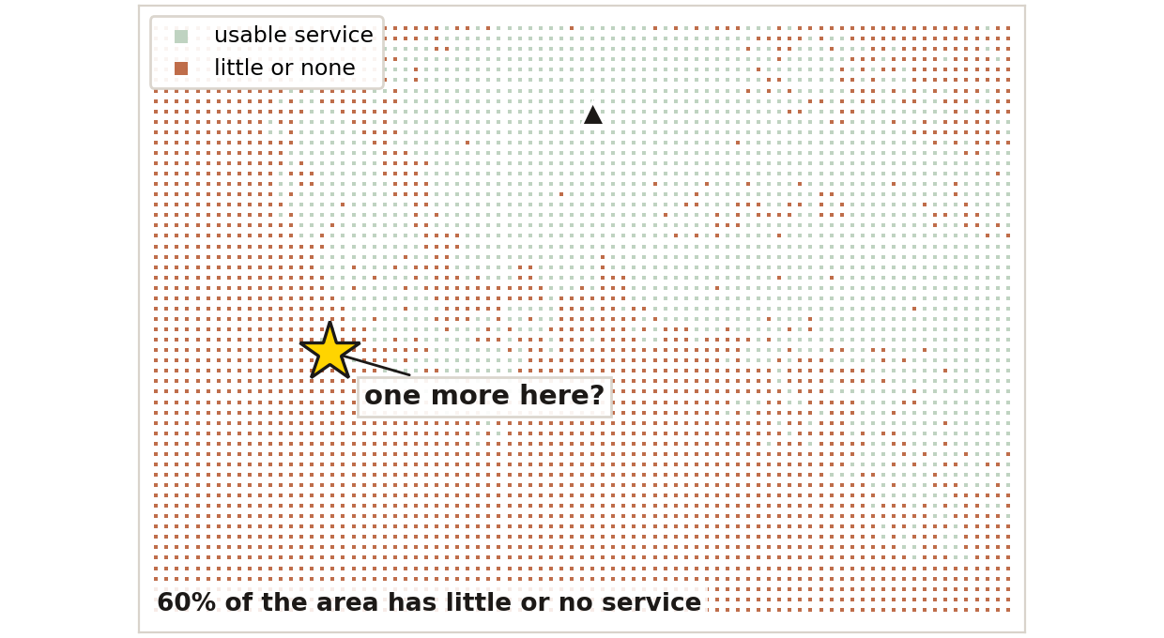
Arathon Challenge 03
Where should the next tower go?
Rural network planning on 7% of the map
Four towers serve this area today, and most of it still has no usable signal — 42% of the samples the van took found no cell at all. One more asset could change that. The question is where to put it.
Red is where service fails today. The star is where our planner would put the next tower.
unserved today
we measured
with one more site
60%
7%
44% → 69%
of the area, by our model
of it · the rest is predicted
of route covered
Mingyue Tang · David Alcantara · Ishan Bansal
AgWireless '26 · ARA COTS RAN, Ames IA

Slide 2
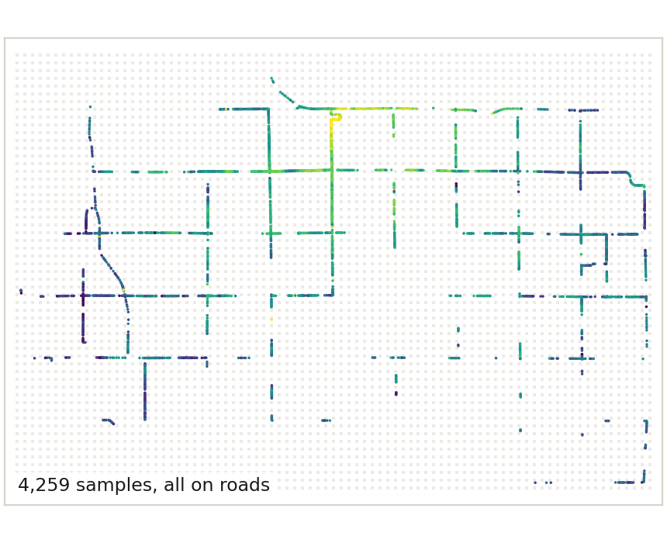
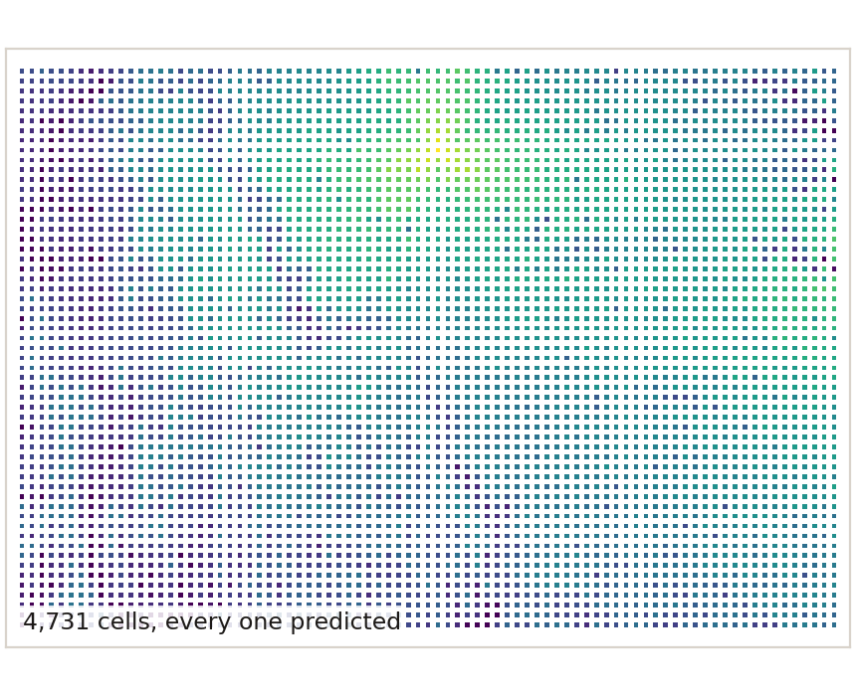
the gap
Measurements alone cannot site a tower
Same ground, same scale, same colours. Only the coverage differs.
What we measured
What the twin predicts
42%
of samples found no cell
938
of 8,176 cells measured
0
candidate sites visited
7,144 samples · 117 km of road · a 178 km² box

Slide 3
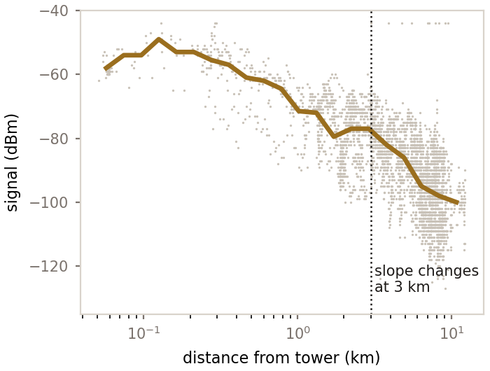
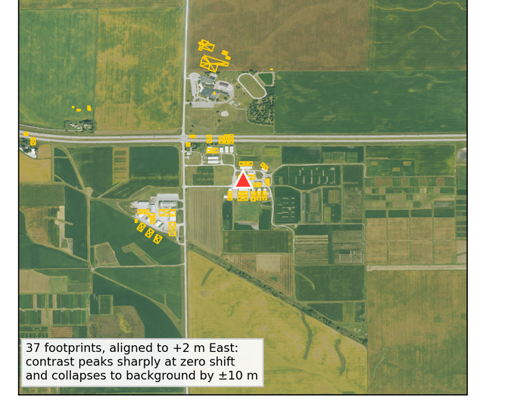
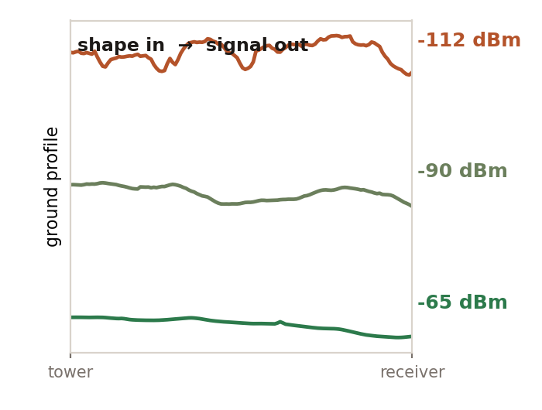
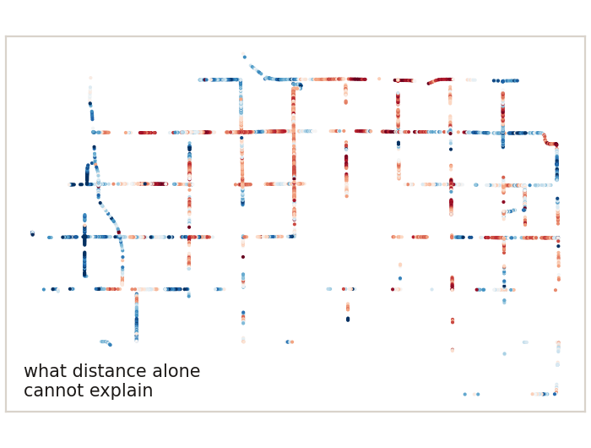
approaches
Four ways to fill in the map
They differ in what they need to know before they can answer.
Baseline
Ray tracing
Deep learning
PINN
The physical law of how signal falls with distance, with its constants fitted to this network.
Rebuild the ground and the buildings, then trace the signal through them.
No assumed law. Learn the mapping from the ground under each link to the signal.
Learn what the distance law cannot explain, with physics as a penalty on the answer.
needs: distance and direction
needs: a 3-D model of the ground
needs: thousands of measurements
needs: measurements, and a law

Slide 4
results
In sample is not the same as somewhere new
RSRP error in dB. Lower is better. Same rows, same splits, same 200 m buffer between train and test.
Ray tracing barely moves
7.61 dB on training ground, 7.95 dB on new ground. It is the only one of the four that barely changes.
The learned models memorise
A terrain profile is nearly a unique location label. Feed the operator the wrong links' profiles and it scores 13.16 dB against 13.13 with the right ones — it never used the terrain.
Left bar: error on data the model was trained on. Right bar: error somewhere it has never been. A tall right bar means it memorised.
Held out by region · 200 m buffer between train and test

Slide 5
the planner
Turning a surface into a decision
Change one assumption at a time, and measure how far the recommendation moves.
Predict
Define served
Score
Constrain
→
→
→
a value in every 200 m cell
eight definitions, one threshold
route-km and area gained
power, access, structures, backhaul
How far the recommended site moves when you change one assumption
The definition beats the physics
Changing what counts as service moves the site twice as far as changing the model. It was chosen, not measured.
A neighbourhood, not a pin
Requiring grid power within 1 km moves it 11 km. The exact site repeats in 10% of draws; 3 km in 99%.
198 combinations of model, asset, criterion, threshold and weighting

Slide 6
demo
The planner, live
Place an asset and watch coverage, gain and uncertainty change.
Rural Coverage Planner
approach
Baseline — fitted physics ▾
what counts as served
Availability ▾
target
≥ 50% of the time
route vs area
0.70 / 0.30
asset
Macro · 37 m · 0 dB
Find the best site
route-km
score
51.9 → 80.5
0.421 → 0.652
map scale ▬ 2 km · ▪ one 200 m demand cell
Pick a model, pick what counts as service, drop an asset anywhere — coverage, gain and uncertainty all re-solve live.
Runs in a browser. No server, no install, no network.

