Slide 1
Vehicle Blind Spot Assist
Tanzim Mokammel
Valikhan Kuparov
Hani Hadidi

Slide 2
Outline
Reducing Vehicle Accidents
Our Objective
The Big Picture
Finer Details
Challenges Ahead

Slide 3
Reducing Vehicle Accidents
Background and Motivation

Slide 4
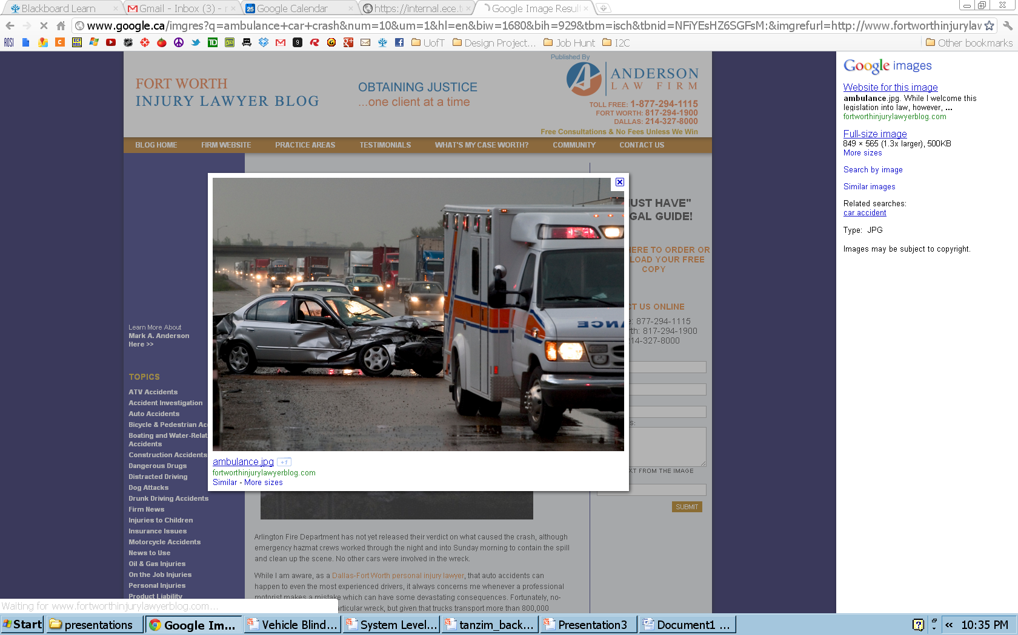
Vehicle Accidents
Vehicle accidents are accountable for:
Physical injuries
Mental Trauma
Financial Loss
Death
Notes:
http://www.google.ca/imgres?q=ambulance+car+crash&num=10&um=1&hl=en&biw=1680&bih=929&tbm=isch&tbnid=NFiYEsHZ6SGFsM:&imgrefurl=http://www.fortworthinjurylawyerblog.com/truck_bus_wrecks/&docid=6gVGBuWXSdgBTM&imgurl=http://www.fortworthinjurylawyerblog.com/ambulance.jpg&w=849&h=565&ei=bbYgT_j0A4Hn0QH01I3rCA&zoom=1&iact=hc&vpx=904&vpy=54&dur=1625&hovh=183&hovw=275&tx=151&ty=82&sig=106739473343961642775&sqi=2&page=1&tbnh=132&tbnw=173&start=0&ndsp=40&ved=1t:429,r:4,s:0

Slide 5
Accident Rates are Declining
Over the years, we have been seeing a decline in the number of vehicle accidents.
Figure 5: Fatal Collisions and Fatality Victims (1990-2009)
Figure 6: Collisions Resulting in Injury and Victims Injured (1990-2009)
Notes:
[1] Transport Canada, “Canadian Motor Vehicle Traffic Collision Statistics: 2009”, Internet: http://www.tc.gc.ca/eng/roadsafety/resources-researchstats-menu-847.htm, Jun. 01, 2011 [Sep.11, 2011].

Slide 6
Room for Improvement
The numbers are still high!

Slide 7
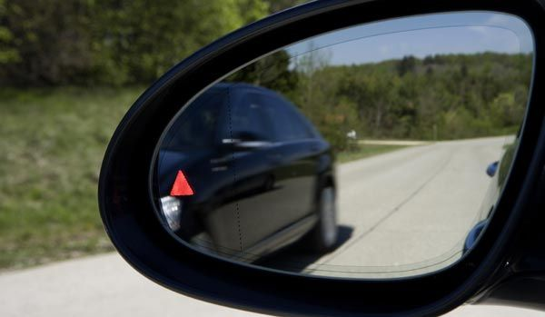
Why the Blind Spot?
95% of accidents are caused by bad driving behavior
One common driving behavior is to not check the vehicle’s blind spot while changing lanes

Slide 8
Similar Concerns
Over the years, many major manufacturing companies have been motivated by similar concerns:
-BMW
-Volvo
-Ford
-Mercedes

Slide 9
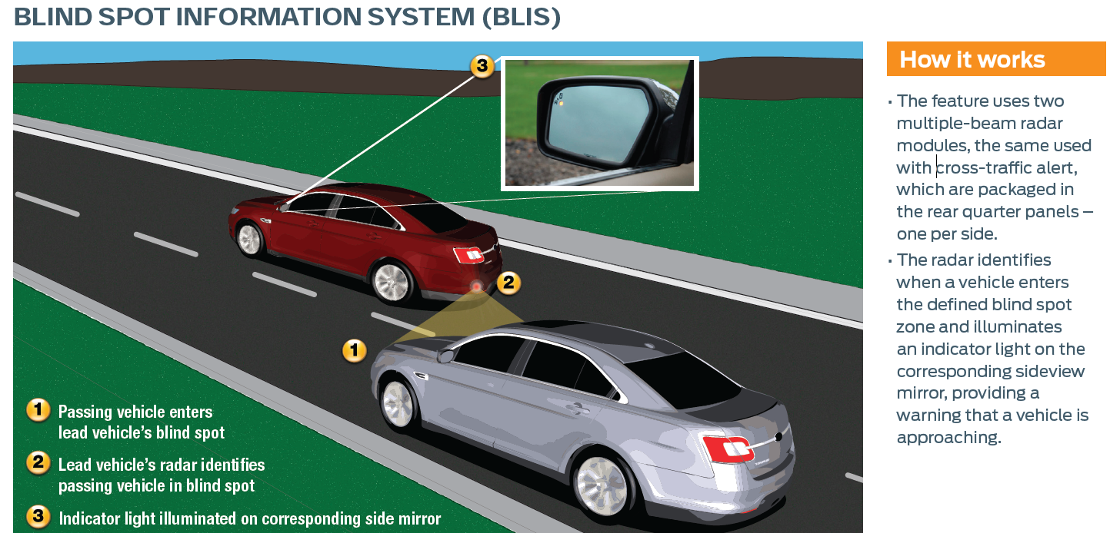
Example – Ford BLIS
Notes:
[5] Unknown. “Blind Spot Information System (BLIS) with Cross-Traffic Alert”. Internet: http://media.ford.com/images/10031/BLIS.pdf, Jun. 7, 2011 [Sep. 15, 2011].

Slide 10
Room for Improvement
Problems
Not everyone wants a Ford, BMW, etc
What about older models?
Solution
Help reduce accidents through an universally fittable, accessible and affordable device which aids users be aware of dangers in the Blind Spot, and make improvements to the currently available technology

Slide 11
Our Objective
Project Goals and Requirements

Slide 12

Project Goal
Design a device, which will:
Identify obstacle in blind spot
Anticipate approaching obstacle
Warn user about danger
Automated lock of steering into obstacle

Slide 13
Project Requirements
Functional Requirements
The unit shall have sensors mounted on the sides
The unit shall have a feedback mechanism to warn the user
The unit shall have an override mechanism that will prevent users from making unsafe lane changes

Slide 14
Project Requirements
Objectives
Work correctly regardless of light and weather conditions
The blind spot detection component of the unit (no vehicle override) should be a standalone device
The microcontroller should be hidden from the user’s view

Slide 15
The Big Picture
System Level Overview

Slide 16
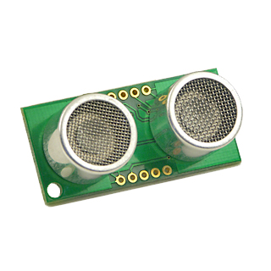
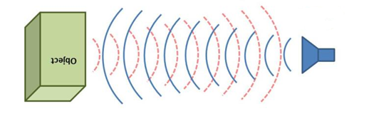
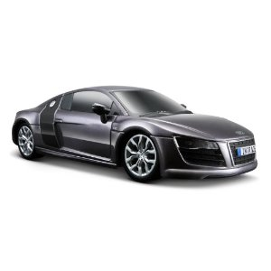

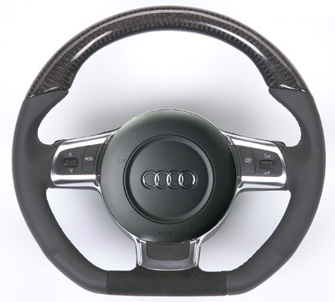
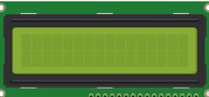
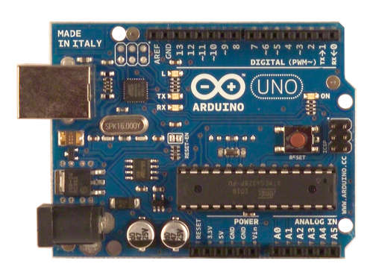
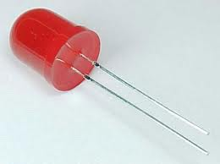
The Big Picture
Detection/Anticipation
Automation
User Vehicle
Echo
F
L
R
Pulse
Ultrasonic Sensor -SRF05
Obstacle
B
Time of Flight
Speed, Direction
Output
Distance
Arduino
LCD screen
Distance, Speed, Time
LED
Blinking Frequency
Speed, time calculations

Slide 17
Finer Details
and Progress to Date

Slide 18
Detection/Anticipation Module
Arduino
Echo
Pulse
Ultrasonic Sensor -SRF05
Obstacle
Distance
Time of Flight
Speed, time calculations

Slide 19
Detection/Anticipation Module – Completed Milestones
Distance Calculations
Distance between an object and the sensor can be measured to the nearest cm
Sensor
Arduino

Slide 20
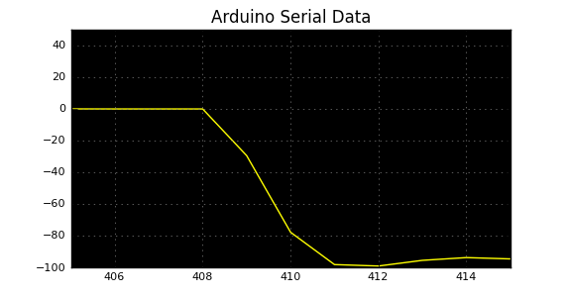
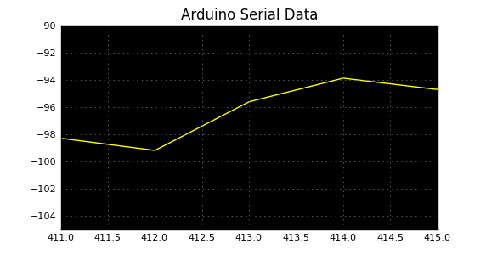
Speed Calculations - Results
Speed Calculations
Speed can be calculated within ±10% accuracy between the stationary sensor, and a moving obstacle; need new test standard
Example:
Speed
Speed
Sample Point
Sample Point

Slide 21
Detection/Anticipation Module – Issues
Sensor’s range (1.5 m to 3 m)
Error of mounted sensors
Real-Time Plots for Verification
Wireless retrieval of microcontroller data

Slide 22
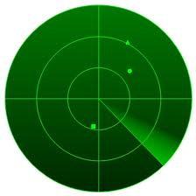
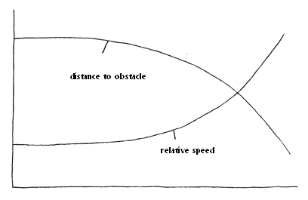
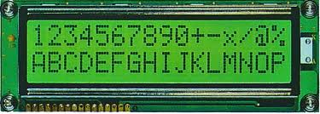
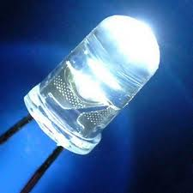
Output Module - Possible Solutions and Design Alternatives
Possible solution | Type
Visual | Graphical
 | Numerical
 | Simple - blinking light

Slide 23

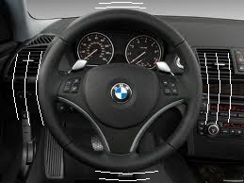
Output Module - Possible Solutions and Design Alternatives
Possible solution | Type
Auditory | Beeping sounds
Physical | Vibration of the steering wheel

Slide 24
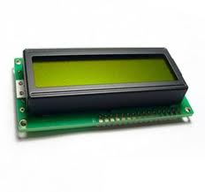
Output Module - Proposed Solution: Output module
+
simple, yet informative feedback
quantitative feedback
the least costly among the alternatives

Slide 25
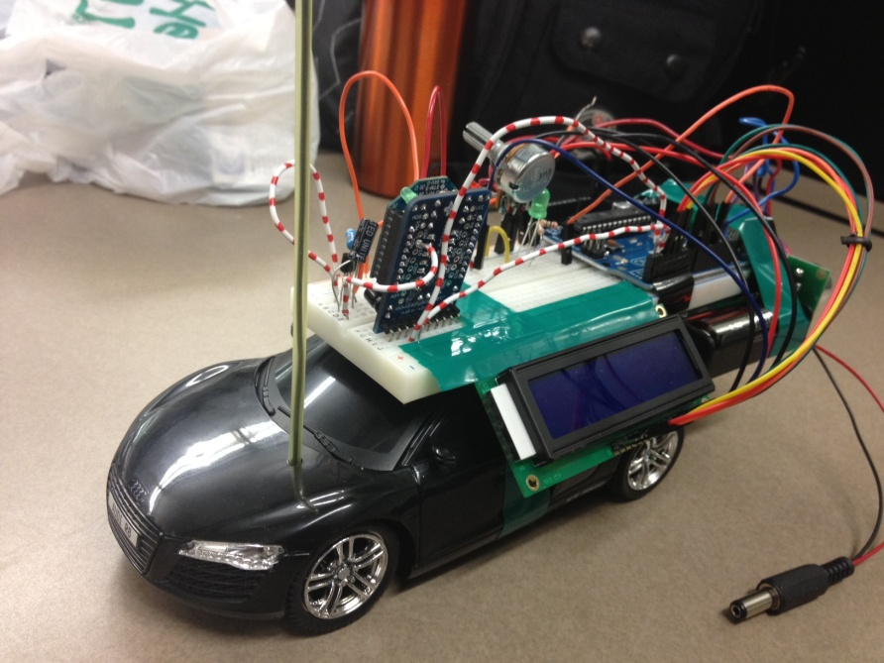
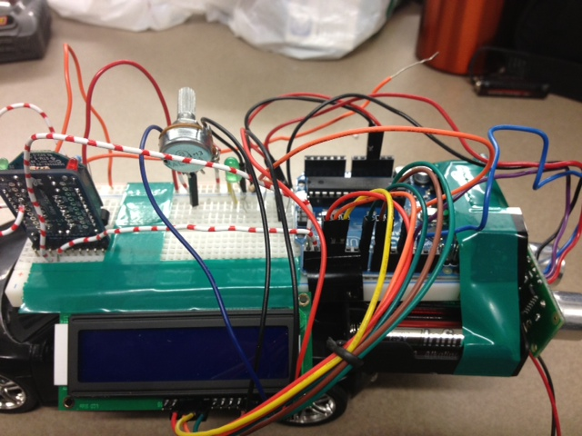
Output Module - Implementation
LCD Display
LED light
Number of Characters: 16 characters x 2 Lines
Character Table: English-European
Module dimension: 80.0 x 36.0 x 13.2mm3
View area: 66.0 x 16.0 mm
Character size: 2.96 x 5.46 mm
Operating Temperature: -20°C to + 70°C
Blinking frequency: 1-4 Hz to solid state
Size: 5 mm diameter
Wavelength: 565nm
Operating Temperature: -38°C to + 78°C

Slide 26
Automation
Simulating Driving
Steering lock mechanism
Controlling relative speed
Verify anticipation module

Slide 27


Automation - Input
Char
i
l
j
k
,
.
ASCI DEC
105
108
106
107
44
46
PWM-
Speed control
User Input
Computer output

Slide 28
Automation - Output
Action
Forward
Right
Left
Backward
Increase speed
Decrease speed
ASCI DEC
105
108
106
107
44
46
F
L
R
B

Slide 29

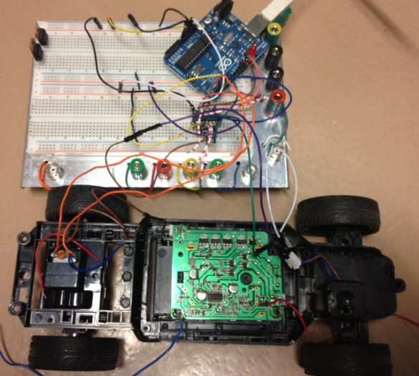
Automation
I received:
ASCI DEC
105
108
106
107
Speed Value: 200
Serial output from car

Slide 30
Challenges Ahead

Slide 31
Summary of Next Steps
Obstacle Detection + Output
Time calculations
Improve accuracy
Automation
More user friendly Control
Integration
Combining detection and automation modules
Testing
Check Blind Spot Coverage
Redefine Danger Levels

Slide 32
Conclusion
Project is on track to be completed before design fair
Thank You
Questions?

