Slide 2

Project Goal
Design a device, which will:
Identify obstacle in blind spot
Anticipate approaching obstacle
Warn user about danger
Automated lock of steering into obstacle

Slide 3
Project Requirements
Functional Requirements
The unit shall have sensors mounted on the sides
The unit shall have a microcontroller to compute:
the relative speed of the obstacle (max 10% error)
time before approaching obstacle appears in blind spot (if not already there)
The unit shall have a feedback mechanism to warn the user
The unit shall have an override mechanism that will prevent users from making unsafe lane changes

Slide 4
Project Requirements (continued)
Constraints
The unit must cost less than $500
The unit must weigh less than 1kg
The unit must not impede the user’s view of the road

Slide 5
Project Requirements (continued)
Objectives
Work correctly regardless of light and weather conditions
The blind spot detection component of the unit (no vehicle override) should be a standalone device
The microcontroller should be hidden from the user’s view

Slide 6
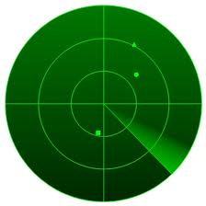
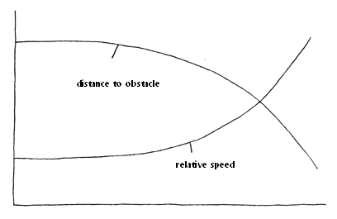
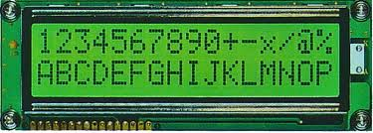
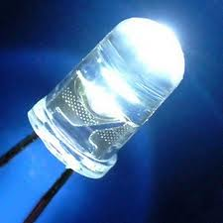
Possible Solutions and Design Alternatives
Possible solution | Type
Visual | Graphical
 | Numerical
 | Simple - blinking light

Slide 7

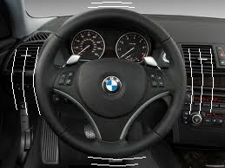
Possible Solutions and Design Alternatives
Possible solution | Type
Auditory | Beeping sounds
Physical | Vibration of the steering wheel

Slide 8
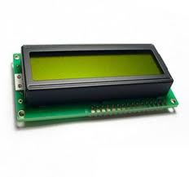

Proposed Solution: Output module
+
simple, yet informative feedback
quantitative feedback
the least costly among the alternatives

Slide 9
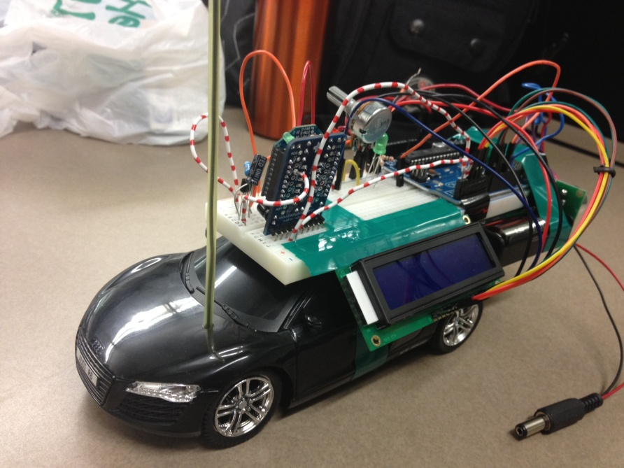
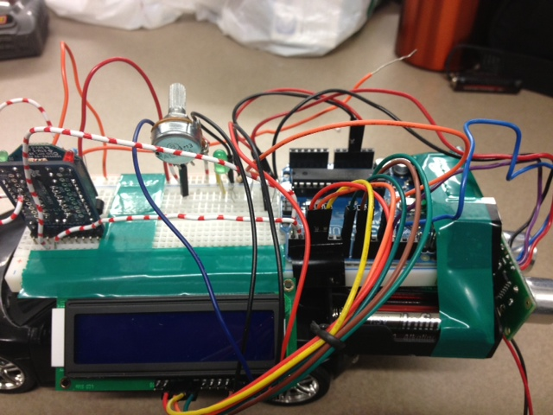
Output Module Implementation
LCD Display
LED light
Number of Characters: 16 characters x 2 Lines
Character Table: English-European
Module dimension: 80.0 x 36.0 x 13.2mm3
View area: 66.0 x 16.0 mm
Character size: 2.96 x 5.46 mm
Operating Temperature: -20°C to + 70°C
Blinking frequency: 1-4 Hz to solid state
Size: 5 mm diameter
Wavelength: 565nm
Operating Temperature: -38°C to + 78°C

Slide 10

Next step
Relative speed
Distance to obstacle
Remaining time to change lane
Need: to implement algorithm

