Slide 1
Background and Motivation

Slide 2
Vehicle Accidents
Vehicle accidents are great cause of loss, and are accountable for:
Physical injuries
Mental Trauma
Financial Loss
Death

Slide 3
Technology Can Help
Over the years, many auto manufacturing companies have been working towards vehicle safety features
-BMW
-Volvo
-Ford
-Mercedes

Slide 4
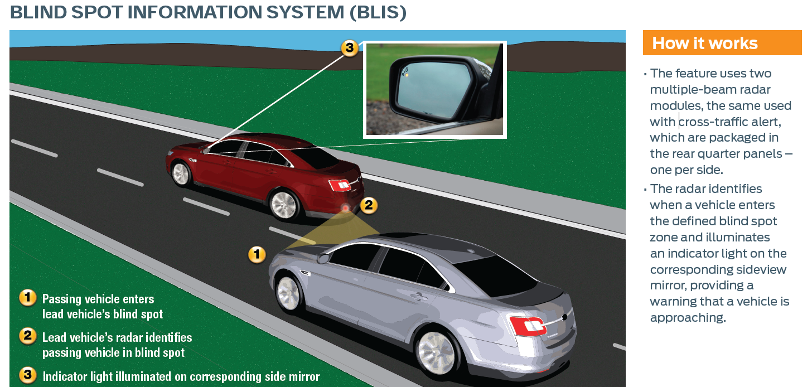
Example – Ford BLIS
[5] Unknown. “Blind Spot Information System (BLIS) with Cross-Traffic Alert”. Internet: http://media.ford.com/images/10031/BLIS.pdf, Jun. 7, 2011 [Sep. 15, 2011].

Slide 5
Accident Rates are Declining
Over the years, we have been seeing a decline in the number of vehicle accidents, and we believe the advances in safety technology is a significant factor

Slide 6
Accident Rates are Declining
Figure 5: Fatal Collisions and Fatality Victims (1990-2009)
Figure 6: Collisions Resulting in Injury and Victims Injured (1990-2009)
[1] Transport Canada, “Canadian Motor Vehicle Traffic Collision Statistics: 2009”, Internet: http://www.tc.gc.ca/eng/roadsafety/resources-researchstats-menu-847.htm, Jun. 01, 2011 [Sep.11, 2011].

Slide 7
Room for Improvement
However, the number of accidents are still high, and improvements need to be made in the current technology to make it more accessible, and improve functionality

Slide 8
Progress – Detection/Anticipation Overview
To Summarize again, the planned functions of the detection/anticipation module are:
Gather Distance Data
Calculate the relative speed b/w Obstacle and Vehicle
Calculate time remaining to make a lane change
Using the aforementioned variables, decide whether or not the user should change lanes using a look up table

Slide 9
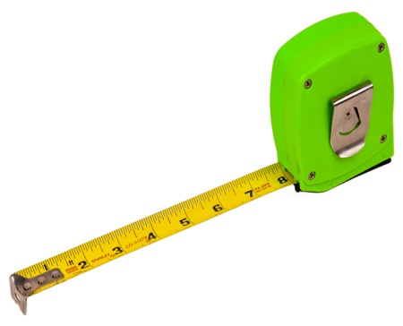
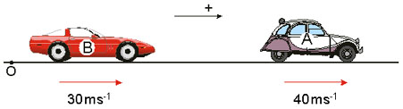


Progress – Detection/Anticipation Overview
Distance
Relative Speed
Time

Slide 10
Detection/Anticipation Module – Completed Milestones
Distance Calculations
Distance between an object and the sensor can be measured to the nearest cm

Slide 11
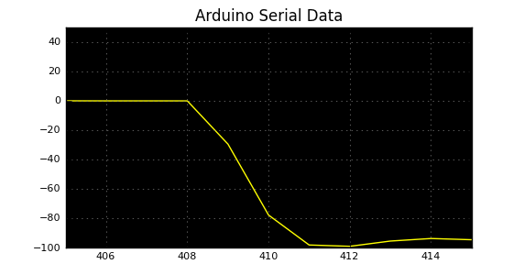
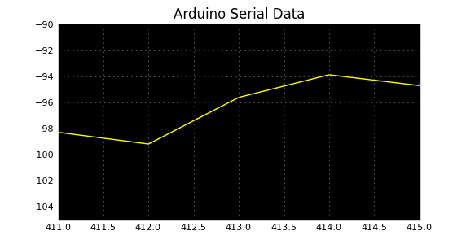
Detection/Anticipation Module – Completed Milestones
Speed Calculations
Speed can be calculated within +-10% accuracy between the stationary sensor, and a moving obstacle
Example:

Slide 12
Detection/Anticipation Module – Completed Milestones
Speed Calculations
Speed can also be calculated while the sensor moves, and the obstacle is stationary
Insert the picture in laptop here

Slide 13
Detection/Anticipation Module – Issues Faced
Sensor’s range is highly reduced due to the size of the obstacle (1.5 m to 3 m)
We anticipate further error margin once the sensor is mounted on the vehicle
Real-Time Plots for Verification
Wireless retrieval of microcontroller data for verification

Slide 14
Detection/Anticipation Module – Next Steps
Verify code for time calculations
Mount sensor on vehicle and start integrated testing
Verify blind spot coverage
Recalculate accuracy of relative speed calculations
Refine the look-up table for danger level detection

