Slide 1
WLS (GPR177/Wntless) in Human Dental Pulp Stem Cells
A donor-aware single-cell analysis of GSE164157
Md Tariqul Islam
Laboratory of Professor Wei Hsu, The ADA Forsyth Institute
October 2026
Data: GEO GSE164157 (5 donors, 10x Genomics) | Code: github.com/mtariqi/dpsc-wls-human-scRNAseq
Notes:
Title slide. Every slide ends with a source line naming the dataset, the script that produced the result and the results file it came from, so any number can be traced in the repository.

Slide 2
The answer up front
Is WLS expressed, and enriched, in human DPSCs?
WLS is expressed in candidate DPSCs in every donor, but it is not enriched in them.
11.1%
1.9×
0 of 4
median WLS⁺ candidate DPSCs per donor (all 5 donors)
lower than pulp fibroblasts (pseudobulk FDR 0.0014)
DPSC definitions in which WLS was higher
Tables: results/07_WLS/WLS_summary_by_group.csv | results/07_WLS/WLS_pseudobulk_edgeR_tests.csv | results/07b_sensitivity/WLS_sensitivity_by_definition.csv
Notes:
Headline result. H1 (WLS expressed) is supported; H2 (WLS enriched in DPSCs) is not. The comparison with fibroblasts is a donor-paired pseudobulk test, so the five donors are the replicates.

Slide 3
Data and study design
Secondary analysis of a public human dental pulp atlas
GEO sample | Donor | Singlets
GSM4998457 | Pulp1 | 4,775
GSM4998458 | Pulp2 | 5,406
GSM4998459 | Pulp3 | 5,395
GSM4998460 | Pulp4 | 3,717
GSM4998461 | Pulp5 | 4,034
Total |  | 23,327
1
Tissue, not culture
Freshly dissociated pulp cells; DPSCs defined by marker combinations
2
Donors as replicates
All inference by donor-paired pseudobulk; cell-level tests exploratory only
3
Robustness built in
Four DPSC definitions and depth-adjusted models
Data: GEO GSE164157 | Scripts: scripts/02_download_GEO.R (GEOquery), scripts/04_QC.R | Table: results/06a_batch/doublets_by_sample.csv
Notes:
Five pulp samples from GSE164157 in 10x Cell Ranger format. Singlet counts are after QC and doublet removal. Clinical details of the teeth are not in the processed files; the original GSE164157 publication should be cited.

Slide 4
Reproducible pipeline
Each stage is one script; outputs go to a numbered results folder
QC
Clustering
Doublets + Harmony
Annotation + DPSCs
WLS by donor
Sensitivity
04_QC.R
05_clustering.R
06a_batch_doublets.R
06_annotation.R
07_WLS_expression.R
07b_WLS_sensitivity.R
Environment: R 4.6, Seurat v5, harmony, scDblFinder, edgeR, lme4; versions locked in renv.lock
Next: 08_DEG.R (WLS⁺ vs WLS⁻), 09_GSEA.R, ligand–receptor analysis, validation in a second dataset
Code: github.com/mtariqi/dpsc-wls-human-scRNAseq/scripts | Environment: renv.lock | Session info: results/*/sessionInfo.txt
Notes:
Run order is shown left to right. Each script reads the previous stage output from data/processed and writes figures, CSV tables and sessionInfo.txt to its results folder.

Slide 5
Quality control and doublet removal
Even doublet rates across donors
25,886
cells loaded
25,030
after QC filters
23,327
singlets analysed
Scripts: scripts/04_QC.R (nFeature > 200, nCount > 500, mt < 20%), scripts/06a_batch_doublets.R | Table: results/06a_batch/doublets_by_sample.csv
Notes:
856 cells (3.3%) failed QC; 1,703 doublets (6.8%) were removed, run per donor because doublets form only within one 10x capture.

Slide 6
Harmony integration mixes the donors
Share of each cluster coming from its largest donor (0.2 = perfect mixing)
Mesenchymal, endothelial and glial clusters: 27–48% from their largest donor
T/NK cluster 6 comes only from Pulp4 and Pulp5, likely an immune infiltrate; retained
Epithelial cluster 14 is 82% Pulp3, likely contamination; excluded
Script: scripts/06a_batch_doublets.R (Harmony, 20 PCs, res. 0.5) | Tables: results/06a_batch/cluster_by_sample_before.csv, cluster_by_sample_after.csv
Notes:
After Harmony the mesenchymal clusters draw cells evenly from all donors, so the DPSC comparison is not driven by one donor. Figure: results/06a_batch/07_UMAP_after_harmony.png.

Slide 7
Nine cell types in human dental pulp
All 16 clusters had a clear marker match and were confirmed manually
41%
of cells are pulp fibroblasts
No odontoblast cluster
Often lost during pulp extraction; lymphatic and mast cells too rare to cluster
Script: scripts/06_annotation.R (14 marker panels, module scores) | Tables: data/annotation/cluster_labels.csv, results/06_annotation/cell_type_by_sample.csv
Notes:
Orange bars are mesenchymal lineages. UMAP figure: results/06_annotation/03_UMAP_cell_types.png. Marker dot plot: results/06_annotation/01_DotPlot_lineage_markers.png.

Slide 8
Candidate DPSCs are perivascular cells
Stem/progenitor score of each mesenchymal sub-cluster, scored separately from perivascular genes
Stem score: THY1, NT5E, ENG, NGFR, FRZB, LEPR, PRRX1, CXCL12
Only 3 perivascular sub-clusters score above background: 2,847 cells
Their perivascular scores (0.62–1.13) far exceed stem scores (0.04–0.20)
Fits the CD146⁺ perivascular niche (Shi & Gronthos 2003)
Script: scripts/06_annotation.R (mesenchyme sub-clustering, res. 0.4) | Table: results/06_annotation/mesenchymal_subclusters_DPSC_score.csv
Notes:
Candidate DPSCs = mesenchymal sub-clusters with a positive mean stem score. Figure: results/06_annotation/04_mesenchyme_DPSC_score.png.

Slide 9
WLS is detected in candidate DPSCs in every donor
Median % of WLS⁺ cells across donors
Range across donors
Candidate DPSC: 1.3–16.8%
Pulp fibroblast: 6.3–24.0%
Detection understates expression
10x data capture a fraction of transcripts, so compare groups, not absolute %.
Script: scripts/07_WLS_expression.R | Tables: results/07_WLS/WLS_summary_by_group.csv, results/07_WLS/WLS_per_donor_per_group.csv
Notes:
Groups with at least 20 cells per donor. Figures: results/07_WLS/01_UMAP_WLS_and_groups.png and 05_WLS_pct_per_donor.png.

Slide 10
Donor-level tests: WLS is not enriched
WLS log2 fold change, candidate DPSC vs each group (pseudobulk edgeR, 5 donors)
Comparison | FDR
vs Pulp fibroblast | 0.0014
vs Myeloid | 0.0001
vs Endothelial | 0.0002
vs Schwann/glia | 0.32
vs All other cells | 0.57
Mixed model (mesenchyme): OR 0.43 (95% CI 0.37–0.50)
Script: scripts/07_WLS_expression.R (edgeR QL, ~ donor + group; lme4) | Tables: results/07_WLS/WLS_pseudobulk_edgeR_tests.csv, WLS_mixed_model.csv
Notes:
Positive = higher in candidate DPSCs. Lower than fibroblasts and myeloid cells, higher than endothelial, equal to the pulp average. The mixed-model p-value is overly small because it treats cells as observations; use the pseudobulk FDRs for inference.

Slide 11
WLS–WNT co-expression was a depth artefact
Odds ratio for WLS in WNT⁺ vs WNT⁻ cells, before and after adjusting for genes per cell
Scripts: 07_WLS_expression.R, 07b_WLS_sensitivity.R | Tables: results/07_WLS/WLS_WNT_coexpression.csv, results/07b_sensitivity/WLS_WNT_coexpression_depth_adjusted.csv, WNT_ligand_pct_by_group.csv
Notes:
After adjusting for genes detected per cell, the association is gone everywhere except Schwann/glia (OR 1.80, 95% CI 1.18–2.73, p = 0.006). Fibroblasts express WNT5A/WNT5B; candidate DPSCs mainly WNT6.

Slide 12
Robust to the DPSC definition
WLS log2FC, candidate DPSCs vs other mesenchymal cells
Definition | Cells | p
A | 2,847 | 2.3e-4
B | 2,495 | 7.9e-4
C | 1,423 | 0.38
D | 1,538 | 0.011
Definitions overlap only 21–79%, yet WLS is never higher in candidate DPSCs.
Script: scripts/07b_WLS_sensitivity.R | Tables: results/07b_sensitivity/WLS_sensitivity_by_definition.csv, definition_overlap.csv
Notes:
Definition C selects the best-sequenced cells, which favours WLS detection, so it is least likely to show a deficit. Figure: results/07b_sensitivity/01_sensitivity_log2FC.png.

Slide 13
Donor differences track sequencing depth
% WLS⁺ candidate DPSCs, donors ordered by median genes per cell
Pulp3 has ~⅓ of the genes per cell of the best donors, hence 1.3% WLS⁺
Pulp4/5 have high mitochondrial reads but the highest WLS detection
Pseudobulk tests compare within donors, so fold changes are unaffected
Do not compare % WLS⁺ between donors
Script: scripts/07b_WLS_sensitivity.R | Table: results/07b_sensitivity/candidate_DPSC_by_donor_QC.csv
Notes:
Median UMIs per candidate DPSC: Pulp3 656, Pulp2 1,723, Pulp4 2,338, Pulp5 2,485, Pulp1 3,228.

Slide 14
Interpretation and limitations
What the data say
Caveats
H1 supported: WLS is expressed in candidate DPSCs
H2 not supported: DPSCs are at the pulp average
Fibroblasts are the main WLS⁺ mesenchymal cells, with WNT5A/WNT5B
No evidence of WLS–WNT co-expression in DPSCs
One dataset (GSE164157); needs validation
DPSCs defined computationally, not functionally
Fresh tissue: cultured DPSCs may differ
RNA only; no WLS protein or secretion data
Donor clinical details unknown
Reports: docs/WLS_DPSC_Progress_Report_2.docx, docs/WLS_DPSC_Graduate_Report.docx | All tables: results/07_WLS/, results/07b_sensitivity/
Notes:
Key message: WLS is present in DPSCs but they are not a specialised WLS-high population in uninjured adult pulp.

Slide 15
Next steps and questions
08_DEG.R: WLS⁺ vs WLS⁻ cells in DPSCs and fibroblasts (pseudobulk, GSEA)
Ligand–receptor mapping of Wnt senders and receivers
Validation: GSE202476 / Pagella 2021 atlas; cultured DPSCs (Lee 2022)
Bench: WLS immunostaining with MCAM/THY1 on pulp sections
For Professor Hsu
Which DPSC definition matters most to the lab?
Tissue DPSCs, or cultured DPSCs?
Should we follow up fibroblasts as the main WLS source?
Approve public release (Zenodo DOI) and authorship?
Repository: github.com/mtariqi/dpsc-wls-human-scRNAseq | Planned scripts: scripts/08_DEG.R, scripts/09_GSEA.R
Notes:
Close by asking the four questions; the answers decide the next stage.

Slide 16
Validation: the answer holds
Same question, same pipeline, three independent datasets
WLS is expressed in DPSCs in all four datasets, but enriched in none of them.
4 of 4
0 of 4
3 of 3
datasets with WLS⁺ candidate DPSCs (11–70% of cells)
datasets in which WLS is higher in DPSCs than in comparison cells
pulp tissues in which fibroblasts are the top WLS⁺ mesenchymal cells
Code: github.com/mtariqi/dpsc-wls-validation | Table: results/WLS_cross_dataset_summary.csv | Scripts: scripts/02–04
Notes:
Validation of the GSE164157 result in GSE202476, GSE185222 (sound tooth) and GSE227731 (DPSC vs PDLSC), with the same QC, marker panels and DPSC definition A as 06_annotation.R. The answer is unchanged: WLS is present in DPSCs but they are not a WLS-high population.

Slide 17
Four datasets, one answer
Candidate DPSCs (definition A) vs comparison cells within each dataset
Dataset | Sample | DPSCs | % WLS⁺ DPSC | % WLS⁺ comparison | log2FC | Statistics
GSE164157 | Fresh pulp, 5 donors | 2,847 | 11.1 | pulp avg. | −0.14 | Pseudobulk, FDR 0.57
GSE202476 | Fresh pulp, 13-year-old | 1,011 | 33.8 | 36.7 | −0.16 | Descriptive, 1 donor
GSE185222 | Fresh pulp, sound tooth | 122 | 14.8 | 16.9 | +0.21 | Descriptive, 1 donor
GSE227731 | Stem cells: DPSC vs PDLSC | 2,150 | 69.5 | 83.7 (PDLSC) | −0.72 | Descriptive, 1 library each
No dataset shows enrichment. log2FC is DPSC vs all other cells (vs PDLSC for GSE227731); positive = higher in DPSCs. Compare within a row: % WLS⁺ varies between datasets with depth, chemistry and culture.
Table: github.com/mtariqi/dpsc-wls-validation/results/WLS_cross_dataset_summary.csv | Per-dataset tests: results/<GEO>/WLS_tests.csv
Notes:
Read each row within its dataset. Percentages of WLS-positive cells differ between datasets because of sequencing depth, chemistry and culture, so only the DPSC-vs-comparison direction is comparable. Only GSE164157 has donor-level replication; the other three are descriptive.

Slide 18
Fibroblasts, not DPSCs, lead WLS expression
% of cells expressing WLS by cell type; candidate DPSCs in burgundy
No WLS-high DPSC subset
Main DPSC sub-clusters: 64–80% WLS⁺. One sub-cluster (187 cells) is WLS-low at 14%.
Tables: results/GSE202476/WLS_by_cell_type.csv, results/GSE185222/WLS_by_cell_type.csv, results/GSE227731/WLS_by_cell_type.csv, WLS_by_DPSC_subcluster.csv
Notes:
GSE185222 is the sound tooth only (887 cells; odontoblasts n = 18). In GSE227731 the main DPSC sub-clusters are 64–80% WLS-positive; one sub-cluster (187 cells) is WLS-low at 14%. T/NK cells are essentially WLS-negative in every dataset.

Slide 19
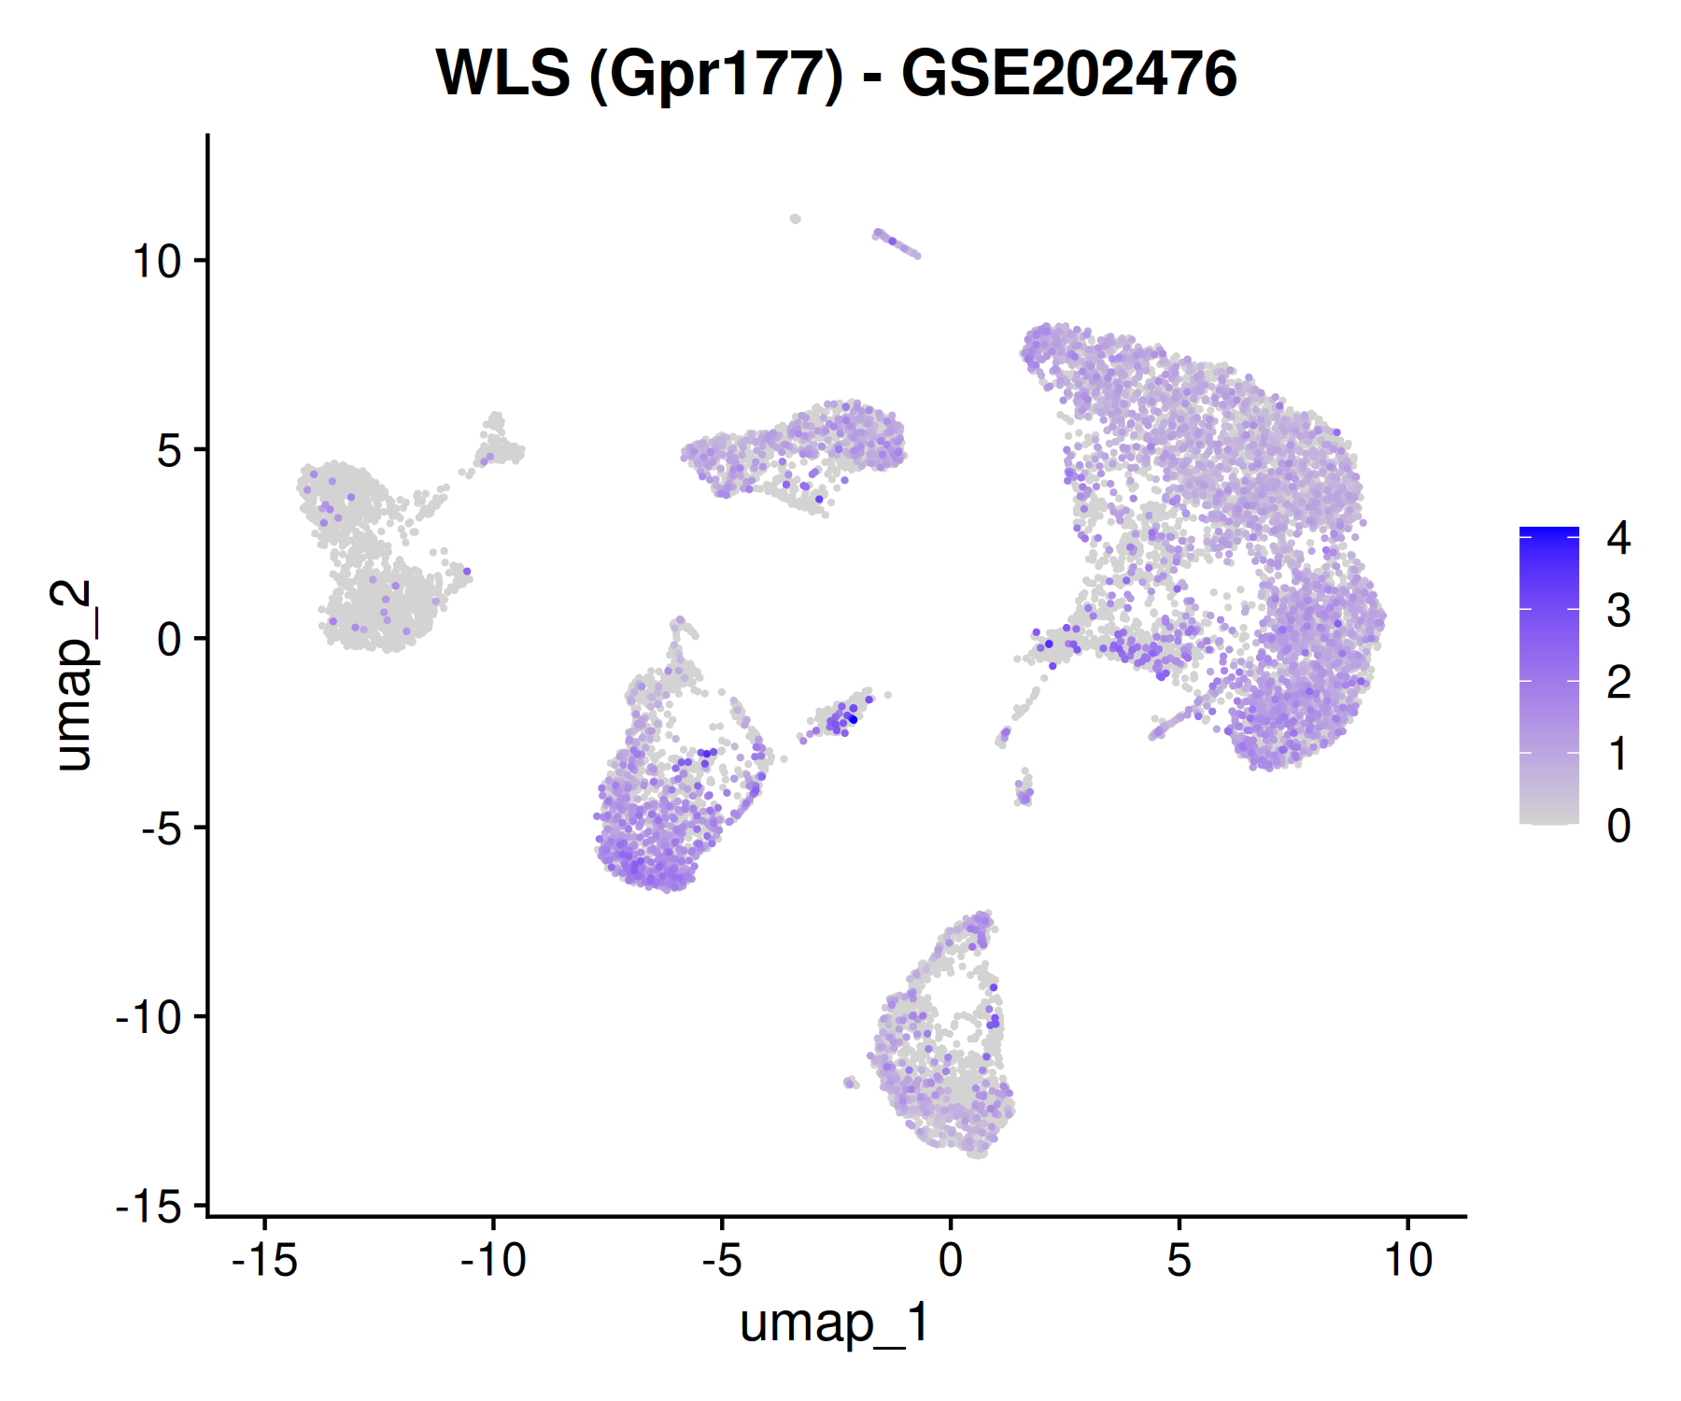
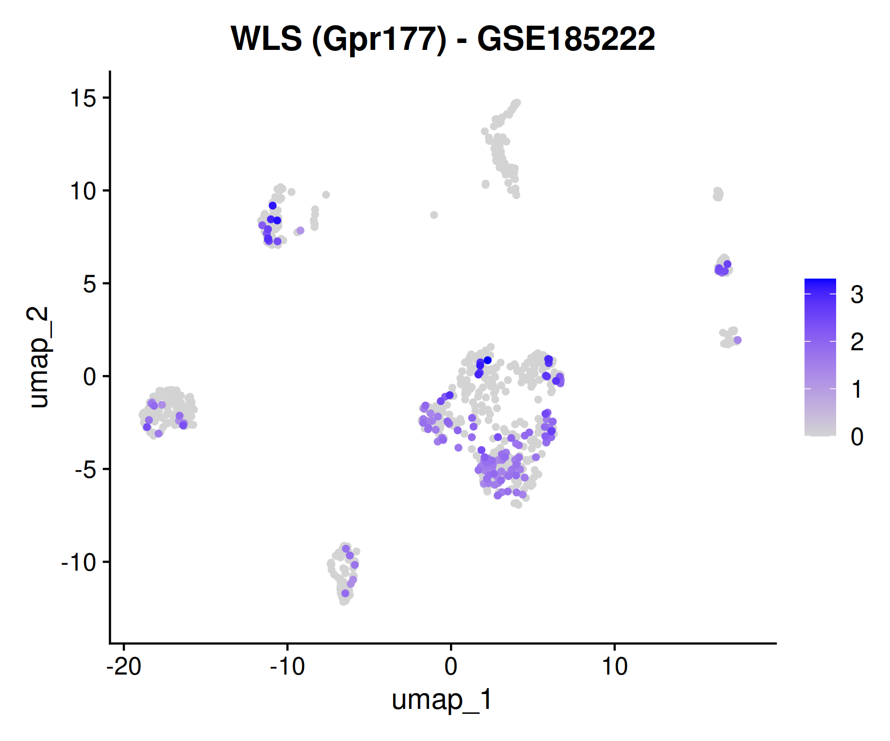
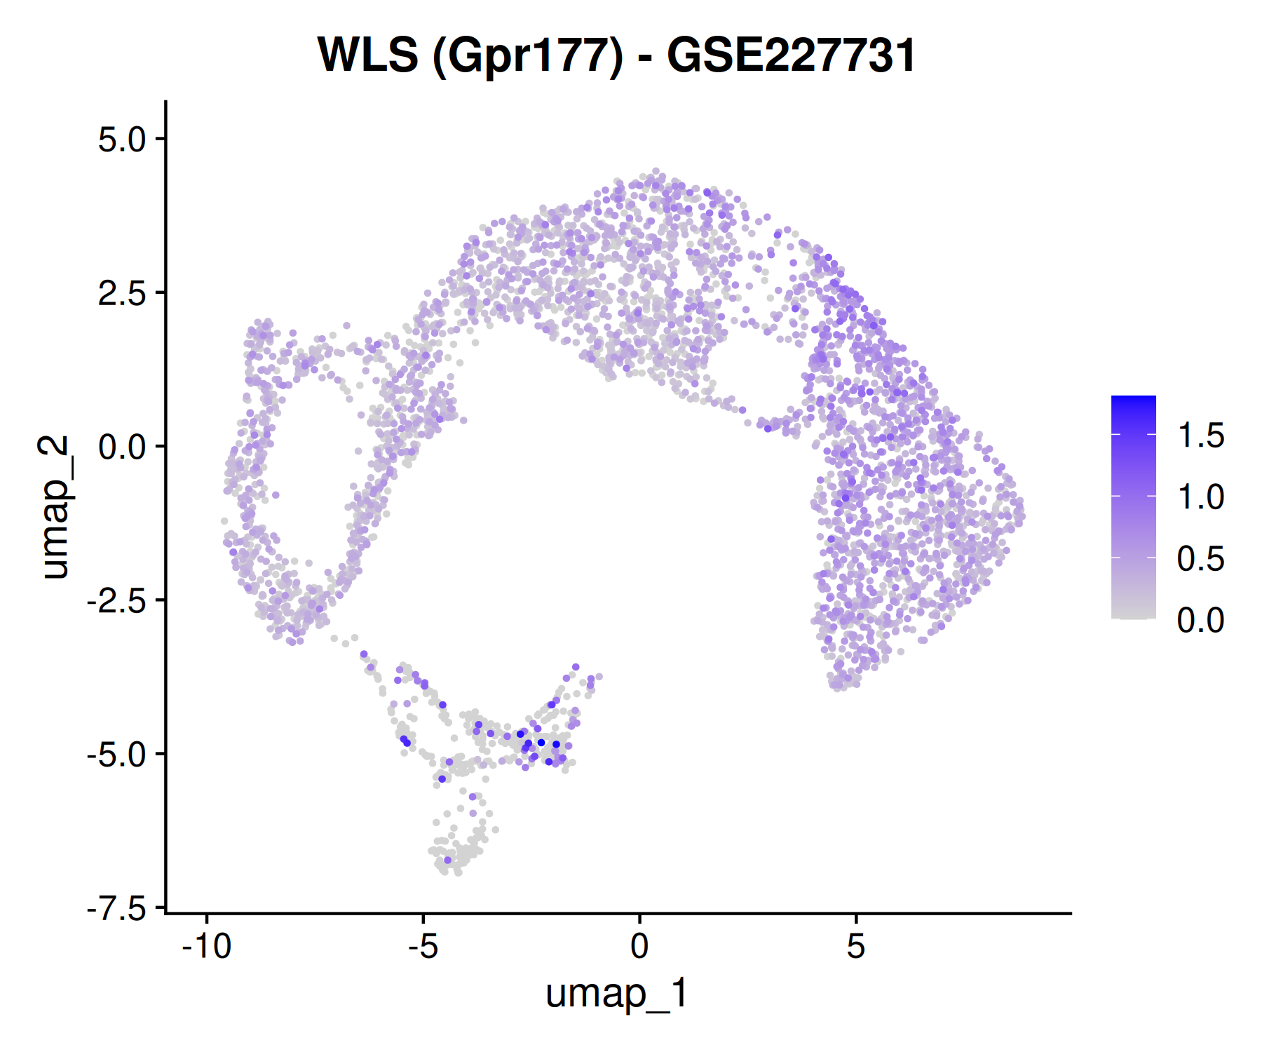
Where WLS is detected
WLS expression on each validation dataset's UMAP (grey = not detected)
GSE202476
Young tooth, 11,298 cells
GSE185222
Sound tooth (DTP_01), 887 cells
GSE227731
DPSCs + PDLSCs, 4,015 cells
In pulp tissue the densest WLS signal is the fibroblast mass; in culture, WLS is broad across DPSCs and PDLSCs.
Figures: results/GSE202476/WLS_umap.png, results/GSE185222/WLS_umap.png, results/GSE227731/WLS_umap.png | Script: scripts/03_WLS_analysis.R
Notes:
Left: the large WLS-positive mass on the right is the fibroblasts; the perivascular island (candidate DPSCs) shows sparser signal. Middle: sound tooth only. Right: cultured DPSCs and PDLSCs together; WLS is broad.

Slide 20
What validation adds
What the data now say
Caveats
WLS is expressed in DPSCs in all four datasets
Never enriched: DPSCs sit at or below the pulp average
Fibroblasts lead WLS⁺ mesenchyme in all three pulp tissues
Carious teeth show the same pattern
Stem cells: DPSCs below PDLSCs; no WLS-high DPSC subset
Validation sets have one donor or library per group: descriptive only
DPSCs defined computationally, with the same rule in every dataset
% WLS⁺ is not comparable between datasets
GSE227731 culture conditions to confirm with the authors
RNA only; no WLS protein or secretion data
Repository: github.com/mtariqi/dpsc-wls-validation | Discovery: github.com/mtariqi/dpsc-wls-human-scRNAseq
Notes:
Key message: across four datasets, WLS is present in DPSCs at or below the level of surrounding cells. GSE227731 comes from the Kantarci lab at ADA Forsyth, so culture conditions and donor numbers can be confirmed directly.

