Slide 1

Submitted by Md Tariqul Islam (Tariq) Data Science, Metro College Submitted to Dr. Tareq Jaber

Slide 2
PREAMBLE
DATA ANALYSIS IN A HOSPITAL ENVIRONMENT
DATA SOURCE: KAGGLE
137057 obs. of 17 variable
BULLET POINTS:
HOSPITAL REGION
ADMISSION TYPE
ADMISSION DEPOSIT
AGE GROUP
DEPARTMENT
SEVERITY OF ILLNESS

Slide 3

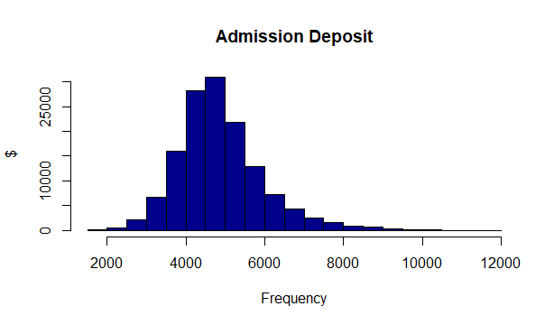
1
Let’s start with the first set of slides
#Total Admission Deposit
$ 667.43 Million

Slide 4
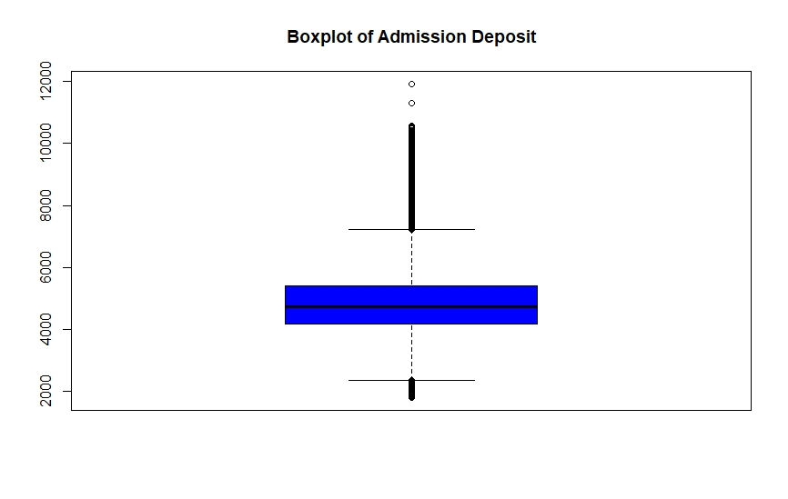

Slide 5

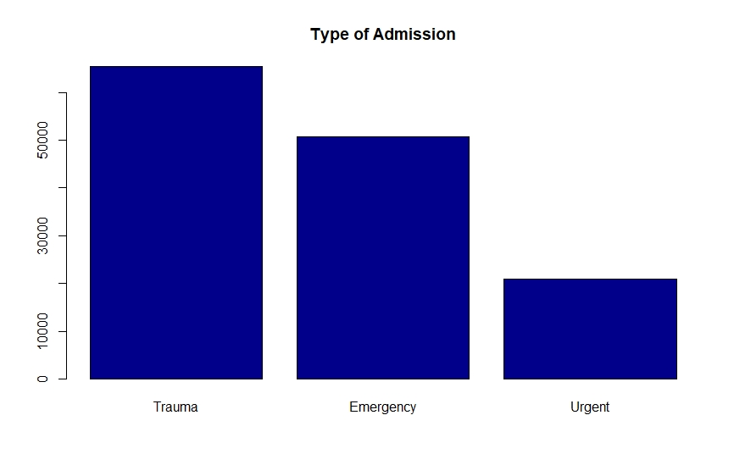

Slide 6

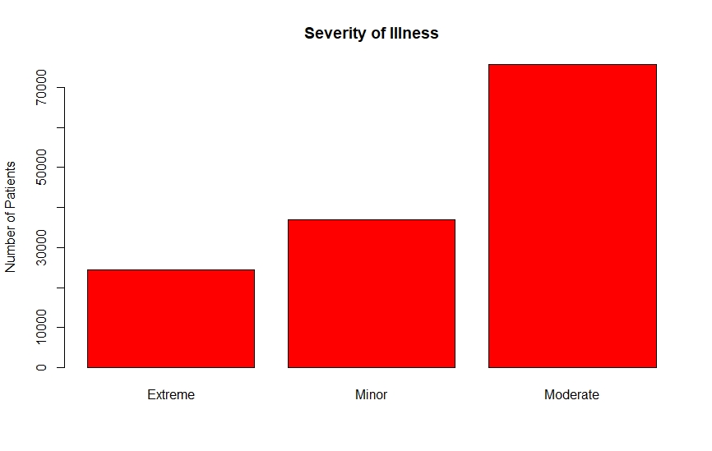

Slide 7
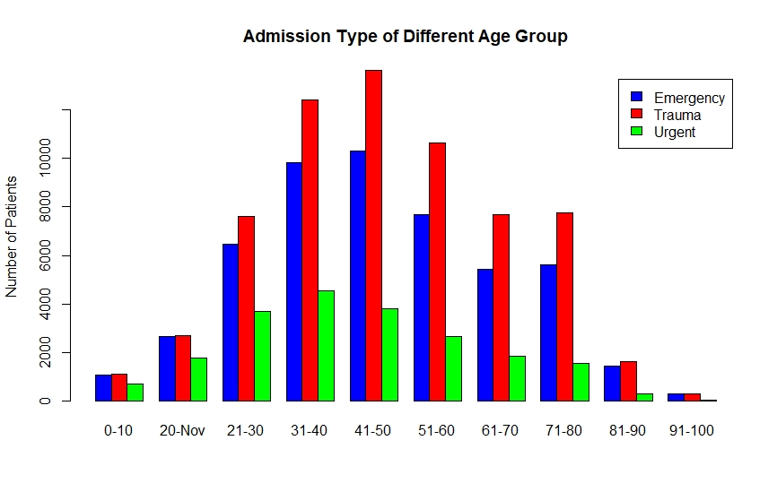
This is a slide title

Slide 8
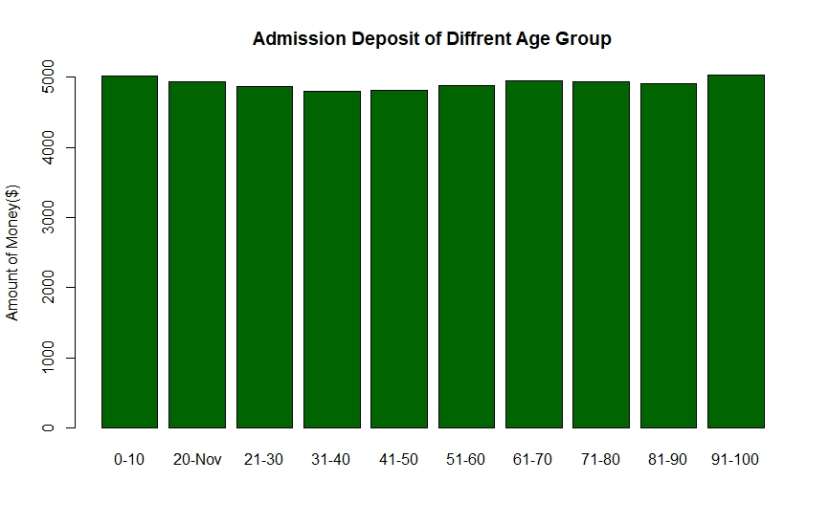
You can also split your content

Slide 9
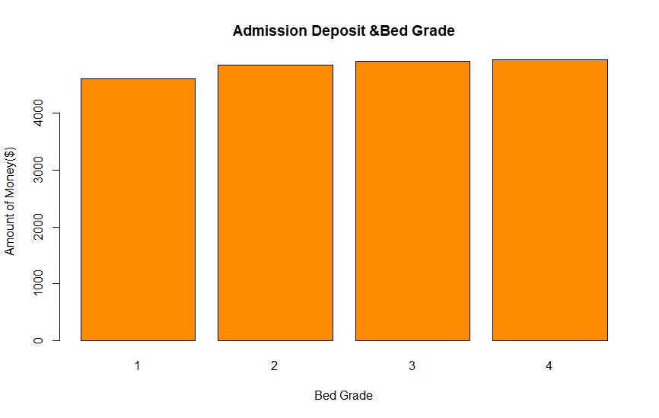
Yellow
Is the color of gold, butter and ripe lemons. In the spectrum of visible light, yellow is found between green and orange.
Blue
Is the colour of the clear sky and the deep sea. It is located between violet and green on the optical spectrum.
Red
Is the color of blood, and because of this it has historically been associated with sacrifice, danger and courage.

Slide 10
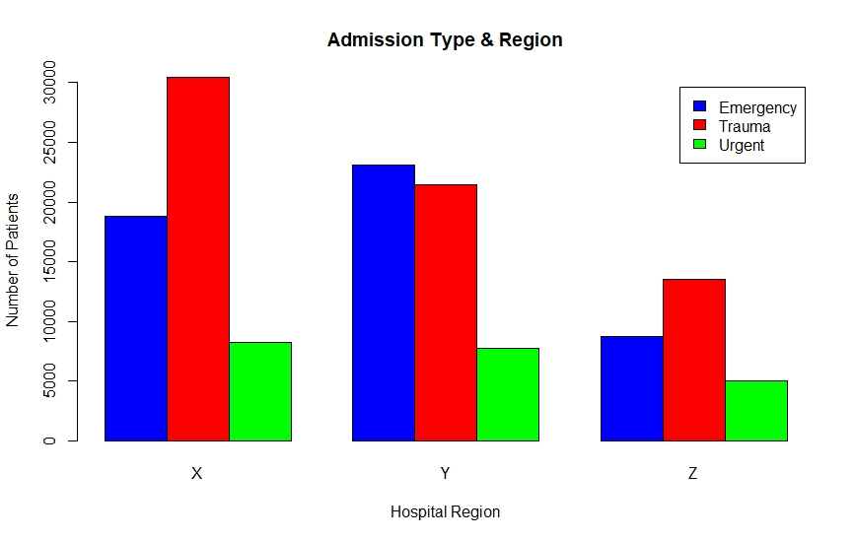

Slide 11
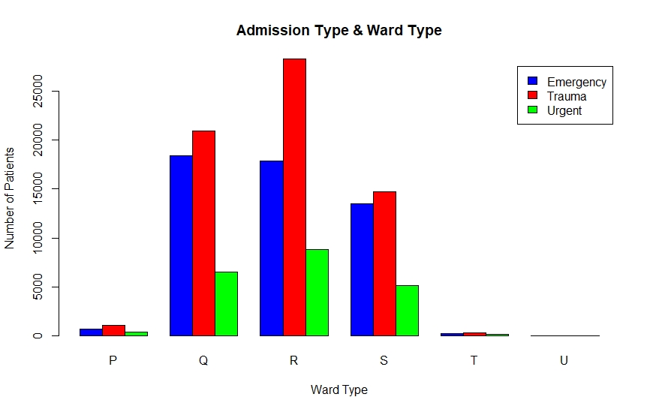

Slide 12
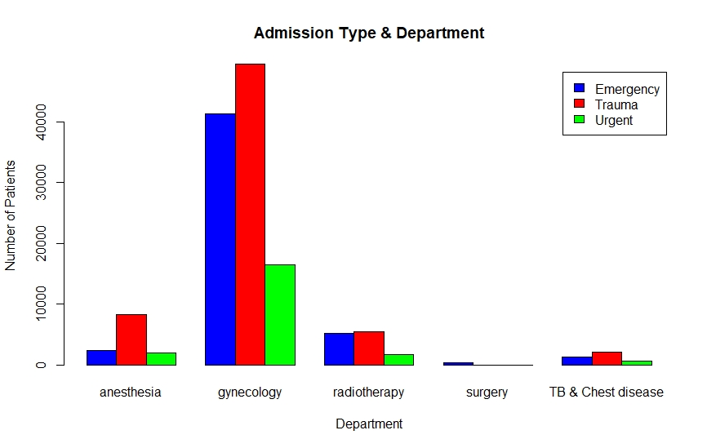

Slide 13
CORRELATION
Pearson's product-moment correlation
data: hd$Bed.Grade and hd$Admission_Deposit
t = 24.778, df = 137020, p-value < 2.2e-16
alternative hypothesis: true correlation is not equal to 0
90 percent confidence interval:
0.06236345 0.07121099
sample estimates:
cor
0.06678853

Slide 14
CONCLUSION
When it comes to various types of diseases in the given dataset, individuals in the age group of 41-50 are getting more attention.
I also show that, relative to other hospitals, more patients are admitted by hospitals in the "X" region.
Apart from this, Ward “R” offer more facilities for patients with Trauma compared to other wards in the hospital.
In the same way, the hospital's gynaecology department is the busiest in terms of treating more patients than other units.
I could not find any significant difference when it comes to “Bed Grade”.
However, relative to the rest of the age group, the youngest and oldest patients put up more deposits.
You can insert graphs from Excel or Google Sheets

Slide 15
