Slide 2
After this lecture, you will be able to
  introduce Data Warehouse
  analyse the features and need of Data Warehouse.
  understand different Data Warehouse Models.
  differentiate between OLAP and OLTP

Slide 3


Goal: Unified Access to Data
Collects and combines information
Provides integrated view, uniform user interface
Supports sharing
Integration System
World
Wide
Web
Digital Libraries
Scientific Databases
Personal
Databases

Slide 4
What is Data Warehouse?
“A data warehouse is a subject - oriented, integrated, time variant and non-volatile collection of data in support of management decision making process.”
These four keywords - subject-oriented, integrated, time-variant, and nonvolatile distinguish data warehouses from other data repository systems, such as relational database systems, transaction processing systems, and file systems.

Slide 5
Data Warehouse Properties
Subject
Oriented
Integrated
Data
Warehouse
Non-Volatile
Time Variant

Slide 6
Data Warehouse Properties
Subject-Oriented
  Stored data according to target specific subjects.
  Example: It may store data regarding total Sales, Number of Customers, etc. and not general data on everyday operations.

Slide 7
Data Warehouse Properties
Integrated
  Data may be distributed across heterogeneous sources which have to be integrated.
  Example: Sales data may be on RDB, Customer information on Flat files, etc.

Slide 8
Data Warehouse Properties
Time Variant
  Data are stored to provide information from an historic perspective.
  Example: Data of sales in last 5 years, etc.

Slide 9
Data Warehouse Properties
Non-Volatile
  It is separate from the Enterprise Operational Database and hence is not subject to frequent modification.
  It generally has only 2 operations performed on it
    Loading of data
    Access of data.

Slide 10
The Warehousing Approach
Information integrated in advance
Stored for direct querying and analysis

Slide 11
The Warehousing Approach
Clients
Data
Warehouse
Integration System
Metadata
Extractor/
Monitor
Extractor/
Monitor
Extractor/
Monitor
Source
Source
Source

Slide 12
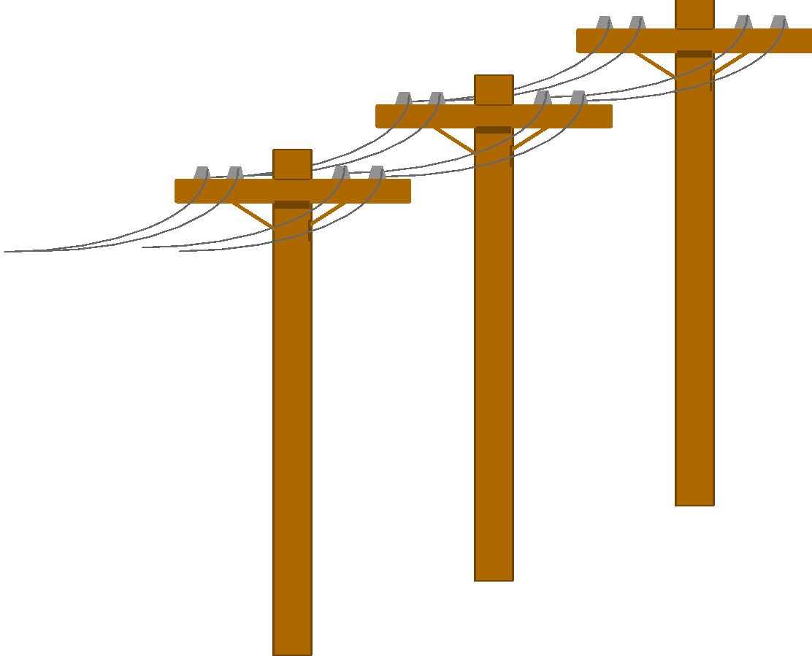


Heterogeneous Information Sources
“Heterogeneities are everywhere”
Personal
Databases
World
Wide
Web
Scientific Databases
Digital Libraries

Slide 13
Heterogeneous Information Sources
Different interfaces.
Different data representations.
Duplicate and inconsistent information.

Slide 14
Features of a Warehouse
It is separate from Operational Database.
Integrates data from heterogeneous systems.
Stores HUGE amount of data, more historical than current data.
Does not require data to be highly accurate.
Queries are generally complex.
Goal is to execute statistical queries and provide results which can influence decision making in favor of the Enterprise.
These systems are thus called Online Analytical Processing Systems (OLAP).

Slide 15
Need of a Separate Data Warehouse
Use of OLAP query on OLTP system degrades system’s performance.
OLAP systems access historical data and not current volatile data while OLTP systems access current up-to-date data and do not need historical data.
An Operational Database is designed for known tasks like indexing and hashing using primary keys, searching for particular records, and many more.

Slide 16
Need of a Separate Data Warehouse
Data Warehouse queries are often complex.
The computation of large data groups at summarized levels, and may require the use of special data organization, access, and implementation methods based on multidimensional views.

Slide 17
Data Warehousing: Two Distinct Issues
How to get information into warehouse?
  -“Data warehousing”
What to do with data once it’s in warehouse?
  -“Warehouse DBMS”

Slide 18
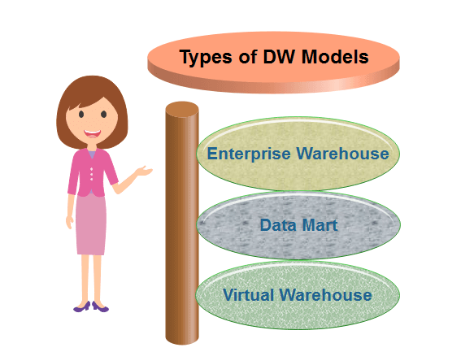
Data Warehouse Models

Slide 19
Difference between OLAP & OLTP
OLAP | OLTP
Consists of historical data from various Databases. | Consists only operational current data.
It is subject oriented. | It is application oriented.
Used for Data Mining, Analytics, etc. | Used for business tasks.
The data is used in planning, problem solving and decision making. | The data is used to perform day to day fundamental operations.

Slide 20
Difference between OLAP & OLTP
OLAP | OLTP
It reveals a snapshot of present business tasks. | It provides a multi-dimensional view of different business tasks.
Relatively slow as more data involved. Queries may take hours. | Very Fast as the queries operate on 5% of the data.
It only need backup from time to time as compared to OLTP. | Backup and recovery process is maintained religiously.
This data is generally managed by CEO, MD, GM. | This data is managed by clerks, managers.

