Slide 1
U01-T03

Slide 2
After this lecture, you will be able to
introduce Data Cube
understand various terminologies used in Data Cube.
learn how Data Cube Model n-dimensional data.
visualize various OLAP Operations

Slide 3
What is Data Cube?
A data cube allows data to be modeled and viewed in multiple dimensions. It is defined by dimensions and facts.
Dimensions are the entities with respect to which an organization wants to keep records.
Facts are numerical measures. It is the quantities by which we want to analyze relationships between dimensions.

Slide 4
What is Data Cube?
The data cube is used by the users of the decision support system to see their data.
The cuboid that holds the lowest level of summarization is called the base cuboid.
The 0-D cuboid, which holds the highest level of summarization, is called the apex cuboid.

Slide 5
Cube: A Lattice of Cuboids
all
0-D (apex) cuboid
time
item
location
supplier
1-D cuboids
time,location
item,location
location,supplier
2-D cuboids
time,supplier
item,supplier
time,location,supplier
3-D cuboids
time,item,supplier
item,location,supplier
4-D(base) cuboid

Slide 6
A Sample Data Cube
6
Total annual sales
of TV in U.S.A.
Date
1Qtr
2Qtr
3Qtr
4Qtr
sum
Product
TV
PC
U.S.A
VCR
sum
Canada
Country
Mexico
sum
All, All, All

Slide 7
Cuboids Corresponding to the Cube
all
0-D(apex) cuboid
product
date
country
1-D cuboids
product, date
product, country
date, country
2-D cuboids
3-D(base) cuboid
product, date, country

Slide 8
Operations in the Multidimensional Data Model (OLEP)
In the multidimensional model, data are organized into multiple dimensions, and each dimension contains multiple levels of abstraction defined by concept hierarchies.
Organization provides users with the flexibility to view data from different perspectives.

Slide 9
Operations in the Multidimensional Data Model (OLEP)
A number of OLAP data cube operations exist to materialize these different views, allowing interactive querying and analysis of the data at hand.

Slide 10
Typical OLAP Operations
Roll up (drill-up): summarize data
by climbing up hierarchy or by dimension reduction
Drill down (roll down): reverse of roll-up
from higher level summary to lower level summary or detailed data, or introducing new dimensions

Slide 11
Typical OLAP Operations
Slice and dice: project and select
The Slice operation performs a selection on one dimension of the given cube, resulting in a subcube. The dice operation defines a subcube by performing a selection on two or more dimensions.
Pivot (rotate):
Reorient the cube, visualization, 3D to series of 2D planes.

Slide 12
Drill-Up Or Roll-Up
The roll-up operation performs aggregation on a data cube either by climbing up the hierarchy or by dimension reduction.
Location | Medal
Delhi | 5
New York | 2
Patiala | 3
Los Angles | 5
Location | Medal
India | 8
America | 7

Slide 13
Roll-Down Or Drill Down
Stepping down a concept hierarchy for a dimension.
By introducing a new dimension.
Location | Medal
Delhi | 5
New York | 2
Patiala | 3
Los Angles | 5
Location | Medal
India | 8
America | 7

Slide 14
Slice
The slice operation performs a selection on one dimension of the given cube, resulting in a subcube. Reduces the dimensionality of the cubes.
For example, if we want to make a select where Medal = 5.
Location | Medal
Delhi | 5
Los Angles | 5

Slide 15
Dice
The dice operation defines a sub-cube by performing a selection on two or more dimensions.
For example, if we want to make a select where Medal = 3 or Location = New York.
Location | Medal
Patiala | 3
New York | 2

Slide 16
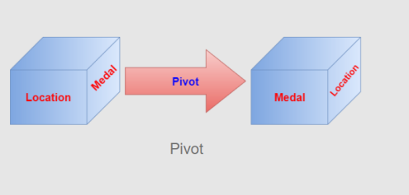
Pivot
Pivot is also known as rotate. It Rotates the data axis to view the data from different perspectives.

Slide 17
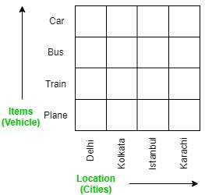
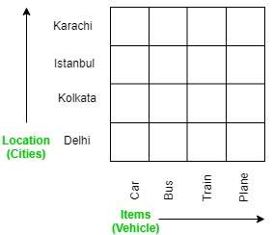
Before and After Pivoting

