Slide 1
U01-T04

Slide 2
After this lecture, you will be able to
  define business analysis framework for data warehouse design.
  analyse the design process
  understand various methods for the efficient implementation of data warehouse systems.
  apply indexing on OLAP data.

Slide 3
Data Warehouse Design
The Design of a Data Warehouse: A Business Analysis Framework
“What can business analysts gain from having a data warehouse?”

Slide 4
Data Warehouse Design
Competitive advantage (by presenting relevant information to help win over competitors).
Data warehouse can enhance business productivity (because it is able to quickly and efficiently gather information that accurately describes the organization).

Slide 5
Data Warehouse Design
Data warehouse facilitates customer relationship management (because it provides a consistent view of customers and items across all lines of business, all departments, and all markets).
Cost reduction by tracking trends, patterns, and exceptions over long periods in a consistent and reliable manner.

Slide 6
Data Warehouse Design
To design an effective data warehouse we need to understand and analyze business needs and construct a business analysis framework.

Slide 7
Views in data warehouse design
Four different views regarding the design of a data warehouse must be considered:
The top-down view allows the selection of the relevant information necessary for the data warehouse. This information matches the current and future business needs.

Slide 8
Views in data warehouse design
The data source view exposes the information being captured, stored, and managed by operational systems.
The data warehouse view includes fact tables and dimension tables. It represents the information that is stored inside the data warehouse.

Slide 9
Views in data warehouse design
The business query view is the perspective of data in the data warehouse from the viewpoint of the end user.

Slide 10
Process of Data Warehouse Design
Data warehouse can be built using a
top-down approach,
bottom-up approach, or
combination of both.

Slide 11
Process of Data Warehouse Design
Top-down approach starts with the overall design and planning. It is used where technology is mature and well known & business problems that must be solved are clear and well understood.
Bottom-up approach starts with experiments and prototypes. Useful in the early stage of business modeling and technology development.

Slide 12
Process of Data Warehouse Design
Combined approach, an organization can exploit the planned and strategic nature of the top-down approach while retaining the rapid implementation and opportunistic application of the bottom-up approach.

Slide 13
Warehouse design process
Steps:
Choose a business process to model (e.g., orders, invoices, shipments, inventory, account administration, sales, or the general ledger).
Choose the business process grain, which is the fundamental, atomic level of data to be represented in the fact table for this process (e.g., individual transactions, individual daily snapshots, and so on).

Slide 14
Warehouse design process
Choose the dimensions that will apply to each fact table record.
Choose the measures that will populate each fact table record. Typical measures are numeric additive quantities like dollars_sold and units_ sold.

Slide 15
Data Warehouse usage
Initially, the data warehouse is mainly used for generating reports and answering predefined queries.
Progressively, it is used to analyze summarized and detailed data.

Slide 16
Data Warehouse usage
Later, the data warehouse is used for performing multidimensional analysis and sophisticated slice-and-dice operations.
Finally, the data warehouse employed for knowledge discovery and strategic decision making using data mining tools.

Slide 17
Data Warehouse Applications
There are three kinds of data warehouse applications:
  information processing
  analytical processing
  data mining.

Slide 18
Data Warehouse Applications
  Information processing
    supports querying, basic statistical analysis, and reporting using crosstabs, tables, charts and graphs

Slide 19
Data Warehouse Applications
  Analytical processing
    It generally operates on historic data in both summarized and detailed forms.
    supports basic OLAP operations, slice-dice, drilling, pivoting.

Slide 20
Data Warehouse Applications
  Data mining
  knowledge discovery from hidden patterns
  supports associations, constructing analytical models, performing classification and prediction, and presenting the mining results using visualization tools

Slide 21
Question
“How does data mining relate to information processing and online analytical processing? ”
Information processing, based on queries, can find useful information directly stored in databases or computable by aggregate functions.
It do not reflect hidden patterns or regularities buried in the database.
Therefore, information processing is not data mining.

Slide 22
Question
“Do OLAP systems perform data mining? Are OLAP systems actually data mining systems?”
OLAP is a data summarization/aggregation tool that helps simplify data analysis.
Data mining allows the automated discovery of implicit patterns and interesting knowledge hidden in large amounts of data.

Slide 23
Question
“Do OLAP systems perform data mining? Are OLAP systems actually data mining systems?”
OLAP is a data summarization/aggregation tool that helps simplify data analysis.
Data mining allows the automated discovery of implicit patterns and interesting knowledge hidden in large amounts of data.

Slide 24
Question
OLAP functions are essentially for user-directed data summarization and comparison.
Data mining covers a much broader spectrum than simple OLAP operations, because it performs not only data summarization and comparison but also association, classification, prediction, clustering, time-series analysis, and other data analysis tasks.

Slide 25
From Online Analytical Processing to Multidimensional Data Mining
Multidimensional data mining (also known as exploratory multidimensional data mining, online analytical mining, or OLAM) integrates OLAP with data mining to uncover knowledge in multidimensional databases.
Multidimensional data mining is particularly important for the following reasons:

Slide 26
From Online Analytical Processing to Multidimensional Data Mining
High quality of data in data warehouses
OLAP-based exploration of multidimensional data
Online selection of data mining functions.

Slide 27
Data Warehouse Implementation
Data warehouses contain huge volumes of data.
OLAP servers demand that decision support queries be answered in the order of seconds.
Therefore, it is crucial for data warehouse systems to support highly efficient cube computation techniques, access methods, and query processing techniques.

Slide 28
Efficient Data Cube Computation
One approach to cube computation extends SQL to include a compute cube operator.
The compute cube operator computes aggregates over all subsets of the dimensions specified in the operation.
This can require excessive storage space, especially for large numbers of dimensions.

Slide 29
Example
Suppose that you want to create a data cube for All Electronics sales that contains the following: city, item, year, and sales_in_ dollars.
Taking the three attributes, city, item, and year, as the dimensions for the data cube, and sales_in_dollars as the measure.

Slide 30
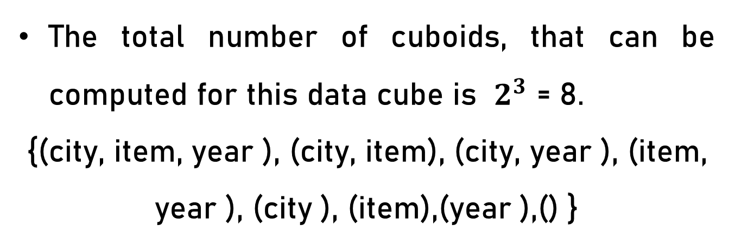
Example
The total number of cuboids, that can be computed for this data cube is $2^{3}$ = 8.
{(city, item, year ), (city, item), (city, year ), (item, year ), (city ), (item),(year ),() }

Slide 31
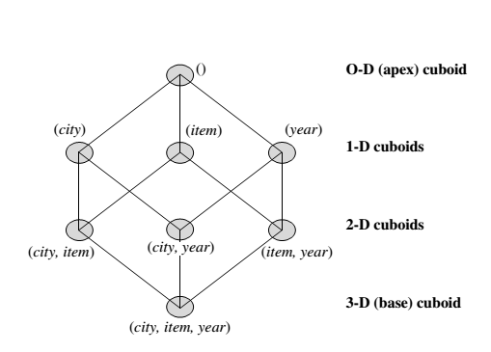
Example
If we start at the apex cuboid and explore downward in the lattice, this is equivalent to drilling down within the data cube. If we start at the base cuboid and explore upward, this is akin to rolling up.

Slide 32
Example
An SQL query containing no group-by (e.g., “compute the sum of total sales”) is a zero-dimensional operation.
An SQL query containing one group-by (e.g., “compute the sum of sales, group-by city”) is a one-dimensional operation.
A cube operator on n dimensions is equivalent to a collection of group-by statements, one for each subset of the n dimensions.

Slide 33
Example
A statement such as compute cube sales_cube would explicitly instruct the system to compute the sales aggregate cuboids for all eight subsets of the set {city, item, year}, including the empty subset.

Slide 34
Example
Transform it into a SQL-like language (with a new operator cube by, introduced by Gray et al.’96)
    SELECT item, city, year, SUM (amount)
    FROM SALES CUBE BY item, city, year

Slide 35
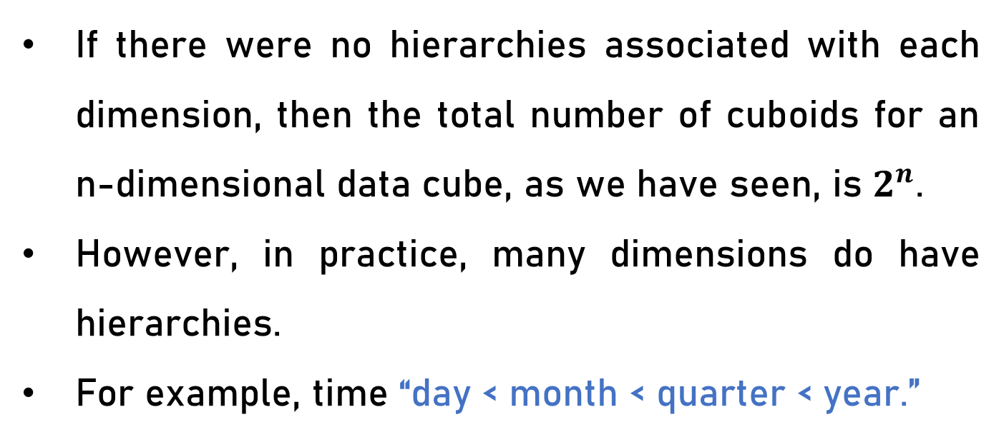
Question
“How many cuboids are there in an n-dimensional
data cube ?”
If there were no hierarchies associated with each dimension, then the total number of cuboids for an
n-dimensional data cube, as we have seen, is $2^{n}$.
However, in practice, many dimensions do have hierarchies.
For example, time “day < month < quarter < year.”

Slide 36

Question
For an n-dimensional data cube, the total number of cuboids that can be generated is

Slide 37
Partial Materialization:
Selected Computation of Cuboids
There are three choices for data cube materialization given a base cuboid:
    No materialization:
    Full materialization
    Partial materialization

Slide 38
Indexing OLAP Data:
Bitmap Index and Join Index
To facilitate efficient data accessing, most data warehouse systems support index structures and materialized views (using cuboids).

Slide 39
Bitmap Index
The bitmap indexing method is popular in OLAP because it allows quick searching in data cubes.
If the attribute has the value v for a given row in the data table, then the bit representing that value is set to 1 in the corresponding row of the bitmap index. All other bits for that row are set to 0.

Slide 40
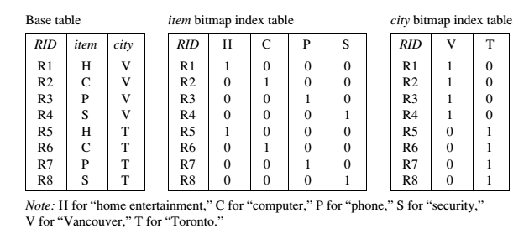
Bitmap Index

Slide 41
Bitmap Index Facts
Bitmap indexing is especially useful for low-cardinality domains.
Bitmap indexing leads to significant reductions in space and input/output (I/O) since a string of characters can be represented by a single bit.
For higher-cardinality domains, the method can be adapted using compression techniques.

Slide 42
Joining Index
Join indexing registers the joinable rows of two relations from a relational database.
  Join index: JI(R-id, S-id) where R (R-id, …)  S (S-id, …)
Join indexing is especially useful for maintaining the relationship between a foreign key and its matching primary keys, from the joinable relation.

Slide 43
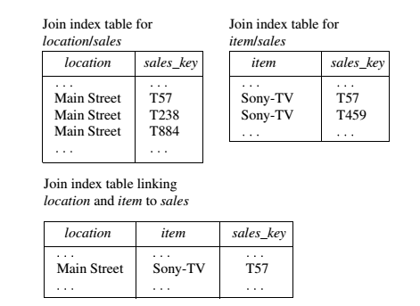
Example

Slide 44
Efficient Processing of OLAP Queries
The purpose of materializing cuboids and constructing OLAP index structures is to speed up query processing in data cubes. Given materialized views, query processing should proceed as follows:
  Determine which operations should be performed on the available cuboids.
  Determine to which materialized cuboid(s) the relevant operations should be applied.

Slide 45
Example
Suppose that we define a data cube for All Electronics of the form “sales cube [time, item, location]: sum(sales in dollars)”.
The dimension hierarchies used are:
“day < month < quarter < year” for time ;
“item name < brand < type” for item;
“street < city < province or state < country” for location.

Slide 46
Example
Suppose that the query to be processed is on {brand, province_or_ state}, with the selection constant “year = 2010.” Also, suppose that there are four materialized cuboids available, as follows:
  cuboid 1: {year, item_name, city}
  cuboid 2: {year, brand, country }
  cuboid 3: {year, brand, province_or_state}
  cuboid 4: {item_name, province_or_state }, where year = 2010
“Which of these four cuboids should be selected to process the query?”

Slide 47
Result
Finer-granularity data cannot be generated from coarser-granularity data.
Therefore, cuboid 2 cannot be used because country is a more general concept than province or state.
Cuboids 1, 3, and 4 can be used to process the query.

Slide 48
Question
“How would the costs of each cuboid compare if used to process the query?”

