Slide 2
After this lecture, you will be able to
know the concept data mining
understand the knowledge discovery process
analyze different types of data repositories

Slide 3
Why Data Mining?
Identify Data
Prepare Data
Model & Evaluate Data
Present data
Business Goal

Slide 4
Why Data Mining?
I am not able to find the data I need (Data is dispersed over the network) .
The data I have access to is poorly documented (Proper information is missing).
I am not able to use the data I have (Unexpected results).

Slide 5
What is Data Mining?
Data mining refers to extracting or “mining” Knowledge from large amount of data.
We live in a world where vast amounts of data are collected daily. Analyzing such data is an important need.

Slide 6
What is Data Mining?
Data mining focuses on extraction of information from a large set of data and transforms it into an easily interpretable structure for further use.

Slide 7
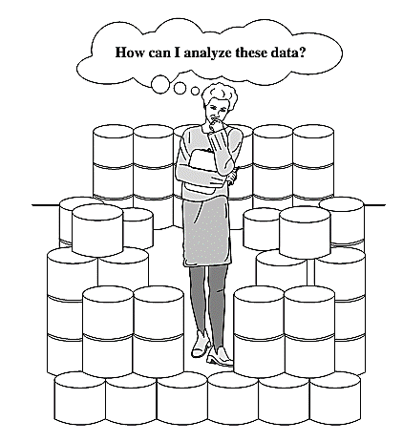
The World is Data Rich but Information Poor

Slide 8
What is Data Mining?
Data collected in large data repositories become “data tombs”. The data mining tools that can turn data tombs into “golden nuggets” of knowledge. Golden nuggets means “small but valuable facts”.
Data mining is also called as knowledge mining from data, knowledge extraction, data/pattern analysis, data archaeology, and data dredging.

Slide 9
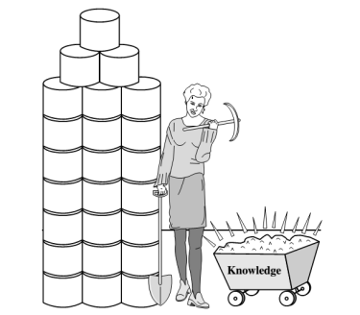
What is Data Mining?

Slide 10
The Knowledge Discovery Process
It is an iterative sequence of the following steps:
Data cleaning (to remove noise and inconsistent data)
Data integration (where multiple data sources may be combined)
Data selection (where data relevant to the analysis task are retrieved from the database)

Slide 11
The Knowledge Discovery Process
Data transformation (where data are transformed and consolidated into forms appropriate for mining by performing summary or aggregation operations)
Data mining (an essential process where intelligent methods are applied to extract data patterns)

Slide 12
The Knowledge Discovery Process
Pattern evaluation (to identify the truly interesting patterns representing knowledge based on interestingness measures)
Knowledge presentation (where visualization and knowledge representation techniques are used to present mined knowledge to users)

Slide 13
The Knowledge Discovery Process
Selection
Pre-processing
Transformation
Data Mining
Evaluation
Data
Target Data
Preprocessed Data
Transformed Data
Patterns
Knowledge

Slide 14
Types of Data Repositories
Types of Data Repositories
Flat Files
Relational Databases
Data Warehouse
Transactional Databases
Multimedia Databases
Spatial Databases
Time series Databases
World Wide Web (WWW)

Slide 15
Flat Files
Flat files is defined as data files in text form or binary form with a structure that can be easily extracted by data mining algorithms.
Data stored in flat files have no relationship or path among themselves, like if a relational database is stored on flat file, then there will be no relations between the tables.

Slide 16
Flat Files
Flat files are represented by data dictionary. Example: CSV file.
Application: Used in Data Warehousing to store data, Used in carrying data to and from server, etc.

Slide 17
Relational Databases
Data mining algorithms using relational databases can be more versatile than data mining algorithms specifically written for flat files.
Data mining can benefit from SQL for data selection.

Slide 18
Relational Databases
Relational databases are one of the most commonly available and richest information repositories.
Application: Data Mining, ROLAP model, etc.

Slide 19
Data Warehouse
A data warehouse is defined as the collection of data integrated from multiple sources that will queries and decision making.
There are three types of data warehouse: Enterprise data warehouse, Data Mart and Virtual Warehouse.

Slide 20
Data Warehouse
Two approaches can be used to update data in Data Warehouse: Query-driven Approach and Update-driven Approach.
Application: Business decision making, Data mining, etc.

Slide 21
Data warehouse
A data warehouse is usually modeled by a multidimensional data structure, called a data cube.
Each dimension corresponds to an attribute or a set of attributes in the schema, and each cell stores the value of some aggregate measure such as count or sum (sales_amount).

Slide 22
Transactional Databases
Transactional databases is a collection of data organized by time stamps, date, etc to represent transaction in databases.
This type of database has the capability to roll back or undo its operation when a transaction is not completed or committed.
Follows ACID property of DBMS.

Slide 23
Transactional Databases
The typical data mining analysis on such data is called the market basket analysis or association rules in which associations between items occurring or in sequence.
Application: Banking, Distributed systems, Object databases, etc.

Slide 24
Multimedia databases
It includes video, images, audio and text media.
They can be stored on object-oriented databases or simply on a file system.
Multimedia is characterized by high dimensionality, which makes data mining even more challenging.

Slide 25
Multimedia Databases
It may require computer vision, computer graphics, image interpretation and natural language processing.
Application: Digital libraries, video-on demand, news-on demand, musical database, etc.

Slide 26
Spatial Databases
Store geographical information.
Stores data in the form of coordinates, topology, lines, polygons, etc.
Application: Maps, Global positioning, etc.

Slide 27
Time series data
It contains time related data.
Like stock market data and logged activities.
Data mining in such databases includes the study of trends and correlations between evaluations of different variables as well as a prediction of trends.

Slide 28
World Wide Web
WWW refers to World wide web is a collection of documents and resources like audio, video, text, etc which are identified by Uniform Resource Locators (URLs) through web browsers, linked by HTML pages, and accessible via the Internet network.
It is the most heterogeneous and dynamic data repository.

Slide 29
World Wide Web
Data in the WWW is organized in interconnected documents.
These documents can be audio, video, text etc.
Application: Online shopping, Job search, Research, studying, etc.

