Slide 1
UNIT-02: Introduction to Data Mining

Slide 2
After this lecture, you will be able to
understand various data mining functionalities.
learn different categories of data mining task.
know the concept of frequent pattern
generate association rule.

Slide 3
Data Mining Functionalities
Data mining functionalities are used to specify the kind of patterns to be found in data mining tasks.
Data mining tasks can be classified into two categories:
descriptive
predictive

Slide 4
Concept/Class Description
Data entries can be associated with classes or concepts.
For example: -
classes of items for sale include computers and printers, and concepts of customers include BigSpenders and BudgetSpenders. Such descriptions of a class or a concept are called class/concept descriptions.

Slide 5
Data Characterization
Data characterization is a summarization of the general characteristics or features of a target class of data.
The output of data characterization can be presented in various forms.
Examples: -
pie charts, bar charts, curves etc.

Slide 6
Data Discrimination
Data discrimination is a comparison of the general features of target class data objects with the general features of objects from one or a set of contrasting classes.
For example: -
a user may want to compare the general features of software products with sales that increased by 10% last year against those with sales that decreased by at least 30% during the same period.

Slide 7
Mining Frequent Patterns
Frequent patterns, as the name suggests, are patterns that occur frequently in data.
There are many kinds of frequent patterns, including item-sets, and subsequences.

Slide 8
Mining Frequent Patterns
A frequent item-set typically refers to a set of items that frequently appear together in a transactional data set, such as milk and bread, which are frequently bought together in grocery stores by many customers.
Mining frequent patterns leads to the discovery of interesting associations and correlations within data.

Slide 9
Association Analysis
Suppose, as a marketing manager, you would like to determine which items are frequently purchased together within the same transactions.
buys(X,“computer”) = buys(X,“software”)
[support = 1%, confidence=50%]

Slide 10
Association Analysis
[support=1%,confidence=50%]
Confidence=50% means that if a customer buys a computer, there is a 50% chance that she will buy software as well.
Support=1% means that 1% of all of the transactions under analysis showed that computer and software were purchased together.

Slide 11
Classification and Prediction
Classification is the process of finding a model (or function) that describes and distinguishes data classes or concepts. Example : male or female
The derived model is based on the analysis of a set of training data (i.e., data objects for which the class labels are known).

Slide 12
Classification and Prediction
The model is used to predict the class label of objects for which the class label is unknown.
Regression analysis is a statistical methodology that is most often used for numeric prediction, although other methods exist as well.

Slide 13
How Is The Derived Model Presented?
The derived model may be represented in various forms, such as classification (IF-THEN) rules, decision trees, mathematical formulae, or neural networks.

Slide 14
IF - THEN Rules
age(X, “youth”) AND income(X, “high”) class(X, “A”)
age(X, “youth”) AND income(X, “low”) class(X, “B”)
age(X, “middle_aged”) class(X, “C”)
age(X, “senior”) class(X, “C”)

Slide 15
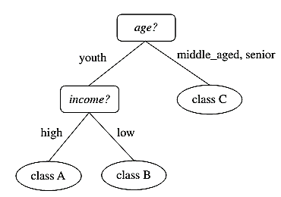
Decision Tree

Slide 16
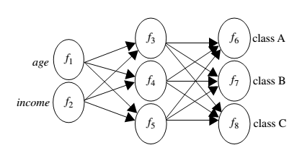
Neural Net

Slide 17
Cluster Analysis
Unlike classification and prediction, which analyze class-labeled data objects, clustering analyzes data objects without consulting a known class label.
In general, the class labels are not present in the training data simply because they are not known to begin with. Clustering can be used to generate such labels.

Slide 18
Cluster Analysis
The objects are clustered or grouped based on the principle of
“maximizing the intra-class similarity and minimizing the interclass similarity”

Slide 19
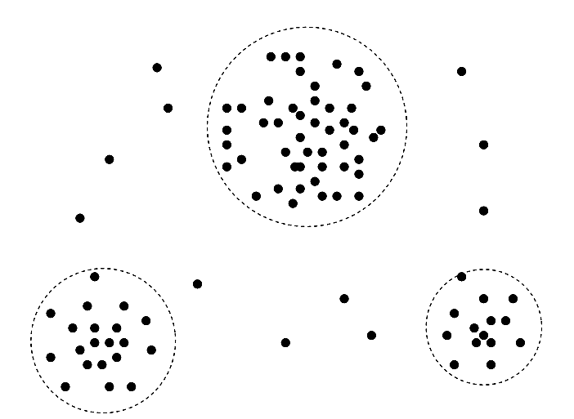
Cluster Analysis

Slide 20
Outlier Analysis
Data objects that do not match with the general behavior or model of the data. Most analysis discard outliers as noise or exceptions.
Outliers may be detected using statistical tests, or using distance measures where objects that are a substantial distance from any other cluster are considered outliers.
The analysis of outlier data is referred to as outlier mining.

Slide 21
Frequent Patterns
Frequent patterns are patterns (e.g., item sets, or subsequences) that appear frequently in a data set.
For example, a set of items, such as milk and bread, that appear frequently together in a transaction data set is a frequent itemset.

Slide 22
Frequent Patterns
A subsequence, such as buying first a PC, then a digital camera, and then a memory card, if it occurs frequently in a shopping history database, is a (frequent ) sequential pattern.

Slide 23
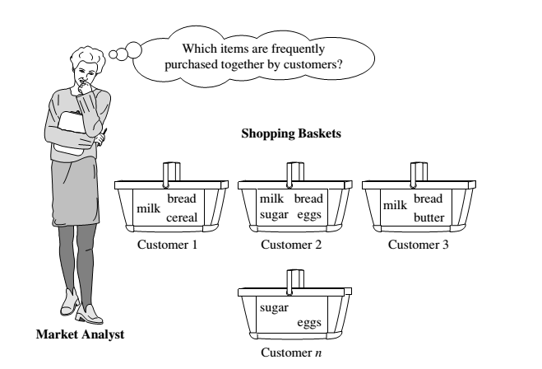
Market Basket Analysis: A Motivating Example

Slide 24
Association Rules
If we think of the universe as the set of items available at the store, then each item has a Boolean variable representing the presence or absence of that item.
Each basket can then be represented by a Boolean vector of values assigned to these variables.

Slide 25
Association Rules
The Boolean vectors can be analyzed for buying patterns that reflect items that are frequently associated or purchased together.
These patterns can be represented in the form of ASSOCIATION RULES.

Slide 26
Association Rules
For example
the information that customers who purchase computers also tend to buy antivirus software at the same time is represented in the following association rule: -
computer antivirus_software [support = 2%, confidence = 60%]

Slide 27
Association Rules
[support = 2%, confidence = 60%]
A support of 2% for Rule means that 2% of all the transactions under analysis show that computer and antivirus software are purchased together.
A confidence of 60% means that 60% of the customers who purchased a computer also bought the software.

Slide 28
Frequent Patterns and Association Rules
Find all the rules X → Y with minimum support and confidence
support, s, probability that a transaction contains X ∪ Y.
confidence, c, conditional probability that a transaction having X also contains Y.

Slide 29
Frequent Patterns and Association Rules
Let sup_{min} = 50%, conf_{min} = 50%
Freq. Pat.: {A:3, B:3, D:4, E:3, AD:3}
Association rules:
A → D (60%, 100%)
D → A (60%, 75%)
Transaction - ID | Items Bought
10 | A, B, D
20 | A, C, D
30 | A, D, E
40 | B, E, F
50 | B, C, D, E, F

Slide 30
Frequent Patterns and Association Rules
Rules that satisfy both a minimum support threshold (min_sup) and a minimum confidence threshold (min_conf ) are called strong.
A set of items is referred to as an itemset. An itemset that contains k items is a k-itemset. The set {computer, antivirus software} is a 2-itemset.

Slide 31
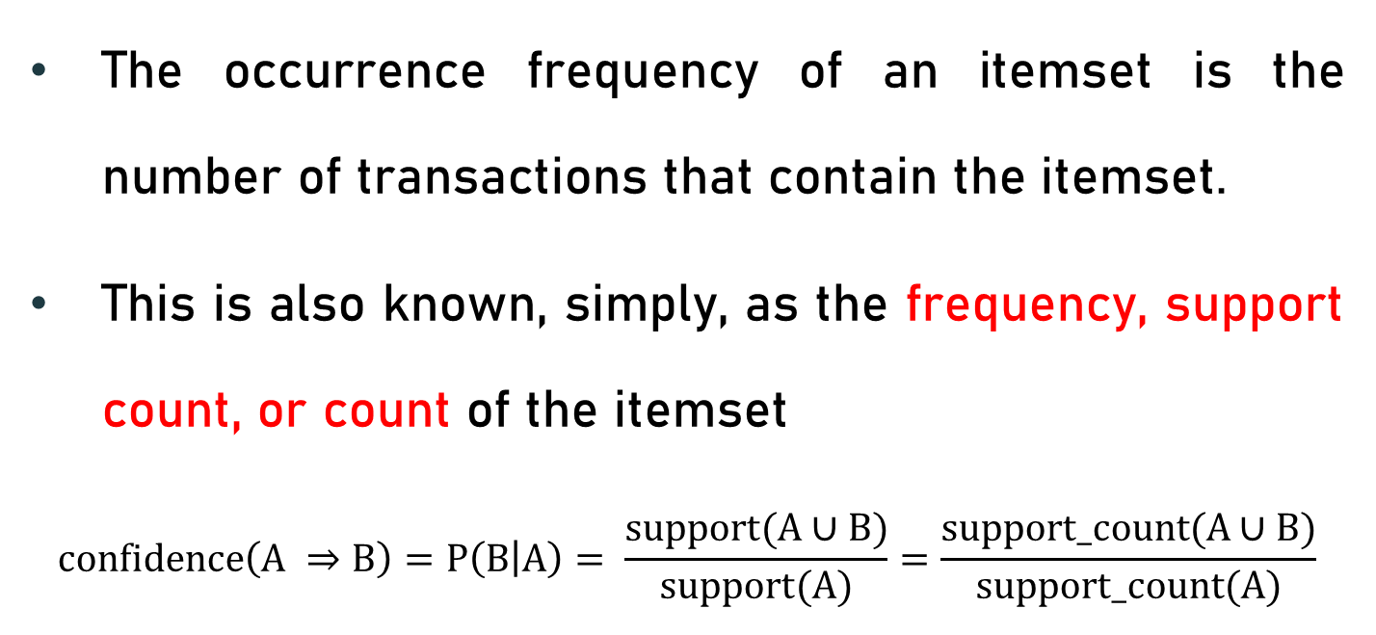
Frequent Patterns and Association Rules
The occurrence frequency of an itemset is the number of transactions that contain the itemset.
This is also known, simply, as the frequency, support count, or count of the itemset
$$confidence\left(A ⇒B\right)=P\left(B | A\right)= \frac{support(A∪B)}{support(A)}=\frac{support_count(A∪B)}{support_count(A)}$$

Slide 32
Frequent Patterns and Association Rules
In general, association rule mining can be viewed as a two-step process:
Find all frequent itemsets: By definition, each of these itemsets will occur at least as frequently as a predetermined minimum support count, min sup.
Generate strong association rules from the frequent itemsets: By definition, these rules must satisfy minimum support and minimum confidence.

