Slide 2
After this lecture, you will be able to
understand the concept of operational data.
learn the architecture and applications of operational data store.
learn the functions and architecture of various process managers

Slide 3
Process Manager
Process managers are responsible for maintaining the flow of data both into and out of the data warehouse.
There are three different types of process managers:
Load manager
Warehouse manager
Query manager

Slide 4
Operational Data
Operational Data is exactly what it sounds like -
Data that is produced by your organization's day to day operations.
The Operational Database is the source of information for the data warehouse.

Slide 5
Operational Data
It includes detailed information used to run the day-to-day operations of the business.
Operational Database Management Systems also called as OLTP are used to manage dynamic data in real-time.

Slide 6
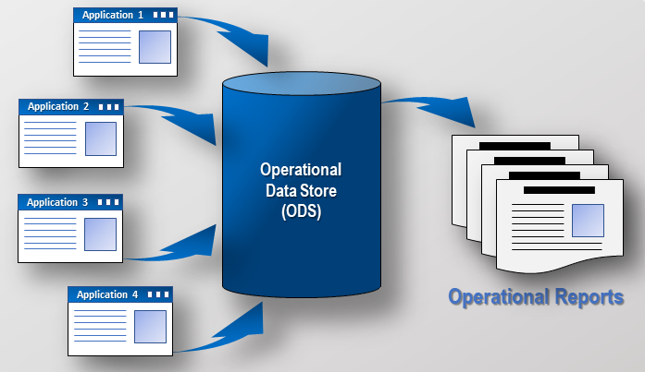
Operational Data Store

Slide 7
Operational Data Store
Operational data stores (ODS) are data repositories that store a snapshot of an organization's current data.
This is a highly volatile data repository that is ideally suited for real-time analysis.

Slide 8
Applications of an Operational Data Store
Applications of ODS
Consolidation
Real-time Reporting
Troubleshooting
System integration

Slide 9
Working of ODS
CRM
Metadata Repository / MDM
Information Portal
ERP
Data Mart
BI Tools
e-commerce
ODS
Data Ware house
Data Mart
ETL
Reports
SCM
Legacy
Data Mart
Info Delivery
External
Other
Enterprise Data Warehouse
“BI” Analytics
User Access
Data Sources

Slide 10
Difference Between Operational Data Source and Data Warehouse
Operational Data Stores | Data Warehouse
ODS means operational reporting and supports current or near real-time reporting requirements. | A data warehouse is intended for historical and trend analysis, usually reporting on a large volume of data.
An ODS consist of only a short window of data. | A data warehouse includes the entire history of data.
It is typically detailed data only. | It contains summarized and detailed data.
It is used for detailed decision making and operational reporting. | It is used for long term decision making and management reporting.

Slide 11
Difference Between Operational Data Source and Data Warehouse
Operational Data Stores | Data Warehouse
It is used at the operational level. | It is used at the managerial level.
It serves as conduct for data between operational and analytics system. | It serves as a repository for cleansed and consolidated data sets.
It is updated often as the transactions system generates new data. | It is usually updated in batch processing mode on a set scheme

Slide 12
Data Warehouse Load Manager
Load manager performs the operations required to extract and load the data into the database.
The size and complexity of a load manager varies between specific solutions from one data warehouse to another.

Slide 13
Functions of Load Manager
The load manager does perform the following functions: -
Extract data from the source system.
Fast load the extracted data into temporary data store.
Perform simple transformations into structure similar to the one in the data warehouse.

Slide 14
Architecture of load manager
Load Manager
Controlling Process
Temporary Data Store
Stored Procedures
File Structure
Copy Management Tool
Warehouse Structure
Controlling Process

Slide 15
Warehouse Manager
The warehouse manager is responsible for the warehouse management process.
It consists of a third-party system software, C programs, and shell scripts.
The size and complexity of a warehouse manager varies between specific solutions.

Slide 16
Components
A warehouse manager includes the following: −
The controlling process
Stored procedures or C with SQL
Backup/Recovery tool
SQL scripts

Slide 17
Architecture of Warehouse Manager
Warehouse Manager
Temporary Data Store
Controlling Process
Stored Procedure with C or SQL
Snowflake Schema
Backup/Recovery Tool
Summary Tables
SQL Scripts

Slide 18
Functions of Warehouse Manager
Analyzes the data to perform consistency and referential integrity checks.
Creates indexes, business views, partition views against the base data.
Generates new aggregations and updates the existing aggregations.
Generates normalizations.

Slide 19
Functions of Warehouse Manager
Analyzes the data to perform consistency and referential integrity checks.
Creates indexes, business views, partition views against the base data.
Generates new aggregations and updates the existing aggregations.
Generates normalizations.

Slide 20
Functions of Warehouse Manager
Analyzes the data to perform consistency and referential integrity checks.
Creates indexes, business views, partition views against the base data.
Generates new aggregations and updates the existing aggregations.
Generates normalizations.

Slide 21
Functions of Warehouse Manager
Analyzes the data to perform consistency and referential integrity checks.
Creates indexes, business views, partition views against the base data.
Generates new aggregations and updates the existing aggregations.
Generates normalizations.

Slide 22
Functions of Warehouse Manager
Transforms and merges the source data of the temporary store into the published data warehouse.
Backs up the data in the data warehouse.
Archives the data that has reached the end of its captured life.

Slide 23
Functions of Warehouse Manager
Transforms and merges the source data of the temporary store into the published data warehouse.
Backs up the data in the data warehouse.
Archives the data that has reached the end of its captured life.

Slide 24
Functions of Warehouse Manager
Transforms and merges the source data of the temporary store into the published data warehouse.
Backs up the data in the data warehouse.
Archives the data that has reached the end of its captured life.

