Slide 2
After this lecture, you will be able to
understand the functions and architecture of query manager.
learn the different types of end user access tools.

Slide 3
Query Manager
The query manager is responsible for directing the queries to suitable tables.
By directing the queries to appropriate tables, it speeds up the query request and response process.
In addition, the query manager is responsible for scheduling the execution of the queries posted by the user.

Slide 4
Query Manager Architecture
A query manager includes the following components −
Query redirection via C tool or RDBMS
Stored procedures
Query management tool
Query scheduling via C tool or RDBMS
Query scheduling via third-party software

Slide 5
Functions of Query Manager
It presents the data to the user in a form they understand.
It schedules the execution of the queries posted by the end-user.
It stores query profiles to allow the warehouse manager to determine which indexes and aggregations are appropriate.

Slide 6
Query Manager Functions
Performs operations associated with management of user queries
Constructed using vendor end-user data access tools, data warehouse monitoring tools, database facilities, and custom-built programs
Complexity determined by facilities provided by end-user access tools and database

Slide 7
Query Manager Functions
Operations:
Directing queries to appropriate tables
Scheduling execution of queries

Slide 8
End-user Access Tools
There are five main groups of access tools:–
Data reporting and query tools
Application development tools
Executive information system (EIS) tools
Online analytical processing (OLAP) tools
Data mining tools

Slide 9
Data Reporting and Query Tools
The principal purpose of Data Warehousing is to provide information to business users for strategic decision making.
Different types of users engage in different types of decision support activities, and therefore require different types of tools.

Slide 10
Data Reporting and Query Tools
S. No. | User Type | Activity | Tools
1 | Clerk | Simple Retrieval | 4GL
2 | Executive | Exception report | EIS
3 | Manager | Simple Retrieval | 4GL
4 | Business Analyst | Complex Analysis | Spreadsheet, OLAP

Slide 11
Reporting Tools
Reporting Tools can be divided into two categories:
1. Production Reporting Tools: These tools let companies generate regular operational reports or support high-volume batch jobs, such as calculating and printing paychecks.
Production Reporting Tools include 3GLs such as COBOL, specialized 4GL, such as Information Builders, Inc’s Focus and high-end client/ server tools such as MITTI’s SQR.

Slide 12
Reporting Tools
2. Desktop Report Writers: Report writers are inexpensive desktop tools designed for end users. Product such as Crystal Reports, let users design and run reports without having to rely on the IS Department.

Slide 13
Query Tools
When it comes time to actually start creating reports out of the data in your warehouse and to start making decisions with this data you are going to need to have a good query tool.
Managed query tools shield end user from the Complexities of SQL and database structure by inserting a meta layer between user and the database.

Slide 14
Features for Query Tools
Cross-Browsing of Dimension Attributes
Open Aggregate Navigation
Multipass SQL

Slide 15
Features for Query Tools
Semi-Additive Summations
Show Me What Is Important
Behavioural Studies

Slide 16
Executive Information System (EIS) Tools
An Executive information system, also known as an Executive support system, is a type of management support system that facilitates and supports senior executive information and decision-making needs.
It provides easy access to internal and external information relevant to organizational goals.

Slide 17
OLAP Tools
Provide an intuitive way to view corporate data
Provide navigation through the hierarchies and dimensions with the single click
Aggregate data along common business subjects or dimensions
Users can drill down across, or up levels
Desktop OLAP tools include PoerPlay, BrioQuery, Planning Sciences, Gentium, Pablo.

Slide 18
OLAP Tools
OLAP basically means On-Line Analytical Processing which means that it can be used to extract or retrieve data selectively so that it can be analyzed from different viewpoints.
It is of great value in business intelligence and can be used in the analysis of sales forecasting, financial reporting.

Slide 19
Classification of OLAP Tools
OLAP tools can be classified as the following :
MOLAP
ROLAP
HOLAP

Slide 20
MOLAP
It stands for Multidimensional Online Analytical Processing.
It stores data in multidimensional arrays and requires pre-computation and storage of information in the cube.
Example
IBM Cognos
Microsoft Analysis

Slide 21
ROLAP
The ‘R’ in ROLAP stands for Relational. So, the full form of ROLAP becomes Relational Online Analytical Processing.
The salient feature of ROLAP is that the data is stored in relational databases.

Slide 22
ROLAP
Some of the top ROLAP is as follows:
IBM Cognos
SAP NetWeaver BW
Microsoft Analysis Services
Essbase

Slide 23
HOLAP
It stands for Hybrid Online Analytical Processing.
HOLAP bridges the shortcomings of both MOLAP and ROLAP by combining their capabilities.
Now how does it combine? It combines data by dividing data of database between relational and specialized storage.

Slide 24
Data Mining Tools
Data Mining tools have the objective of discovering patterns/trends/groupings among large sets of data and transforming data into more refined information.
Provide insights into corporate data that are nor easily discerned with managed query or OLAP tools.
Use variety of statistical and AI algorithm to analyze the correlation of variables in data.
Investigate interesting patterns and their relationship

Slide 25
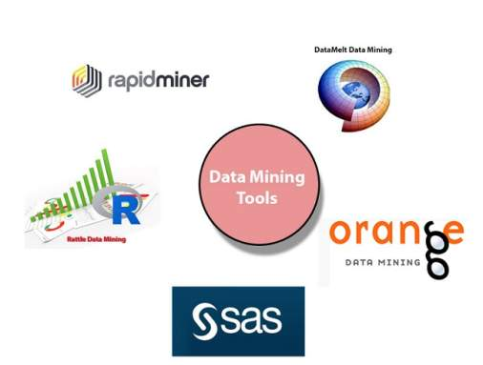
Data Mining tools

Slide 26
Application Development Tools
Sometimes built-in graphical and analytical tools do not satisfy the analytical needs of an organization.
In such cases, custom reports are developed using Application development tools.

