Slide 2
After this lecture, you will be able to
know the different types of data.
differentiate between archive and backup data.
understand the concept of metadata.

Slide 3
Types of Data
Four types of data may be stored in a data warehouse:
Older detail data,
Current detail data,
Lightly summarized data
Highly summarized data.

Slide 4
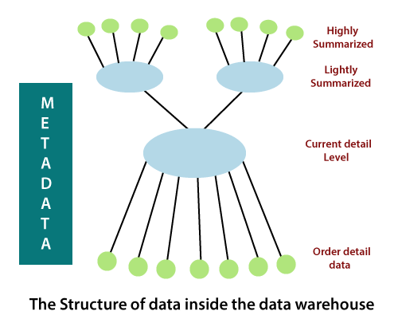
Types of Data

Slide 5
Older Detail Data
Older detail data represents data that is not very recent, maybe as old as ten years or longer.
It is voluminous and most frequently stored on mass storage such as tape, although more expensive disk storage may be used.
Its level of detail is consistent with current detail data but due to its longer time horizon is typically migrated to a "less-expensive" alternate storage medium.

Slide 6
Current Detail
Data represents data of a recent nature and always has a shorter time horizon than older detail data.
Although it can be voluminous, it is almost always stored on disk to permit faster access.

Slide 7
Lightly Summarized Data
Lightly summarized data represents data distilled from current detail data.
It is summarized according to some unit of time and always resides on disk.

Slide 8
Highly Summarized Data
Highly summarized data represents data distilled from lightly summarized data.
It is always compact and easily accessible and resides on disk.
A final component of the data warehouse is that of metadata. Metadata is best described as data about data.

Slide 9
Highly Summarized Data
It provides information about the structure of a data warehouse as well as the various algorithms used in data summarizations.
It provides a descriptive view, or "blueprint", of how data is mapped from the operational level to the data warehouse.

Slide 10
Data Archiving
Data warehouse archiving is the process of moving data that is not likely needed to conduct business operations from the data warehouse to a medium where it can be stored for long-term retention and retrieval if needed.
Archive data consists of older data that remains important to the organization or must be retained for future reference.

Slide 11
Data Archiving
Data archives are indexed and have search capabilities, so files can be located and retrieved.
Some archive systems treat archive data as read-only to protect it from modification, while other data archiving products enable writes, as well as reads.
For example, WORM (write once, read many) technology uses media that is not rewritable.

Slide 12
Backup Data
A data warehouse is a complex system, and it contains a huge volume of data.
Therefore, it is important to back up all the data so that it becomes available for recovery in future as per requirement.

Slide 13
Backup Terminologies
Complete backup
Partial backup
Cold backup
Hot backup
Online backup

Slide 14
Difference
 | Backup | Archiving
What is it ? | Protection for mission critical systems and live data | Searchable records of inactive data in a “steady state”
Why use it ? | Recover- backup restores systems after data loss, interruption or disaster | Searching- allows interrogation of data for regulatory inspections and data investigations
What does it contain ? | Several snapshots of the live system(s) captured on a time basis | One single repository of historical data indexed and quickly searchable

Slide 15
Metadata
Metadata is data about data which defines the data warehouse.
It is used for building, maintaining and managing the data warehouse.
In the Data Warehouse Architecture, meta-data plays an important role as it specifies the source, usage, values, and features of data warehouse data.
It also defines how data can be changed and processed.

Slide 16
Metadata
For example, a line in sales database may contain:
4030 KJ732 299.90
This is a meaningless data until we consult the Meta that tell us it was
Model number: 4030
Sales Agent ID: KJ732
Total sales amount of $299.90
Therefore, Meta Data are essential ingredients in the transformation of data into knowledge.

Slide 17
Metadata
Metadata helps to answer the following questions:
What tables, attributes, and keys does the Data Warehouse contain?
Where did the data come from?
How many times do data get reloaded?
What transformations were applied with cleansing?

Slide 18
Categories of Metadata
Technical Meta Data: This kind of Metadata contains information about warehouse which is used by Data warehouse designers and administrators.
Business Meta Data: This kind of Metadata contains detail that gives end-users a way easy to understand information stored in the data warehouse.

