Slide 2
After this lecture, you will be able to
understand the concept of architecture model.
know the difference in working of 2-tier,3-tier and 4-tier architecture.

Slide 3
Architecture Model
Architecture model is a method of defining the overall architecture of data communication, processing and presentation that exist for end-clients computing within the enterprise.
Applications gather detailed data from day-to-day operations

Slide 4
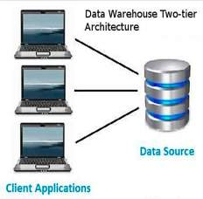
2-tier Architecture
It is client-server architecture.
Direct communication.
Run faster(tight coupled)

Slide 5
Data Warehouse 2-tier Architecture
The data warehouse two-tier architecture is a client – server application.
There is a direct communication between client and data source server, we call it as data layer or database layer.
Usually, there is no intermediate application between client and database layer.

Slide 6
Data Warehouse 2-tier Architecture Components
Following are the two-tier architecture components
Client Application – Client tier
Client tier is the front-end application that client uses to get data out from the data warehouse or data tier.
On the application tier code is writer for saving data or getting data out of database.

Slide 7
Data Warehouse 2-tier Architecture
Database – Data tier
Database or data tier is where the actual data is stored.
Various ETL processes are used to load data into database or data warehouse.

Slide 8
Advantages of Data Warehouse 2-tier Architecture
Easy to maintain
Modification of the stored data is easy

Slide 9
Disadvantages of Data Warehouse 2-tier Architecture
Performance will be degraded with increase user traffic
Cost – ineffective

Slide 10
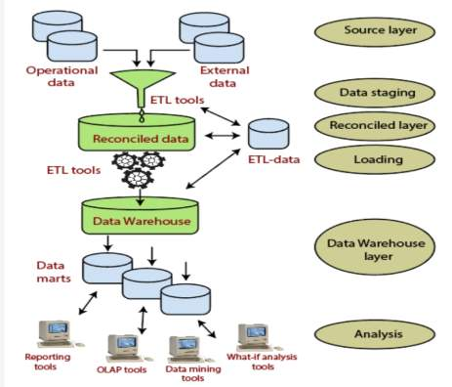
Data Warehouse 3-tier Architecture

Slide 11
Data Warehouse 3-tier Architecture
Bottom Tier
The bottom tier of the architecture is the data warehouse database server.
It is usually the relational database (RDBMS) system.
Data from operational databases and external sources are extracted using application program interfaces and ETL/ELT utilities.

Slide 12
Data Warehouse 3-tier Architecture
Middle Tier
In the middle-tier, there will be OLAP server.
It can be implemented in either of following ways:
Relational OLAP (ROLAP), which is noting but an extended relational database management system.
Multidimensional OLAP (MOLAP) model, which directly implements the multidimensional data and operations.

Slide 13
Data Warehouse 3-tier Architecture
Top-Tier
This tier is the front-end client layer.
Top tier is the tools and API that you connect and get data out from the data warehouse.
This layer holds the query tools and reporting tools, analysis tools and data mining tools.
Various visualization and reporting tools are used to get data out to the user.

Slide 14
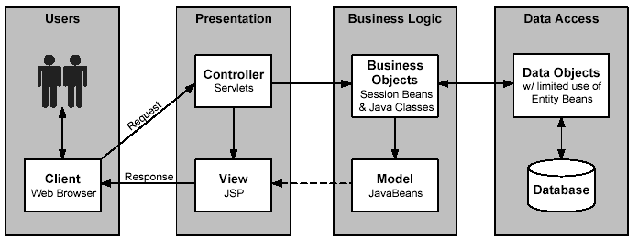
4-tier Architecture

Slide 15
User
At end user layer, data in the ODS, data warehouse, and data marts can be accessed by using a variety of tools such as query and reporting tools, data visualization tools, and analytical applications.

Slide 16
Presentation Layer
Its functions contain receiving data inputted, interpreting users' instructions, and sending requests to the data services layer and displaying the data obtained from the data services layer to users by the way they can understand.
It closest to users and provide an interactive operation interface.

Slide 17
Business Logic
It is located between the PL and data access layer playing a connecting role in the data exchange.
The layer’s concerns are focused primarily on the development of business rules, business processes and business needs related to system.
It’s also known as the domain layer.

Slide 18
Data Access
It is located in the innermost layer that implements persistence logic and responsible for access to the database.
Operations on the data contain finding, adding, deleting, modifying, etc.
This level work independently, without relying on other layers.
DAL extracts the appropriate data from the database and passes the data to the upper.

