Slide 2
After this lecture, you will be able to
understand the use of RapidMiner.
know the different DataMining products.
learn the steps for installing RapidMiner.

Slide 3
RapidMiner
The idea behind Rapid Mining tool is to create one place for everything.
RapidMiner is an integrated enterprise artificial intelligence framework that offers AI solutions to positively impact businesses.
It is used as a data science software platform for data extraction, data mining, deep learning, machine learning, and predictive analytics.

Slide 4
RapidMiner
It is widely used in a number of business and commercial applications as well as in various other fields such as research, training, education, rapid prototyping, and application development.
All major machine learning processes such as data preparation, model validation, results visualization, and optimization can be carried out by using RapidMiner.

Slide 5
Facilities of RapidMiner
1. Rapid Miner provides its own collection of datasets but it also provides options to set up a database in the cloud for storing large amounts of data.
You can store and load the data from Hadoop, Cloud, RDBMS, NoSQL etc.
Apart from this, you can load your CSV data very easily and start using it as well.

Slide 6
Facilities of RapidMiner
2. The standard implementation of procedures like data cleaning, visualization, pre-processing can be done with drag and drop options without having to write even a single line of code.

Slide 7
Facilities of RapidMiner
3. Rapid Miner provides a wide range of machine learning algorithms in classification, clustering and regression as well.
You can also train optimal deep learning algorithms like Gradient Boost, XGBoost etc.
Not only this, but the tool also provides the ability to perform pruning and tuning.

Slide 8
Facilities of RapidMiner
4. Finally, to bind everything together, you can easily deploy your machine learning models to the web or to mobiles through this platform.
You just need to create user interfaces to collect real-time data and run it on the trained model to serve a task.

Slide 9
RapidMiner Products
RapidMiner Studio
With RapidMiner Studio, one can access, load and analyse both traditional structured data and unstructured data like text, images, and media.
It can also extract information from these types of data and transform unstructured data into structured.

Slide 10
RapidMiner Products
RapidMiner Auto Model
Auto Model is an advanced version of RapidMiner Studio that increments the process of building and validating data models.
Majorly three kinds of problems can be resolved with Auto Model namely prediction, clustering and outliers.

Slide 11
RapidMiner Products
RapidMiner Turbo Prep
Data preparation is time-consuming and RapidMiner Turbo Prep is designed to make the preparation of data much easier.

Slide 12
RapidMiner Products
It provides a user interface where your data is always visible front and center, where you can make changes step-by-step and instantly see the results, with a wide range of supporting functions to prepare the data for model-building or presentation.

Slide 13
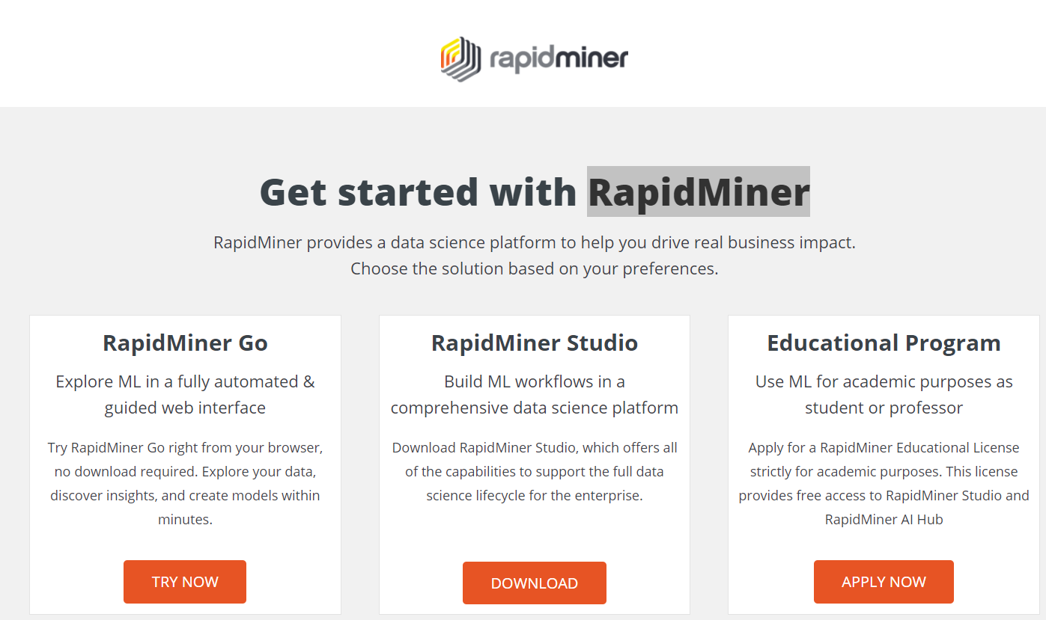
Where to get
https://rapidminer.com/get-started/

Slide 14
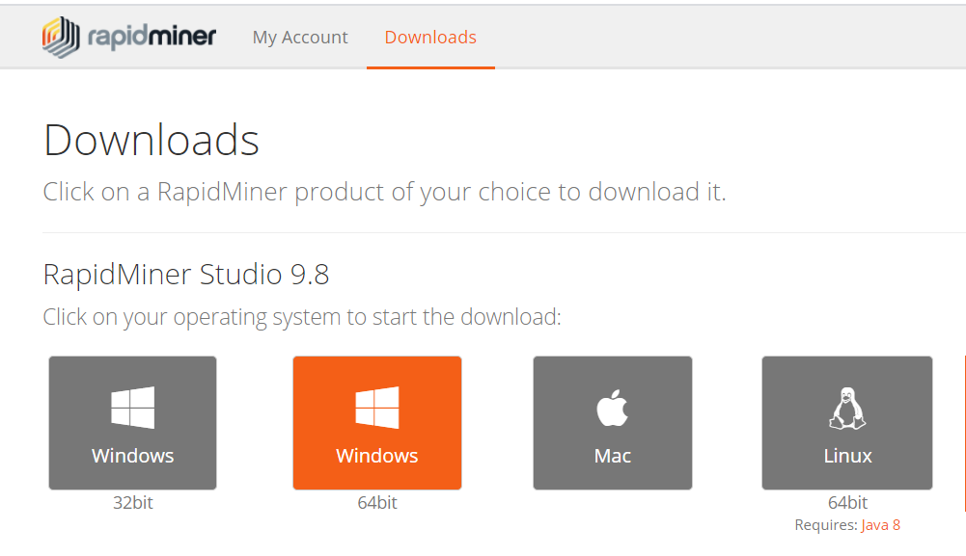
RapidMiner Installation

Slide 15
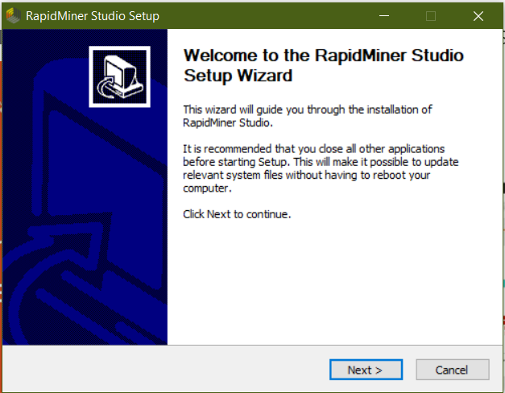
RapidMiner Installation

Slide 16
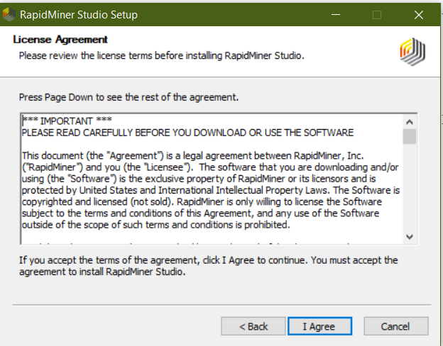
RapidMiner Installation

Slide 17
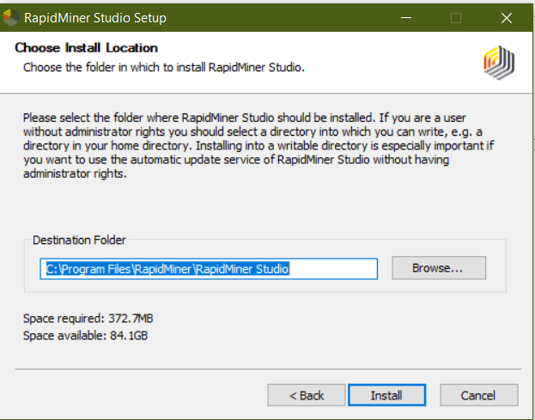
RapidMiner Installation

Slide 18
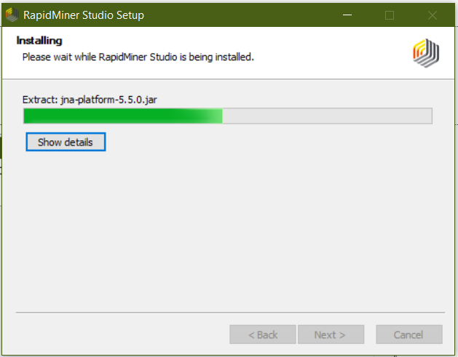
RapidMiner Installation

Slide 19
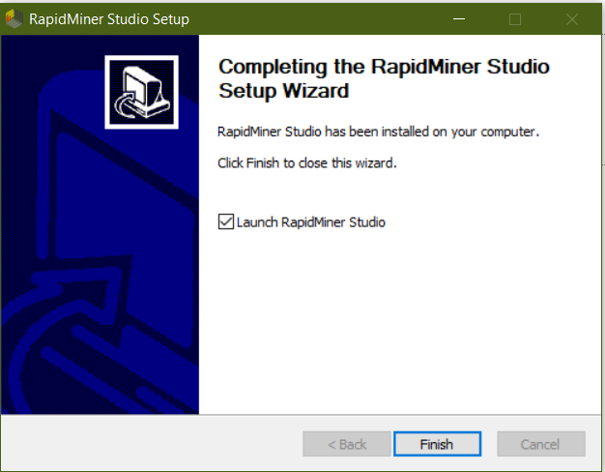
RapidMiner Installation

Slide 20
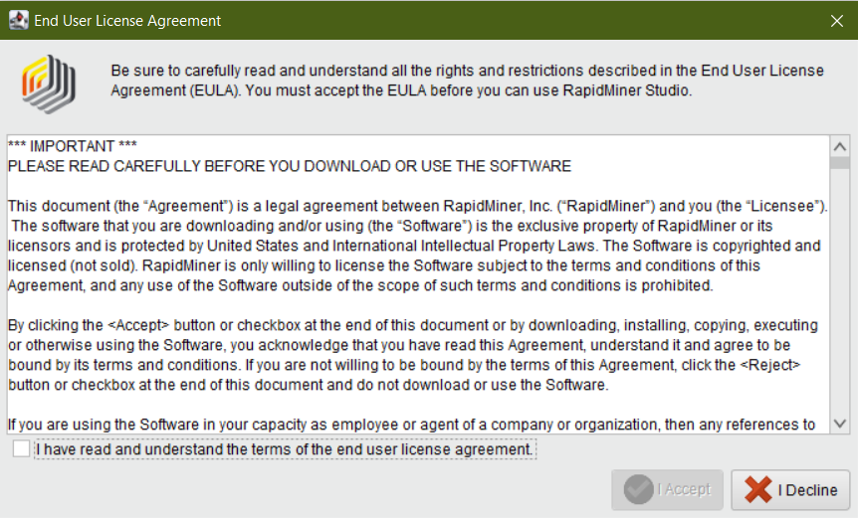
RapidMiner Installation

Slide 21
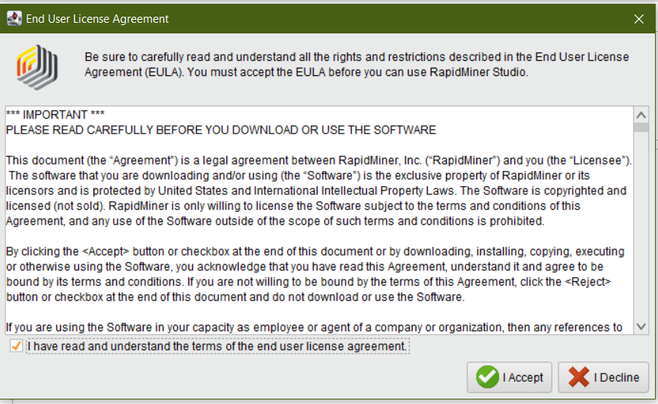
RapidMiner Installation

Slide 22
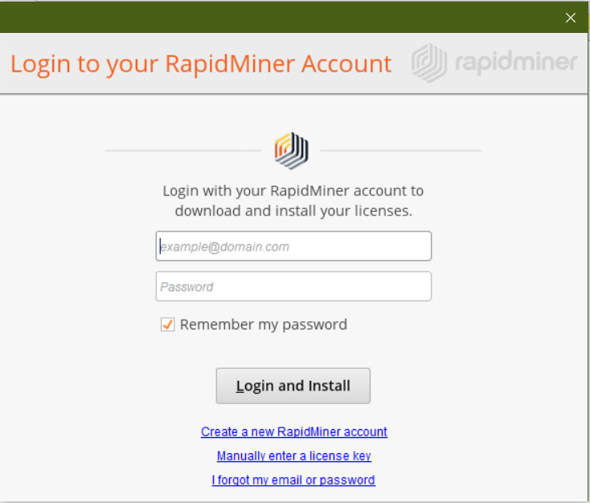
RapidMiner Installation

Slide 23
Register a new account
You'll use your RapidMiner Account to:
download product updates and extensions
upgrade your license (educational and paid)
participate in the Community forum
access your free cloud storage
experience fully automated and guided data science in your browser

Slide 24
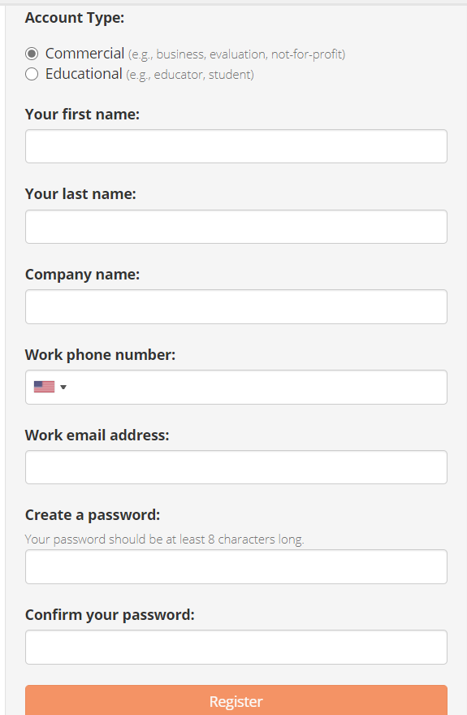
RapidMiner Installation

Slide 25
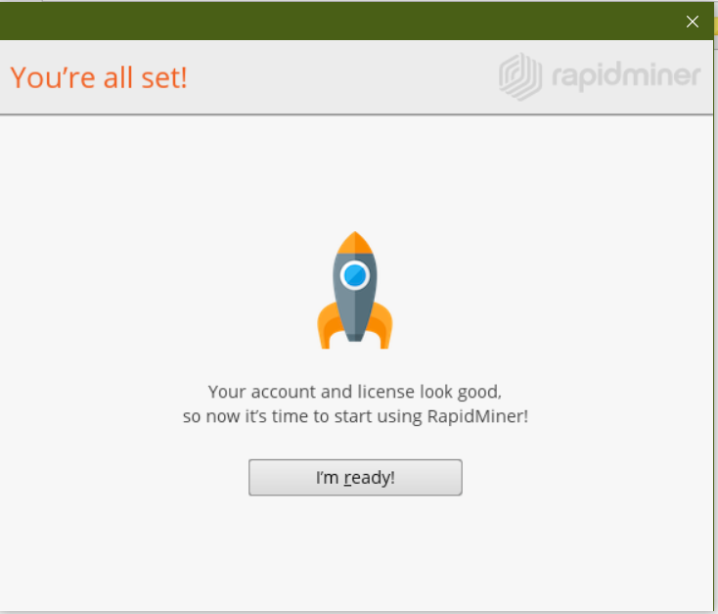
RapidMiner Installation

Slide 26
Login

Slide 27
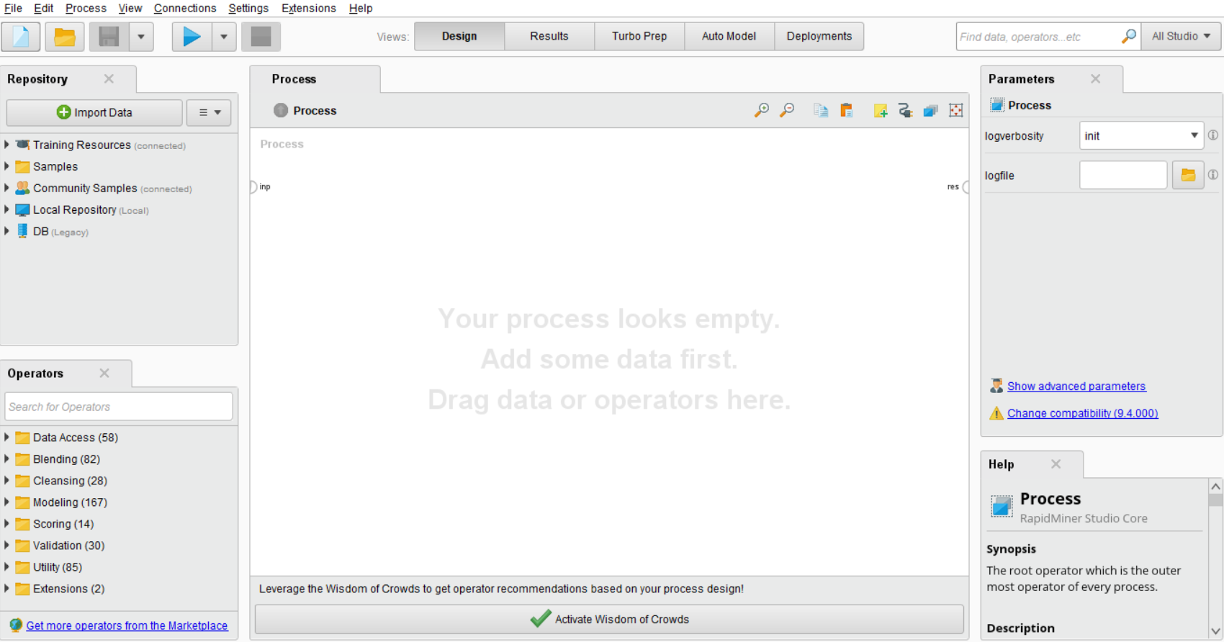
Home Screen of RapidMiner

