Slide 2
After this lecture, you will be able to
understand the use of RapidMiner.
learn the steps for installing RapidMiner.
understand what is WEKA.
learn the installation process of WEKA.

Slide 3
RapidMiner
The idea behind Rapid Mining tool is to create one place for everything.
RapidMiner is an integrated enterprise artificial intelligence framework that offers AI solutions to positively impact businesses.

Slide 4
RapidMiner
It is used as a data science software platform for data extraction, data mining, deep learning, machine learning, and predictive analytics.
It is widely used in a number of business and commercial applications as well as in various other fields such as research, training, education, rapid prototyping, and application development.

Slide 5
RapidMiner
All major machine learning processes such as data preparation, model validation, results visualization, and optimization can be carried out by using RapidMiner.

Slide 6

Where to get?
https://rapidminer.com/get-started/

Slide 7
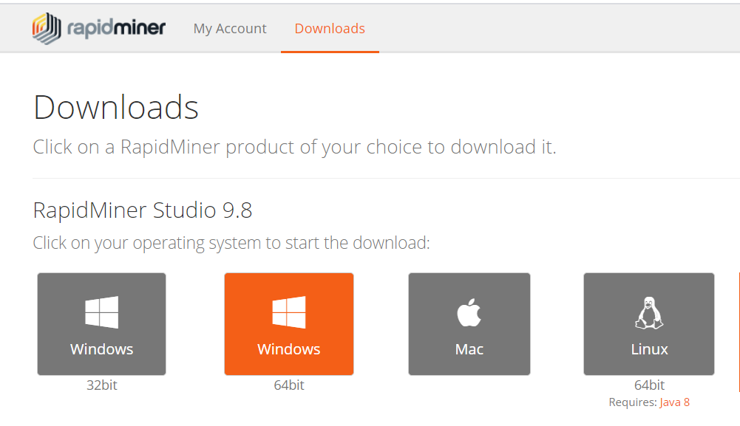
RapidMiner Installation

Slide 8
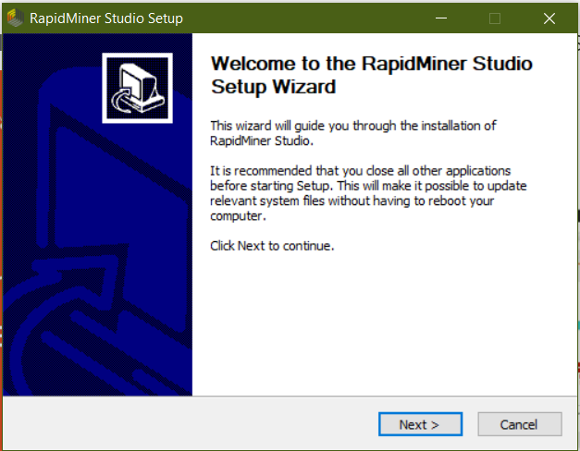
RapidMiner Installation

Slide 9
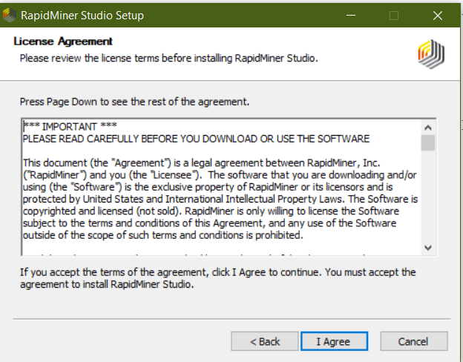
RapidMiner Installation

Slide 10
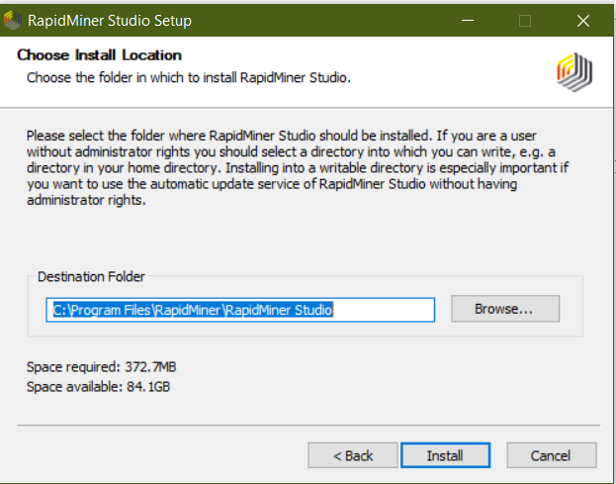
RapidMiner Installation

Slide 11
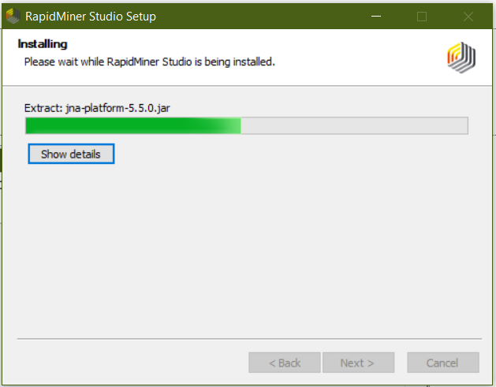
RapidMiner Installation

Slide 12
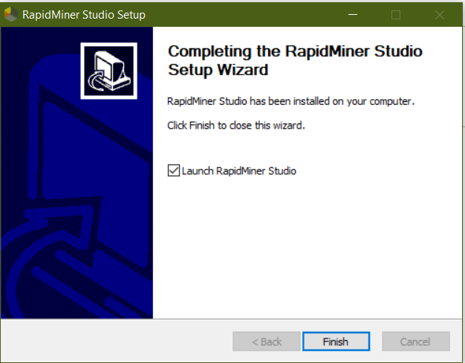
RapidMiner Installation

Slide 13
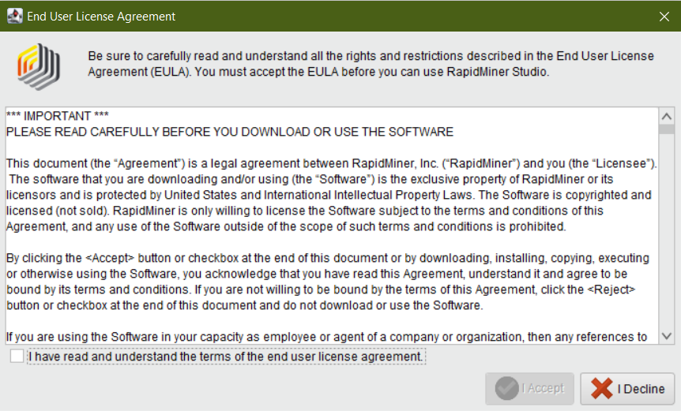
RapidMiner Installation

Slide 14
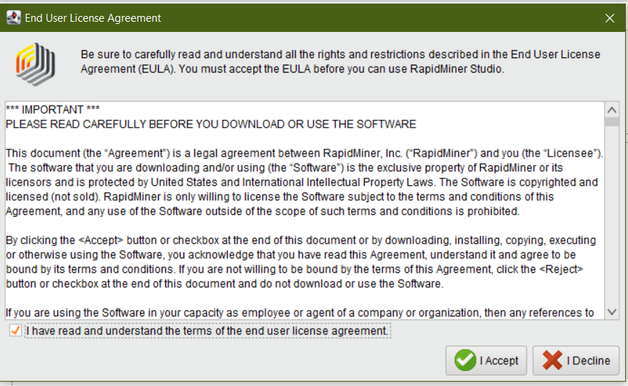
RapidMiner Installation

Slide 15
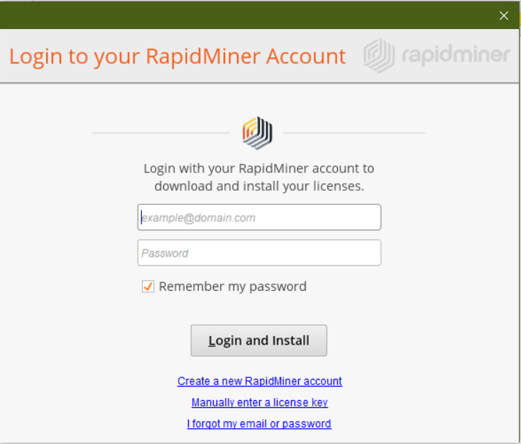
RapidMiner Installation

Slide 16
Register a new account
You'll use your RapidMiner Account to:
download product updates and extensions
upgrade your license (educational and paid)
participate in the Community forum
access your free cloud storage
experience fully automated and guided data science in your browser

Slide 17
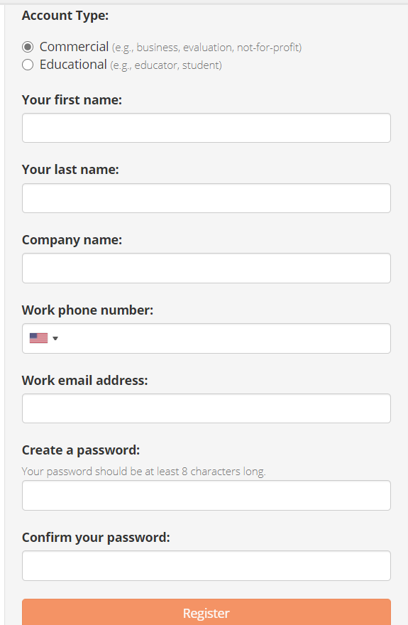
RapidMiner Installation

Slide 18
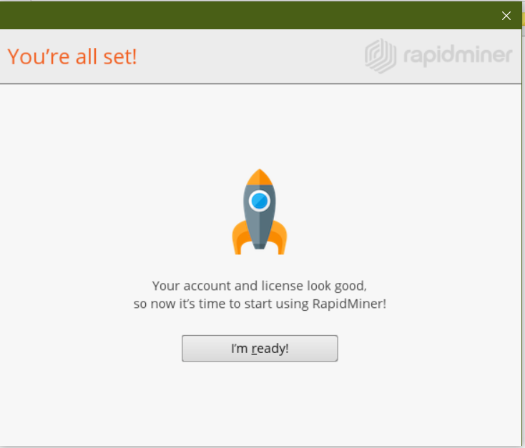
RapidMiner Installation

Slide 19
Login

Slide 20
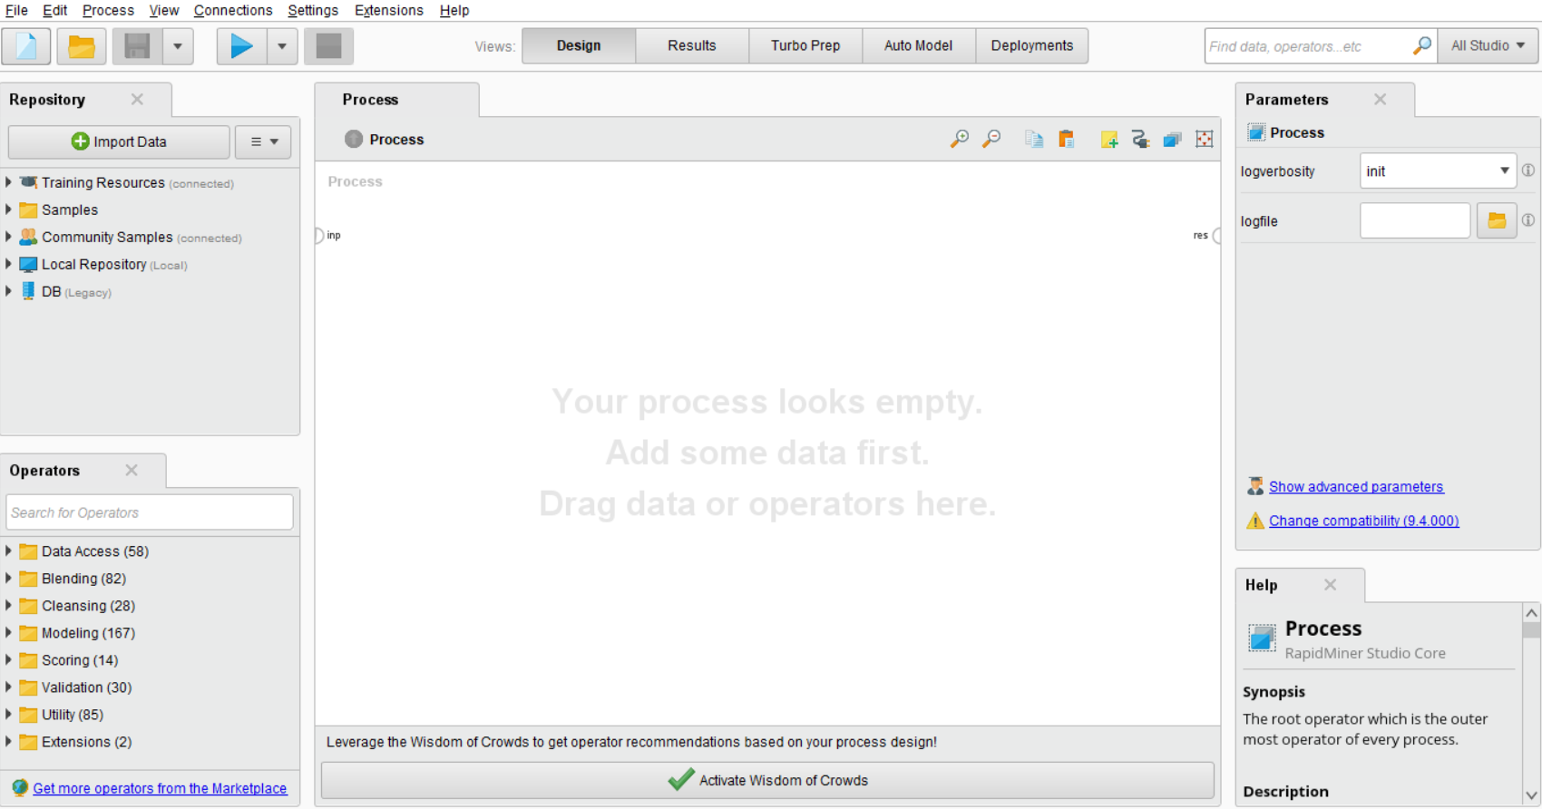
Home Screen of RapidMiner

Slide 21

WEKA Download and Installation.

Slide 22
WEKA
WEKA - an open source software provides tools for data preprocessing, implementation of several Machine Learning algorithms, and visualization tools so that you can develop machine learning techniques and apply them to real-world data mining problems.

Slide 23
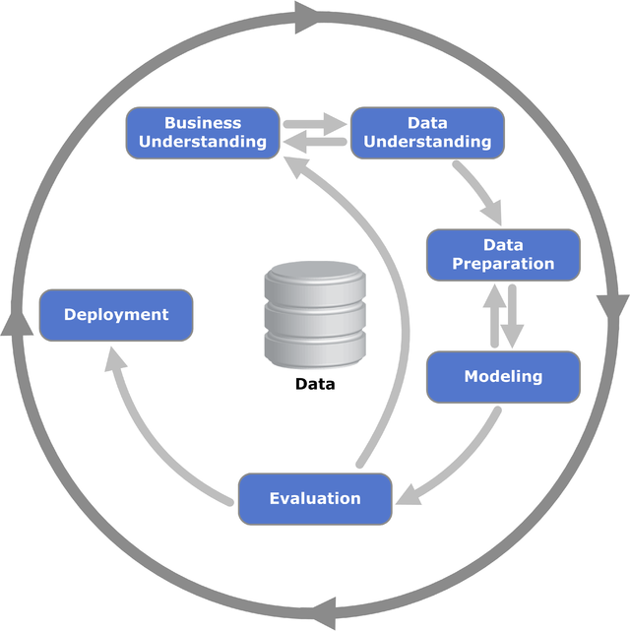
Document Classification using WEKA

Slide 24
Where to find Weka?
https://waikato.github.io/weka-wiki/downloading_weka/
Click here to download a self-extracting executable for 64-bit Windows that includes Azul's 64-bit OpenJDK Java VM 11 (weka-3-8-5-azul-zulu-windows.exe; 124.6 MB)

Slide 25
WEKA — Installation
To install WEKA on your machine, visit WEKA’s official website and download the installation file.
WEKA supports installation on Windows, Mac OS X and Linux.

Slide 26
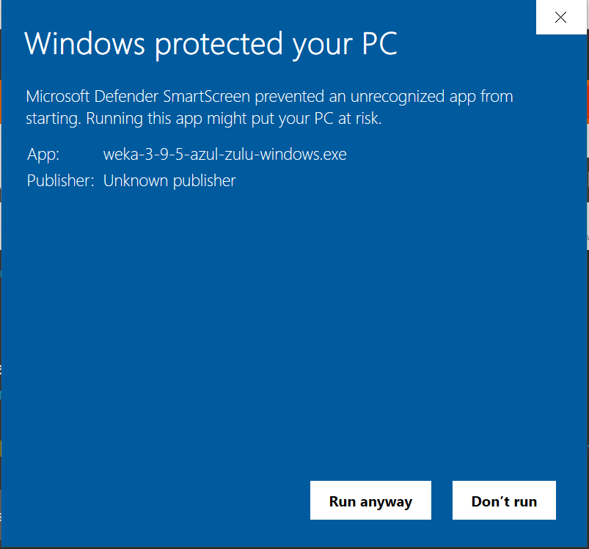
Installation

Slide 27
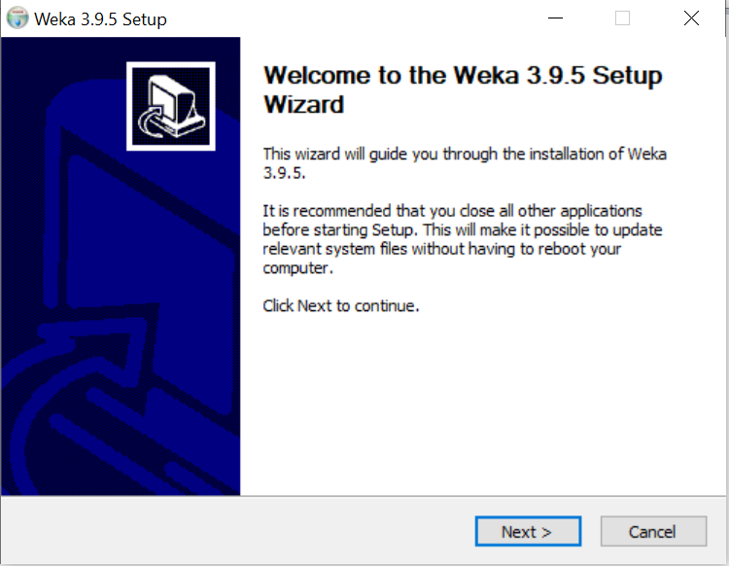
Installation

Slide 28
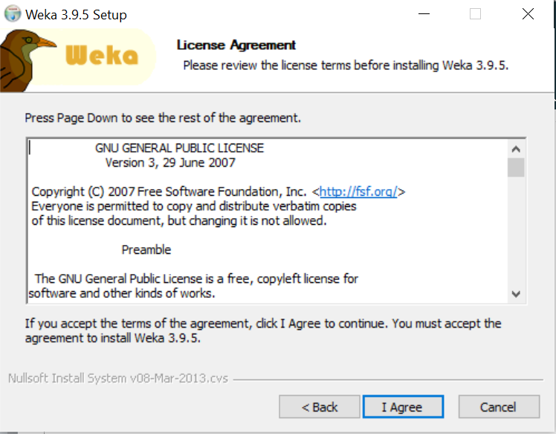
Installation

Slide 29
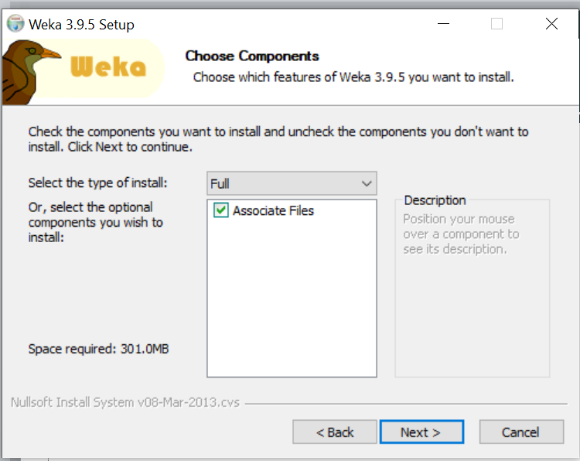
Installation

Slide 30
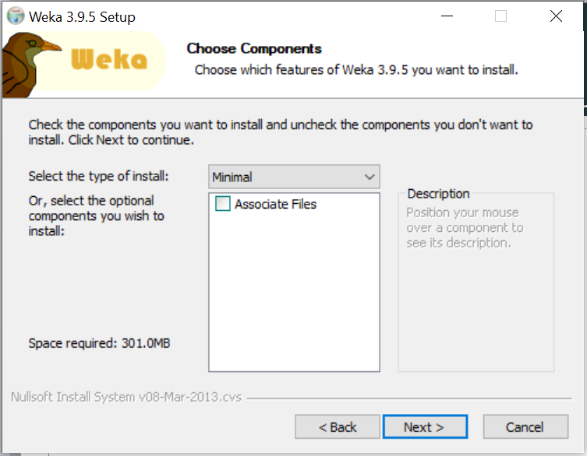
Installation

Slide 31
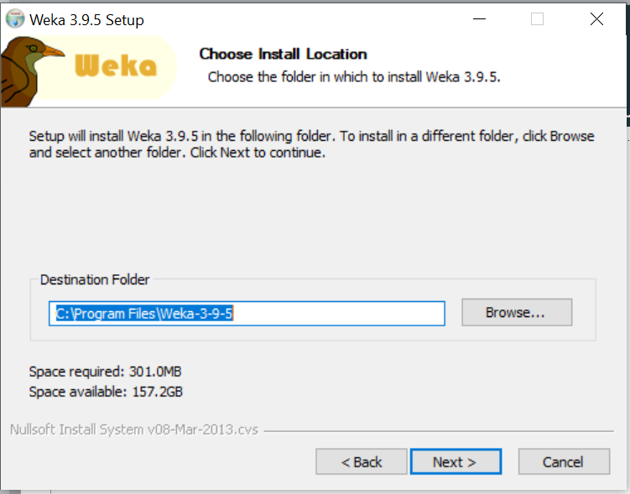
Installation

Slide 32
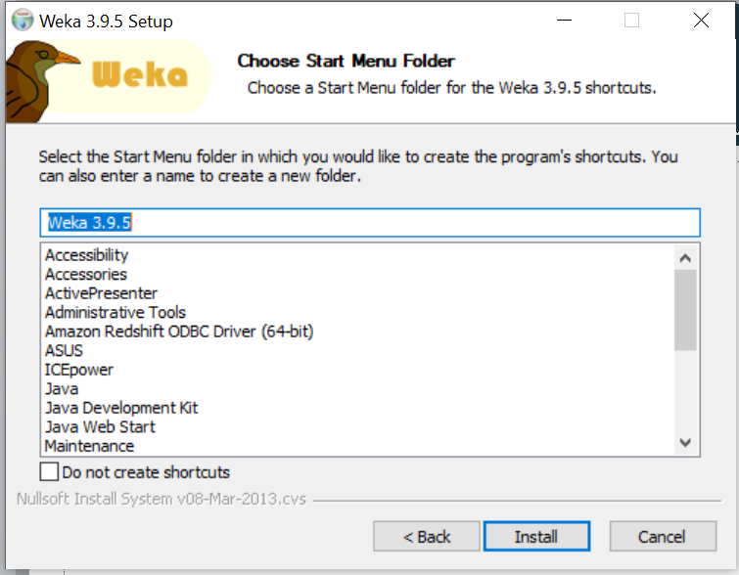
Installation

Slide 33
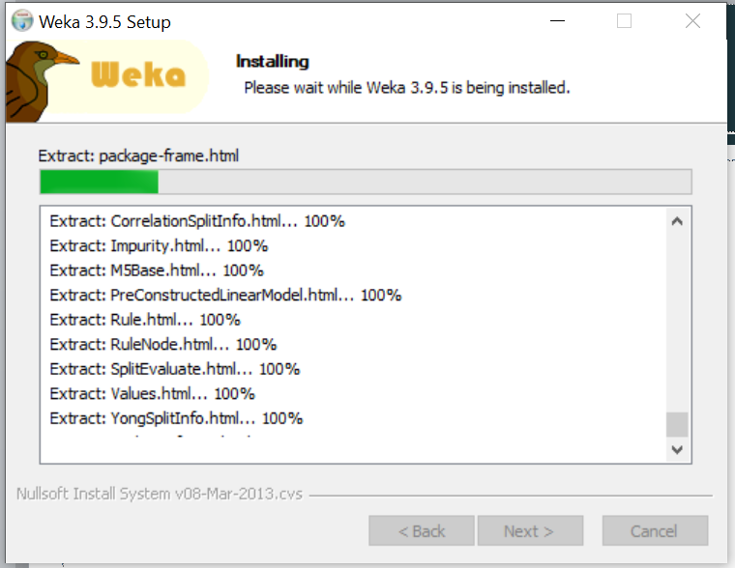
Installation

Slide 34
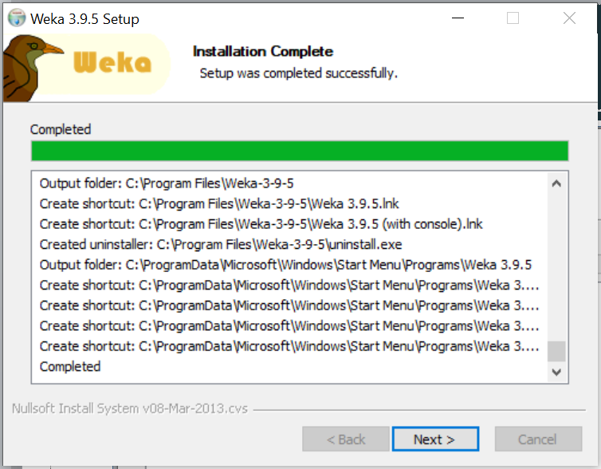
Installation

Slide 35
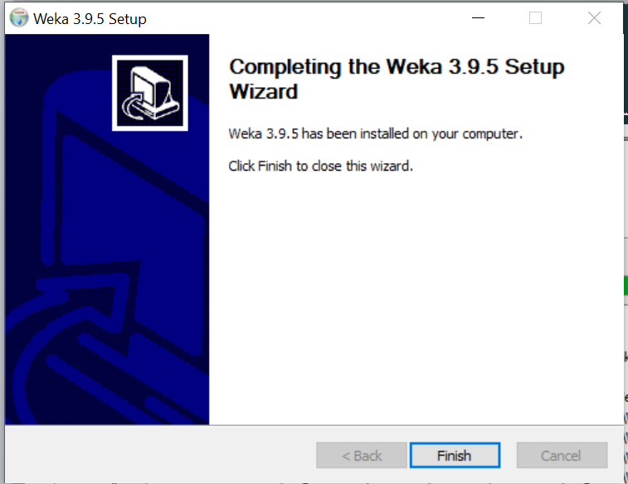
Installation

Slide 36

Post Installation

