Slide 2
After this lecture, you will be able to
understand various features of rapid miner and Weka Tool.
know the Interface of RapidMiner and Weka.

Slide 3
Features of RapidMiner
Application & Interface
Data Access
Data Exploration
Data Prep

Slide 4
Features of RapidMiner
Application & Interface
Data Access
Data Exploration
Data Prep

Slide 5
Features of RapidMiner
Application & Interface
Data Access
Data Exploration
Data Prep

Slide 6
Features of RapidMiner
Application & Interface
Data Access
Data Exploration
Data Prep

Slide 7
Features of RapidMiner
Modeling
Validation
Scoring
Code Control & Management

Slide 8
Features of RapidMiner
Modeling
Validation
Scoring
Code Control & Management

Slide 9
Features of RapidMiner
Modeling
Validation
Scoring
Code Control & Management

Slide 10
Features of RapidMiner
Modeling
Validation
Scoring
Code Control & Management

Slide 11
Features of Weka
Weka features include
Machine learning
Data mining
Preprocessing
Classification
Regression

Slide 12
Features of Weka
Clustering
Association rules
Attribute selection
Experiments
Workflow and visualization.

Slide 13
Creating a Repository
RapidMiner comes with a repository called samples, which has a number of datasets and example processes.
You can not edit the samples repository.

Slide 14
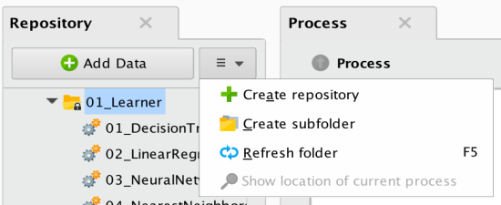
Creating a Repository
To create you own repository, select the drop down box on the repository window, select ‘create repository’, and browse to the folder you created.

Slide 15
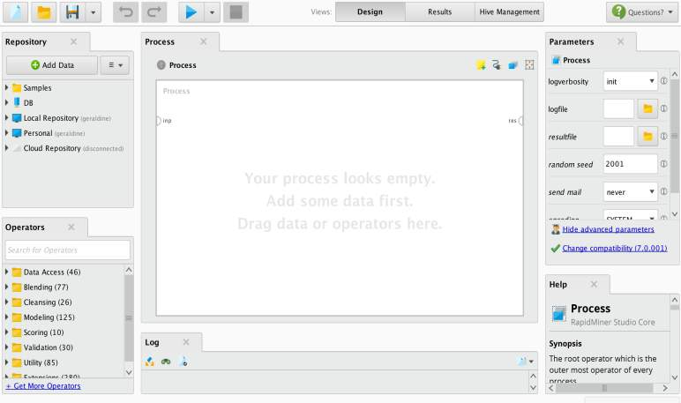
RAPID MINER GUI
Navigate Repositories
Parameter settings for selected
Process design window
Available operators
Explanation of the selected operator
Log of activities, including errors. If this is missing, add from View/Show Panel

Slide 16



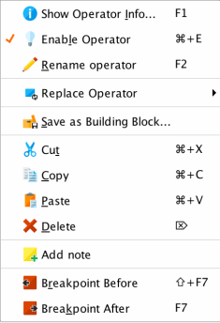





Rapid Miner Toolbars
^{View process results}
^{New}
^{Open}
^{Save}
^{Undo}
^{Redo}
^{Stop process}
^{Process design view}
^{Run process}
^{Right click option}
^{Add a note/ comment}
^{Resize the process window}
^{Enable/disable an operator}
Automatically connect operators
Show and alter the order in which operators run
^{Add/ Remove breakpoints}

Slide 17
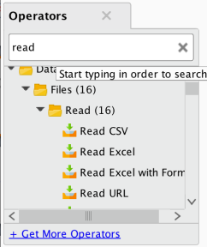
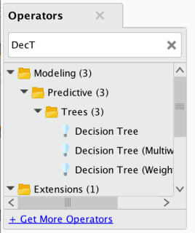
Finding an Operator
Once you get familiar with operator names, you can ﬁnd them more easily using the ﬁlter at the top of the operator window
List all operators that start with ‘read’
List all operators whose ﬁrst word starts with ‘dec’, and 2nd word starts with ‘t’.

Slide 18

Main GUI

Slide 19
WEKA Only Deals With “flat” Files
@relation heart-disease-simplified
@attribute age numeric @attribute sex{female, male} @attribute chest_pain_type { typ_angina, asympt,non_anginal, atyp_angina} @attribute cholesterol numeric
@attribute exercise_induced_angina { no, yes} @attribute class { present, not_present}
@data 63,male,typ_angina,233,no,not_present 67,male,asympt,286,yes,present 67,male,asympt,229,yes,present 38,female,non_anginal,?,no,not_present

Slide 20
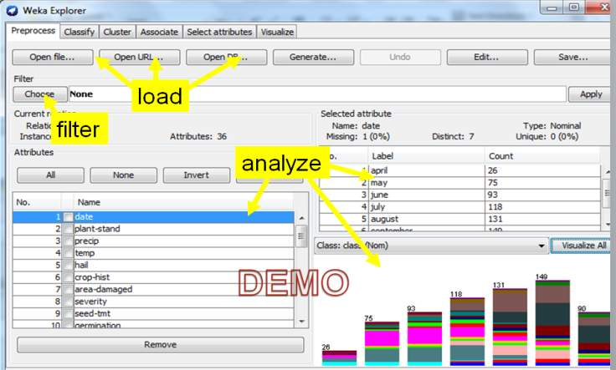
Weka Explorer

