Slide 2
After this lecture, you will be able to
know the usage of RapidMiner and Weka tool.
perform the comparative analysis of RapidMiner and Weka.

Slide 3
Data Mining tools
A number of open source and proprietary based data mining and data visualization tools exist which are used for information extraction from large data repositories and for data analysis.
Some of the data mining tools which exist in the market are Weka, Rapid Miner, Orange, R, KNIME, ELKI, GNU Octave, Apache Mahout, SCaViS, Natural Language Toolkit, Tableau, etc.

Slide 4
Data Mining tools
A number of open source and proprietary based data mining and data visualization tools exist which are used for information extraction from large data repositories and for data analysis.
Some of the data mining tools which exist in the market are Weka, Rapid Miner, Orange, R, KNIME, ELKI, GNU Octave, Apache Mahout, SCaViS, Natural Language Toolkit, Tableau, etc.

Slide 5


Data Mining tools
In the comparative study, I have concentrated on 2 of the commonly used tools:

Slide 6
The Rapid Miner Tool
Rapid Miner is one of the most widely used open source data mining tool .
Rapid Miner is an XML based data mining tool used to implement various machine learning and data mining processes.

Slide 7
The Rapid Miner Tool
It is a popular tool to implement classification and clustering algorithms.
An important feature of Rapid Miner is its ability to display results visually.

Slide 8
The Rapid Miner Tool
“Rapid Miner provides learning schemes and models and algorithms from Weka and R scripts that can be used through extensions.”
The Rapid Miner Extensions marketplace provides a platform for developers to create data analysis algorithms and publish them to the community .

Slide 9
The Rapid Miner Tool
Rapid Miner Studio provides 3 perspectives for users to work with:
The first perspective is Home perspective
The second is Design perspective
The third perspective is Wizard perspective

Slide 10
Home perspective
This is the default perspective when you start Rapid miner for the first time.
Rapid Miner provides information about new releases or current version which the user is running in this perspective.

Slide 11
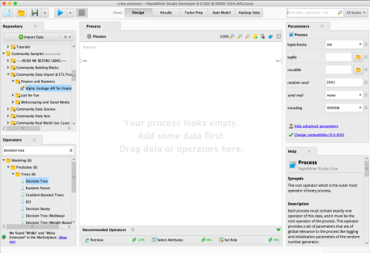
Design perspective
It is the main Rapid Miner Studio perspective where in all the processes are implemented and worked with.

Slide 12
Design perspective
It displays various modules view of Rapid Miner Studio:
The “Operator” View
“Process” View
“Repository” View
“Problems” View
“Parameters” View

Slide 13
Wizard perspective
This perspective is used to apply data mining algorithms on the user’s data set.
A great feature of Rapid Miner is its drag-and-drop methodology.

Slide 14
Wizard perspective
Users can select operators and combine them by using this approach.
Another important feature of Rapid Miner is that it provides very good visualizations of the data like 3-D graphs and matrices.

Slide 15
Weka
Weka is one of the very popular open source data mining tools developed at the University of Waikato in New Zealand in 1992.
It is a Java based tool and can be used to implement various machine learning and data mining algorithms written in Java.

Slide 16
Weka
Weka supports reading of files from several different databases and also allows importing the data from the internet, from web pages or from a remotely located SQL database server by entering the URL of resource.

Slide 17
Weka
Among all the available data mining tools, Weka is the most commonly used of all due to :
its fast performance
support for major classification and clustering algorithm.

Slide 18
Weka
Weka can be easily downloaded and deployed.
Weka provides both, a GUI and a CLI for performing data mining tasks .
Weka supports a variety of data formats like CSV (Comma-separated Value), ARFF and Binary.

Slide 19
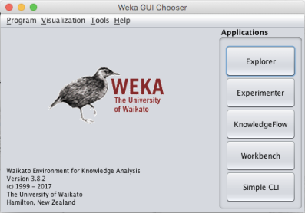
Weka
Weka supports the following three graphical user interfaces-
The Explorer
The Experimenter
The Knowledge Flow

Slide 20
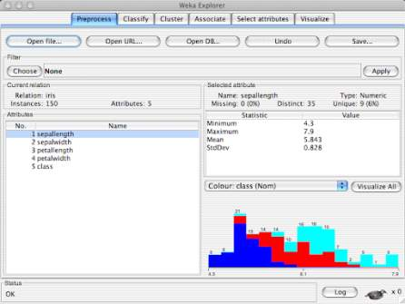
Explorer
This interface consists of different tabs to access various components for performing data mining .

Slide 21
Explorer
The different tabs are-
Pre-Processing
Classify
Associate
Cluster
Select attributes
Visualize

Slide 22
Features for Comparative Study
Features For Comparative Study
Usability
Data Set Size
Speed
Visualization
Algorithms supported
Memory Usage
Primary Usage
Interface Type Supported

Slide 23
Comparative Study
Features | Rapid Miner | Weka
Usability | Easy to use | Easiest to use.
Speed | Require more memory to operate. | Works faster on any machine.
Visualization | More options | Less options.
Algorithms supported | Classification and clustering | Classification and clustering
Data Set Size | Support small and large data sets. | Supports only small data sets.
Memory Usage | Requires more memory | Requires less memory and hence works faster.
Primary Usage | Data mining, predictive analysis | Machine learning
Interface type supported | GUI | GUI/CLI

