Slide 2
After this lecture, you will be able to
Learn the need of preprocessing of data.
Know the major Tasks in Data Preprocessing
Understand the concept of missing data and various methods for handling missing data.

Slide 3
Why Data Pre-processing?
Data in the real world is dirty
Incomplete: lacking attribute values, lacking certain attributes of interest, or containing only aggregate data
Noisy: containing errors or outliers
Inconsistent: containing discrepancies in codes or names

Slide 4
Why Data Pre-processing?
No quality data, no quality mining results!
Quality decisions must be based on quality data
Data warehouse needs consistent integration of quality data

Slide 5
Multi-Dimensional Measure of Data Quality
Accuracy
Completeness
Consistency
TimelinessBelievability
Value added
Interpretability
Accessibility

Slide 6
Major Tasks in Data Preprocessing
Data Cleaning
Data Reduction
Data Discretization
Data Transformation
Data Integration

Slide 7
Major Tasks in Data Preprocessing
Data cleaning
Fill in missing values, smooth noisy data, identify or remove outliers, and resolve inconsistencies
Data integration
Integration of multiple databases, data cubes, or files
Data transformation
Normalization and aggregation

Slide 8
Major Tasks in Data Preprocessing
Data reduction
Obtains reduced representation in volume but produces the same or similar analytical results
Data discretization
Part of data reduction but with particular importance, especially for numerical data

Slide 9
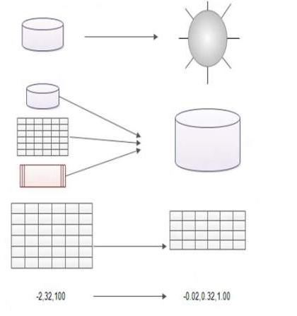
Forms of data preprocessing
Data Cleaning
Data Integration
Data Reduction
Data Transformation

Slide 10
Data Cleaning
Data cleaning tasks
Fill in missing values
Identify outliers and smooth out noisy data
Correct inconsistent data

Slide 11
Data Cleaning
Data cleaning tasks
Fill in missing values
Identify outliers and smooth out noisy data
Correct inconsistent data

Slide 12
Data Cleaning
Data cleaning tasks
Fill in missing values
Identify outliers and smooth out noisy data
Correct inconsistent data

Slide 13
Missing Data
Data is not always available
E.g., many tuples have no recorded value for several attributes, such as customer income in sales data

Slide 14
Missing Data
Missing data may be due to
equipment malfunction
inconsistent with other recorded data and thus deleted
data not entered due to misunderstanding
certain data may not be considered important at the time of entry

Slide 15
Missing Data
Missing data may be due to
equipment malfunction
inconsistent with other recorded data and thus deleted
data not entered due to misunderstanding
certain data may not be considered important at the time of entry

Slide 16
Missing Data
Missing data may be due to
equipment malfunction
inconsistent with other recorded data and thus deleted
data not entered due to misunderstanding
certain data may not be considered important at the time of entry

Slide 17
Missing Data
Missing data may be due to
equipment malfunction
inconsistent with other recorded data and thus deleted
data not entered due to misunderstanding
certain data may not be considered important at the time of entry

Slide 18
How to Handle Missing Data?
Ignore the tuple
Fill in the missing value manually
Use a global constant to fill in the missing value: e.g., “unknown”, a new class?!
Use the attribute mean to fill in the missing value
Use the most probable value to fill in the missing value

Slide 19
Noisy Data
Noise: random error or variance in a measured variable
Incorrect attribute values may be due to
faulty data collection instruments
data entry problems
data transmission problems
technology limitation
inconsistency in naming convention

Slide 20
Missing Data
Other data problems which requires data cleaning
duplicate records
incomplete data
inconsistent data

Slide 21
How to Handle Noisy Data?
Binning method:
first sort data and partition into (equi-depth) bins
then smooth by bin means, smooth by bin median, smooth by bin boundaries, etc.
Clustering
detect and remove outliers

Slide 22
How to Handle Noisy Data?
Combined computer and human inspection
detect suspicious values and check by human
Regression
smooth by fitting the data into regression functions

Slide 23
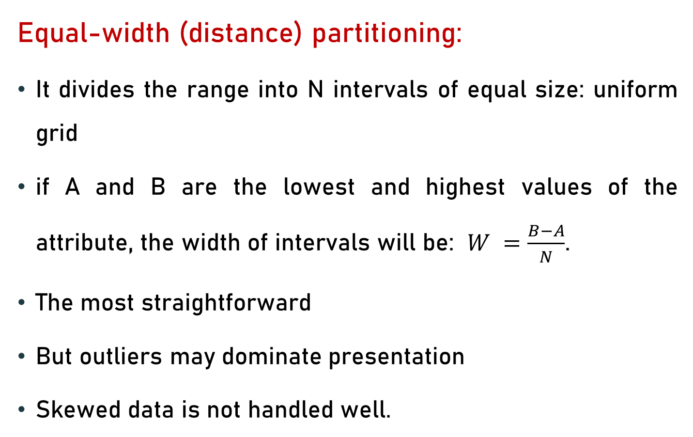
Simple Discretization Methods: Binning
Equal-width (distance) partitioning:
It divides the range into N intervals of equal size: uniform grid
if A and B are the lowest and highest values of the attribute, the width of intervals will be: $W =\frac{B−A}{N}$.
The most straightforward
But outliers may dominate presentation
Skewed data is not handled well.

Slide 24
Simple Discretization Methods: Binning
Equal-depth (frequency) partitioning:
It divides the range into N intervals, each containing approximately same number of samples
Good data scaling
Managing categorical attributes can be tricky.

Slide 25
Binning Methods for Data Smoothing
Sorted data for price (in dollars): 4, 8, 9, 15, 21, 21, 24, 25, 26, 28, 29, 34
Partition into (equi-depth) bins:
- Bin 1: 4, 8, 9, 15
- Bin 2: 21, 21, 24, 25
- Bin 3: 26, 28, 29, 34
Smoothing by bin means:
- Bin 1: 9, 9, 9, 9
- Bin 2: 23, 23, 23, 23
- Bin 3: 29, 29, 29, 29

Slide 26
Binning Methods for Data Smoothing
Smoothing by bin boundaries:
- Bin 1: 4, 4, 4, 15
- Bin 2: 21, 21, 25, 25
- Bin 3: 26, 26, 26, 34

