Slide 2
After this lecture, you will be able to
learn the concept of data integration and transformation.
know about the various issues related to data integration.
understand different transformation strategies

Slide 3
Data Integration
Data integration:
Combines data from multiple sources into a coherent store.
Careful integration can help reduce and avoid redundancies and inconsistencies in resulting data set.
This can help improve the accuracy and speed of the subsequent data mining process.

Slide 4
Data Integration
Data integration:
combines data from multiple sources into a coherent store.
Careful integration can help reduce and avoid redundancies and inconsistencies in resulting data set.
This can help improve the accuracy and speed of the subsequent data mining process.

Slide 5
Data Integration
Data integration:
combines data from multiple sources into a coherent store.
Careful integration can help reduce and avoid redundancies and inconsistencies in resulting data set.
This can help improve the accuracy and speed of the subsequent data mining process.

Slide 6
Approaches for data integration
Tight Coupling
Loose Coupling

Slide 7
Issues in Data Integration
There are several issues to consider during data integration.
Schema Integration
Redundancy
Detection and resolution of data value conflicts

Slide 8
Handling Redundant Data
Redundant data occur often when integration of multiple databases
The same attribute may have different names in different databases.
Careful integration of the data from multiple sources may help reduce/avoid redundancies and inconsistencies and improve mining speed and quality.

Slide 9
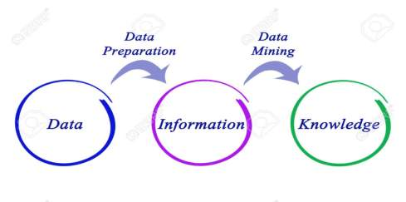
Data Transformation
Data transformation is the process of changing the format, structure, or values of data.

Slide 10
Strategies for data transformation
Strategies for data transformation are:
Smoothing
Attribute Construction
Aggregation
Generalization
Normalization
Discretization

Slide 11
Data Transformation by Normalization
The measurement unit used can affect the data analysis.
For example, changing measurement units from meters to inches for height, or from kilograms to pounds for weight, may lead to very different results.

Slide 12
Data Transformation by Normalization
To help avoid dependence on the choice of measurement units, the data should be normalized or standardized.
This involves transforming the data to fall within a smaller or common range such as [−1,1] or [0.0, 1.0].

Slide 13
Methods for Normalization
min-max normalization
z-score normalization
normalization by decimal scaling

Slide 14
min-max normalization
Let A be the numeric attribute with n observed values v1, v2…………vn
This transforms the original data linearly.
min_A is the minima and max_A is the maxima of an attribute, P

Slide 15
min-max normalization
We Have the Formula:
Where v is the value you want to plot in the new range.
v’ is the new value you get after normalizing the old value.

Slide 16
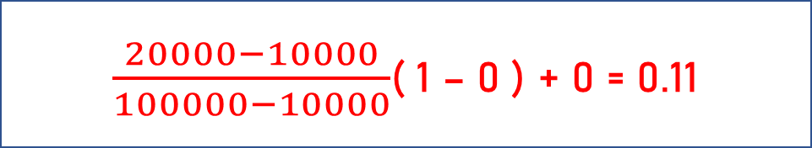
Example
Suppose the minimum and maximum value for an attribute profit(P) are Rs. 10, 000 and Rs. 100, 000. We want to plot the profit in the range [0, 1]. Using min-max normalization the value of Rs. 20, 000 for attribute profit can be plotted to:
And hence, we get the value of v’ as 0.11
$\frac{20000−10000}{100000−10000}$( 1 – 0 ) + 0 = 0.11

Slide 17
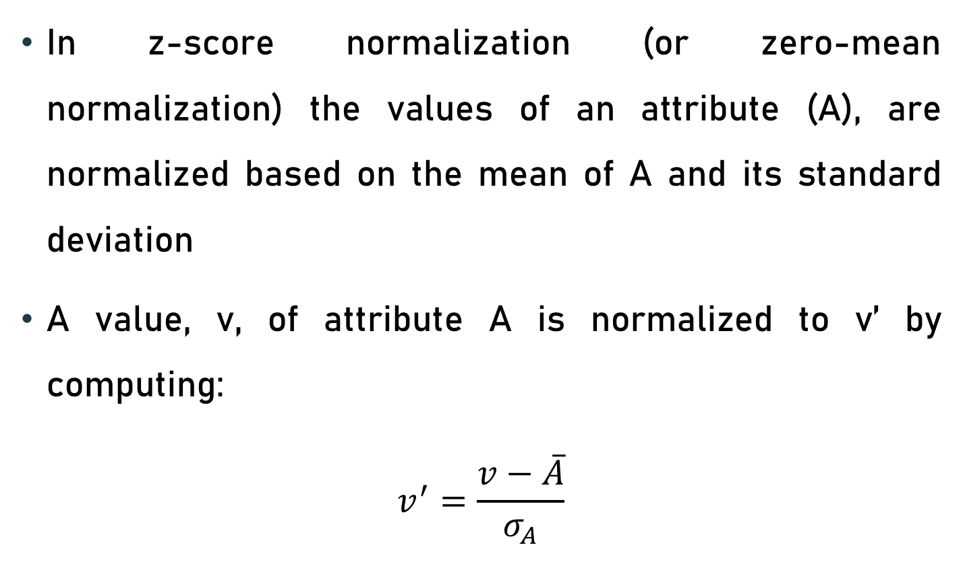
z-score normalization
In z-score normalization (or zero-mean normalization) the values of an attribute (A), are normalized based on the mean of A and its standard deviation
A value, v, of attribute A is normalized to v’ by computing:
$$v^{′}=\frac{v−\overline{A}}{σ_{A}}$$

Slide 18

Example
Let mean of an attribute P = 60, 000, Standard Deviation = 10, 000, for the attribute P. Using z-score normalization, a value of 85000 for P can be transformed to:
And hence we get the value of v’ to be 2.5
$\frac{85000−60000}{10000}$= 2.50

Slide 19
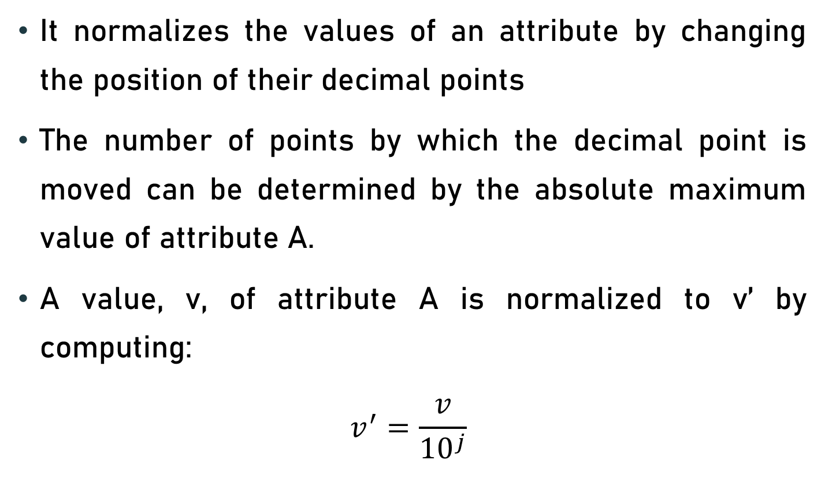
Normalization By Decimal Scaling
It normalizes the values of an attribute by changing the position of their decimal points
The number of points by which the decimal point is moved can be determined by the absolute maximum value of attribute A.
A value, v, of attribute A is normalized to v’ by computing:
$$v^{′}=\frac{v}{{10}^{j}}$$

Slide 20
Example
Suppose: Values of an attribute P varies from -99 to 99.
The maximum absolute value of P is 99.
For normalizing the values we divide the numbers by 100 (i.e., j = 2) or (number of integers in the largest number) so that values come out to be as 0.98, 0.97 and so on.

