Slide 2
After this lecture, you will be able to
learn the concept of data discretization and data reduction.
understand the various strategies of data reduction.

Slide 3
Discretization
The raw values of a numeric attribute (e.g., age) are replaced by interval labels (e.g., 0–10, 11–20, etc.) or conceptual labels (e.g., youth, adult, senior ).
Three types of attributes:
Nominal — values from an unordered set
Ordinal — values from an ordered set
Continuous — real numbers

Slide 4
Discretization
Divide the range of a continuous attribute into intervals
Some classification algorithms only accept categorical attributes.
Reduce data size by discretization
Prepare for further analysis

Slide 5
Discretization
Top-down(spliting)
Bottom-up(merging)
Supervised
Unsupervised.

Slide 6
Splitting
Student
Top Down
Is a
Ex-student
Curr-student

Slide 7
Bottom-Up Approach
Animal
Is a
Bottom Up
Tiger
Lion
Elephant

Slide 8
Supervised
Supervised discretization is when you take the class into account when making discretization boundaries.
It's important that the discretization is determined solely by the training set and not the test set.

Slide 9
Unsupervised discretization
Unsupervised discretization algorithms are the simplest algorithms to make use of, because the only parameter you would specify is the number of intervals to use; or else, how many values should be included in each interval.

Slide 10
Need of data reduction
Data reduction process reduces the size of data and makes it suitable and feasible for analysis.
In the reduction process, integrity of the data must be preserved, and data volume is reduced.
There are many strategies that can be used for data reduction.

Slide 11
Data Reduction Strategies
Data cube aggregation
Numerosity reductions
Dimensionality reduction
Statistics
Discretization and concept hierarchy generation
Attribute subset selection

Slide 12
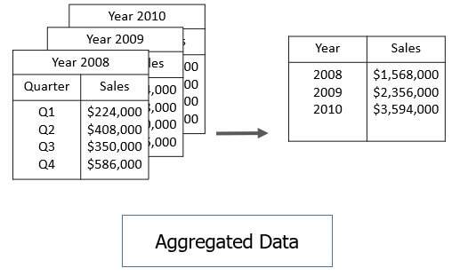
Data Cube Aggregation

Slide 13
Dimension reduction
Whenever we come across any data which is weakly important, then we use the attribute required for our analysis.
Step-wise Forward Selection
Step-wise Backward Selection
Combination of forwarding and Backward Selection

Slide 14
Step-wise Forward Selection
Initial attribute Set: {X1, X2, X3, X4, X5, X6}
Initial reduced attribute set: { }
Step-1: {X1}
Step-2: {X1, X2}
Step-3: {X1, X2, X5}
Final reduced attribute set: {X1, X2, X5}

Slide 15
Step-wise Backward Selection
Initial attribute Set: {X1, X2, X3, X4, X5, X6}
Initial reduced attribute set: {X1, X2, X3, X4, X5, X6 }
Step-1: {X1, X2, X3, X4, X5}
Step-2: {X1, X2, X3, X5}
Step-3: {X1, X2, X5}
Final reduced attribute set: {X1, X2, X5}

Slide 16
Data Compression
The data compression technique reduces the size of the files using different encoding mechanisms.
Techniques of data compression:
Lossless Compression
Lossy Compression

Slide 17
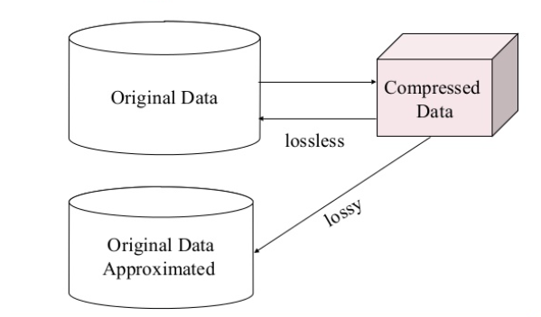
Data Compression

Slide 18
Numerosity Reduction
Numerosity Reduction is a data reduction technique which replaces the original data by smaller form of data representation.
Techniques for numerosity reduction-
Parametric
Non-Parametric

Slide 19
Discretization & Concept Hierarchy Operation
Techniques of data discretization are used to divide the attributes of the continuous nature into data with intervals.
We replace many constant values of the attributes by labels of small intervals.
This means that mining results are shown in a concise, and easily understandable way.
Top-down discretization
Bottom-up discretization

Slide 20
Concept hierarchies
It reduces the data size by collecting and then replacing the low-level concepts (age) to high-level concepts (categorical variables such as middle age or Senior).
All
Youth
20-39
Middle-aged
40-59
Senior
60-89

