Slide 2
After this lecture, you will be able to
understand the concept of frequent patterns and association rules.
learn how to calculate support and confidence.

Slide 3
Scenario
Imagine that you are a sales manager, and you are talking to a customer who recently bought a PC and a digital camera from the store. What should you recommend to her next?
Frequent patterns and association rules are the knowledge that you want to mine in such a scenario.

Slide 4
Basic concepts
Frequent patterns are patterns (e.g., itemsets, or subsequences) that appear frequently in a data set.
For example, a set of items, such as milk and bread, that appear frequently together in a transaction data set is a frequent item-set.

Slide 5
Basic concepts
A subsequence, such as buying first a PC, then a digital camera, and then a memory card, if it occurs frequently in a shopping history database, is a (frequent ) sequential pattern.
Frequent pattern mining searches for recurring relationships in a given data set.

Slide 6
Market Basket Analysis: A Motivating Example
This process analyzes customer buying habits by finding associations between the different items that customers place in their “shopping baskets” .
The discovery of these associations can help retailers develop marketing strategies by gaining insight into which items are frequently purchased together by customers.

Slide 7
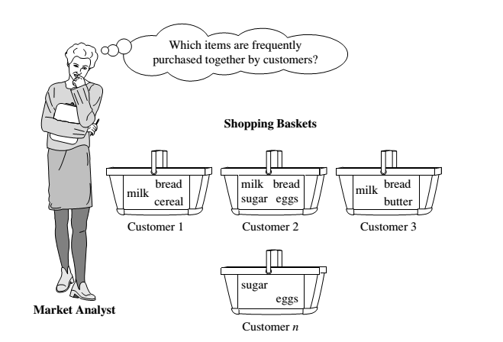
Market Basket Analysis

Slide 8
Association rules
Rule form
Antecedent → Consequent [support, confidence]
(support and confidence are user defined measures of interestingness)
Examples
age(x, “30..39”) ^ income(x, “42..48K”) →buys(x, “car”) [1%,75%]

Slide 9
Basic Concepts Association Rule: Basic Concepts
Given:
(1) database of transactions,
(2) each transaction is a list of items purchased by a customer in a visit
Find:
all rules that correlate the presence of one set of items
(item-set) with that of another set of items

Slide 10
Association rules
If we think of the universe as the set of items available at the store, then each item has a Boolean variable representing the presence or absence of that item.
Each basket can then be represented by a Boolean vector of values assigned to these variables.

Slide 11
Association rules
The Boolean vectors can be analyzed for buying patterns that reflect items that are frequently associated or purchased together.
These patterns can be represented in the form of ASSOCIATION RULES.

Slide 12
Association rules
For example, the information that customers who purchase computers also tend to buy antivirus software at the same time is represented in the following association rule:
Computer = antivirus_software [ support = 2%, confidence = 60%].

Slide 13
Association rules
A support of 2% for Rule means that 2% of all the transactions under analysis show that computer and antivirus softwares are purchased together.
A confidence of 60% means that 60% of the customers who purchased a computer also bought the software.

Slide 14
Frequent Patterns and Association Rules
Itemset X = {x₁, …, x_{k}}
Find all the rules X → Y with minimum support and confidence
support, s, probability that a transaction contains X ∪ Y.
confidence, c, conditional probability that a transaction having X also contains Y.

Slide 15
Example
Let sup min = 50%, conf min = 50%
Freq. Pat.: {A:3, B:3, D:4, E:3, AD:3}
Association rules:
A -> D (60%, 100%)
D ->A (60%, 75%)
Transaction-id | Items bought
10 | A, B, D
20 | A, C, D
30 | A, D, E
40 | B, E, F
50 | B, C, D, E, F

Slide 16
Frequent Patterns and Association Rules
Support (A=>B)= (Number of transactions includes both A and B)/ (Total number of transactions).
Confidence (A=>B) = (Number of transactions includes both A and B)/ (Number of transactions includes only product A)

Slide 17
Frequent Patterns and Association Rules
Rules that satisfy both a minimum support threshold (min_sup) and a minimum confidence threshold (min_conf ) are called strong.
A set of items is referred to as an itemset. An itemset that contains k items is a k-itemset. The set {computer, antivirus software} is a 2-itemset.

Slide 18
Frequent Patterns and Association Rules
The occurrence frequency of an itemset is the number of transactions that contain the itemset.
This is also known, simply, as the frequency, support count, or count of the itemset.

Slide 19
Frequent Patterns and Association Rules
In general, association rule mining can be viewed as a two-step process:
Find all frequent itemsets: By definition, each of these itemsets will occur at least as frequently as a predetermined minimum support count, min sup.
Generate strong association rules from the frequent itemsets: By definition, these rules must satisfy minimum support and minimum confidence.

