Slide 2
After this lecture, you will be able to
understand the basic concepts of Apriori algorithm.
learn the working of Apriori algorithm.

Slide 3
The Apriori Algorithm: Basics
Key Concepts:
Frequent Item-sets: The sets of item which has minimum support
Apriori Property: Any subset of frequent item-set must be frequent.
Join Operation: To find Lk, a set of candidate k-item-sets is generated by joining Lk-1 with itself.

Slide 4
The Apriori Algorithm
Find the frequent item-sets: the sets of items that have minimum support
–A subset of a frequent item-set must also be a frequent item-set
i.e., if {AB} is a frequent item-set, both {A} and {B} should be a frequent item-set
–Iteratively find frequent item-sets with cardinality from 1 to k (k-item-set)
Use the frequent item-sets to generate association rules.

Slide 5
The Apriori Algorithm: Example
Consider a database, D , consisting of 9 transactions.
Suppose min. support count required is 2 (i.e. min_sup = 2/9 = 22 % )
Let minimum confidence required is 70%.
We have to first find out the frequent item-set using Apriori algorithm.
Then, Association rules will be generated using min. support & min. confidence.
Tid | List of Items
1 | I1, I2, I5
2 | I2, I4
3 | I2, I3
4 | I1, I2, I4
5 | I1, I3
6 | I2, I3
7 | I1, I3
8 | I1, I2 ,I3, I5
9 | I1, I2, I3

Slide 6
Step 1: Generating 1-itemset Frequent Pattern
Scan D for count of each candidate
Compare candidate support count with minimum support count
Itemset | Sup.Count
{I1} | 6
{I2} | 7
{I3} | 6
{I4} | 2
{I5} | 2
Itemset | Sup.Count
{I1} | 6
{I2} | 7
{I3} | 6
{I4} | 2
{I5} | 2

Slide 7
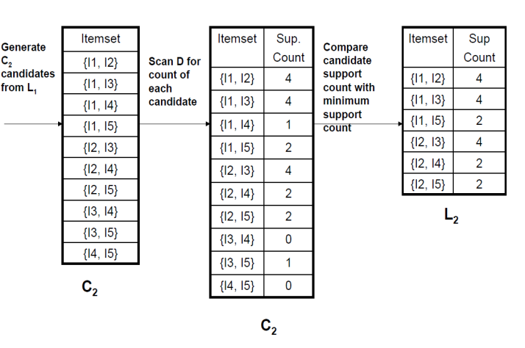
Step 2: Generating 2-itemset Frequent Pattern
Compare candidate support count with minimum support count
Generate C₂ candidates from L₁
Scan D for count of each candidate

Slide 8
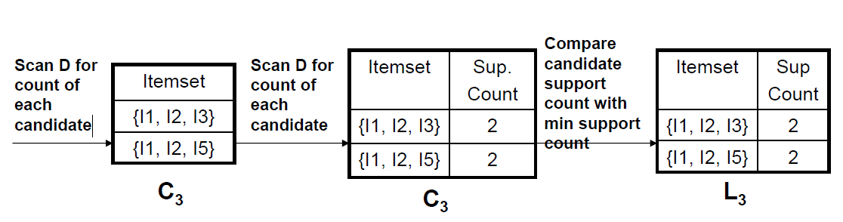
Step 3: Generating 3-itemset Frequent Pattern
In order to find C3, we compute L2 Join L2.
C3= L2 JoinL2 = {{I1, I2, I3}, {I1, I2, I5}, {I1, I3, I5}, {I2, I3, I4}, {I2, I3, I5}, {I2, I4, I5}}.

Slide 9
Step 4: Generating 4-itemset Frequent Pattern
The algorithm uses L3 Join L3 to generate a candidate set of 4-itemsets, C4.
Although the join results in {{I1, I2, I3, I5}}, this item-set is pruned since its subset {{I2, I3, I5}}is not frequent.
Thus, C4= φ, and algorithm terminates, having found all the frequent items. This completes our Apriori Algorithm.

Slide 10
Step 5:Generating Association Rules from Frequent Item-sets
Procedure:
For each frequent item-set “l”,generate all nonempty subsets of l.
For every nonempty subset sof l, output the rule “s ->(l-s)”
if support_count(l) / support_count(s) >= min_conf where min_confis minimum confidence threshold.

Slide 11
Step 5:Generating Association Rules from Frequent Item-sets
Back To Example
We had L = {{I1}, {I2}, {I3}, {I4}, {I5}, {I1,I2}, {I1,I3}, {I1,I5}, {I2,I3}, {I2,I4}, {I2,I5}, {I1,I2,I3}, {I1,I2,I5}}.
– Let's take l = {I1,I2,I5}.
– Its all-nonempty subsets are {I1,I2}, {I1,I5}, {I2,I5}, {I1}, {I2}, {I5}.

Slide 12
Step 5: Generating Association Rules from Frequent Item-sets
Let minimum confidence threshold is , say 70%.
The resulting association rules are shown below, each listed with its confidence.
–R1: I1 ^ I2 ->I5
Confidence = sc{I1,I2,I5}/sc{I1,I2} = 2/4 = 50%

Slide 13
Step 5: Generating Association Rules from Frequent Item-sets
R1 is Rejected.
–R2: I1 ^ I5 ->I2
•Confidence = sc{I1,I2,I5}/sc{I1,I5} = 2/2 = 100%
R2 is Selected.
-R4: I1 ->I2 ^ I5
Confidence = sc{I1,I2,I5}/sc{I1} = 2/6 = 33%

Slide 14
Step 5: Generating Association Rules from Frequent Item-sets
R4 is Rejected.
–R3: I2 ^ I5 ->I1
Confidence = sc{I1,I2,I5}/sc{I2,I5} = 2/2 = 100%
R3 is Selected.
–R5: I2 ->I1 ^ I5
Confidence = sc{I1,I2,I5}/{I2} = 2/7 = 29%

Slide 15
Step 5: Generating Association Rules from Frequent Item-sets
R5 is Rejected.
–R6: I5 ->I1 ^ I2
Confidence = sc{I1,I2,I5}/ {I5} = 2/2 = 100%
R6 is Selected.
In this way, We have found three strong association rules.

