Slide 2
After this lecture, you will be able to
understand the process of finding frequent pattern using FP-tree.
know the applications of association rule mining.

Slide 3
Process of FP growth
FP-Growth: allows frequent itemset discovery without candidate itemset generation. Two step approach:
Step 1: Build a compact data structure called the FP-tree.
Step 2: Extracts frequent itemsets directly from the FP-tree

Slide 4
Step 1: FP-Tree Construction
FP-Tree is constructed using 2 passes over the data-set:
Pass 1:
Scan data and find support for each item.
Discard infrequent items.
Sort frequent items in decreasing order based on their support.

Slide 5
Step 1: FP-Tree Construction
Pass 2:
Nodes correspond to items and have a counter
FP-Growth reads 1 transaction at a time and maps it to a path
Fixed order is used, so paths can overlap when transactions share items .
Pointers are maintained between nodes containing the same item, creating singly linked lists (dotted lines)
Frequent itemsets extracted from the FP-Tree.

Slide 6
Association Rules
Let’s have an example
T100 1,2,5
T200 2,4
T300 2,3
T400 1,2,4
T500 1,3
T600 2,3
T700 1,3
T800 1,2,3,5
T900 1,2,3

Slide 7
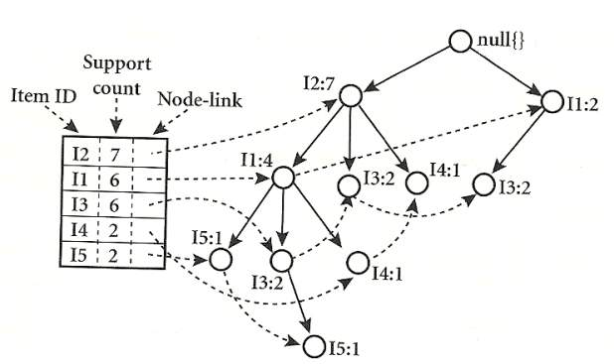
FP Tree

Slide 8
FP-Tree size
Best case scenario: all transactions contain the same set of items.
1 path in the FP-tree

Slide 9
FP-Tree size
Worst case scenario: every transaction has a unique set of items (no items in common)
Size of the FP-tree is at least as large as the original data.
Storage requirements for the FP-tree are higher - need to store the pointers between the nodes and the counters.
FP-Growth extracts frequent itemsets from the FP-tree.

Slide 10
Step 2: Frequent Itemset Generation
Bottom-up algorithm - from the leaves towards the root.
Divide and conquer: first look for frequent itemsets ending in e, then de, etc. . . then d, then cd, etc. . .
First, extract prefix path sub-trees ending in an item(set).

Slide 11
Mining the FP tree
Item | Conditional pattern base | Conditional FP-tree | Frequent patterns generated
15 | {{I2, I1:1},{I2,I1,I3:1}} | <I2:2,I1:2> | {I2,I5:2},{I1,15:2},{I2,I1,I5:2}
14 | {{I2, I1:1},{I2:1}} | <I2:2> | {I2,I4:2}
13 | {{I2, I1:1},{I2:2},{I1:2}} | <I2:4,I1:2>,<I1:2> | {I2,I3:4},{I1,I3:4},{I2,I1,I3:2}
11 | {{I2:4}} | <I2:4> | {I2,I1:4}

Slide 12
Benefits of the FP-tree Structure
Completeness
Compactness

Slide 13
Association Rule mining
Association rule learning is a type of unsupervised learning technique that checks for the dependency of one data item on another data item .
It tries to find some interesting relations or associations among the variables of dataset.
It is based on different rules to discover the interesting relations between variables in the database.

Slide 14
Applications of Association Rule Learning
Below are some popular applications of association rule learning:
Market Basket Analysis
Medical Diagnosis
Protein Sequence
It is also used for the Catalog Design and Loss-leader Analysis and many more other applications.

