Slide 2
After this lecture, you will be able to
learn the various measures of similarity.
know the concept of unsupervised learning.
understand the working of K-Means Algorithm.

Slide 3
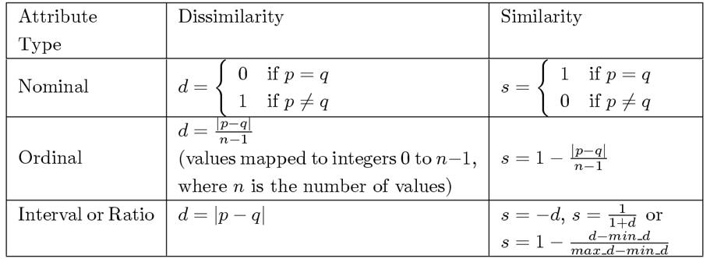
Similarity/Dissimilarity for Simple Attributes
Where p and q are the attribute values for two data objects.

Slide 4
Euclidean Distance
Euclidean Distance
Where n is the number of dimensions (attributes) and p_{k} and q_{k} are, respectively, the k^{th} attributes (components) or data objects p and q.
Standardization is necessary, if scales differ.

Slide 5
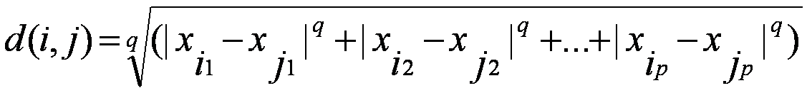

Minskowski Distance and Manhattan Distance
where i = (x_{i1}, x_{i2}, …, x_{ip}) and j = (x_{j1}, x_{j2}, …, x_{jp}) are two p-dimensional data objects, and q is a positive integer
If q = 1 , d gives the Manhattan distance

Slide 6
Common Properties of a Distance
Distances, such as the Euclidean distance, have some well-known properties.
d(p, q) ≥ 0 for all p and q and d(p, q) = 0 only if p = q. (Positive definiteness)
d(p, q) = d(q, p) for all p and q. (Symmetry)
d(p, r) ≤ d(p, q) + d(q, r) for all points p, q, and r. (Triangle Inequality)
where d(p, q) is the distance (dissimilarity) between points (data objects), p and q.
A distance that satisfies these properties is a metric

Slide 7
Common Properties of a Similarity
Similarities, also have some well-known properties.
s(p, q) = 1 (or maximum similarity) only if p = q.
s(p, q) = s(q, p) for all p and q. (Symmetry)
where s(p, q) is the similarity between points (data objects), p and q.

Slide 8
Unsupervised Learning (Clustering)
Unsupervised learning is a type of machine learning in which models are trained using unlabelled dataset and are allowed to act on that data without any supervision.
The goal of unsupervised learning is to:
find the underlying structure of dataset,
group that data according to similarities
represent that dataset in a compressed format.

Slide 9
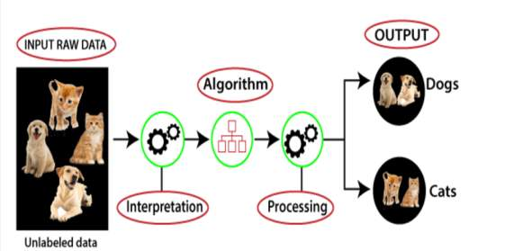
Working of Unsupervised Learning
Working of unsupervised learning can be understood by the below diagram:

Slide 10
K-Means Clustering
K-Means Clustering is an unsupervised learning algorithm that is used to solve the clustering problems in machine learning.
K-Means Clustering is an Unsupervised Learning algorithm, which groups the unlabeled dataset into different clusters.
Here K defines the number of pre-defined clusters that need to be created in the process, as if K=2, there will be two clusters, and for K=3, there will be three clusters, and so on.

Slide 11
K-Means Clustering
K-Means Clustering is an unsupervised learning algorithm that is used to solve the clustering problems in machine learning .
K-Means Clustering is an Unsupervised Learning algorithm, which groups the unlabeled dataset into different clusters.
Here K defines the number of pre-defined clusters that need to be created in the process, as if K=2, there will be two clusters, and for K=3, there will be three clusters, and so on.

Slide 12
K-Means Clustering
K-Means Clustering is an unsupervised learning algorithm that is used to solve the clustering problems in machine learning .
K-Means Clustering is an Unsupervised Learning algorithm, which groups the unlabeled dataset into different clusters.
Here K defines the number of pre-defined clusters that need to be created in the process, as if K=2, there will be two clusters, and for K=3, there will be three clusters, and so on.

Slide 13
K-Means Clustering
It is a centroid-based algorithm, where each cluster is associated with a centroid.
The main aim of this algorithm is to minimize the sum of distances between the data point and their corresponding clusters.

Slide 14
K-Means Clustering
It is a centroid-based algorithm, where each cluster is associated with a centroid.
The main aim of this algorithm is to minimize the sum of distances between the data point and their corresponding clusters.

Slide 15
K-Means Clustering
The algorithm takes the unlabeled dataset as input, divides the dataset into k-number of clusters, and repeats the process until it does not find the best clusters.
The value of k should be predetermined in this algorithm.

Slide 16
K-Means Clustering
The algorithm takes the unlabeled dataset as input, divides the dataset into k-number of clusters, and repeats the process until it does not find the best clusters.
The value of k should be predetermined in this algorithm.

Slide 17
K-Means Clustering
The k-means clustering algorithm mainly performs two tasks:
Determines the best value for K center points or centroids by an iterative process.
Assigns each data point to its closest k-center. Those data points which are near to the particular k-center, create a cluster.

Slide 18
K-Means Clustering
The k-means clustering algorithm mainly performs two tasks:
Determines the best value for K center points or centroids by an iterative process.
Assigns each data point to its closest k-center. Those data points which are near to the particular k-center, create a cluster.

Slide 19
K-Means Clustering
The k-means clustering algorithm mainly performs two tasks:
Determines the best value for K center points or centroids by an iterative process.
Assigns each data point to its closest k-center. Those data points which are near to the particular k-center, create a cluster.

Slide 20
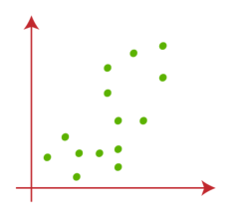
Working of K-Means Algorithm
Step-1: Select the number K to decide the number of clusters.
Suppose we have two variables M1 and M2. The x-y axis scatter plot of these two variables is given below:

Slide 21
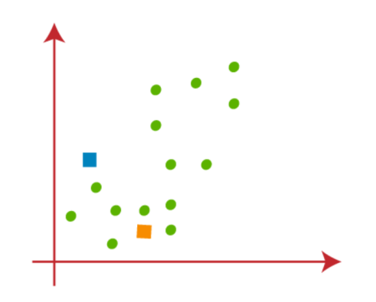
Working of K-Means Algorithm
Step-2:

Slide 22
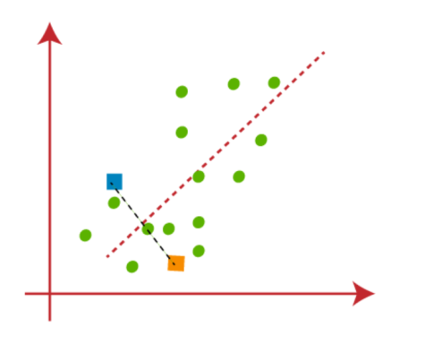
Working of K-Means Algorithm
Step-3:

Slide 23
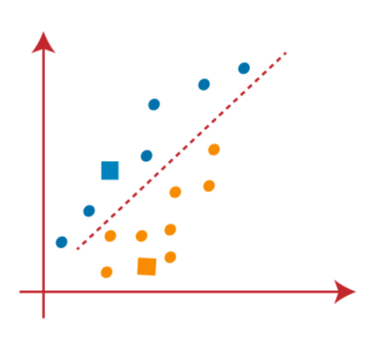
Working of K-Means Algorithm
Step-4:

Slide 24
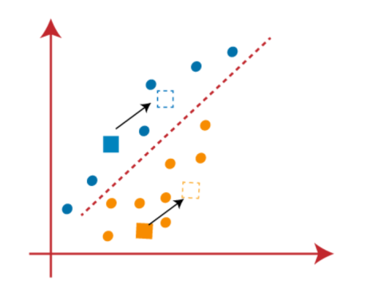
Working of K-Means Algorithm
Step-5:

Slide 25
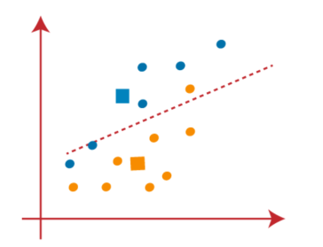
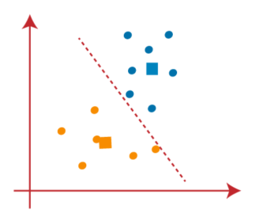
Working of K-Means Algorithm
Step-6:

Slide 26
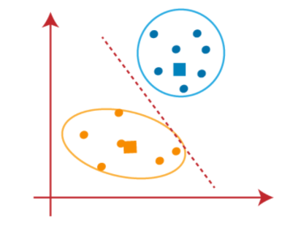
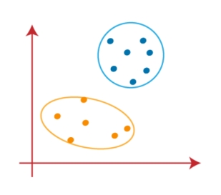
Working of K-Means Algorithm
Step-7:

