Slide 2
After this lecture, you will be able to
understand the working of K-mediods and Clarans clustering algorithms.

Slide 3
K-Medoids clustering(PAM)
Initialize: select k random points out of the n data points as the medoids.
Associate each data point to the closest medoid by using any common distance metric methods.
While the cost decreases:
For each medoid m, for each data o point which is not a medoid:
Swap m and o, associate each data point to the closest medoid, recompute the cost.
If the total cost is more than that in the previous step, undo the swap.

Slide 4
K-Medoids clustering(PAM)
Initialize: select k random points out of the n data points as the medoids.
Associate each data point to the closest medoid by using any common distance metric methods.
While the cost decreases:
For each medoid m, for each data o point which is not a medoid:
Swap m and o, associate each data point to the closest medoid, recompute the cost.
If the total cost is more than that in the previous step, undo the swap.

Slide 5
K-Medoids clustering(PAM)
Initialize: select k random points out of the n data points as the medoids.
Associate each data point to the closest medoid by using any common distance metric methods.
While the cost decreases:
For each medoid m, for each data o point which is not a medoid:
Swap m and o, associate each data point to the closest medoid, recompute the cost.
If the total cost is more than that in the previous step, undo the swap.

Slide 6
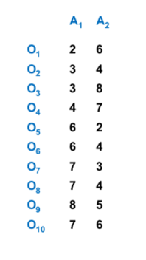
K-Medoids Method: Example
Data Objects

Slide 7
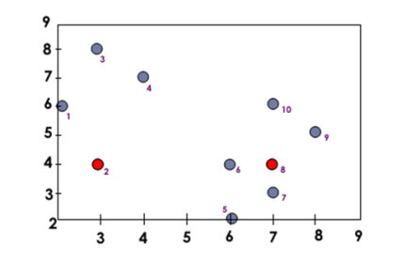
Goal: Create Two Clusters
02 = (3,4)
08= (7,4)

Slide 8
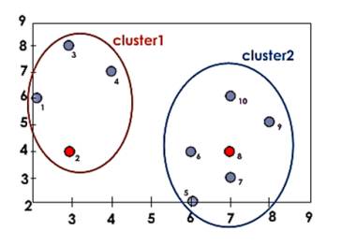
K-Medoids Method: Example
Data Objects
Assign each object to the closest representative object
Using LI Metric (Manhattan), we form the following clusters
Cluster1 = {O1, O2, O3, O4}
Cluster2 = {O5, O6, O7, O8, O9, O10}

Slide 9
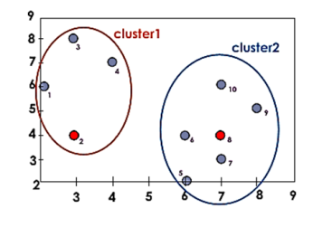
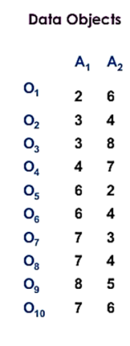
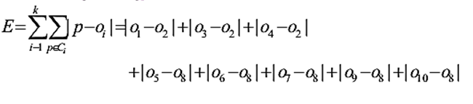
K-Medoids Method: Example
Compute the absolute error criterion [for the set of Medoids (02,08)

Slide 10
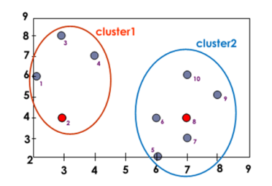
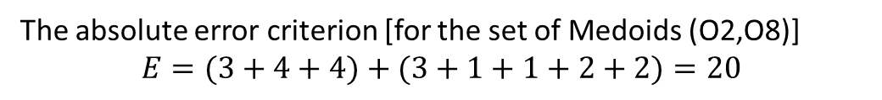
K-Medoids Method: Example
Data Objects
The absolute error criterion [for the set of Medoids (O2,O8)]
$$E=(3+4+4)+(3+1+1+2+2)=20$$

Slide 11
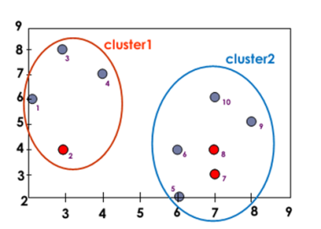

K-Medoids Method: Example
Data Objects
Choose a random object O
Swap O8 and O7
Compute the absolute error criterion [for the set of Medoids (02,07)]
$$E = (3 +4 + 4)+ (2 + 2+1+3 +3) = 22$$

Slide 12
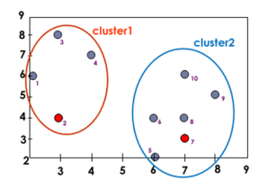
K-Medoids Method: Example
Data Objects
Compute the cost function Absolute error [for O2,O7]
Absolute error [O2,O8]
S = 22-20=2
S> 0 it is a bad idea to replace O8 by O7

Slide 13
Which method is more robust—k-means or k-medoids?”
The k-medoids method is more robust than k-means.
Because in the presence of noise and outliers medoid is less influenced by outliers or other extreme values than a mean.

Slide 14
The CLARANS algorithm
CLARANS has two parameters:
maxNeighbor
The maximum number of neighbors examined
numLocal
The number of local minima obtained (. The higher the value of maxNeighbor, the closer is CLARANS to PAM

Slide 15
The CLARANS algorithm
Clustering Large Applications based upon RANdomized Search.
CLARANS is an efficient medoid-based clustering algorithm.
The k-medoids algorithm is an adaptation of the k-means algorithm.

Slide 16
The CLARANS algorithm
Rather than calculate the mean of the items in each cluster, a representative item, or medoid, is chosen for each cluster at each iteration.
In CLARANS, the process of finding k medoids from n objects is viewed abstractly as searching through a certain graph.

Slide 17
The CLARANS algorithm
CLARANS (Clustering Large Applications based upon RANdomized Search ) was proposed to improve the quality and the scalability of CLARA .
It combines sampling techniques with PAM.
It does not confine itself to any sample at a given time
It draws a sample with some randomness in each step of the search

Slide 18
The CLARANS algorithm
In the graph, a node is represented by a set of k objects as selected medoids.
Two nodes are neighbors if their sets differ by only one object.
In each iteration, CLARANS considers a set of randomly chosen neighbor nodes as candidate of new medoids.

Slide 19
The CLARANS algorithm
We will move to the neighbor node if the neighbor is a better choice for medoids.
Otherwise, a local optima is discovered. The entire process is repeated multiple time to find better.

Slide 20
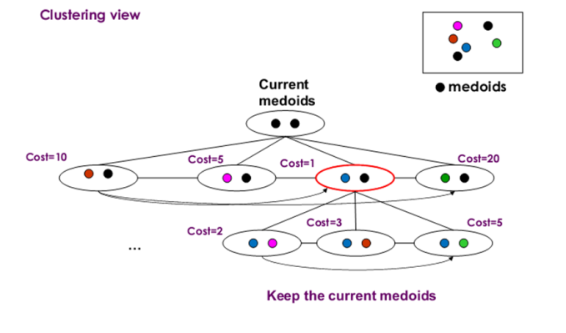
CLARANS –Basic Idea

Slide 21
CLARANS –Basic Idea
Draws a sample of nodes at the beginning of the search .
Neighbors are from the chosen sample.
Restricts the search to a specific area of the original data

Slide 22
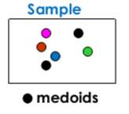
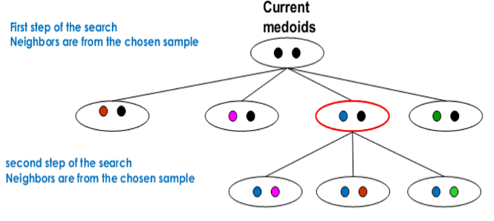
CLARANS –Basic Idea

Slide 23
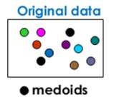
CLARANS –Basic Idea
Does not confine the search to a localized area.
Stops the search when a local minimum is found.
Finds several local optimums and output the clustering with the best local optimum

Slide 24
CLARANS Properties
Advantages
Experiments show that CLARANS is more effective than both PAM and CLARA .
Handles outliers
Disadvantages
The computational complexity of CLARANS is O(n2), where n is the number of objects .
The clustering quality depends on the sampling method

