Slide 2
After this lecture, you will be able to
understand the concept of cluster analysis.
learn the different clustering approaches.

Slide 3
What is Cluster Analysis?
The process of dividing a set of input data into possibly overlapping, subsets, where elements in each subset are considered related by some similarity measure

Slide 4
What is Cluster Analysis?
Clusters by Shape
2 Clusters
Clusters by Color
3 Clusters

Slide 5
Clustering Approaches
Two Approaches of Clustering
Density-Based Clustering
Graph Based Clustering

Slide 6
Density-Based Clustering
Density-Based Clustering refers to unsupervised learning methods that identify distinctive groups/clusters in the data, based on the idea that a cluster in a data space is a contiguous region of high point density, separated from other such clusters by contiguous regions of low point density.

Slide 7
Density-Based Clustering
The basic idea is to continue growing the given cluster as long as the density in the neighborhood exceeds some threshold.
For each data point within a given cluster, the radius of a given cluster has to contain at least a minimum number of points.

Slide 8
Density-Based Clustering
The basic idea is to continue growing the given cluster as long as the density in the neighborhood exceeds some threshold.
For each data point within a given cluster, the radius of a given cluster has to contain at least a minimum number of points.

Slide 9
Density-Based Clustering
Major features
Discover Clusters of Arbitrary Shape
Handle Noise
One Scan
Need Density Parameters as Termination Condition

Slide 10
Density-Based Clustering
Two parameters:
Eps: Maximum radius of the neighbourhood.
MinPts: Minimum number of points in an Eps-neighbourhood of that point.

Slide 11
Density-Based Clustering
Directly density-reachable: A point p is directly density-reachable from a point q w.r.t. Eps, MinPts
p
MinPts = 5
Eps = 1 cm
q

Slide 12
Density-Based Clustering
A point in a DBSCAN can of three types:
core point - which has at least min pts points in its neighborhood
border point - one which has a core point in its neighborhood
noise point - one which is neither a core nor a border point and is considered an outlier in the dataset

Slide 13
Density-Based Clustering
A point in a DBSCAN can of three types:
core point - which has at least min pts points in its neighborhood
border point - one which has a core point in its neighborhood
noise point - one which is neither a core nor a border point and is considered an outlier in the dataset

Slide 14
Density-Based Clustering
A point in a DBSCAN can of three types:
core point - which has at least min pts points in its neighborhood
border point - one which has a core point in its neighborhood
noise point - one which is neither a core nor a border point and is considered an outlier in the dataset

Slide 15
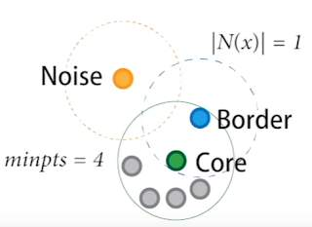
DBSCAN: Core, Border, and Noise Points

Slide 16
DBSCAN Algorithm
Arbitrary select a point p
Retrieve all points density-reachable from p w.r.t. Eps and MinPts
If p is a core point, a cluster is formed
If p is a border point, no points are density-reachable from p and DBSCAN visits the next point of the database
Continue the process until all of the points have been processed

Slide 17
DBSCAN Algorithm
Arbitrary select a point p
Retrieve all points density-reachable from p w.r.t. Eps and MinPts
If p is a core point, a cluster is formed
If p is a border point, no points are density-reachable from p and DBSCAN visits the next point of the database
Continue the process until all of the points have been processed

Slide 18
DBSCAN Algorithm
Arbitrary select a point p
Retrieve all points density-reachable from p w.r.t. Eps and MinPts
If p is a core point, a cluster is formed
If p is a border point, no points are density-reachable from p and DBSCAN visits the next point of the database
Continue the process until all of the points have been processed

Slide 19
DBSCAN Algorithm
Arbitrary select a point p
Retrieve all points density-reachable from p w.r.t. Eps and MinPts
If p is a core point, a cluster is formed
If p is a border point, no points are density-reachable from p and DBSCAN visits the next point of the database
Continue the process until all of the points have been processed

Slide 20
DBSCAN Algorithm
Arbitrary select a point p
Retrieve all points density-reachable from p w.r.t. Eps and MinPts
If p is a core point, a cluster is formed
If p is a border point, no points are density-reachable from p and DBSCAN visits the next point of the database
Continue the process until all of the points have been processed

Slide 21
Advantages of DBSCAN
It can discover any number of clusters.
Clusters of varying shapes and sizes can be obtained using the DBSCAN algorithm.
It can detect and ignore outliers.

Slide 22
Advantages of DBSCAN
It can discover any number of clusters.
Clusters of varying shapes and sizes can be obtained using the DBSCAN algorithm.
It can detect and ignore outliers.

Slide 23
Advantages of DBSCAN
It can discover any number of clusters.
Clusters of varying shapes and sizes can be obtained using the DBSCAN algorithm.
It can detect and ignore outliers.

Slide 24
Disadvantages of DBSCAN
The epsilon value is too sensitive
too small a value can result in elimination of spare clusters as outliers
too large a value would merge dense clusters together giving incorrect clusters

Slide 25
Disadvantages of DBSCAN
The epsilon value is too sensitive
too small a value can result in elimination of spare clusters as outliers
too large a value would merge dense clusters together giving incorrect clusters

Slide 26
What is Graph Clustering
Graph clustering refers to clustering of data in the form of graphs

Slide 27
What is Graph Clustering
Types of Graph Clustering
Between-graph - Clustering a set of graphs
Within-graph - Clustering the nodes/edges of a single graph

Slide 28
Between-graph Clustering
Between-graph clustering methods divide a set of graphs into different clusters

Slide 29
Between-graph Clustering
E.g., A set of graphs representing chemical compounds can be grouped into clusters based on their structural similarity

Slide 30
Within-graph Clustering
Within-graph clustering methods divides the nodes of a graph into clusters

Slide 31
Within-graph Clustering
E.g., In a social networking graph, these clusters could represent people with same/similar hobbies

Slide 32
K-Spanning Tree
K groups
of
non-overlapping
vertices
2
1
3
k-Spanning Tree
3
2
5
2
4
4
Minimum Spanning Tree
k

Slide 33
K-Spanning Tree
STEPS:
Obtains the Minimum Spanning Tree (MST) of input graph G
Removes k-1 edges from the MST
Results in k clusters

Slide 34
What is a Spanning Tree?
A connected subgraph with no cycles that includes all vertices in the graph
G
2
2
1
3
6
1
3
6
7
3
2
5
7
2
5
Weight = 17
4
2
4
4
2
4
5

Slide 35
What is a Spanning Tree?
Note: Weight can represent either distance or similarity between two vertices or similarity of the two vertices

Slide 36
What is a Minimum Spanning Tree (MST)?
The spanning tree of a graph with the minimum possible sum of edge weights, if the edge weights represent distance.

Slide 37
What is a Minimum Spanning Tree (MST)?
G
Weight = 11
1
2
3
2
6
1
3
7
3
2
5
4
3
2
5
2
4
4
5
2
4
4
2
1
3
2
5
Weight = 13
2
2
4
4
1
3
6
5
7
2
5
Weight = 17
2
4

Slide 38
What is a Minimum Spanning Tree (MST)?
Note: maximum possible sum of edge weights, if the edge weights represent similarity

Slide 39
Algorithm to Obtain MST Prim’s Algorithm
Given Input Graph G
2
1
3
6
7
2
5
3
4
2
4
4
5

Slide 40
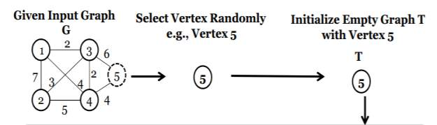
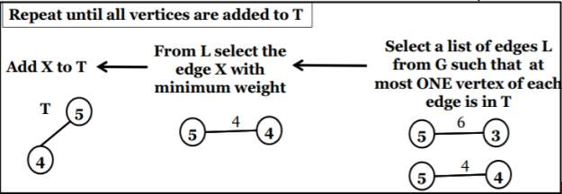
Algorithm to Obtain MST Prim’s Algorithm

Slide 41
Algorithm to Obtain MST Prim’s Algorithm
2
1
3
Remove k-1 edges with highest weight
3
2
5
2
4
4
E.g., k=3
E.g., k=3
2
1
3
1
3
5
3
2
5
2
4
2
4
4
Note:
k – is the number of clusters
3 Clusters

