Slide 2
After this lecture, you will be able to
learn various cluster evaluation methods.
understand the concept of outlier and the different types of outliers.

Slide 3
Words
“When I try out a clustering method on data set, how can I evaluate whether the clustering results are good?”

Slide 4
Cluster Evaluation
Cluster evaluation assesses the feasibility of clustering analysis on a data set and the quality of the results generated by a clustering method.
Clustering evaluation include the following tasks:
Assessing clustering tendency.
Determining the number of clusters in a data set.
Measuring clustering quality

Slide 5
Cluster Evaluation
Cluster evaluation assesses the feasibility of clustering analysis on a data set and the quality of the results generated by a clustering method.
Clustering evaluation include the following tasks:
Assessing clustering tendency.
Determining the number of clusters in a data set.
Measuring clustering quality

Slide 6
Assessing Clustering Tendency
Before applying any clustering method on your data, it’s important to evaluate whether the data sets contains meaningful clusters (i.e.: non-random structures) or not.
If yes, then how many clusters are there.
This process is defined as the assessing of clustering tendency

Slide 7
Assessing Clustering Tendency
The Hopkins statistic is used to assess the clustering tendency of a data set by measuring the probability that a given data set is generated by a uniform data distribution.
In other words, it tests the spatial randomness of the data.

Slide 8
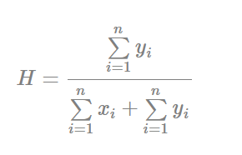


Hopkins Static
The Hopkins statistic can be calculated as follow:
If D were uniformly distributed, then and
would be close to each other, and thus HH would be about 0.5.

Slide 9
Hopkins Static
The null and the alternative hypotheses are defined as follow:
Null hypothesis: the data set D is uniformly distributed (i.e., no meaningful clusters)
Alternative hypothesis: the data set D is not uniformly distributed (i.e., contains meaningful clusters)

Slide 10
Hopkins Static
We can conduct the Hopkins Statistic test iteratively, using 0.5 as the threshold to reject the alternative hypothesis.
That is, if H < 0.5, then it is unlikely that D has statistically significant clusters.

Slide 11
Hopkins Static
Null hypothesis: the data set D is uniformly distributed
Alternative hypothesis: the data set D is not uniformly distributed
If the value of Hopkins statistic is close to 1, then we can reject the null hypothesis and conclude that the dataset D is significantly a cluster able data.

Slide 12
Determining the Number of Clusters
Determining the “right” number of clusters in a data set is important, not only because some clustering algorithms like k-means require such a parameter, but also because the appropriate number of clusters controls the proper granularity of cluster analysis.

Slide 13
Determining the Number of Clusters
It can be regarded as finding a good balance between compressibility and accuracy in cluster analysis.

Slide 14
Determining the Number of Clusters
What if you were to treat the entire data set as a cluster?
On the other hand, treating each object in a data set as a cluster gives the finest clustering resolution.

Slide 15
Determining the Number of Clusters
Figuring out what the right number of clusters should be often depends on the distribution’s shape and scale in the data set, as well as the clustering resolution required by the user.

Slide 16
Measuring Clustering Quality
“How good is the clustering generated by a method, and how can we compare the clustering's generated by different methods?”

Slide 17
Measuring Clustering Quality
“How good is the clustering generated by a method, and how can we compare the clustering's generated by different methods?”
We have a few methods to choose from for measuring the quality of a clustering.
In general, these methods can be categorized into two groups according to whether ground truth is available or not.

Slide 18
Measuring Clustering Quality
If ground truth is available, it can be used by extrinsic methods.
If the ground truth is unavailable, we can use intrinsic methods.

Slide 19
Measuring Clustering Quality
Ground truth can be considered as supervision in the form of “cluster labels.” Hence, extrinsic methods are also known as supervised methods, while intrinsic methods are unsupervised methods.

Slide 20
Extrinsic Methods
A measure Q on clustering quality is effective if it satisfies the following four essential criteria:
Cluster Homogeneity
Cluster Completeness
Rag-bag

Slide 21
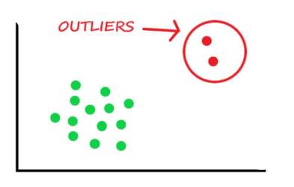
What Are Outliers?
Outlier: A data object that deviates significantly from the normal objects as if it were generated by a different mechanism.

Slide 22

Example

Slide 23
Applications
Credit card fraud detection
Telecom fraud detection
Customer segmentation
Medical analysis

Slide 24
Types of Outliers
Global Outliers
Contextual Outliers
Collective Outliers.

Slide 25

Global Outliers

Slide 26
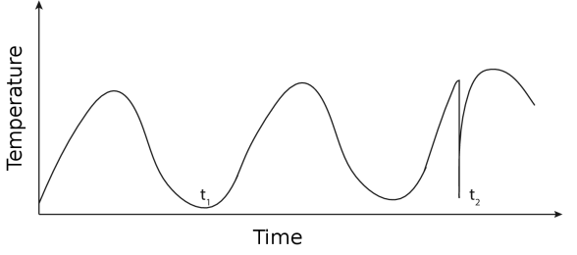
Contextual Outliers

Slide 27
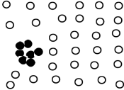
Collective Outliers
A subset of data objects collectively deviate significantly from the whole data set, even if the individual data objects may not be outliers
Applications: E.g., intrusion detection:
When a number of computers keep sending denial-of-service packages to each other

Slide 28
Collective Outliers
Detection of collective outliers
Consider not only behavior of individual objects, but also that of groups of objects
Need to have the background knowledge on the relationship among data objects, such as a distance or similarity measure on objects.

