Slide 2
After this lecture, you will be able to
understand the concept of supervised learning.
learn the concept of classification and various methods used for classification.
know the basic concept of binary classification.

Slide 3
Data Mining
In the process of data mining, large data sets are first sorted, then patterns are identified and relationships are established to perform data analysis and solve problems.

Slide 4
Attributes
Attributes – Represents different features of an object. Different types of attributes are:
Binary: Possesses only two values i.e. True or False
Nominal: When more than two outcomes are possible. It is in Alphabet form rather than being in Integer form.
Ordinal: Values that must have some meaningful order.
Continuous: May have infinite number of values, it is in float type
Discrete: Finite number of values.

Slide 5
Supervised Learning
Basically, supervised learning is a learning in which we teach or train the machine using data which is well labeled that means some data is already tagged with the correct answer.

Slide 6
Supervised Learning
Basically, supervised learning is a learning in which we teach or train the machine using data which is well labeled that means some data is already tagged with the correct answer.
After that, the machine is provided with a new set of examples so that supervised learning algorithm analyses the training data and produces a correct outcome from labeled data.

Slide 7
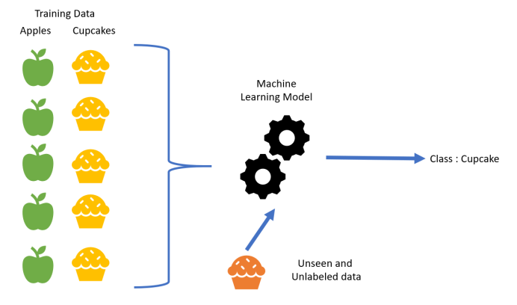
Supervised Learning

Slide 8
Classification
Classification is a data mining function that assigns items in a collection to target categories or classes.
The goal of classification is to accurately predict the target class for each case in the data.

Slide 9
Classification
Following are the examples of cases where the data analysis task is Classification −
A bank loan officer wants to analyze the data in order to know which customer (loan applicant) are risky or which are safe.
A marketing manager at a company needs to analyze a customer with a given profile, who will buy a new computer.

Slide 10
Classification
It is a two-step process such as :
Learning step (where a classification model is constructed)

Slide 11
Classification
It is a two-step process such as :
Classification step (where the model is used to predict class labels for given data).

Slide 12
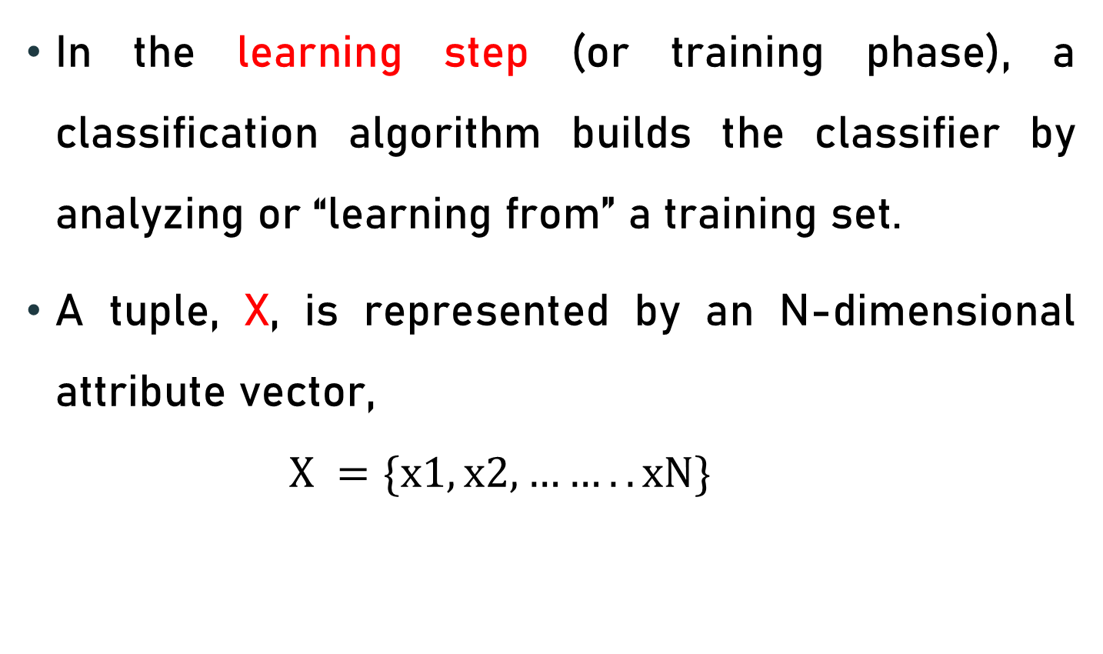
Learning Step
In the learning step (or training phase), a classification algorithm builds the classifier by analyzing or “learning from” a training set.
A tuple, X, is represented by an N-dimensional attribute vector,
$$X =\{x1, x2,……..xN\}$$

Slide 13
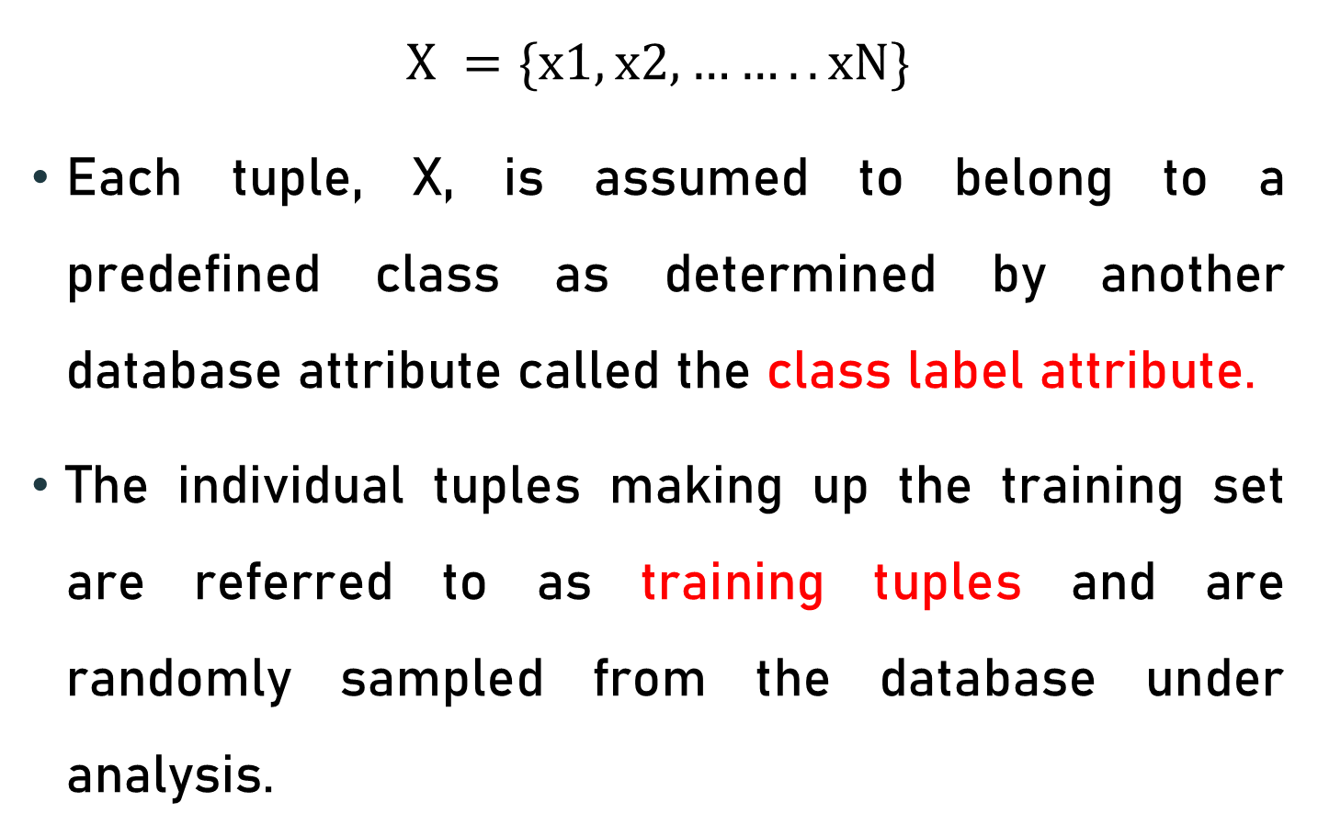
Learning Step
$$X =\{x1, x2,……..xN\}$$
Each tuple, X, is assumed to belong to a predefined class as determined by another database attribute called the class label attribute.
The individual tuples making up the training set are referred to as training tuples and are randomly sampled from the database under analysis.

Slide 14
Learning Step
Classification
Algorithms
Training
Data
Classifier
(Model)
IF rank = ‘professor’
OR years > 6
THEN tenured = ‘yes’

Slide 15
Classification Step
Model used to predict class labels and testing the constructed model on test data and hence estimate the accuracy of the classification rules.

Slide 16
Classification Step
Classifier
Testing
Data
Unseen Data
(Jeff, Professor, 4)
Tenured?

Slide 17
Issues: Evaluating Classification Methods
Data Cleaning

Slide 18
Issues: Evaluating Classification Methods
Data Cleaning
Relevance Analysis

Slide 19
Issues: Evaluating Classification Methods
Data Cleaning
Relevance Analysis
Data Transformation and reduction

Slide 20
Types of Classifiers:
Classifiers can be categorized into two major types:
Discriminative
Generative

Slide 21
Discriminative
It is a very basic classifier and determines just one class for each row of data. It tries to model just by depending on the observed data, depends heavily on the quality of data rather than on distributions.
Example: Logistic Regression

Slide 22
Generative
It models the distribution of individual classes and tries to learn the model that generates the data behind the scenes by estimating assumptions and distributions of the model. Used to predict the unseen data.
Example: Naive Bayes Classifier

Slide 23
Classification Methods
Decision Tree Induction

Slide 24
Classification Methods
Decision Tree Induction
Bayesian Classification

Slide 25
Classification Methods
Decision Tree Induction
Bayesian Classification
Rule Based Classification

Slide 26
Classification Methods
Decision Tree Induction
Bayesian Classification
Rule Based Classification
k-Nearest Neighbors Method

Slide 27
Decision Tree Induction
Age
young
senior
Student ?
yes
Credit rating ?
no
No
fair
No
Middle aged
yes
Yes
excellent
Yes

Slide 28
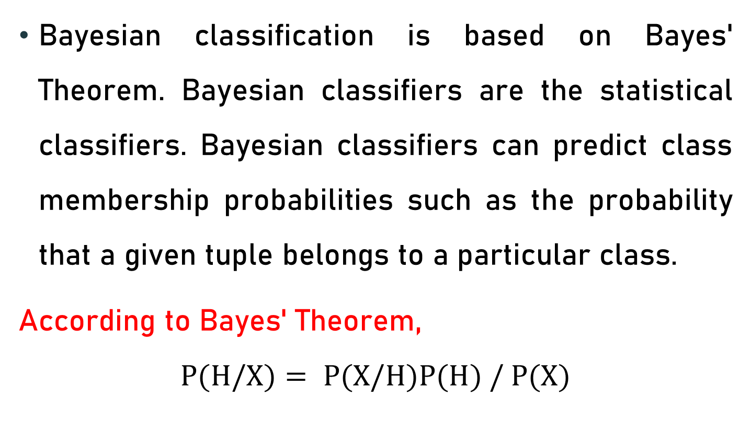
Bayesian Classification
Bayesian classification is based on Bayes' Theorem. Bayesian classifiers are the statistical classifiers. Bayesian classifiers can predict class membership probabilities such as the probability that a given tuple belongs to a particular class.
According to Bayes' Theorem,
$$P(H/X)= P(X/H)P(H) / P(X)$$

Slide 29
Rule Based Classification
IF condition THEN conclusion
Let us consider a rule R1,
R1: IF age = youth AND student = yes THEN buy_computer = yes

Slide 30
Binary Classification
Binary classification is the task of classifying the elements of a set into two groups on the basis of a classification rule. Typical binary classification problems include:
Medical testing to determine if a patient has certain disease or not;
Quality control in industry, deciding whether a specification has been met;
In information retrieval, deciding whether a page should be in the result set of a search or not.

Slide 31
Binary Classification
Typically, binary classification tasks involve one class that is the normal state and another class that is the abnormal state.
Example is “cancer not detected” is the normal state of a task that involves a medical test and “cancer detected” is the abnormal state.
The class for the normal state is assigned the class label 0 and the class with the abnormal state is assigned the class label 1.

Slide 32
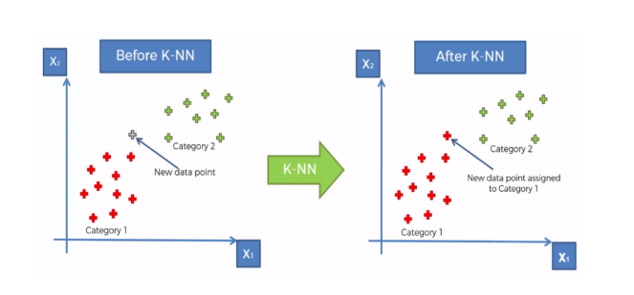
k-Nearest Neighbours Method

Slide 33
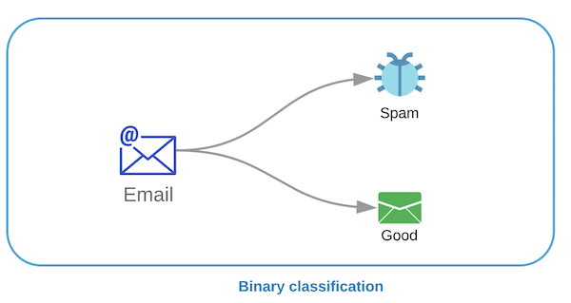
Binary Classification

Slide 34
Binary Classification
Popular algorithms that can be used for binary classification include:
Logistic Regression

Slide 35
Binary Classification
Popular algorithms that can be used for binary classification include:
Logistic Regression
k-Nearest Neighbors

Slide 36
Binary Classification
Popular algorithms that can be used for binary classification include:
Logistic Regression
k-Nearest Neighbors
Decision Trees

Slide 37
Binary Classification
Popular algorithms that can be used for binary classification include:
Logistic Regression
k-Nearest Neighbors
Decision Trees
Support Vector Machine

Slide 38
Binary Classification
Popular algorithms that can be used for binary classification include:
Logistic Regression
k-Nearest Neighbors
Decision Trees
Support Vector Machine
Naive Bayes

