Slide 2
After this lecture, you will be able to
understand the use of Association based classification.
understand the working of rule based classification.
know how KNN algorithm works.

Slide 3
Association based classification
Association rule mining finds interesting associations and relationships among large sets of data items.
It shows how frequently a itemset occurs in a transaction. A typical example is Market Based Analysis.

Slide 4
Association based classification
Market Based Analysis is one of the key techniques used by large relations to show associations between items.
It allows retailers to identify relationships between the items that people buy together frequently.

Slide 5
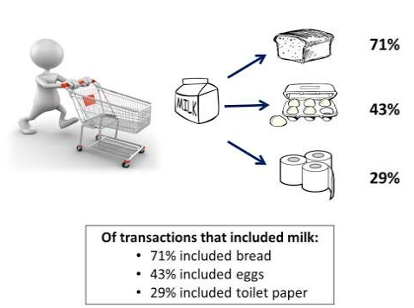
Association based classification

Slide 6
Association based classification
Given a set of transactions, we can find rules that will predict the occurrence of an item based on the occurrences of other Items in the transaction.
TID | Items
1 | Bread, Milk
2 | Bread, Diaper, Beer, Eggs
3 | Milk, Diaper, Beer, Coke
4 | Bread, Milk, Diaper, Beer
5 | Bread, Milk, Diaper, Coke

Slide 7
Association based classification
Before we start defining the rule, let us first see the basic definitions.
Support Count( )- σ Frequency of occurrence of a itemset.
Here σ ({Milk, Bread, Diaper})=2
Frequent Itemset – An itemset whose support is greater than or equal to minsup threshold.
Association Rule – An implication expression of the form X -> Y, where X and Y are any 2 itemsets.
Example: {Milk, Diaper}->{Beer}

Slide 8
Rule Evaluation Metrics
Support(s) – The number of transactions that include items in the {X} and {Y} parts of the rule as a percentage of the total number of transaction.It is a measure of how frequently the collection of items occur together as a percentage of all transactions.
Support = σ (X+Y) / total – It is interpreted as fraction of transactions that contain both X and Y.

Slide 9

Rule Evaluation Metrics
Confidence(c) – It is the ratio of the no of transactions that includes all items in {B} as well as the no of transactions that includes all items in {A} to the no of transactions that includes all items in {A}.
– It measures how often each item in Y appears in transactions that contains items in X also.

Slide 10
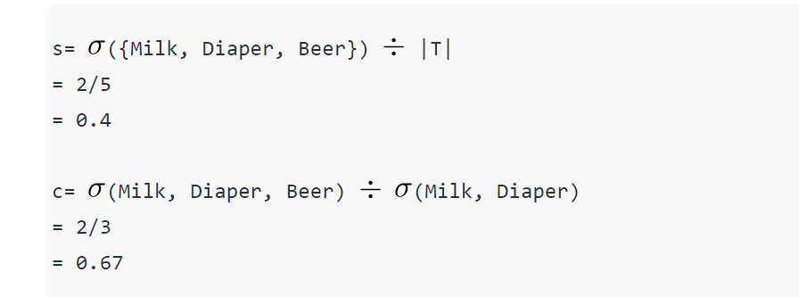
Example
{Milk, Diaper}=>{Beer}

Slide 11
Rule-Based Classifier
Classify records by using a collection of “if…then…” rules
Rule:(Condition) y
where
Condition is a conjunctions of attributes
y is the class label
LHS: rule antecedent or condition
RHS: rule consequent
Examples of classification rules:
(Blood Type=Warm) ^ (Lay Eggs=Yes) Birds

Slide 12
Application of Rule-Based Classifier
A rule r covers an instance x if the attributes of the instance satisfy the condition of the rule
R1: (Give Birth = no) ∧ (Can Fly = yes) → Birds
R2: (Give Birth = no) ∧ (Live in Water = yes) → Fishes
R3: (Give Birth = yes) ∧ (Blood Type = warm) → Mammals R4: (Give Birth = no) ∧ (Can Fly = no) → Reptiles
R5: (Live in Water = sometimes) → Amphibians
Name | Blood Type | Give Birth | Can Fly | Live in Water | Class
Hawk | warm | no | yes | no | ?
grizzly bear | warm | yes | no | no | ?
The rule R1 covers a hawk => Bird
The rule R3 covers the grizzly bear => Mammal

Slide 13
How does Rule-based Classifier Work?
R1: (Give Birth = no) ∧ Can Fly = yes) → Birds
R2: (Give Birth = no) ∧(Live in Water = yes) → Fishes
R3: (Give Birth = yes) ∧ (Blood Type = warm) → Mammals
R4: (Give Birth = no) ∧(Can Fly = no) → Reptiles
R5: (Live in Water = sometimes) → Amphibians
Name | Blood Type | Give Birth | Can Fly | Live in Water | Class
lemur | warm | yes | no | no | ?
turtle | cold | no | no | sometimes | ?
dogfish shark | cold | yes | no | yes | ?
A lemur triggers rule R3, so it is classified as a mammal A turtle triggers both R4 and R5
A dogfish shark triggers none of the rules

Slide 14
From Decision Trees To Rules
Classification Rules
(Refund=Yes) ==> No
(Refund=No, Marital Status={Single,Divorced},
Taxable Income<80K) ==> No
(Refund=No, Marital Status={Single,Divorced},
Taxable Income>80K) ==> Yes
(Refund=No, Marital Status={Married}) ==> No
Refund
Yes
No
NO
Marital Status
{Single, Divorced}
{Married}
NO
Taxable Income
< 80K
> 80K
NO
YES

Slide 15
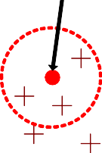
Nearest-Neighbour Classifiers
Requires three things
The set of stored records
Distance Metric to compute distance between records
The value of k, the number of nearest neighbors to retrieve
Unknown record

Slide 16
Nearest-Neighbour Classifiers
To classify an unknown record:
Compute distance to other training records
Identify k nearest neighbors
Use class labels of nearest neighbors to determine the class label of unknown record (e.g., by taking majority vote)

Slide 17
K-Nearest Neighbor Algorithm
To determine the class of a new example E:
Calculate the distance between E and all examples in the training set
Select K-nearest examples to E in the training set
Assign E to the most common class among its K-nearest neighbors
Response
No response
No response
Class: Response
No response
Response

Slide 18
Example : Nearest Neighbors
Customer | Age | Income | No. credit cards | Response
John | 35 | 35K | 3 | No
Rachel | 22 | 50K | 2 | Yes
Hannah | 63 | 200K | 1 | No
Tom | 59 | 170K | 1 | No
Nellie | 25 | 40K | 4 | Yes
David | 37 | 50K | 2 | ?

Slide 19
Example : Nearest Neighbors
Customer | Age | Income (K) | No. cards
John | 35 | 35 | 3
Rachel | 22 | 50 | 2
Hannah | 63 | 200 | 1
Tom | 59 | 170 | 1
Nellie | 25 | 40 | 4
David | 37 | 50 | 2
Response
No
Yes
No
No
Yes
Distance from David
sqrt [(35-37)²+(35-50)² +(3-2)²]=15.16
sqrt [(22-37)²+(50-50)² +(2-2)²]=15
sqrt [(63-37)²+(200-50)² +(1-2)²]=152.23
sqrt [(59-37)²+(170-50)² +(1-2)²]=122
sqrt [(25-37)²+(40-50)² +(4-2)²]=15.74

Slide 20
Example : Nearest Neighbors
Customer | Age | Income (K) | No. cards
John | 35 | 35 | 3
Rachel | 22 | 50 | 2
Hannah | 63 | 200 | 1
Tom | 59 | 170 | 1
Nellie | 25 | 40 | 4
David | 37 | 50 | 2
Response
No
Yes
No
No
Yes

Slide 21
Example : Nearest Neighbors
Customer | Age | Income (K) | No. cards
John | 35 | 35 | 3
Rachel | 22 | 50 | 2
Hannah | 63 | 200 | 1
Tom | 59 | 170 | 1
Nellie | 25 | 40 | 4
David | 37 | 50 | 2
Response
No
Yes
No
No
Yes
Yes

