Slide 2
After this lecture, you will be able to
understand the working of Decision tree algorithm.
know the various attribute selection methods.
explain the concept of ensemble approach and the working of random forest.

Slide 3
Decision Tree
A decision tree is a structure that includes a root node, branches, and leaf nodes.
Each internal node denotes a test on an attribute, each branch denotes the outcome of a test, and each leaf node holds a class label.

Slide 4
Decision Tree
The following decision tree is for the concept buy computer that indicates whether a customer at a company is likely to buy a computer or not.
age?
young
senior
Middle-age
student?
yes
credit rating?
Excellent
Fair
NO
YES
no
yes
no
yes

Slide 5
Decision Tree Induction: Training Dataset

Slide 6
Output: A Decision Tree for “buys_computer”
age?
<=30
>40
31….40
student?
yes
credit rating?
Excellent
Fair
NO
YES
no
yes
no
yes

Slide 7
How are decision trees used for classification?
Given a tuple, X, for which the associated class label is unknown.
The attribute values of the tuple are tested against the decision tree.
A path is traced from the root to a leaf node, which holds the class prediction for that tuple.
Decision trees can easily be converted to classification rules.

Slide 8
Why are decision tree classifiers so popular?
The construction of decision tree classifiers does not require any domain knowledge or parameter setting.
Decision trees can handle multidimensional data.
Their representation of acquired knowledge in tree form is intuitive and generally easy to understand by humans.
The learning and classification steps of decision tree induction are simple and fast.

Slide 9
Attribute Selection Criteria
A is discrete-valued: In this case, the outcomes of the test at node N correspond directly to the known values of A.
A is continuous-valued: In this case, the test at node N has two possible outcomes, corresponding to the conditions A <= split point and A >= split point, respectively.
A is discrete-valued in Set form.

Slide 10
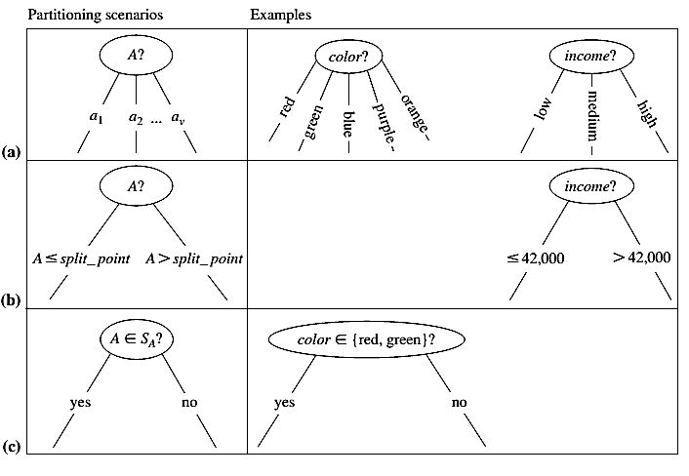
Attribute Selection Criteria

Slide 11
Attribute Selection Measure: Information Gain
Initial entropy:
A log function to the base 2 is used, because the information is encoded in bits.
New entropy (after using A to split D into v partitions) to classify D:

Slide 12
Attribute Selection Measure: Information Gain
Information gained by branching on attribute A

Slide 13
Attribute Selection Measure: Information Gain
RID | age | income | student | Credit_rating | Class:buys_computer
1 | youth | high | no | fair | no
2 | youth | high | no | excellent | no
3 | middle aged | high | no | fair | yes
4 | senior | medium | no | fair | yes
5 | senior | low | yes | fair | yes
6 | senior | low | yes | excellent | no
7 | middle aged | low | yes | excellent | yes
8 | youth | medium | no | fair | no
9 | youth | low | yes | fair | yes
10 | senior | medium | yes | fair | yes
11 | youth | medium | yes | excellent | yes
12 | middle aged | medium | no | excellent | yes
13 | middle aged | high | yes | fair | yes
14 | senior | medium | no | excellent | no

Slide 14

Attribute Selection Measure: Information Gain
The class label attribute, buys_computer, has two distinct values (namely, {yes, no}); therefore, there are two distinct classes (i.e., m = 2).
There are nine tuples of class yes and five tuples of class no.

Slide 15
Attribute Selection Measure: Information Gain
We need to look at the distribution of yes and no tuples for each category of age. For the age category “youth,” there are two yes tuples and three no tuples. For the category “middle aged,” there are four yes tuples and zero no tuples. For the category “senior,” there are three yes tuples and two no tuples.

Slide 16

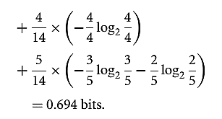

Attribute Selection Measure
Hence, the gain in information from such a partitioning would be
Similarly, we can compute Gain(income) = 0.029 bits, Gain(student) = 0.151 bits, and Gain(credit_rating) = 0.048 bits. Because age has the highest information gain among the attributes, it is selected as the splitting attribute. Node N is labelled with age.

Slide 17
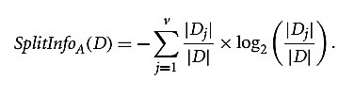

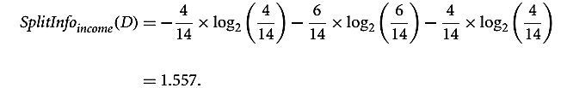
Attribute Selection Measure: Gain Ratio
A test on income splits the data into three partitions, namely low, medium, and high, containing four, six, and four tuples, respectively.
Gain(Income) = 0.029
Gain Ratio (Income) = 0.029 / 1.557 = 0.019

Slide 18

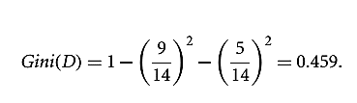
Attribute Selection Measure: Gini Index
The Gini index is used in CART. Using the notation previously described, the Gini index measures the impurity of D, a data partition or set of training tuples, as:

Slide 19
Random Forest
Random Forest is a popular machine learning algorithm that belongs to the supervised learning technique
It is based on the concept of ensemble learning, which is a process of combining multiple classifiers to solve a complex problem and to improve the performance of the model.

Slide 20
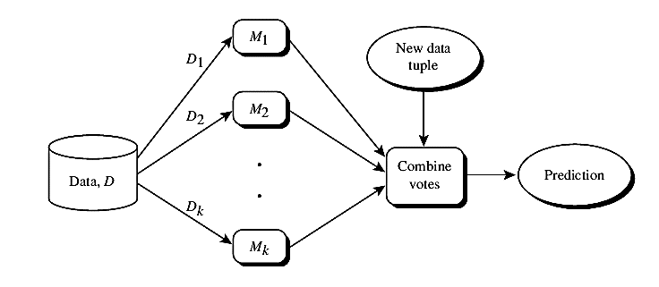
Ensemble Learning

Slide 21
Random Forest
"Random Forest is a classifier that contains a number of decision trees on various subsets of the given dataset and takes the average to improve the predictive accuracy of that dataset."

Slide 22
Random Forest
"Random Forest is a classifier that contains a number of decision trees on various subsets of the given dataset and takes the average to improve the predictive accuracy of that dataset."
Instead of relying on one decision tree, the random forest takes the prediction from each tree and based on the majority votes of predictions, and it predicts the final output.

Slide 23
Random Forest
The greater number of trees in the forest leads to higher accuracy and prevents the problem of overfitting.

Slide 24
Working of Random Forest
Step-1: Select random K data points from the training set.
Step-2: Build the decision trees associated with the selected data points (Subsets).
Step-3: Choose the number N for decision trees that you want to build.

Slide 25
Working of Random Forest
Step-4: Repeat Step 1 & 2.
Step-5: For new data points, find the predictions of each decision tree, and assign the new data points to the category that wins the majority votes.

Slide 26
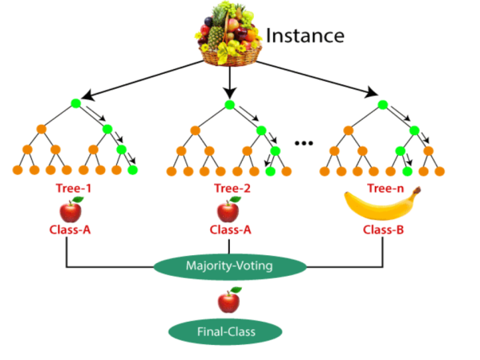
Example

Slide 27
Advantages of Random Forest
It is capable of handling large datasets with high dimensionality.
It enhances the accuracy of the model and prevents the overfitting issue.
Random Forest is capable of performing both Classification and Regression tasks.

Slide 28
Disadvantages of Random Forest
Complexity is the main disadvantage
of Random forest algorithms.
Construction of Random forests are much harder and time-consuming than decision trees.
More computational resources are required to implement Random Forest algorithm.

