Slide 2
After this lecture, you will be able to
understand the concept multi-category classifier.
learn the working of cross validation.
know the concept of overfitting.

Slide 3
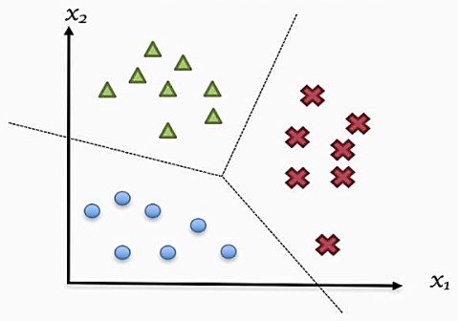
Multi-category Classification

Slide 4
Multi-category Classification
Multiclass or multinomial classification is the problem of classifying instances into one of three or more classes

Slide 5
One-versus-all
One-versus-all method is usually implemented using a “Winner-Takes-All” (WTA) strategy.

Slide 6
One-versus-all
One-versus-all method is usually implemented using a “Winner-Takes-All” (WTA) strategy.
It constructs M binary classifier models where M is the number of classes.

Slide 7
One-versus-all
One-versus-all method is usually implemented using a “Winner-Takes-All” (WTA) strategy.
It constructs M binary classifier models where M is the number of classes.
The i^{th} binary classifier is trained with all the examples from i^{th} class Wi with positive labels (typically +1), and the examples from all other classes with negative labels (typically -1).

Slide 8
One-versus-one
One-versus-one method is usually implemented using a “Max-Wins” voting (MWV) strategy.

Slide 9
One-versus-one
One-versus-one method is usually implemented using a “Max-Wins” voting (MWV) strategy.
This method constructs one binary classifier for every pair of distinct classes and so, all together it constructs M(M - 1)/2 binary classifiers.

Slide 10
One-versus-one
One-versus-one method is usually implemented using a “Max-Wins” voting (MWV) strategy.
This method constructs one binary classifier for every pair of distinct classes and so, all together it constructs M(M - 1)/2 binary classifiers.
The binary classifier Cij is trained with examples from ith class Wi and jth class Wj only, where examples from class Wi take positive labels while examples from class Wj take negative labels.

Slide 11
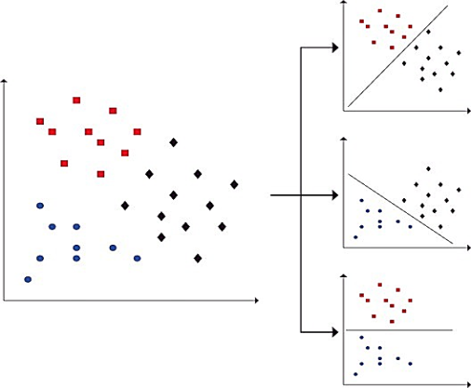
One-versus-one

Slide 12
All-together
Some researchers also proposed “all-together” approaches that solve the multi-category classification problem in one step by considering all the examples from all classes together at once. However, the training speed of “all-together” methods is usually slow.

Slide 13
Cross Validation
Cross-validation is a technique in which we train our model using the subset of the data-set and then evaluate using the complementary subset of the data-set.

Slide 14
Cross Validation
The three steps involved in cross-validation are as follows :

Slide 15
Cross Validation
The three steps involved in cross-validation are as follows :
Reserve some portion of sample data-set.

Slide 16
Cross Validation
The three steps involved in cross-validation are as follows :
Reserve some portion of sample data-set.
Using the rest data-set train the model.

Slide 17
Cross Validation
The three steps involved in cross-validation are as follows :
Reserve some portion of sample data-set.
Using the rest data-set train the model.
Test the model using the reserve portion of the data-set.

Slide 18
Methods of Cross Validation
Validation
In this method, we perform training on the 50% of the given data-set and rest 50% is used for the testing purpose.

Slide 19
Methods of Cross Validation
Validation
In this method, we perform training on the 50% of the given data-set and rest 50% is used for the testing purpose.
The major drawback of this method is that we perform training on the 50% of the dataset, it may possible that the remaining 50% of the data contains some important information which we are leaving while training our model

Slide 20
LOOCV (Leave One Out Cross Validation)
In this method, we perform training on the whole data-set but leaves only one data-point of the available data-set and then iterates for each data-point.

Slide 21
Advantages and Disadvantages
An advantage of using this method is that we make use of all data points and hence it is low bias.

Slide 22
Advantages and Disadvantages
An advantage of using this method is that we make use of all data points and hence it is low bias.
The major drawback of this method is that it leads to higher variation in the testing model as we are testing against one data point.

Slide 23
Advantages and Disadvantages
An advantage of using this method is that we make use of all data points and hence it is low bias.
The major drawback of this method is that it leads to higher variation in the testing model as we are testing against one data point.
If the data point is an outlier it can lead to higher variation.

Slide 24
Advantages and Disadvantages
An advantage of using this method is that we make use of all data points and hence it is low bias.
The major drawback of this method is that it leads to higher variation in the testing model as we are testing against one data point.
If the data point is an outlier it can lead to higher variation.
Another drawback is it takes a lot of execution time as it iterates over ‘the number of data points’ times.

Slide 25
K-Fold Cross Validation
In this method, we split the data-set into k number of subsets(known as folds) then we perform training on the all the subsets but leave one(k-1) subset for the evaluation of the trained model.

Slide 26
K-Fold Cross Validation
In this method, we split the data-set into k number of subsets(known as folds) then we perform training on the all the subsets but leave one(k-1) subset for the evaluation of the trained model.
In this method, we iterate k times with a different subset reserved for testing purpose each time

Slide 27
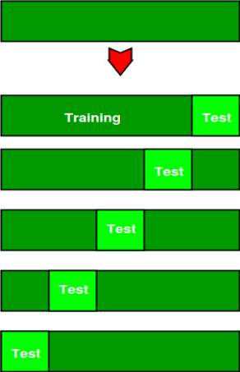
Example

Slide 28
Advantages of Train/Test Split
This runs K times faster than Leave One Out cross-validation because K-fold cross-validation repeats the train/test split K-times.

Slide 29
Advantages of Train/Test Split
This runs K times faster than Leave One Out cross-validation because K-fold cross-validation repeats the train/test split K-times.
Simpler to examine the detailed results of the testing process.

Slide 30
Advantages of Cross-validation
More accurate estimate of out-of-sample accuracy.

Slide 31
Advantages of Cross-validation
More accurate estimate of out-of-sample accuracy.
More “efficient” use of data as every observation is used for both training and testing.

Slide 32
Overfitting
Bias – Assumptions made by a model to make a function easier to learn.

Slide 33
Overfitting
Bias – Assumptions made by a model to make a function easier to learn.
Variance – If you train your data on training data and obtain a very low error, upon changing the data and then training the same previous model you experience high error, this is variance.

Slide 34
Overfitting
A statistical model is said to be overfitted, when we train it with a lot of data.

Slide 35
Overfitting
A statistical model is said to be overfitted, when we train it with a lot of data.
When a model gets trained with so much of data, it starts learning from the noise and inaccurate data entries in our data set.

Slide 36
Overfitting
A statistical model is said to be overfitted, when we train it with a lot of data.
When a model gets trained with so much of data, it starts learning from the noise and inaccurate data entries in our data set.
Then the model does not categorize the data correctly, because of too many details and noise.

Slide 37
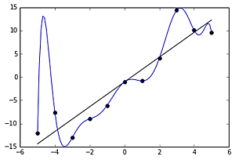
Overfitting

Slide 38
Techniques to Reduce Overfitting
Increase training data.

Slide 39
Techniques to Reduce Overfitting
Increase training data.
Reduce model complexity.

Slide 40
Techniques to Reduce Overfitting
Increase training data.
Reduce model complexity.
Early stopping during the training phase

Slide 41
Techniques to Reduce Overfitting
Increase training data.
Reduce model complexity.
Early stopping during the training phase
Remove features

Slide 42
Techniques to Reduce Overfitting
Increase training data.
Reduce model complexity.
Early stopping during the training phase
Remove features
Ensembling

Slide 43
Techniques to Reduce Overfitting
Increase training data.
Reduce model complexity.
Early stopping during the training phase
Remove features
Ensembling
Regularization

