Slide 2
After this lecture, you will be able to
understand the concept and different types of web mining.
learn the various applications of web mining.

Slide 3
Web Mining
Web Mining is the process of Data Mining techniques to automatically discover and extract information from Web documents and services.

Slide 4
Web Mining
Web Mining is the process of Data Mining techniques to automatically discover and extract information from Web documents and services.
The main purpose of web mining is discovering useful information from the World-Wide Web and its usage patterns.

Slide 5
Types of Web Mining
Web Mining
Content Mining
Structure Mining
Usage Mining
Web page content Mining
General Access Pattern Tracking
Search result mining
Customized usage Tracking

Slide 6
Web Content Mining
Web Content Mining can be used for the mining of useful data, information, and knowledge from web page content.

Slide 7
Web Content Mining
Web Content Mining can be used for the mining of useful data, information, and knowledge from web page content.
Web content mining performs scanning and mining of the text, images, and group of web pages according to the content of the input, by displaying the list in search engines.

Slide 8
Web Content Mining
There are two approaches that are used for Web Content Mining :
Agent-based approach
Data-based approach

Slide 9
Web Structure Mining
Web structure mining, one of three categories of web mining for data, is a tool used to identify the relationship between Web pages linked by information or direct link connection.

Slide 10
Web Structure Mining
Web structure mining, one of three categories of web mining for data, is a tool used to identify the relationship between Web pages linked by information or direct link connection.
It offers information about how different pages are linked together to form this huge web.

Slide 11
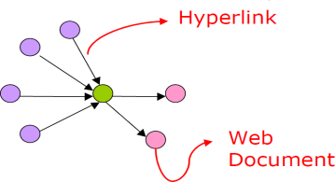
Web Structure Mining
The structure of a typical Web graph consists of Web pages as nodes, and hyperlinks as edges connecting between two related pages

Slide 12
Web Structure Mining
Web Structure Mining can be is the process of discovering structure information from the Web.

Slide 13
Web Structure Mining
Web Structure Mining can be is the process of discovering structure information from the Web.
This type of mining can be performed either at the (intra-page) document level or at the (inter-page) hyperlink level.

Slide 14
Web Structure Mining
Web Structure Mining can be is the process of discovering structure information from the Web.
This type of mining can be performed either at the (intra-page) document level or at the (inter-page) hyperlink level.
The research at the hyperlink level is also called Hyperlink Analysis.

Slide 15
Web Structure Terminology
Web-Graph

Slide 16
Web Structure Terminology
Web-Graph
Node

Slide 17
Web Structure Terminology
Web-Graph
Node
Link

Slide 18
Web Structure Terminology
Web-Graph
Node
Link
In-degree

Slide 19
Web Structure Terminology
Web-Graph
Node
Link
In-degree
Out-degree

Slide 20
Web Structure Terminology
Web-Graph
Node
Link
In-degree
Out-degree
Directed Path

Slide 21
Web Structure Terminology
Web-Graph
Node
Link
In-degree
Out-degree
Directed Path
Shortest Path

Slide 22
Web Structure Terminology
Web-Graph
Node
Link
In-degree
Out-degree
Directed Path
Shortest Path
Diameter

Slide 23
Web Usage Mining
The process of extracting useful usage patterns from the Web data.

Slide 24
Web Usage Mining
The process of extracting useful usage patterns from the Web data.
Process of extracting useful knowledge from web server logs, database logs, user queries, client-side cookies and user profiles in order to analyze web users’ behavior.

Slide 25
Web Usage Mining
The process of extracting useful usage patterns from the Web data.
Process of extracting useful knowledge from web server logs, database logs, user queries, client-side cookies and user profiles in order to analyze web users’ behavior.
Applies data mining techniques in log data to extract the behavior of users which is used in various applications.

Slide 26
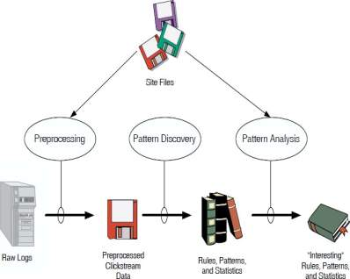
Phases of Web Usage Mining
Our Focus
Data Preprocessing:
Pattern Discovery
Pattern Analysis

Slide 27
Applications of Web Mining
Web mining helps to improve the power of web search engine by classifying the web documents and identifying the web pages.
It is used for Web Searching e.g., Google, Yahoo etc and Vertical Searching .
Web mining is used to predict user behavior.
Personalized Customer Experience in B2C E-commerce.

