Slide 2
After this lecture, you will be able to
understand the concept un-supervised learning.
learn the various clustering algorithms.
know the difference in clustering and classification.

Slide 3
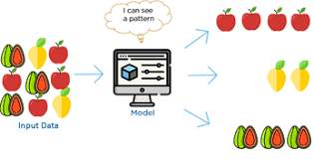
Unsupervised Learning
Unsupervised Learning, as clearly defined through its name, uses no classification or labelled information as input to the algorithm.

Slide 4
Unsupervised Learning
In unsupervised learning “The outcome or output for the given inputs is unknown”

Slide 5
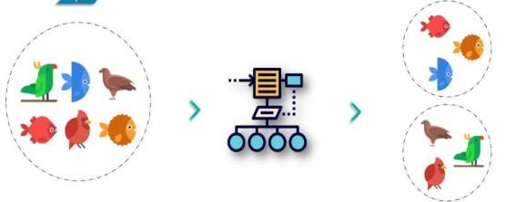
Example
Input
Raw Data
Unsupervised Learning Algorithm
Clusters

Slide 6
Key Points
It is used for Clustering problems(grouping), Anomaly Detection (in banks for unusual transactions) where there is a need for finding relationships among the data given.
Unlabeled data is used in unsupervised learning.
Popular Algorithms: k-means clustering, Association rule.
It is mainly used in Descriptive Modelling.

Slide 7
Key Points
It is used for Clustering problems(grouping), Anomaly Detection (in banks for unusual transactions) where there is a need for finding relationships among the data given.
Unlabeled data is used in unsupervised learning.
Popular Algorithms: k-means clustering, Association rule.
It is mainly used in Descriptive Modelling.

Slide 8
Key Points
It is used for Clustering problems(grouping), Anomaly Detection (in banks for unusual transactions) where there is a need for finding relationships among the data given.
Unlabeled data is used in unsupervised learning.
Popular Algorithms: k-means clustering, Association rule.
It is mainly used in Descriptive Modelling.

Slide 9
Key Points
It is used for Clustering problems(grouping), Anomaly Detection (in banks for unusual transactions) where there is a need for finding relationships among the data given.
Unlabeled data is used in unsupervised learning.
Popular Algorithms: k-means clustering, Association rule.
It is mainly used in Descriptive Modelling.

Slide 10
Clustering
Clustering is grouping of similar objects, keeping in mind that: -
objects of one cluster are similar to one another.
objects of two different clusters differ from each other.

Slide 11
Clustering Methods
Hierarchical
Partitional
Clustering Methods
Density-Based
Grid Based

Slide 12
Clustering methods
Hierarchical Based Methods
The clusters formed in this method forms a tree-type structure based on the hierarchy. New clusters are formed using the previously formed one. It is divided into two categories:
Agglomerative (bottom-up approach)
Divisive (top-down approach)

Slide 13
Clustering methods
Density-Based Methods
These methods consider the clusters as the dense region having some similarity and different from the lower dense region of the space.
These methods have good accuracy and ability to merge two clusters.
Example DBSCAN , OPTICS

Slide 14
Clustering methods
Partitioning Methods
These methods partition the objects into k clusters and each partition forms one cluster.
This method is used to optimize an objective criterion similarity function such as when the distance is a major parameter example K-means, CLARANS

Slide 15
Clustering methods
Grid-based Methods
In this method the data space is formulated into a finite number of cells that form a grid-like structure.
All the clustering operation done on these grids are fast and independent of the number of data objects example STING, wave cluster, CLIQUE etc.

Slide 16
Marketing
Applications of Clustering
Biology
Libraries
Insurance
City Planning
Earthquake studies

Slide 17
Marketing
Applications of Clustering
Biology
Libraries
Insurance
City Planning
Earthquake studies

Slide 18
Marketing
Applications of Clustering
Biology
Libraries
Insurance
City Planning
Earthquake studies

Slide 19
Marketing
Applications of Clustering
Biology
Libraries
Insurance
City Planning
Earthquake studies

Slide 20
Marketing
Applications of Clustering
Biology
Libraries
Insurance
City Planning
Earthquake studies

Slide 21
Marketing
Applications of Clustering
Biology
Libraries
Insurance
City Planning
Earthquake studies

Slide 22
Difference between classification and clustering
Parameter | Classification | Clustering
Type | used for supervised learning | used for unsupervised learning
Basic | process of classifying the input instances based on their corresponding class labels | grouping the instances based on their similarity without the help of class labels
Need | it has labels so there is need of training and testing dataset for verifying the model created | there is no need of training and testing dataset

Slide 23
Difference between classification and clustering
Parameter | Classification | Clustering
Complexity | more complex as compared to clustering | less complex as compared to classification
Example Algorithms | Logistic regression, Naive Bayes classifier, Support vector machines etc. | k-means clustering algorithm, Fuzzy c-means clustering algorithm, Gaussian (EM) clustering algorithm etc.

