Slide 1
ECAP446 UNIT-01: Data Warehousing and Online Analytical Processing
U01-T01

Slide 2
After this lecture, you will be able to
introduce Data Warehouse
analyse the features and need of Data Warehouse.
understand different Data Warehouse Models.
differentiate between OLAP and OLTP

Slide 3


Goal: Unified Access to Data
Collects and combines information
Provides integrated view, uniform user interface
Supports sharing
Integration System
World
Wide
Web
Digital Libraries
Scientific Databases
Personal
Databases

Slide 4
What is Data Warehouse?
“A data warehouse is a subject - oriented, integrated, time variant and non-volatile collection of data in support of management decision making process.”
These four keywords - subject-oriented, integrated, time-variant, and nonvolatile distinguish data warehouses from other data repository systems, such as relational database systems, transaction processing systems, and file systems.

Slide 5
Data Warehouse Properties
Subject
Oriented
Integrated
Data
Warehouse
Non-Volatile
Time Variant

Slide 6
Data Warehouse Properties
Subject-Oriented
Stored data according to target specific subjects.
Example: It may store data regarding total Sales, Number of Customers, etc. and not general data on everyday operations.

Slide 7
Data Warehouse Properties
Integrated
Data may be distributed across heterogeneous sources which have to be integrated.
Example: Sales data may be on RDB, Customer information on Flat files, etc.

Slide 8
Data Warehouse Properties
Time Variant
Data are stored to provide information from an historic perspective.
Example: Data of sales in last 5 years, etc.

Slide 9
Data Warehouse Properties
Non-Volatile
It is separate from the Enterprise Operational Database and hence is not subject to frequent modification.
It generally has only 2 operations performed on it
Loading of data
Access of data.

Slide 10
The Warehousing Approach
Information integrated in advance
Stored for direct querying and analysis

Slide 11
The Warehousing Approach
Clients
Data
Warehouse
Integration System
Metadata
Extractor/
Monitor
Extractor/
Monitor
Extractor/
Monitor
Source
Source
Source

Slide 12
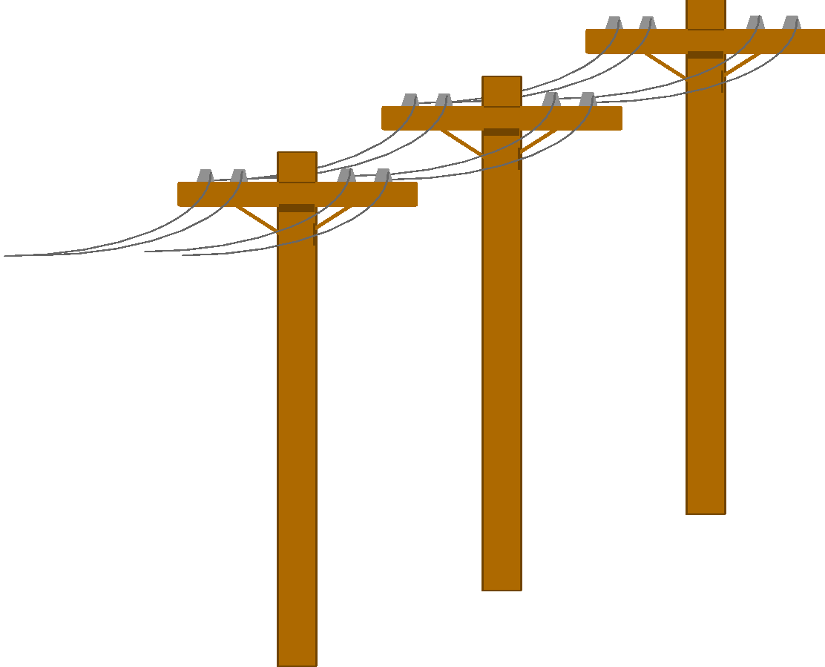


Heterogeneous Information Sources
“Heterogeneities are everywhere”
Personal
Databases
World
Wide
Web
Scientific Databases
Digital Libraries

Slide 13
Heterogeneous Information Sources
Different interfaces.
Different data representations.
Duplicate and inconsistent information.

Slide 14
Features of a Warehouse
It is separate from Operational Database.
Integrates data from heterogeneous systems.
Stores HUGE amount of data, more historical than current data.
Does not require data to be highly accurate.
Queries are generally complex.
Goal is to execute statistical queries and provide results which can influence decision making in favor of the Enterprise.
These systems are thus called Online Analytical Processing Systems (OLAP).

Slide 15
Need of a Separate Data Warehouse
Use of OLAP query on OLTP system degrades system’s performance.
OLAP systems access historical data and not current volatile data while OLTP systems access current up-to-date data and do not need historical data.
An Operational Database is designed for known tasks like indexing and hashing using primary keys, searching for particular records, and many more.

Slide 16
Need of a Separate Data Warehouse
Data Warehouse queries are often complex.
The computation of large data groups at summarized levels, and may require the use of special data organization, access, and implementation methods based on multidimensional views.

Slide 17
Data Warehousing: Two Distinct Issues
How to get information into warehouse?
-“Data warehousing”
What to do with data once it’s in warehouse?
-“Warehouse DBMS”

Slide 18
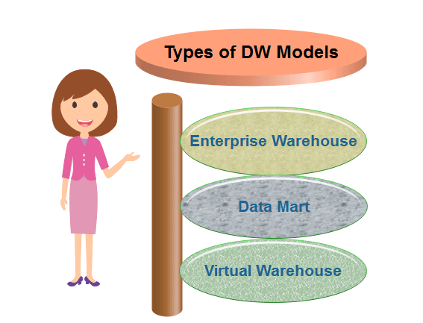
Data Warehouse Models

Slide 19
Difference between OLAP & OLTP
OLAP | OLTP
Consists of historical data from various Databases. | Consists only operational current data.
It is subject oriented. | It is application oriented.
Used for Data Mining, Analytics, etc. | Used for business tasks.
The data is used in planning, problem solving and decision making. | The data is used to perform day to day fundamental operations.

Slide 20
Difference between OLAP & OLTP
OLAP | OLTP
It reveals a snapshot of present business tasks. | It provides a multi-dimensional view of different business tasks.
Relatively slow as more data involved. Queries may take hours. | Very Fast as the queries operate on 5% of the data.
It only need backup from time to time as compared to OLTP. | Backup and recovery process is maintained religiously.
This data is generally managed by CEO, MD, GM. | This data is managed by clerks, managers.

Slide 21
U01-T02

Slide 22
After this lecture, you will be able to
understand Multi-dimensional Data Model
understand types of conceptual models
use concept of hierarchy
understand types of measures
understand computation methods of measures

Slide 23
Multi-dimensional data model
The entity-relationship data model is commonly used in the design of relational databases, where a database schema consists of a set of entities and the relationships between them.
Such a data model is appropriate for on-line transaction processing.

Slide 24
Multi-dimensional data model
The data warehouse requires concise, subject oriented schema that facilitates OLAP.
Data warehouses and OLAP tools are based on a multidimensional data model. This model views data in the form of a data cube.

Slide 25
Multi-dimensional data model
A data warehouse is based on a multidimensional data model which views data in the form of a data cube
A data cube, such as sales, allows data to be modeled and viewed in multiple dimensions
Dimension tables, such as item (item_name, brand, type), or time(day, week, month, quarter, year)
Fact table contains measures (such as dollars_sold) and keys to each of the related dimension tables

Slide 26
Multi-dimensional data model
In data warehousing literature, an n-D base cube is called a base cuboid. The topmost 0-D cuboid, which holds the highest-level of summarization, is called the apex cuboid.
The most popular data model for a data warehouse is a multidimensional model, which can exist in the form of a star schema, a snowflake schema, or a fact constellation schema.

Slide 27
Conceptual Modeling of Data Warehouses
Modeling data warehouses: dimensions & measures
Star schema: A fact table in the middle connected to a set of dimension tables
Snowflake schema: A refinement of star schema where some dimensional hierarchy is normalized into a set of smaller dimension tables, forming a shape similar to snowflake
Fact constellations: Multiple fact tables share dimension tables, viewed as a collection of stars, therefore called galaxy schema or fact constellation

Slide 28
Conceptual Modeling of Data Warehouses
Data warehouse contains:
A large central table (fact table) containing the bulk of the data, with no redundancy, and
A set of smaller attendant tables (dimension tables), one for each dimension.

Slide 29
Example of Fact Constellation
TIME
time_key
time_key
day
day_of_the_week
month
quarter
year
ITEM
item_key
Sales Fact Table
item_key
item_name
brand
type
supplier_type
shipper_key
time_key
From_location
item_key
To_location
branch_key
dollars_cost
BRANCH
LOCATION
location_key
units_shipped
branch_key
branch_name
branch_type
location_key
street
city
province_or_street
country
units_sold
dollars_sold
SHIPPER
avg_sales
shipper_key
shipper_name
location_key
shipper_type
Measures

Slide 30
Defining a Star Schema in DMQL
define cube sales_star [time, item, branch, location]:
dollars_sold = sum (sales_in_dollars),
avg_sales = avg (sales_in_dollars), units_sold = count(*)
define dimension time as (time_key, day, day_of_week, month, quarter, year)
define dimension item as (item_key, item_name, brand, type, supplier_type)

Slide 31
Defining a Star Schema in DMQL
define dimension branch as (branch_key, branch_name, branch_type)
define dimension location as (location_key, street, city, province_or_state, country)

Slide 32
Defining a Snowflake Schema in DMQL
define cube sales_snowflake [time, item, branch, location]:
dollars_sold = sum(sales_in_dollars),
avg_sales = avg(sales_in_dollars), units_sold = count(*)
define dimension time as (time_key, day, day_of_week, month, quarter, year)
define dimension item as (item_key, item_name, brand, type, supplier(supplier_key, supplier_type))

Slide 33
Defining a Snowflake Schema in DMQL
define dimension branch as (branch_key, branch_name, branch_type)
define dimension location as (location_key, street, city(city_key, province_or_state, country))

Slide 34
Concept hierarchy
A concept hierarchy defines a sequence of mappings from a set of low-level concepts to higher-level, more general concepts.

Slide 35
A Concept Hierarchy: Dimension (location)
All
All
Europe
...
North America
Region
Country
Germany
...
Spain
Canada
...
Mexico
City
Frankfurt
...
Vancouver
...
Toronto
Office
...
L. Chan
M. Wind

Slide 36
Multidimensional Data
Sales volume as a function of product, month, and region
Dimensions: Product, Location, Time
Hierarchical summarization paths
Region
Industry Region Year
Category Country Quarter
Product City Month Week
Office Day
Product
Month

Slide 37
Measures: Their Categorization and Computation
“How are measures computed?” To answer this question, we first study how measures can be categorized.
A data cube measure is a numeric function that can be evaluated at each point in the data cube space.

Slide 38
Measures: Their Categorization and Computation
Measures can be organized into three categories
Distributive
Algebraic
Holistic

Slide 39
1. Distributive
The data are partitioned into n sets. We apply the function to each partition, resulting in n aggregate values.
count(), min(), and max() are distributive aggregate functions.

Slide 40
2. Algebraic
An aggregate function is algebraic if it can be computed by an algebraic function with M arguments where M is a constant.
For example, avg() can be computed by sum()/count(), min N() and max N(), and
standard deviation() are algebraic aggregate functions.

Slide 41
3. Holistic
An aggregate function is holistic if there is no constant bound on the storage size needed to describe a sub-aggregate.
Examples of holistic functions include:
Median ()
Mode ()
Rank ()

Slide 42
U01-T03

Slide 43
After this lecture, you will be able to
introduce Data Cube
understand various terminologies used in Data Cube.
learn how Data Cube Model n-dimensional data.
visualize various OLAP Operations

Slide 44
What is Data Cube?
A data cube allows data to be modeled and viewed in multiple dimensions. It is defined by dimensions and facts.
Dimensions are the entities with respect to which an organization wants to keep records.
Facts are numerical measures. It is the quantities by which we want to analyze relationships between dimensions.

Slide 45
What is Data Cube?
The data cube is used by the users of the decision support system to see their data.
The cuboid that holds the lowest level of summarization is called the base cuboid.
The 0-D cuboid, which holds the highest level of summarization, is called the apex cuboid.

Slide 46
Cube: A Lattice of Cuboids
all
0-D (apex) cuboid
time
item
location
supplier
1-D cuboids
time,location
item,location
location,supplier
2-D cuboids
time,supplier
item,supplier
time,location,supplier
3-D cuboids
time,item,supplier
item,location,supplier
4-D(base) cuboid

Slide 47
A Sample Data Cube
47
Total annual sales
of TV in U.S.A.
Date
1Qtr
2Qtr
3Qtr
4Qtr
sum
Product
TV
PC
U.S.A
VCR
sum
Canada
Country
Mexico
sum
All, All, All

Slide 48
Cuboids Corresponding to the Cube
all
0-D(apex) cuboid
product
date
country
1-D cuboids
product, date
product, country
date, country
2-D cuboids
3-D(base) cuboid
product, date, country

Slide 49
Operations in the Multidimensional Data Model (OLEP)
In the multidimensional model, data are organized into multiple dimensions, and each dimension contains multiple levels of abstraction defined by concept hierarchies.
Organization provides users with the flexibility to view data from different perspectives.

Slide 50
Operations in the Multidimensional Data Model (OLEP)
A number of OLAP data cube operations exist to materialize these different views, allowing interactive querying and analysis of the data at hand.

Slide 51
Typical OLAP Operations
Roll up (drill-up): summarize data
by climbing up hierarchy or by dimension reduction
Drill down (roll down): reverse of roll-up
from higher level summary to lower level summary or detailed data, or introducing new dimensions

Slide 52
Typical OLAP Operations
Slice and dice: project and select
The Slice operation performs a selection on one dimension of the given cube, resulting in a subcube. The dice operation defines a subcube by performing a selection on two or more dimensions.
Pivot (rotate):
Reorient the cube, visualization, 3D to series of 2D planes.

Slide 53
Drill-Up Or Roll-Up
The roll-up operation performs aggregation on a data cube either by climbing up the hierarchy or by dimension reduction.
Location | Medal
Delhi | 5
New York | 2
Patiala | 3
Los Angles | 5
Location | Medal
India | 8
America | 7

Slide 54
Roll-Down Or Drill Down
Stepping down a concept hierarchy for a dimension.
By introducing a new dimension.
Location | Medal
Delhi | 5
New York | 2
Patiala | 3
Los Angles | 5
Location | Medal
India | 8
America | 7

Slide 55
Slice
The slice operation performs a selection on one dimension of the given cube, resulting in a subcube. Reduces the dimensionality of the cubes.
For example, if we want to make a select where Medal = 5.
Location | Medal
Delhi | 5
Los Angles | 5

Slide 56
Dice
The dice operation defines a sub-cube by performing a selection on two or more dimensions.
For example, if we want to make a select where Medal = 3 or Location = New York.
Location | Medal
Patiala | 3
New York | 2

Slide 57
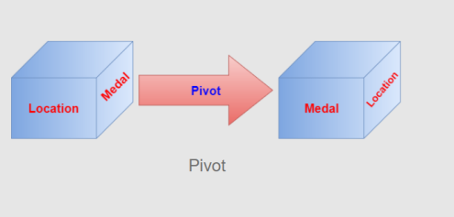
Pivot
Pivot is also known as rotate. It Rotates the data axis to view the data from different perspectives.

Slide 58
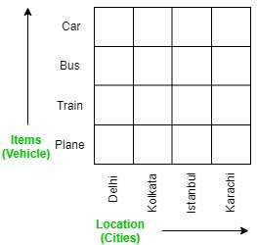
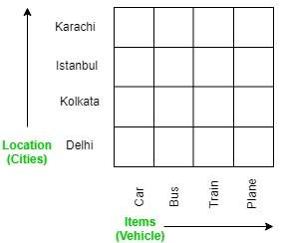
Before and After Pivoting

Slide 59
U01-T04

Slide 60
After this lecture, you will be able to
define business analysis framework for data warehouse design.
analyse the design process
understand various methods for the efficient implementation of data warehouse systems.
apply indexing on OLAP data.

Slide 61
Data Warehouse Design
The Design of a Data Warehouse: A Business Analysis Framework
“What can business analysts gain from having a data warehouse?”

Slide 62
Data Warehouse Design
Competitive advantage (by presenting relevant information to help win over competitors).
Data warehouse can enhance business productivity (because it is able to quickly and efficiently gather information that accurately describes the organization).

Slide 63
Data Warehouse Design
Data warehouse facilitates customer relationship management (because it provides a consistent view of customers and items across all lines of business, all departments, and all markets).
Cost reduction by tracking trends, patterns, and exceptions over long periods in a consistent and reliable manner.

Slide 64
Data Warehouse Design
To design an effective data warehouse we need to understand and analyze business needs and construct a business analysis framework.

Slide 65
Views in data warehouse design
Four different views regarding the design of a data warehouse must be considered:
The top-down view allows the selection of the relevant information necessary for the data warehouse. This information matches the current and future business needs.

Slide 66
Views in data warehouse design
The data source view exposes the information being captured, stored, and managed by operational systems.
The data warehouse view includes fact tables and dimension tables. It represents the information that is stored inside the data warehouse.

Slide 67
Views in data warehouse design
The business query view is the perspective of data in the data warehouse from the viewpoint of the end user.

Slide 68
Process of Data Warehouse Design
Data warehouse can be built using a
top-down approach,
bottom-up approach, or
combination of both.

Slide 69
Process of Data Warehouse Design
Top-down approach starts with the overall design and planning. It is used where technology is mature and well known & business problems that must be solved are clear and well understood.
Bottom-up approach starts with experiments and prototypes. Useful in the early stage of business modeling and technology development.

Slide 70
Process of Data Warehouse Design
Combined approach, an organization can exploit the planned and strategic nature of the top-down approach while retaining the rapid implementation and opportunistic application of the bottom-up approach.

Slide 71
Warehouse design process
Steps:
Choose a business process to model (e.g., orders, invoices, shipments, inventory, account administration, sales, or the general ledger).
Choose the business process grain, which is the fundamental, atomic level of data to be represented in the fact table for this process (e.g., individual transactions, individual daily snapshots, and so on).

Slide 72
Warehouse design process
Choose the dimensions that will apply to each fact table record.
Choose the measures that will populate each fact table record. Typical measures are numeric additive quantities like dollars_sold and units_ sold.

Slide 73
Data Warehouse usage
Initially, the data warehouse is mainly used for generating reports and answering predefined queries.
Progressively, it is used to analyze summarized and detailed data.

Slide 74
Data Warehouse usage
Later, the data warehouse is used for performing multidimensional analysis and sophisticated slice-and-dice operations.
Finally, the data warehouse employed for knowledge discovery and strategic decision making using data mining tools.

Slide 75
Data Warehouse Applications
There are three kinds of data warehouse applications:
information processing
analytical processing
data mining.

Slide 76
Data Warehouse Applications
Information processing
supports querying, basic statistical analysis, and reporting using crosstabs, tables, charts and graphs

Slide 77
Data Warehouse Applications
Analytical processing
It generally operates on historic data in both summarized and detailed forms.
supports basic OLAP operations, slice-dice, drilling, pivoting.

Slide 78
Data Warehouse Applications
Data mining
knowledge discovery from hidden patterns
supports associations, constructing analytical models, performing classification and prediction, and presenting the mining results using visualization tools

Slide 79
Question
“How does data mining relate to information processing and online analytical processing? ”
Information processing, based on queries, can find useful information directly stored in databases or computable by aggregate functions.
It do not reflect hidden patterns or regularities buried in the database.
Therefore, information processing is not data mining.

Slide 80
Question
“Do OLAP systems perform data mining? Are OLAP systems actually data mining systems?”
OLAP is a data summarization/aggregation tool that helps simplify data analysis.
Data mining allows the automated discovery of implicit patterns and interesting knowledge hidden in large amounts of data.

Slide 81
Question
“Do OLAP systems perform data mining? Are OLAP systems actually data mining systems?”
OLAP is a data summarization/aggregation tool that helps simplify data analysis.
Data mining allows the automated discovery of implicit patterns and interesting knowledge hidden in large amounts of data.

Slide 82
Question
OLAP functions are essentially for user-directed data summarization and comparison.
Data mining covers a much broader spectrum than simple OLAP operations, because it performs not only data summarization and comparison but also association, classification, prediction, clustering, time-series analysis, and other data analysis tasks.

Slide 83
From Online Analytical Processing to Multidimensional Data Mining
Multidimensional data mining (also known as exploratory multidimensional data mining, online analytical mining, or OLAM) integrates OLAP with data mining to uncover knowledge in multidimensional databases.
Multidimensional data mining is particularly important for the following reasons:

Slide 84
From Online Analytical Processing to Multidimensional Data Mining
High quality of data in data warehouses
OLAP-based exploration of multidimensional data
Online selection of data mining functions.

Slide 85
Data Warehouse Implementation
Data warehouses contain huge volumes of data.
OLAP servers demand that decision support queries be answered in the order of seconds.
Therefore, it is crucial for data warehouse systems to support highly efficient cube computation techniques, access methods, and query processing techniques.

Slide 86
Efficient Data Cube Computation
One approach to cube computation extends SQL to include a compute cube operator.
The compute cube operator computes aggregates over all subsets of the dimensions specified in the operation.
This can require excessive storage space, especially for large numbers of dimensions.

Slide 87
Example
Suppose that you want to create a data cube for All Electronics sales that contains the following: city, item, year, and sales_in_ dollars.
Taking the three attributes, city, item, and year, as the dimensions for the data cube, and sales_in_dollars as the measure.

Slide 88
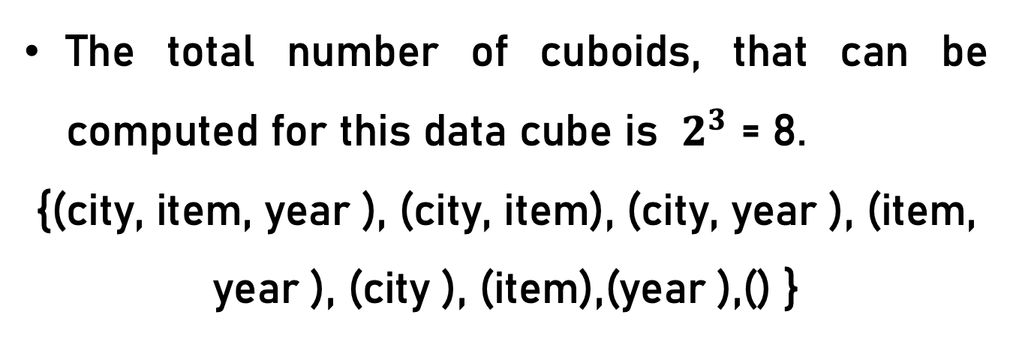
Example
The total number of cuboids, that can be computed for this data cube is $2^{3}$ = 8.
{(city, item, year ), (city, item), (city, year ), (item, year ), (city ), (item),(year ),() }

Slide 89
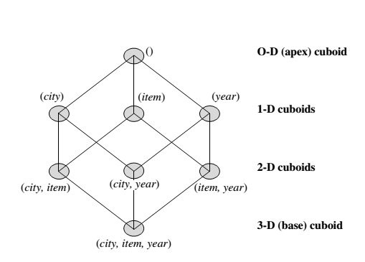
Example
If we start at the apex cuboid and explore downward in the lattice, this is equivalent to drilling down within the data cube. If we start at the base cuboid and explore upward, this is akin to rolling up.

Slide 90
Example
An SQL query containing no group-by (e.g., “compute the sum of total sales”) is a zero-dimensional operation.
An SQL query containing one group-by (e.g., “compute the sum of sales, group-by city”) is a one-dimensional operation.
A cube operator on n dimensions is equivalent to a collection of group-by statements, one for each subset of the n dimensions.

Slide 91
Example
A statement such as compute cube sales_cube would explicitly instruct the system to compute the sales aggregate cuboids for all eight subsets of the set {city, item, year}, including the empty subset.

Slide 92
Example
Transform it into a SQL-like language (with a new operator cube by, introduced by Gray et al.’96)
SELECT item, city, year, SUM (amount)
FROM SALES CUBE BY item, city, year

Slide 93
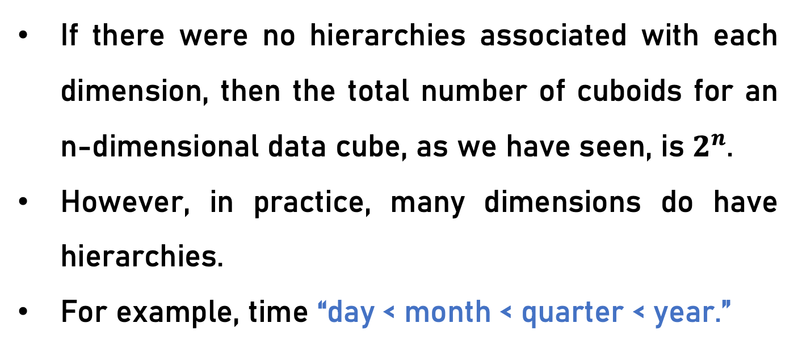
Question
“How many cuboids are there in an n-dimensional data cube ?”
If there were no hierarchies associated with each dimension, then the total number of cuboids for an n-dimensional data cube, as we have seen, is $2^{n}$.
However, in practice, many dimensions do have hierarchies.
For example, time “day < month < quarter < year.”

Slide 94

Question
For an n-dimensional data cube, the total number of cuboids that can be generated is

Slide 95
Partial Materialization: Selected Computation of Cuboids
There are three choices for data cube materialization given a base cuboid:
No materialization:
Full materialization
Partial materialization

Slide 96
Indexing OLAP Data: Bitmap Index and Join Index
To facilitate efficient data accessing, most data warehouse systems support index structures and materialized views (using cuboids).

Slide 97
Bitmap Index
The bitmap indexing method is popular in OLAP because it allows quick searching in data cubes.
If the attribute has the value v for a given row in the data table, then the bit representing that value is set to 1 in the corresponding row of the bitmap index. All other bits for that row are set to 0.

Slide 98
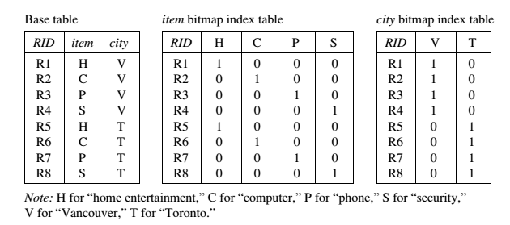
Bitmap Index

Slide 99
Bitmap Index Facts
Bitmap indexing is especially useful for low-cardinality domains.
Bitmap indexing leads to significant reductions in space and input/output (I/O) since a string of characters can be represented by a single bit.
For higher-cardinality domains, the method can be adapted using compression techniques.

Slide 100
Joining Index
Join indexing registers the joinable rows of two relations from a relational database.
Join index: JI(R-id, S-id) where R (R-id, …)  S (S-id, …)
Join indexing is especially useful for maintaining the relationship between a foreign key and its matching primary keys, from the joinable relation.

Slide 101
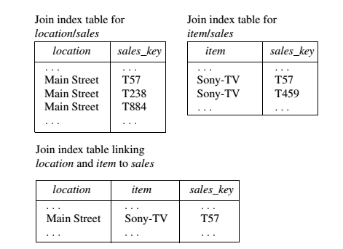
Example

Slide 102
Efficient Processing of OLAP Queries
The purpose of materializing cuboids and constructing OLAP index structures is to speed up query processing in data cubes. Given materialized views, query processing should proceed as follows:
Determine which operations should be performed on the available cuboids.
Determine to which materialized cuboid(s) the relevant operations should be applied.

Slide 103
Example
Suppose that we define a data cube for All Electronics of the form “sales cube [time, item, location]: sum(sales in dollars)”.
The dimension hierarchies used are:
“day < month < quarter < year” for time ;
“item name < brand < type” for item;
“street < city < province or state < country” for location.

Slide 104
Example
Suppose that the query to be processed is on {brand, province_or_ state}, with the selection constant “year = 2010.” Also, suppose that there are four materialized cuboids available, as follows:
cuboid 1: {year, item_name, city}
cuboid 2: {year, brand, country }
cuboid 3: {year, brand, province_or_state}
cuboid 4: {item_name, province_or_state }, where year = 2010
“Which of these four cuboids should be selected to process the query?”

Slide 105
Result
Finer-granularity data cannot be generated from coarser-granularity data.
Therefore, cuboid 2 cannot be used because country is a more general concept than province or state.
Cuboids 1, 3, and 4 can be used to process the query.

Slide 106
Question
“How would the costs of each cuboid compare if used to process the query?”

