Slide 1
Linux and Shell Scripting

Slide 2
Learning Outcomes
Understand what is RPM
See the RPM Package Management tool
Add and remove the packages
Query the RPM package
Install package in TAR format

Slide 3
What Is RPM?
The RPM package manager is an open source packaging system distributed under the GNU GPL.
It runs on most Linux distributions and makes it easy for you to install, uninstall, and upgrade the software on your machine.
RPM files can be easily recognized by their .rpm file extension and the 'package' icon that appears in your navigation window.

Slide 4
Benefits of using RPM
Simplicity
Upgradability
Manageability
Package Queries
Uninstalling
System Verification
Security

Slide 5
Ways to use RPM
RPM can be used in two different, yet complementary ways −
From the desktop, using the GUI interface,
From the command line.

Slide 6
The RPM package management (GUI) tool
This tool is a graphical user interface (GUI) designed for the management of package installation and removal.
The GUI allows us to add and remove packages at the click of a mouse.

Slide 7
The RPM package management (GUI) tool
Starting the RPM Package Management Tool
There are two ways to start RPM.
Main Menu, select Main Menu | System Settings | Add/Remove Applications.
$ redhat−config−packages

Slide 8
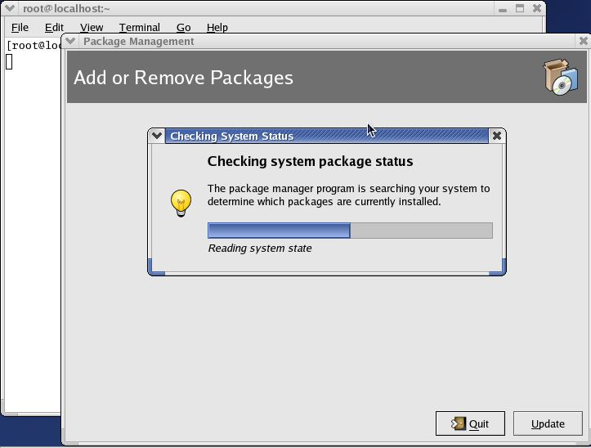
The RPM package management (GUI) tool

Slide 9
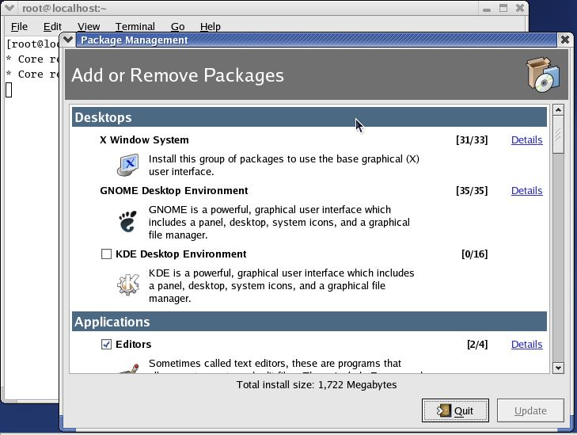
The RPM package management (GUI) tool

Slide 10
The RPM package management (GUI) tool
Package category
Package group
Details link
Number of packages installed/Out of total number of packages
Summary of disk space required to install the package
Update button
Quit button

Slide 11
Package categories and groups
Package Category | Package Groups
Desktop | X Window System GNOME Desktop Environment KDE Desktop Environment
Applications | Editors Engineering and Scientific Graphical Internet Text−based Internet Office/Productivity Sound and Video Authoring and Publishing Graphics Games and Entertainment

Slide 12
Package categories and groups
Servers | Server Configuration Tools Web Server Mail Server Windows File Server DNS Name Server FTP Server SQL Database Server News Server Network Servers
Development | Development Tools Kernel Development X Software Development GNOME Software Development KDE Software Development
System | Administration Tools System Tools Printing Support

Slide 13
Standard and extra packages
Each group may have standard packages and extra packages, or just extra packages.
Standard packages are always available when a package group is installed − so you can't add or remove them explicitly unless the entire group is removed.
However, the extra packages are optional so they can be individually selected for installation or removal at any time.

Slide 14
Adding and removing packages
Installing new software from the package management tool is very simple.
When we select any group using the RPM package management tool interface, it automatically selects the standard packages (if any) that are needed for the category as well as any dependent packages that it may have.

Slide 15
Adding and removing packages
We can customize the packages to be installed by clicking on the Details button. Once you've made your selections, click on the Update button on the main window.
The package management tool will then calculate the disk space required for installing packages, as well as any dependencies, before displaying the following dialog:

Slide 16
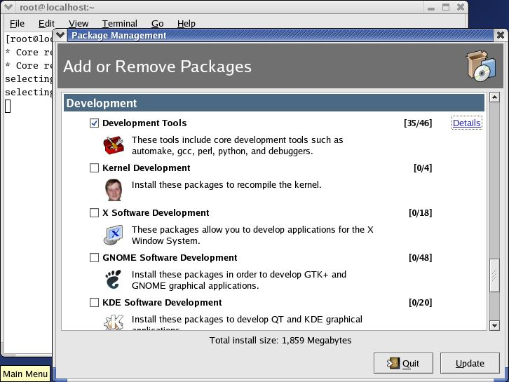
Adding and removing packages

Slide 17
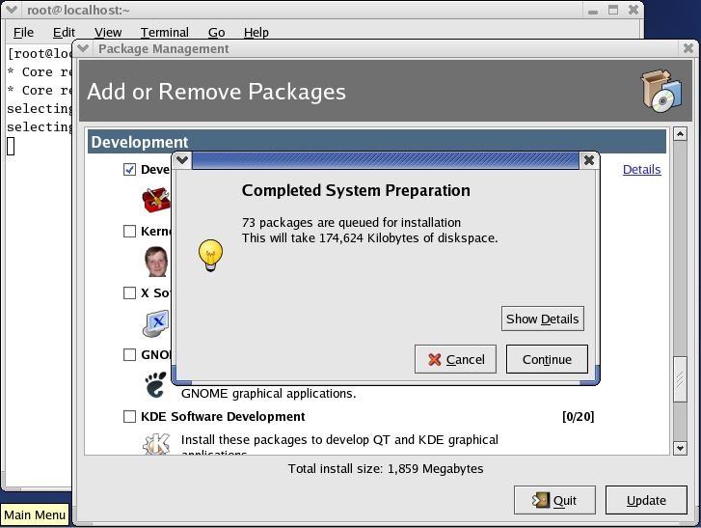
Adding and removing packages

Slide 18
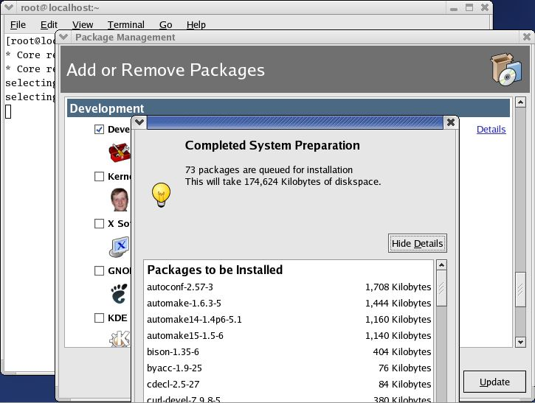
Adding and removing packages

Slide 19
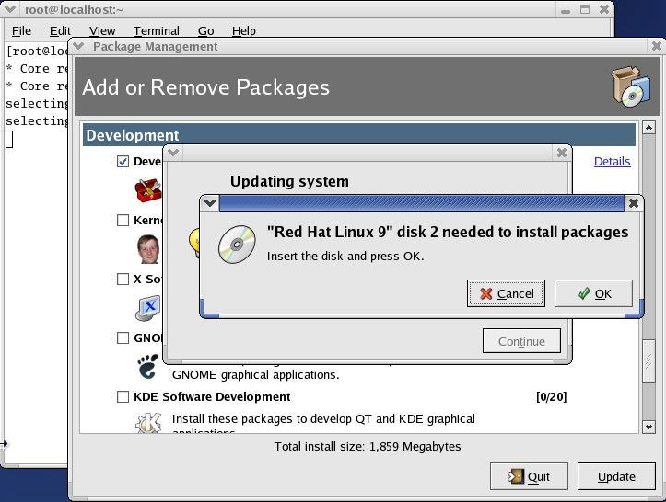
Adding and removing packages

Slide 20
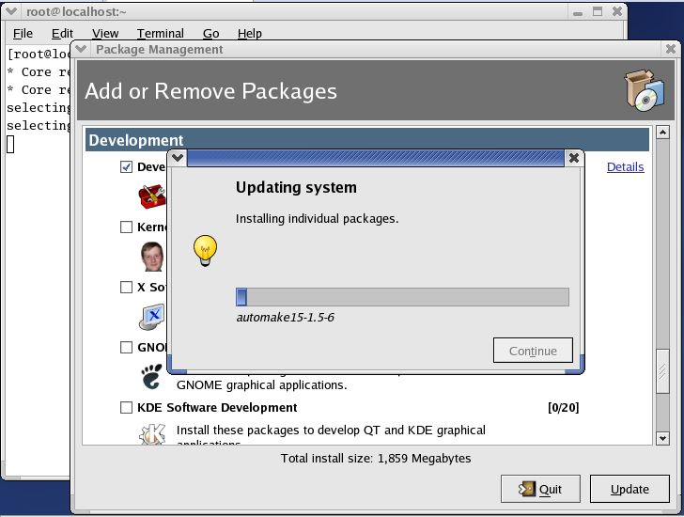
Adding and removing packages

Slide 21
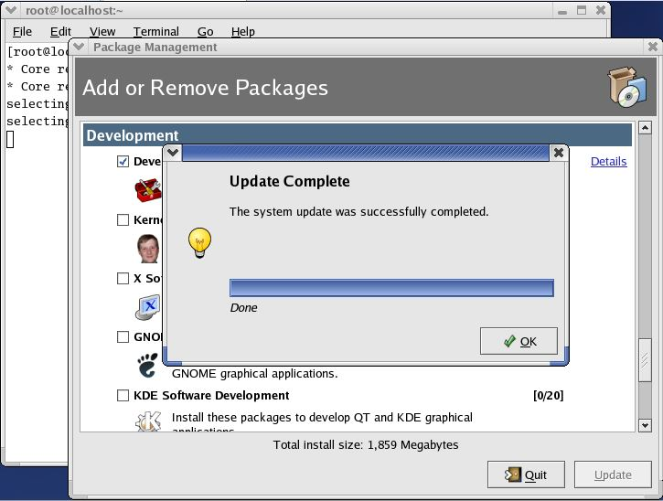
Adding and removing packages

Slide 22
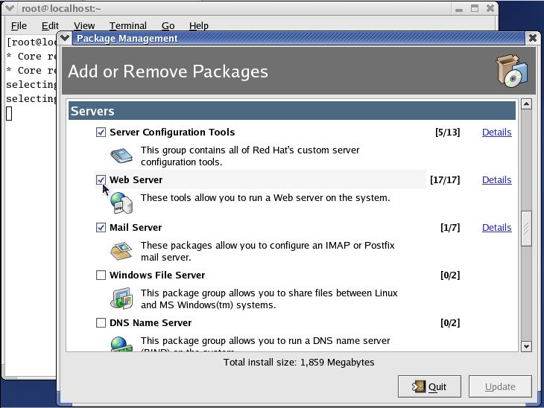
Adding and removing packages

Slide 23
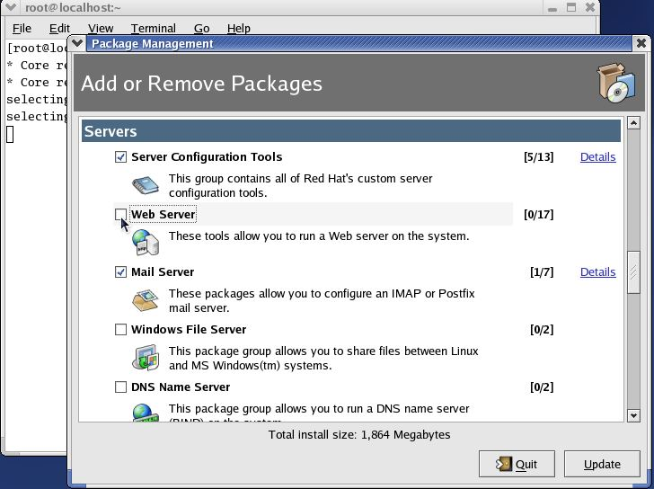
Adding and removing packages

Slide 24
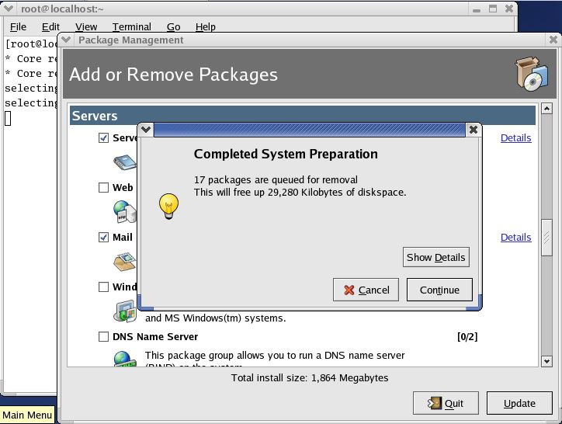
Adding and removing packages

Slide 25
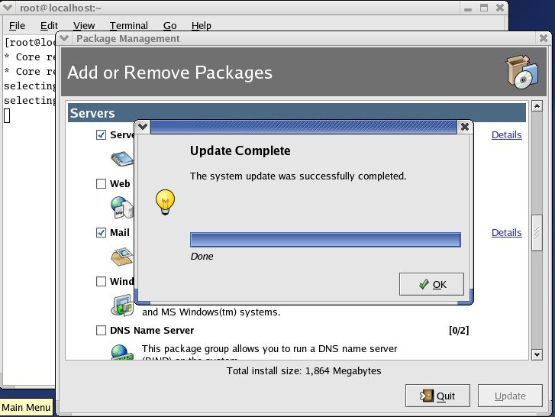
Adding and removing packages

Slide 26
The RPM Command Line Tool
Up to now, we've talked about how to install and remove packages using Red Hat's graphical package management tool. While this tool is simple to use, it's lacking in functionality. For example:
It cannot install packages using network, FTP, or HTTP connections.
It does not show the location the files in a package are installed to.

Slide 27
The RPM Command Line Tool
It lacks the capability to query for specific packages installed on the system.
It does not provide full details of the RPM package − such as the vendor, build date, signature, description, and so on.

Slide 28
The RPM Command Line Tool
It does not have a function to verify a package. That means it cannot compare information about files like size, MD5 sum, permissions, type, owner, and group installed from a package with the same information from the original package.
It does not show all the packages available in a product. So you won't always know if you've got the whole thing.

Slide 29
Querying Packages
RPM keeps a record of all the packages installed on your system in a database.
By querying the database you obtain a complete list of all the packages that you've installed on your system.
Should you want to, you can then go further and query each individual package for more details about itself.

Slide 30
Querying Packages
The syntax for a basic query is as follows:
rpm −q [options] <filename>

Slide 31
Querying Packages
you have list of files and you would like to find out which package belongs to these files.
Syntax: rpm –qf <filename>

Slide 32
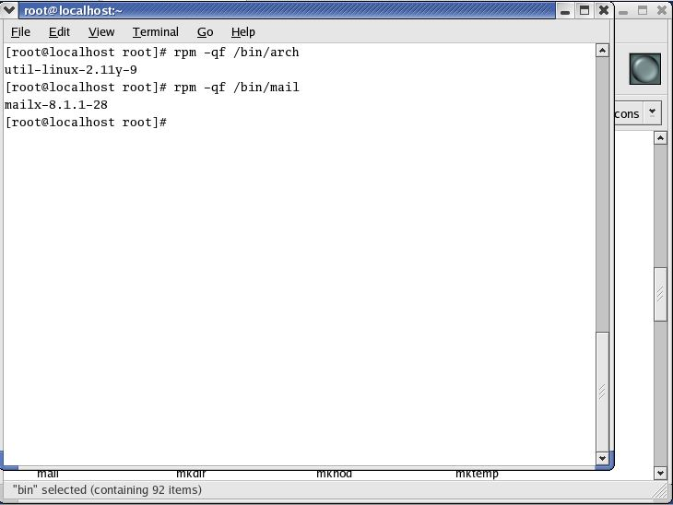
Querying Packages

Slide 33
Querying Packages
You have installed an rpm package and want to know the information about the package.
Syntax: rpm –qi <package _name>

Slide 34
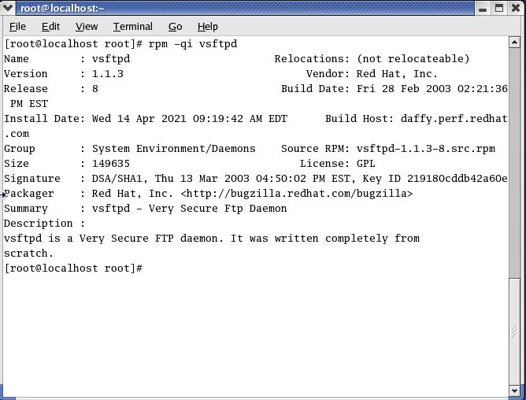
Querying Packages

Slide 35
Querying Packages
You have download a package from the internet and want to know the information of a package before installing.
Syntax: rpm –qip <package_name>

Slide 36
Querying Packages
To get the list of available documentation of an installed package.
Syntax: rpm –qdf <package_name>

Slide 37
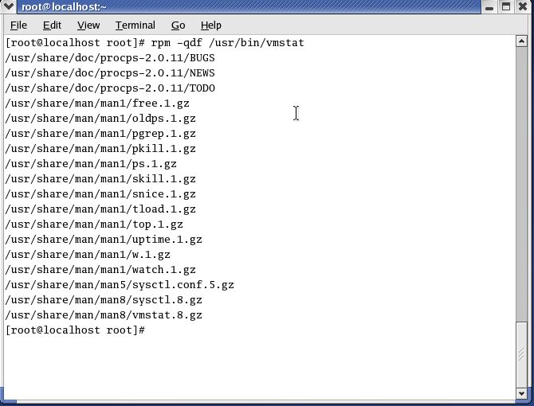
Querying Packages

Slide 38
Package Installation in TAR Format
TAR: Tape Archive.
An archive is nothing but you bundle (put) many files together into a single file on a single tape or disk.

Slide 39
Package Installation in TAR Format
The tar program combines multiple files into a single large file. It is separate from the compression tool, so it allows you to select which compression tool to use or whether you even want compression.
A tar ball is a (usually compressed) archive of files, similar to a Zip file on Windows or a Sit on the Mac. Tar balls come in files that end in .tar, .tar.gz, .tgz, or something along these lines.

Slide 40
Package Installation in TAR Format
Structure of the tar command
[root@localhost /root]# tar [commands and options] filename

Slide 41
Package Installation in TAR Format
Option for tar Description -c Create a new archive. -t View the contents of an archive. -x Extract the contents of an archive. -f Specify the name of the file (or device) in which the archive is located. -v Be verbose during operations. -z Use gzip to compress or decompress the file. -u To upgrade the tar file

Slide 42
Package Installation in TAR Format
To create a tar file
[root@localhost mohit]# tar -cvf filename.tar directory [path of files]
In this example, filename.tar represents the file you are creating and directory/file represents the directory and file you want to put in the archived file.

Slide 43
Package Installation in TAR Format
Where,
-c : Create a tar ball.
-v : Verbose output (show progress).
-f : Output tar ball archive file name.
-x : Extract all files from archive.tar.
-t : Display the contents (file list) of an archive.

Slide 44
Package Installation in TAR Format
To View a Tar Ball
It Contains (list file inside a tar ball)
Type the following command:
tar -tvf /tmp/data.tar ar Ball

Slide 45
Package Installation in TAR Format
To Extract a Tar Ball
Type the following command to extract /tmp/data.tar in a current directory, enter:
tar -xvf /tmp/data.tar

