Slide 1
Linux and Shell Scripting

Slide 2
Learning Outcomes
Understand the basic utilities
Work with files
Understand the Pipe

Slide 3
Command Line Utility
Command-line utilities are often faster, more powerful, or more complete than their GUI counterparts.
When you work with a command-line interface, you are working with a shell.

Slide 4
Basic Utilities
One of the important advantages of Linux is that it comes with thousands of utilities that perform innumerable functions.

Slide 5
Basic Utilities
ls
cat
rm
less
more

Slide 6
Directory
A directory is a resource that can hold files. On other operating systems, like Windows, a directory is referred to as a folder.
When you log in the system, you work in the home directory.

Slide 7
ls: Lists the Names of Files
The ls utility lists the names of files which are available.

Slide 8
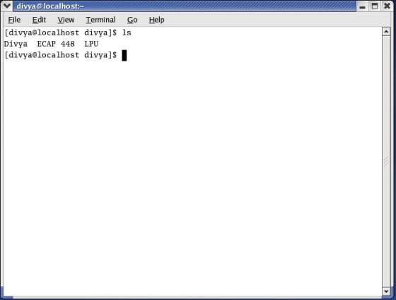
ls: Lists the Names of Files

Slide 9
cat: Displays the Text of File
The cat utility displays the contents of a text file.
The name of the command is derived from catenate, which means to join together, one after the other.

Slide 10
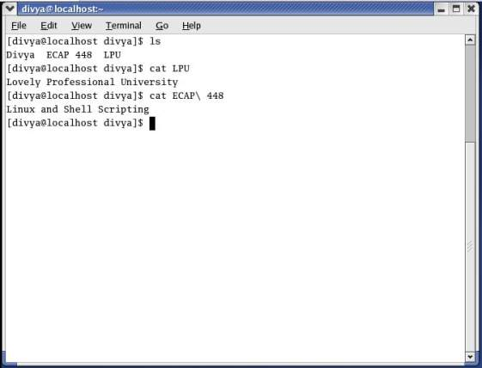
cat: Displays the Text of File

Slide 11
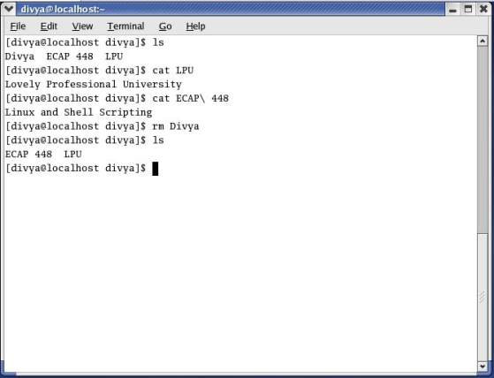
rm: Deletes a File
The rm (remove) utility deletes a file.

Slide 12
rm: Deletes a File
When you follow rm with the –i option and the name of the file you want to delete, rm displays the name of the file and then waits for you to respond with y (yes) before it deletes the file.
It does not delete the file if you respond with a string that begins with a character other than y.

Slide 13
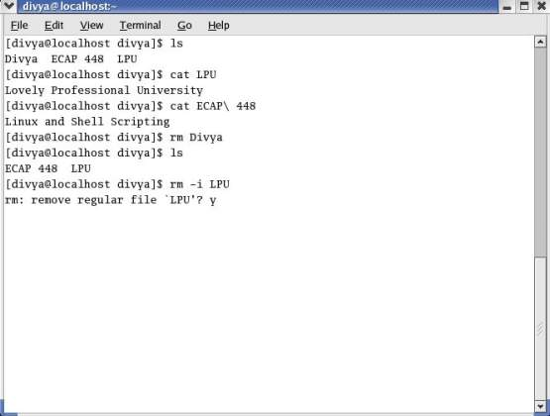
rm: Deletes a File

Slide 14
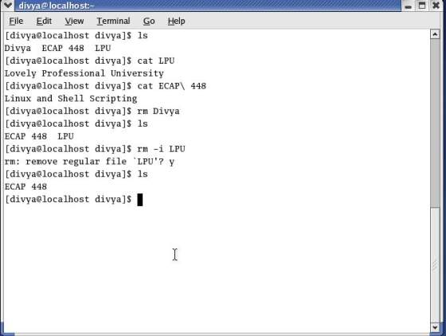
rm: Deletes a File

Slide 15
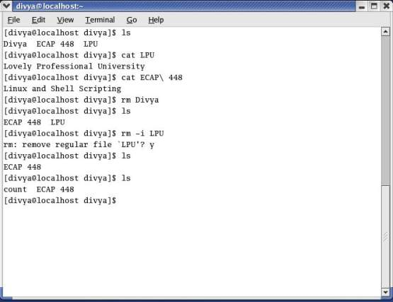
less Is more: Display a Text File One Screen at a Time

Slide 16
less Is more: Display a Text File One Screen at a Time
When you want to view a file that is longer than one screen, you can use either the less utility or the more utility.
Each of these utilities pauses after displaying a screen of text; press the SPACE bar to display the next screen of text.
Because these utilities show one page at a time, they are called pagers.

Slide 17
less Is more: Display a Text File One Screen at a Time
Although less and more are very similar, they have subtle differences. At the end of the file, for example, less displays an END message and waits for you to press q before returning you to the shell. In contrast, more returns you directly to the shell.
While using both utilities you can press h to display a Help screen that lists commands you can use while paging through a file.

Slide 18
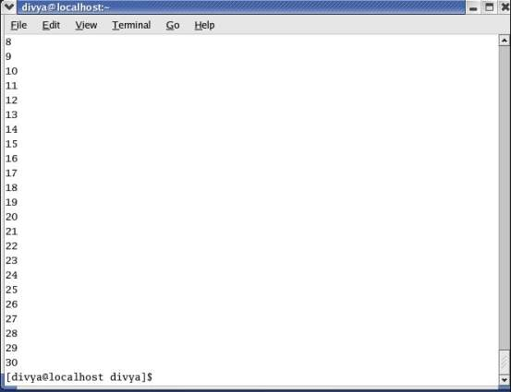
less Is more: Display a Text File One Screen at a Time

Slide 19
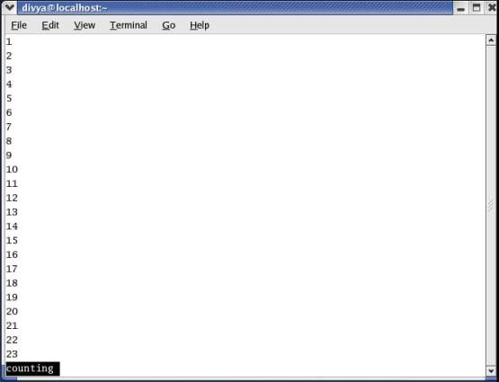
less

Slide 20
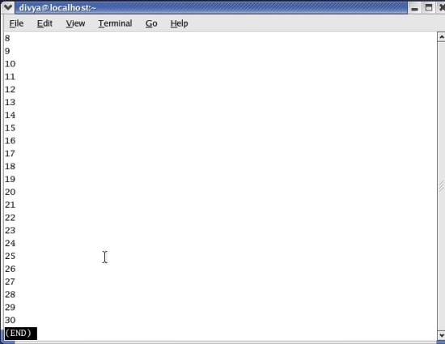
less

Slide 21
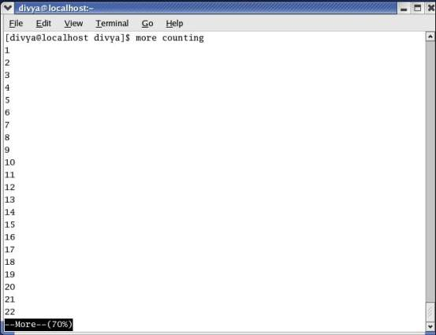
more

Slide 22
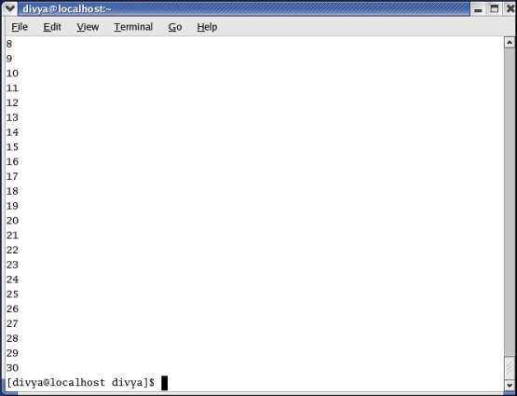
more

Slide 23
Working With Files
cp
mv
grep
head
tail
sort

Slide 24
Working With Files
uniq
diff
file

Slide 25
cp: Copies a File
The cp (copy) utility makes a copy of a file. This utility can copy any file, including text and executable program (binary) files. You can use cp to make a backup copy of a file or a copy to experiment with.
The cp command line uses the following syntax to specify source and destination files: cp source-file destination-file

Slide 26
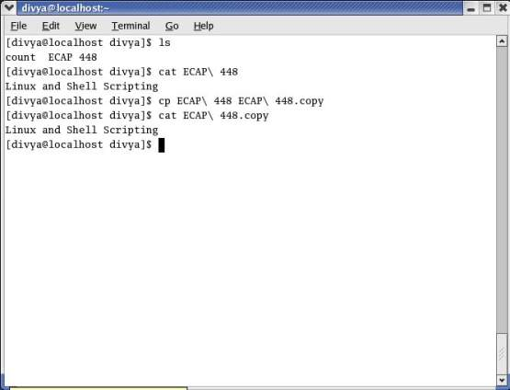
cp: Copies a File

Slide 27
cp can destroy a file
If the destination-file exists before you give a cp command, cp overwrites it.
The cp –i (interactive) option prompts you before it overwrites a file.

Slide 28
mv: Changes the Name of a File
The mv (move) utility can rename a file without making a copy of it.
The mv command line specifies an existing file and a new filename using the same syntax as cp:
mv existing-filename new-filename

Slide 29
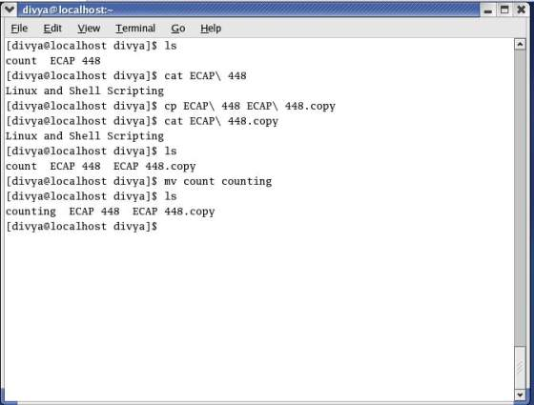
mv: Changes the Name of a File

Slide 30
grep: Searches for a String
The grep utility searches through one or more files to see whether any contain a specified string of characters.
This utility does not change the file it searches but simply displays each line that contains the string.

Slide 31
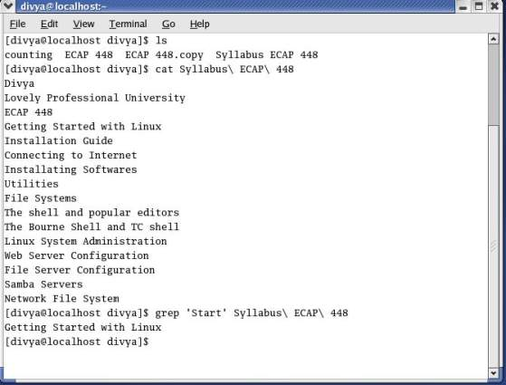
grep: Searches for a String

Slide 32
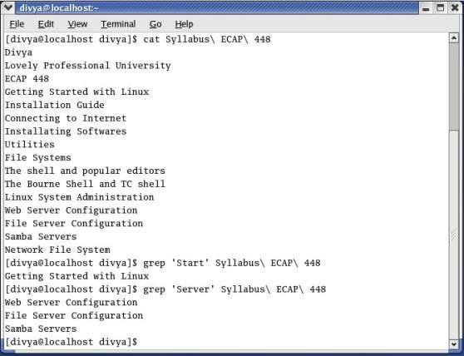
grep: Searches for a String

Slide 33
head: Displays the Beginning of a File
By default the head utility displays the first ten lines of a file.
For example, if you have a file named months that lists the 12 months of the year in calendar order, one to a line, then head displays Jan through Oct.

Slide 34
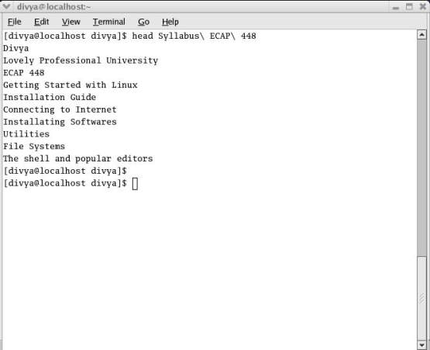
head: Displays the Beginning of a File

Slide 35
head: Displays the Beginning of a File
This utility can display any number of lines, so you can use it to look at only the first line of a file, at a full screen, or even more.
To specify the number of lines displayed, include a hyphen followed by the number of lines you want head to display.

Slide 36
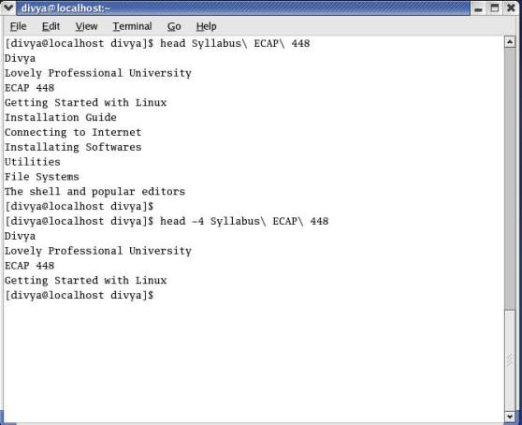
head: Displays the Beginning of a File

Slide 37
tail: Displays the End of a File
The tail utility is similar to head but by default displays the last ten lines of a file.
Depending on how you invoke it, this utility can display fewer or more than ten lines.

Slide 38
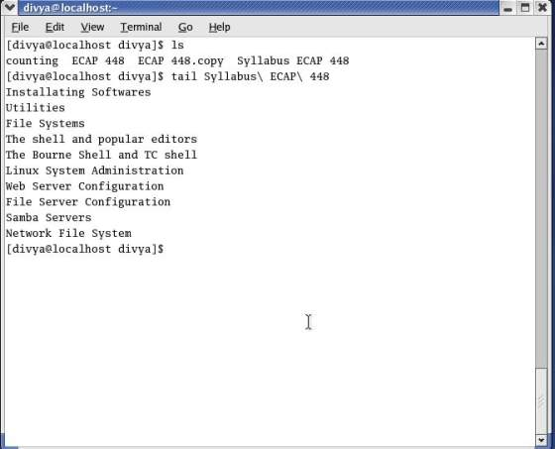
tail: Displays the End of a File

Slide 39
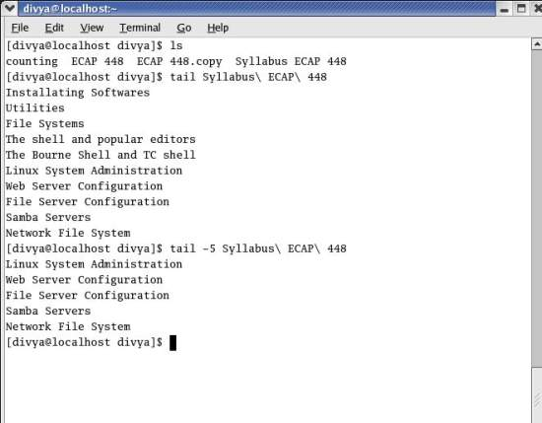
tail: Displays the End of a File

Slide 40
sort: Displays a File in Order
The sort utility displays the contents of a file in order by lines; it does not change the original file.

Slide 41
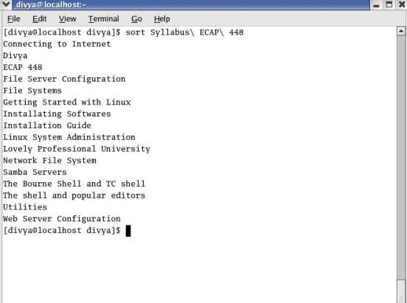
sort: Displays a File in Order

Slide 42
uniq: Removes Duplicate Lines from a File
The uniq (unique) utility displays a file, skipping adjacent duplicate lines, but does not change the original file.
If a file contains a list of names and has two successive entries for the same person, uniq skips the duplicate line.
If a file is sorted before it is processed by uniq, this utility ensures that no two lines in the file are the same.

Slide 43
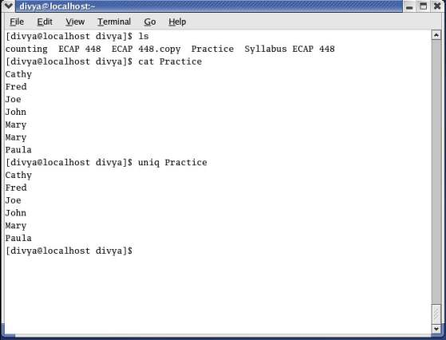
uniq: Removes Duplicate Lines from a File

Slide 44
diff: Compares Two Files
The diff (difference) utility compares two files and displays a list of the differences between them.
This utility does not change either file; it is useful when you want to compare two versions of a letter or a report or two versions of the source code for a program.

Slide 45
diff: Compares Two Files
The diff utility with the –u (unified output format) option first displays two lines indicating which of the files you are comparing will be denoted by a plus sign (+) and which by a minus sign (–).

Slide 46
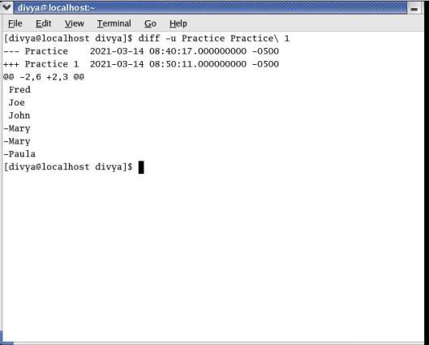
diff: Compares Two Files

Slide 47
file: Identifies the Contents of a File
You can use the file utility to learn about the contents of a file without having to open and examine the file yourself.

Slide 48
| (Pipe): Communicates Between Processes
A process is the execution of a command by Linux.
Communication between processes is one of the hallmarks of both UNIX and Linux.
A pipe (written as a vertical bar [|] on the command line and appearing as a solid or broken vertical line on a keyboard) provides the simplest form of this kind of communication.

Slide 49
| (Pipe): Communicates Between Processes
Simply put, a pipe takes the output of one utility and sends that output as input to another utility.

Slide 50
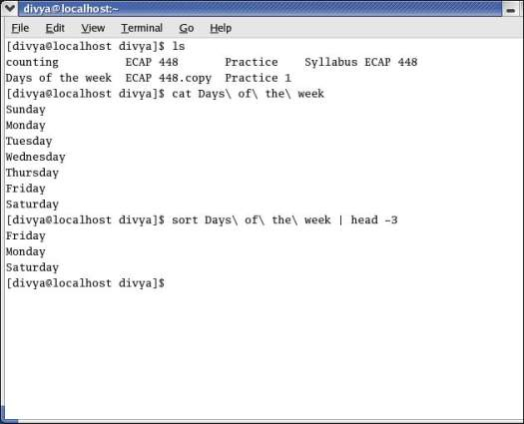
| (Pipe): Communicates Between Processes

Slide 51
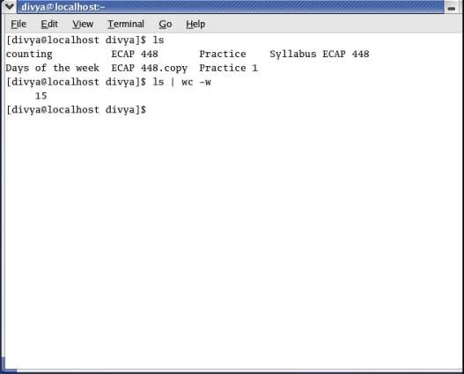
| (Pipe): Communicates Between Processes

