Slide 1
Linux and Shell Scripting

Slide 2
Learning Outcomes
understand the pathnames
work with directories

Slide 3
Pathnames
Every file has a pathname, which is a trail from a directory through part of the directory hierarchy to an ordinary file or a directory.

Slide 4
Pathnames
Within a pathname, a slash (/) to the right of a filename indicates that the file is a directory file.
The file following the slash can be an ordinary file or a directory file.

Slide 5
Pathnames
Pathnames
Absolute Pathnames
Relative Pathnames

Slide 6
Absolute Pathnames
The root directory of the filesystem hierarchy does not have a name.
It is referred to as the root directory.
It is represented by a / (slash) standing alone or at the left end of a pathname.
An absolute pathname starts with a slash (/), which represents the root directory.
The slash is followed by the name of a file located in the root directory.

Slide 7
Absolute Pathnames
The root directory of the filesystem hierarchy does not have a name.
It is referred to as the root directory.
It is represented by a / (slash) standing alone or at the left end of a pathname.
An absolute pathname starts with a slash (/), which represents the root directory.
The slash is followed by the name of a file located in the root directory.

Slide 8
Absolute Pathnames
The root directory of the filesystem hierarchy does not have a name.
It is referred to as the root directory.
It is represented by a / (slash) standing alone or at the left end of a pathname.
An absolute pathname starts with a slash (/), which represents the root directory.
The slash is followed by the name of a file located in the root directory.

Slide 9
Absolute Pathnames
The root directory of the filesystem hierarchy does not have a name.
It is referred to as the root directory.
It is represented by a / (slash) standing alone or at the left end of a pathname.
An absolute pathname starts with a slash (/), which represents the root directory.
The slash is followed by the name of a file located in the root directory.

Slide 10
Absolute Pathnames
The root directory of the filesystem hierarchy does not have a name.
It is referred to as the root directory.
It is represented by a / (slash) standing alone or at the left end of a pathname.
An absolute pathname starts with a slash (/), which represents the root directory.
The slash is followed by the name of a file located in the root directory.

Slide 11
Absolute Pathnames
An absolute pathname continues, tracing a path through all intermediate directories, to the file identified by the pathname.
String all the filenames in the path together, following each directory with a slash (/).
This string of filenames is called an absolute pathname because it locates a file absolutely by tracing a path from the root directory to the file.

Slide 12
Absolute Pathnames
An absolute pathname continues, tracing a path through all intermediate directories, to the file identified by the pathname.
String all the filenames in the path together, following each directory with a slash (/).
This string of filenames is called an absolute pathname because it locates a file absolutely by tracing a path from the root directory to the file.

Slide 13
Absolute Pathnames
An absolute pathname continues, tracing a path through all intermediate directories, to the file identified by the pathname.
String all the filenames in the path together, following each directory with a slash (/).
This string of filenames is called an absolute pathname because it locates a file absolutely by tracing a path from the root directory to the file.

Slide 14

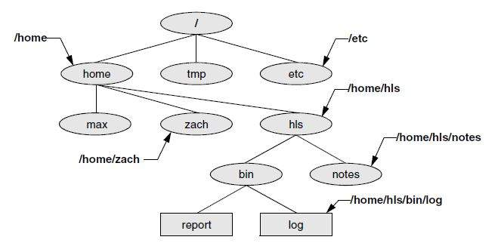
Absolute Pathnames

Slide 15
Absolute Pathnames
Using an absolute pathname, you can list or otherwise work with any file on the local system, regardless of the working directory at the time you give the command.

Slide 16
Absolute Pathnames
For example, Sam can give the following command while working in his home directory to list the files in the /usr/bin directory:
$ pwd
/home/sam
$ ls /usr/bin
7z kwin
7za kwin_killer_helper
822-date kwin_rules_dialog
...

Slide 17
Relative Pathnames
A relative pathname traces a path from the working directory to a file.
The pathname is relative to the working directory.
Any pathname that does not begin with the root directory (represented by /) or a tilde (~) is a relative pathname.
Like absolute pathnames, relative pathnames can trace a path through many directories.
The simplest relative pathname is a simple filename, which identifies a file in the working directory.

Slide 18
Relative Pathnames
A relative pathname traces a path from the working directory to a file.
The pathname is relative to the working directory.
Any pathname that does not begin with the root directory (represented by /) or a tilde (~) is a relative pathname.
Like absolute pathnames, relative pathnames can trace a path through many directories.
The simplest relative pathname is a simple filename, which identifies a file in the working directory.

Slide 19
Relative Pathnames
A relative pathname traces a path from the working directory to a file.
The pathname is relative to the working directory.
Any pathname that does not begin with the root directory (represented by /) or a tilde (~) is a relative pathname.
Like absolute pathnames, relative pathnames can trace a path through many directories.
The simplest relative pathname is a simple filename, which identifies a file in the working directory.

Slide 20
Relative Pathnames
A relative pathname traces a path from the working directory to a file.
The pathname is relative to the working directory.
Any pathname that does not begin with the root directory (represented by /) or a tilde (~) is a relative pathname.
Like absolute pathnames, relative pathnames can trace a path through many directories.
The simplest relative pathname is a simple filename, which identifies a file in the working directory.

Slide 21
Relative Pathnames
A relative pathname traces a path from the working directory to a file.
The pathname is relative to the working directory.
Any pathname that does not begin with the root directory (represented by /) or a tilde (~) is a relative pathname.
Like absolute pathnames, relative pathnames can trace a path through many directories.
The simplest relative pathname is a simple filename, which identifies a file in the working directory.

Slide 22
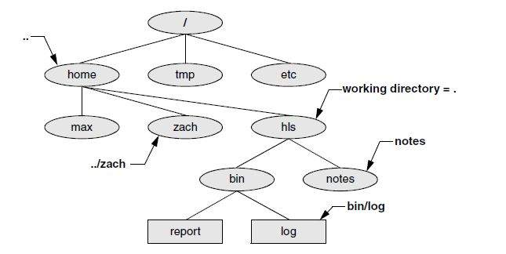
Relative Pathnames

Slide 23
Significance of the Working Directory
To access any file in the working directory, you need only a simple filename.
To access a file in another directory, you must use a pathname.
Typing a long pathname is tedious and increases the chance of making a mistake.
This possibility is less likely under a GUI, where you click filenames or icons. You can choose a working directory for any particular task to reduce the need for long pathnames.

Slide 24
Significance of the Working Directory
To access any file in the working directory, you need only a simple filename.
To access a file in another directory, you must use a pathname.
Typing a long pathname is tedious and increases the chance of making a mistake.
This possibility is less likely under a GUI, where you click filenames or icons. You can choose a working directory for any particular task to reduce the need for long pathnames.

Slide 25
Significance of the Working Directory
To access any file in the working directory, you need only a simple filename.
To access a file in another directory, you must use a pathname.
Typing a long pathname is tedious and increases the chance of making a mistake.
This possibility is less likely under a GUI, where you click filenames or icons. You can choose a working directory for any particular task to reduce the need for long pathnames.

Slide 26
Significance of the Working Directory
To access any file in the working directory, you need only a simple filename.
To access a file in another directory, you must use a pathname.
Typing a long pathname is tedious and increases the chance of making a mistake.
This possibility is less likely under a GUI, where you click filenames or icons. You can choose a working directory for any particular task to reduce the need for long pathnames.

Slide 27
Working with Directories
how to create directories (mkdir),
switch between directories (cd),
remove directories (rmdir)
mv, cp: Move or Copy Files
mv: Moves a Directory

Slide 28
Working with Directories
how to create directories (mkdir),
switch between directories (cd),
remove directories (rmdir)
mv, cp: Move or Copy Files
mv: Moves a Directory

Slide 29
Working with Directories
how to create directories (mkdir),
switch between directories (cd),
remove directories (rmdir)
mv, cp: Move or Copy Files
mv: Moves a Directory

Slide 30
Working with Directories
how to create directories (mkdir),
switch between directories (cd),
remove directories (rmdir)
mv, cp: Move or Copy Files
mv: Moves a Directory

Slide 31
Working with Directories
how to create directories (mkdir),
switch between directories (cd),
remove directories (rmdir)
mv, cp: Move or Copy Files
mv: Moves a Directory

Slide 32
mkdir: Creates a Directory
The mkdir utility creates a directory.
The argument to mkdir becomes the pathname of the new directory.

Slide 33
mkdir: Creates a Directory
$ pwd
/home/max
$ 1s
Demo names temp
$ mkdir literature
$ 1s
Demo literature names temp
$ 1s –F
Demo literature/ names temp
$ 1s literature
$

Slide 34
mkdir: Creates a Directory
He uses a relative pathname (a simple filename) because he wants the literature directory to be a child of the working directory.
Max could have used an absolute pathname to create the same directory: mkdir /home/max/literature or mkdir ~max/literature.

Slide 35
mkdir: Creates a Directory
There are two ways to create the promo directory as a child of the newly created literature directory.
The first way checks that /home/max is the working directory and uses a relative pathname:
$ pwd
/home/max
$ mkdir literature/promo

Slide 36
mkdir: Creates a Directory
There are two ways to create the promo directory as a child of the newly created literature directory.
The second way uses an absolute pathname:
$ mkdir /home/max/literature/promo

Slide 37
mkdir: Creates a Directory
Use the –p (parents) option to mkdir to create both the literature and promo directories with one command:
$ pwd
/home/max
$ ls
demo names temp
$ mkdir -p literature/promo
or
$ mkdir -p /home/max/literature/promo

Slide 38
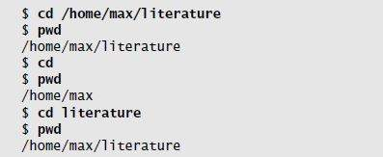
cd: Changes to Another Working Directory
The cd (change directory) utility makes another directory the working directory but does not change the contents of the working directory.

Slide 39
The working directory versus your home directory
The working directory is not the same as your home directory.
Your home directory remains the same for the duration of your session and usually from session to session.
Immediately after you log in, you are always working in the same directory: your home directory.

Slide 40
The working directory versus your home directory
Unlike your home directory, the working directory can change as often as you like.
You have no set working directory, which explains why some people refer to it as the current directory.
When you log in and until you change directories using cd, your home directory is the working directory.

Slide 41
The . and .. Directory Entries
The mkdir utility automatically puts two entries in each directory it creates: a single period (.) and a double period (..).
The . is synonymous with the pathname of the working directory and can be used in its place; the .. Is synonymous with the pathname of the parent of the working directory.
These entries are hidden because their filenames begin with a period.

Slide 42
rmdir: Deletes a Directory
The rmdir (remove directory) utility deletes a directory.
You cannot delete the working directory or a directory that contains files other than the . and .. entries.
If you need to delete a directory that has files in it, first use rm to delete the files and then delete the directory.
You do not have to (nor can you) delete the . and .. entries; rmdir removes them automatically.

Slide 43
rmdir: Deletes a Directory
The following command deletes the promo directory:
$ rmdir /home/max/literature/promo
The rm utility has a –r option (rm –r filename) that recursively deletes files, including directories, within a directory and also deletes the directory itself.

Slide 44
Use rm –r carefully, if at all
Although rm –r is a handy command, you must use it carefully. Do not use it with an ambiguous file reference such as *.
It is shockingly easy to wipe out your entire home directory with a single short command.

Slide 45
mv, cp: Move or Copy Files
Mv: You can use this utility to move files from one directory to another (change the pathname of a file) as well as to change a simple filename.
When used to move one or more files to a new directory, the mv command has this syntax:
mv existing-file-list directory

Slide 46
mv, cp: Move or Copy Files
If the working directory is /home/max, Max can use the following command to move the files names and temp from the working directory to the literature directory:
$ mv names temp literature

Slide 47
mv, cp: Move or Copy Files
This command changes the absolute pathnames of the names and temp files from /home/max/names and /home/max/temp to /home/max/literature/names and /home/max/literature/temp, respectively.
Like most Linux commands, mv accepts either absolute or relative pathnames.
The cp utility works in the same way as mv does, except that it makes copies of the existing-file-list in the specified directory.

Slide 48
mv: Moves a Directory
Just as it moves ordinary files from one directory to another, so mv can move directories.
The syntax is similar except that you specify one or more directories, not ordinary files, to move:
mv existing-directory-list new-directory

Slide 49
mv: Moves a Directory
If new-directory does not exist, the existing-directory-list must contain just one directory name, which mv changes to new-directory (mv renames the directory).
Although you can rename directories using mv, you cannot copy their contents with cp unless you use the –r (recursive) option.

Slide 50
A typical FHS-based Linux filesystem structure
/
bin
var
dev
sbin
usr
etc
tmp
home
root
mail
spool
bin
sbin
max
zach
hls

Slide 51
Important Standard Directories and Files
/ | Root: The root directory, present in all Linux filesystem structures, is the ancestor of all files in the filesystem.
/bin | Essential command binaries Holds the files needed to bring the system up and run it when it first comes up in single-user or recovery mode.
/boot | Static files of the boot loader Contains all files needed to boot the system.
/dev | Device files Contains all files that represent peripheral devices, such as disk drives, terminals, and printers
/etc | Machine–local system configuration files Holds administrative, configuration, and other system files. One of the most important is /etc/passwd, which contains a list of all users who have permission to use the system.
/etc/opt | Configuration files for add-on software packages kept in /opt
/etc/X11 | Machine–local configuration files for the X Window System

Slide 52
Important Standard Directories and Files
/home | User home directories
/lib | Shared libraries
/lib/modules | Loadable kernel modules
/mnt | Mount point for temporarily mounting filesystems
/opt | Add-on (optional) software packages
/proc | Kernel and process information virtual filesystem
/root | Home directory for the root account
/sbin | Essential system binaries Utilities used for system administration are stored in /sbin and /usr/sbin. The /sbin directory includes utilities needed during the booting process, and /usr/sbin holds utilities used after the system is up and running.
/sys | Device pseudofilesystem
/tmp | Temporary Files

Slide 53
Important Standard Directories and Files
/usr/games | Games and educational programs
/usr/include | Header files used by C programs
/usr/lib | Libraries
/usr/local | Local hierarchy Holds locally important files and directories that are added to the system. Subdirectories can include bin, games, include, lib, sbin, share, and src.
/usr/sbin | Nonvital system administration binaries See /sbin.
/usr/share | Architecture-independent data Subdirectories can include dict, doc, games, info, locale, man, misc, terminfo, and zoneinfo.
/usr/share/doc | Documentation
/usr/share/info | GNU info system’s primary directory

Slide 54
Important Standard Directories and Files
/usr/share/man | Online manuals
/usr/src | Source code
/var | Variable data Files with contents that vary as the system runs are kept in subdirectories under /var. The most common examples are temporary files, system log files, spooled files, and user mailbox files.
/var/log | Log files Contains lastlog (a record of the last login by each user), messages (system messages from syslogd), and wtmp (a record of all logins/logouts), among other log files.
/var/spool | Spooled application data Contains anacron, at, cron, lpd, mail, mqueue, samba, and other directories.

