Slide 1
Linux and Shell Scripting

Slide 2
Learning Outcomes
Understand the access permission

Slide 3
Introduction
Linux supports two methods of controlling who can access a file and how they can access it:
Traditional Linux access permissions
Access Control Lists (ACLs).

Slide 4
Types of Users
Three types of users can access a file:
The owner of the file (owner),
A member of a group that the file is associated with (group),
Everyone else (other).

Slide 5
Ways to Access an Ordinary File
A user can attempt to access an ordinary file in three ways:
Read from
Write to
Execute it.

Slide 6
Access Permissions
ls –l: Displays Permissions
chmod: Changes Access Permissions
Setuid and Setgid Permissions
Directory Access Permissions

Slide 7
ls –l: Displays Permissions
When you call ls with the –l option and the name of one or more ordinary files, ls displays a line of information about the file.

Slide 8
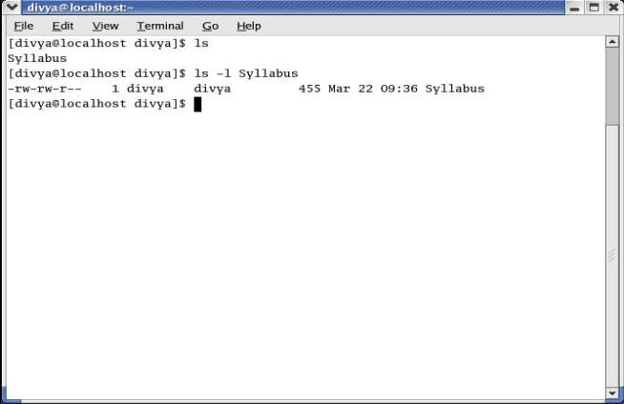
ls –l: Displays Permissions

Slide 9
ls –l: Displays Permissions
From left to right, the lines that an ls –l command displays contain:
The type of file (first character)
The file’s access permissions (the next nine characters)
The ACL flag (present if the file has an ACL)
The number of links to the file

Slide 10
ls –l: Displays Permissions
The name of the owner of the file (usually the person who created the file)
The name of the group the file is associated with
The size of the file in characters (bytes)
The date and time the file was created or last modified
The name of the file

Slide 11
ls –l: Displays Permissions (Type of file)
The type of file is a hyphen (–) because it is an ordinary file.

Slide 12
ls –l: Displays Permissions (Type of file)
Character | Meaning
- | Ordinary
b | Block Device
c | Character Device
d | Directory
p | FIFO (names Pipe)
l | Symbolic link

Slide 13
ls –l: Displays Permissions
The next three characters specify the access permissions for the owner of the file.
R indicates read permission,
w indicates write permission,
x indicates execute permission.

Slide 14
ls –l: Displays Permissions
A – in one of the positions indicates that the owner does not have the permission associated with that position.

Slide 15
ls –l: Displays Permissions
In a similar manner the next three characters represent permissions for the group.
The final three characters represent permissions for other (everyone else).

Slide 16
ls –l: Displays Permissions
Although execute permission can be allowed for any file, it does not make sense to assign execute permission to a file that contains a document, such as a letter.

Slide 17
chmod: Changes Access Permissions
The Linux file access permission scheme lets you give other users access to the files you want to share yet keep your private files confidential.
You can allow other users to read from and write to a file.
You can also allow others only to read from a file.
Or you can allow others only to write to a file.

Slide 18
chmod: Changes Access Permissions
A user with root privileges can access any file on the system.
Anyone who can gain root privileges has full access to all files, regardless of the file’s owner or access permissions.

Slide 19
chmod: Changes Access Permissions
The owner of a file controls which users have permission to access the file and how those users can access it.
When you own a file, you can use the chmod (change mode) utility to change access permissions for that file.
You can specify symbolic (relative) or numeric (absolute) arguments to chmod.

Slide 20
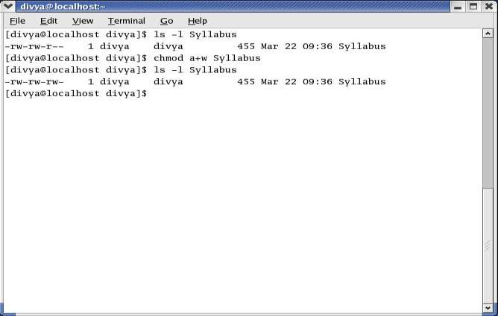
Symbolic Arguments to chmod

Slide 21
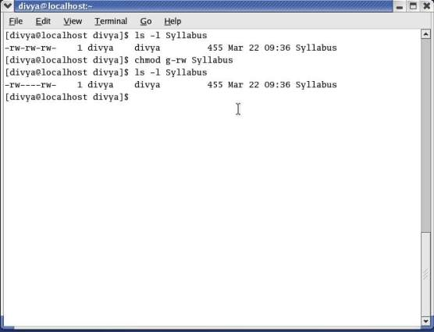
Symbolic Arguments to chmod

Slide 22
Symbolic Arguments to chmod
When using chmod, many people assume that the o stands for owner; it does not. The o stands for other, whereas u stands for owner (user).
UGO (user-group-other)

Slide 23
Numeric Arguments to chmod
You can also use numeric arguments to specify permissions with chmod.
In place of the letters and symbols specifying permissions used, here numeric arguments comprise three octal digits.

Slide 24
Numeric Arguments to chmod
The first digit specifies permissions for the owner, the second for the group, and the third for other users.
A 1 gives the specified user(s) execute permission, a 2 gives write permission, and a 4 gives read permission.
Construct the digit representing the permissions for the owner, group, or others by ORing (adding) the appropriate values.

Slide 25
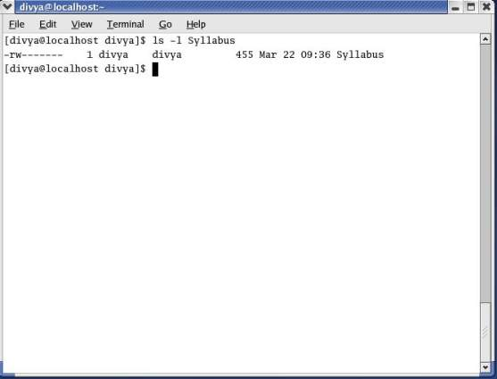
Numeric Arguments to chmod

Slide 26
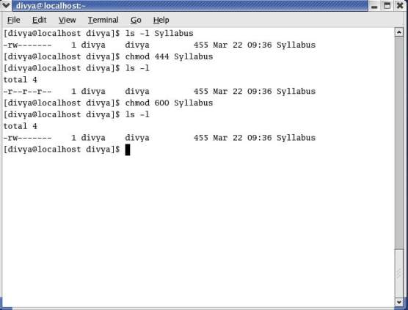
Numeric Arguments to chmod

Slide 27
Setuid and Setgid Permissions
When you execute a file that has setuid (set user ID) permission, the process executing the file takes on the privileges of the file’s owner.
For example, if you run a setuid program that removes all files in a directory, you can remove files in any of the file owner’s directories, even if you do not normally have permission to do so.

Slide 28
Setuid and Setgid Permissions
In a similar manner, setgid (set group ID) permission gives the process executing the file the privileges of the group the file is associated with.

Slide 29
Directory Access Permissions
Access permissions have slightly different meanings when they are used with directories.
Although the three types of users can read from or write to a directory, the directory cannot be executed.

Slide 30
Directory Access Permissions
Execute permission is redefined for a directory: It means that you can cd into the directory and/or examine files that you have permission to read from in the directory.
It has nothing to do with executing a file.

Slide 31
Directory Access Permissions
When you have only execute permission for a directory, you can use ls to list a file in the directory if you know its name. You cannot use ls without an argument to list the entire contents of the directory.

Slide 32
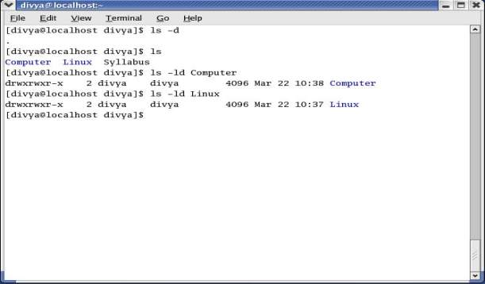
Directory Access Permissions

Slide 33
Directory Access Permissions
The d at the left end of the line that ls displays indicates that Linux is a directory.
The person has read, write, and execute permissions; members of the group also have read, write and execute permissions; and other users have only read and execute permissions.

