Slide 1
Linux and Shell Scripting

Slide 2
Learning Outcomes
understand the Access Control Lists.
understand the Links.

Slide 3
Access Control Lists
The ACLs provide finer-grained control over which users can access specific directories and files than do traditional Linux permissions.
Using ACLs you can specify the ways in which each of several users can access a directory or file.

Slide 4
Access Control Lists-Reduced Performance
Because ACLs can reduce performance, do not enable them on filesystems that hold system files, where the traditional Linux permissions are sufficient.
Also be careful when moving, copying, or archiving files: Not all utilities preserve ACLs.
In addition, you cannot copy ACLs to filesystems that do not support ACLs.

Slide 5
Access Control Lists-Rules
An ACL comprises a set of rules.
Rule: It specifies how a specific user or group can access the file that the ACL is associated with.
There are two kinds of rules: access rules and default rules.

Slide 6
Access Control Lists-Rules
Access rule: It specifies access information for a single file or directory.
Default ACL: It pertains to a directory only; it specifies default access information (an ACL) for any file in the directory that is not given an explicit ACL.

Slide 7
Most utilities do not preserve ACLs
cp utility: When used with the –p (preserve) or –a (archive) option, cp preserves ACLs when it copies files.
mv utility: It also preserves ACLs.
Other utilities, such as tar, cpio, and dump, do not support ACLs.

Slide 8
Enabling ACLs
Before you can use ACLs you must install the acl software package.
Linux officially supports ACLs on ext2, ext3, and ext4 filesystems only, although informal support for ACLs is available on other filesystems.
To use ACLs on an ext filesystem, you must mount the device with the ACL option.

Slide 9
Enabling ACLs
For example, if you want to mount the device represented by /home so you can use ACLs on files in /home, you can add acl to its options list in /etc/fstab:
$ grep home /etc/fstab
LABEL=/home /home ext3 defaults,acl 1 2
After changing fstab, you need to remount /home before you can use ACLs.

Slide 10
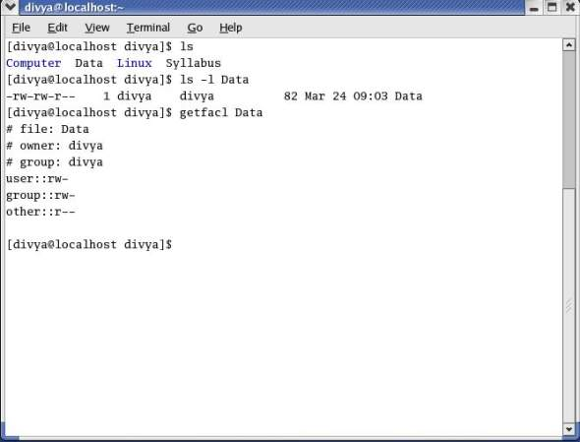
Working with Access Rules

Slide 11
Working with Access Rules
The first three lines of the getfacl output comprise the header; they specify the name of the file, the owner of the file, and the group the file is associated with.

Slide 12
Working with Access Rules
In the line that starts with user, the two colons (::) with no name between them indicate that the line specifies the permissions for the owner of the file.
Similarly, the two colons in the group line indicate that the line specifies permissions for the group the file is associated with.
The two colons following other are there for consistency: No name can be associated with other.

Slide 13
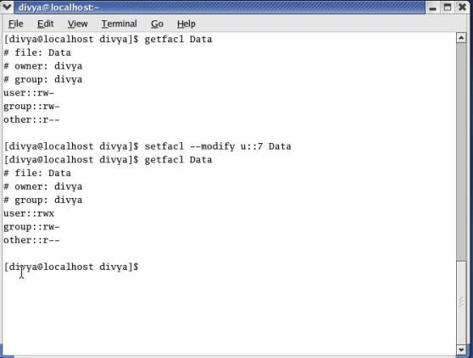
Working with Access Rules

Slide 14
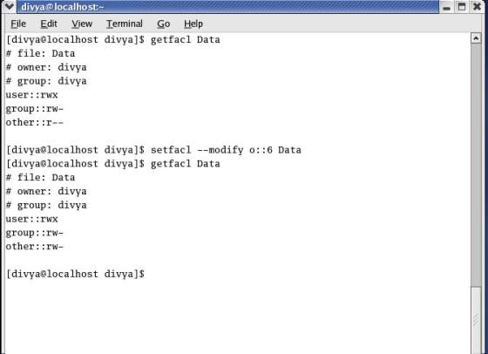
Working with Access Rules

Slide 15
Setting up ACL :
1) To add permission for user
setfacl -m "u:user:permissions" /path/to/file
2) To add permissions for a group
setfacl -m "g:group:permissions" /path/to/file

Slide 16
Setting up ACL :
3) To allow all files or directories to inherit ACL entries from the directory it is within
setfacl -dm "entry" /path/to/dir
4) To remove a specific entry
setfacl -x "entry" /path/to/file
5) To remove all entries
setfacl -b path/to/file

Slide 17
Modifying ACL using setfacl :
To add permissions for a user (user is either the user name or ID): # setfacl -m "u:user:permissions"
To add permissions for a group (group is either the group name or ID): # setfacl –m "g:group:permissions"
To allow all files or directories to inherit ACL entries from the directory it is within: # setfacl -dm "entry"

Slide 18
View ACL :
To show permissions :
# getfacl filename

Slide 19
Remove ACL :
If you want to remove the set ACL permissions, use setfacl command with -b option.

Slide 20
Setting Default Rules for a Directory
The setfacl command uses the –d (default) option to add two default rules to the ACL for dir.
These rules apply to all files in the dir directory that do not have explicit ACLs.

Slide 21
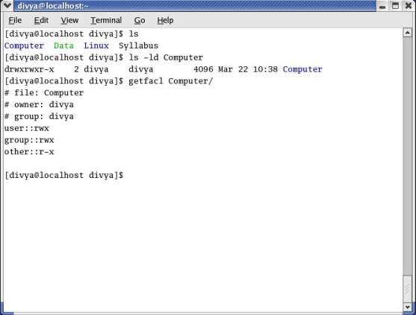
Setting Default Rules for a Directory

Slide 22
Links
A link is a pointer to a file.
Every time you create a file by using vim, touch, cp, or any other means, you are putting a pointer in a directory.
This pointer associates a filename with a place on the disk. When you specify a filename in a command, you are indirectly pointing to the place on the disk that holds the information you want.

Slide 23

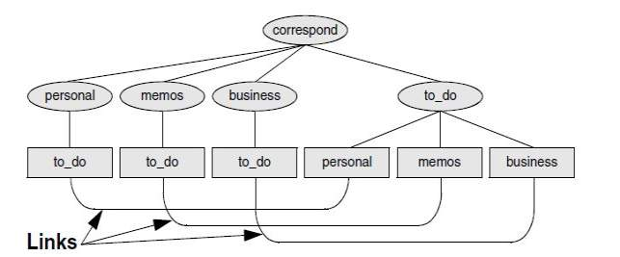
Using links to cross-classify files

Slide 24
Using links
Sharing files can be useful when two or more people are working on the same project and need to share some information.
You can make it easy for other users to access one of your files by creating additional links to the file.

Slide 25
Using links
To share a file with another user, first give the user permission to read from and write to the file.
You may also have to change the access permissions of the parent directory of the file to give the user read, write, or execute permission.
Once the permissions are appropriately set, the user can create a link to the file so that each of you can access the file from your separate directory hierarchies.

Slide 26
Using links
A link can also be useful to a single user with a large directory hierarchy.
You can create links to cross-classify files in your directory hierarchy, using different classifications for different tasks.

Slide 27
Hard Links
A hard link to a file appears as another file.
If the file appears in the same directory as the linked-to file, the links must have different filenames because two files in the same directory cannot have the same name.

Slide 28
Hard Links
You can create a hard link to a file only from within the filesystem that holds the file.
A hard link is a direct link to the data on disk. This means data can be accessed directly via an original filename or a hard link.
Both the original file and the hard link are direct links to the data on disk. The use of a hard link allows multiple filenames to be associated with the same data on disk.

Slide 29
Soft Links
These are also known as symbolic links or symlink.
It refers to a symbolic path indicating the abstract location of another file.

Slide 30
Soft Links
A symbolic link (also sometimes known as a soft link) does not link directly to the data on disk but to another link to the data on disk.
On most operating systems folders may only be linked using a symlink.
Symbolic links can link across file systems to link a folder on an external hard drive.

Slide 31
Hard link vs. Soft link in Linux
Hard links cannot link directories and cross file system boundaries.
Soft or symbolic links are just like hard links. It allows to associate multiple filenames with a single file. However, symbolic links allows:
To create links between directories and can cross file system boundaries.

Slide 32
Hard link vs. Soft link in Linux
These links behave differently when the source of the link is moved or removed.
Symbolic links are not updated.
Hard links always refer to the source, even if moved or removed.

