Slide 1
Linux and Shell Scripting

Slide 2
Learning Outcomes
Understand the Command Line

Slide 3
Operating System
An Operating is made of many components, but its two prime components are :-
Kernel
Shell

Slide 4
Operating System
A Kernel is at the nucleus of a computer. It makes the communication between the hardware and software possible.
While the Kernel is the innermost part of an operating system, a shell is the outermost one.

Slide 5
Operating System
A shell in a Linux operating system takes input from you in the form of commands, processes it, and then gives an output.
It is the interface through which a user works on the programs, commands, and scripts.
A shell is accessed by a terminal which runs it.

Slide 6
Shell
When you run the terminal, the Shell issues a command prompt (usually $), where you can type your input, which is then executed when you hit the Enter key. The output or the result is thereafter displayed on the terminal.
The Shell wraps around the delicate interior of an OS protecting it from accidental damage. Hence the name Shell.

Slide 7
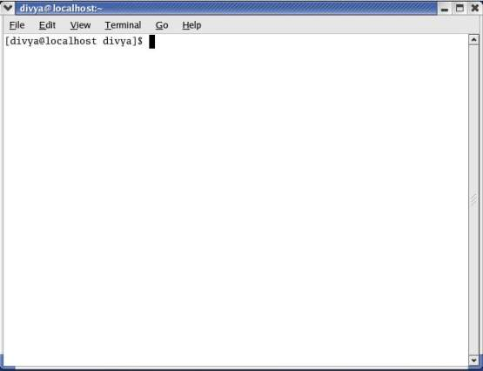
Shell

Slide 8
The Command Line
You can cause the shell to execute various types of programs—such as shell scripts, application programs, and programs you have written—in the same way.
The line that contains the command, including any arguments, is called the command line.

Slide 9
The Command Line
The syntax for a basic command line is
command [arg1] [arg2] ... [argn] RETURN

Slide 10
Rules for commands
One or more SPACEs must separate elements on the command line.
The command is the name of the command, arg1 through argn are arguments, and RETURN is the keystroke that terminates all command lines.
The brackets in the command-line syntax indicate that the arguments they enclose are optional.
Not all commands require arguments.

Slide 11
Command Name
Some useful Linux command lines consist of only the name of the command without any arguments.
Commands that require arguments typically give a short error message, called a usage message.

Slide 12
Arguments
On the command line each sequence of nonblank characters is called a token or word.
An argument is a token, such as a filename, string of text, number, or other object that a command acts on.
For example, the argument to a vim or emacs command is the name of the file you want to edit.

Slide 13
Arguments
The following command line shows cp copying the file named temp to tempcopy: $ cp temp tempcopy
Arguments are numbered starting with the command itself, which is argument zero.
cp arument-0, temp argument-1 and tempcoopy argument-2.
The cp utility requires at least two arguments on the command line.

Slide 14
Options
An option is an argument that modifies the effects of a command.
You can frequently specify more than one option, modifying the command in several different ways.

Slide 15
Options
Most utilities require you to prefix options with a single hyphen. However, this requirement is specific to the utility and not the shell.
GNU program options are frequently preceded by two hyphens in a row. For example, ––help generates a (sometimes extensive) usage message.

Slide 16
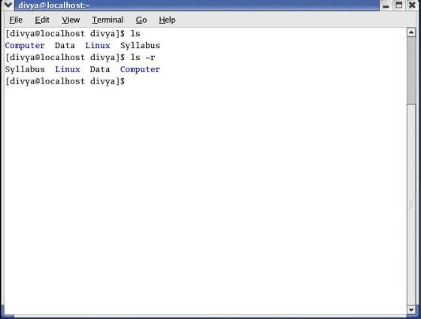
Options

Slide 17
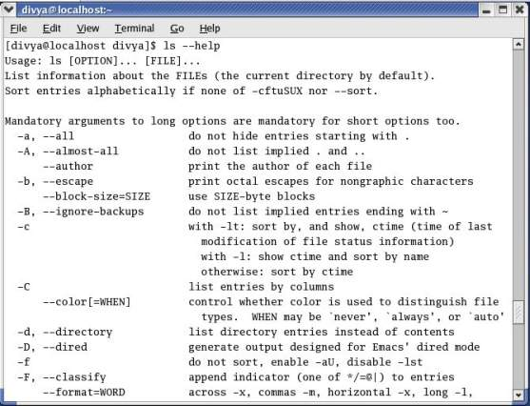
Options

Slide 18
Combining options
When you need to use several options, you can usually group multiple single-letter options into one argument that starts with a single hyphen; do not put SPACEs between the options.
You cannot combine options that are preceded by two hyphens in this way.
Specific rules for combining options depend on the program you are running.

Slide 19
Option arguments
Some utilities have options that themselves require arguments.
For example, the gcc utility has a –o option that must be followed by the name you want to give the executable file that gcc generates.
Typically an argument to an option is separated from its option letter by a SPACE.

Slide 20
Arguments that start with a hyphen
Another convention allows utilities to work with arguments, such as filenames, that start with a hyphen. If a file’s name is –l, the following command is ambiguous:
$ ls -l
This command could mean you want ls to display a long listing of all files in the working directory or a listing of the file named –l.

Slide 21
Processing the Command Line
As you enter a command line, the Linux tty device driver (part of the Linux kernel) examines each character to see whether it must take immediate action.
CONTROL-H : to erase a character
CONTROL-U : to kill a line
CONTROL-W : to erase a word.

Slide 22
Processing the Command Line
When the character you entered does not require immediate action, the device driver stores the character in a buffer and waits for additional characters.
When you press RETURN, the device driver passes the command line to the shell for processing.

Slide 23

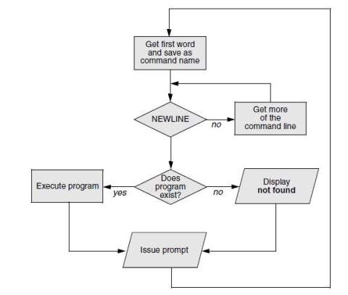
Processing the Command Line

Slide 24
Parsing the command line
When the shell processes a command line, it looks at the line as a whole and parses (breaks) it into its component parts.
Next, the shell looks for the name of the command. Usually the name of the command is the first item on the command line after the prompt (argument zero).
The shell typically takes the first characters on the command line up to the first blank (TAB or SPACE) and then looks for a command with that name.

Slide 25
Parsing the command line
The command name (the first token) can be specified on the command line either as a simple filename or as a pathname.
For example, you can call the ls command in either of the following ways:
$ ls
$ /bin/ls

Slide 26
Pathnames
There are two ways to give the pathnames:
Absolute Pathnames
Relative Pathnames

Slide 27
Executing the Command Line
If it finds an executable file with the same name as the command, the shell starts a new process.
A process is the execution of a command by Linux.
The shell makes each command-line argument, including options and the name of the command, available to the called program.

Slide 28
Executing the Command Line
While the command is executing, the shell waits for the process to finish. At this point the shell is in an inactive state called sleep.
When the program finishes execution, it passes its exit status to the shell. The shell then returns to an active state (wakes up), issues a prompt, and waits for another command.

Slide 29
Editing the Command Line
You can repeat and edit previous commands and edit the current command line.

