Slide 1
Linux and Shell Scripting

Slide 2
Learning Outcomes
Understand the Standard Input and Standard Output

Slide 3
Standard Input and Standard Output
Standard output is a place a program can send information, such as text.
The program never “knows” where the information it sends to standard output is going.
The information can go to a printer, an ordinary file, or the screen.
By default the shell directs standard output from a command to the screen.

Slide 4

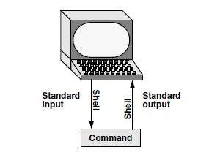
Standard Input and Standard Output

Slide 5
Standard Input and Standard Output
Standard input is a place that a program gets information from.
As with standard output the program never “knows” where the information comes from.
In addition to standard input and standard output, a running program normally has a place to send error messages: standard error.

Slide 6
The Screen as a File
Linux have an additional type of file: a device file.
A device file resides in the Linux file structure, usually in the /dev directory, and represents a peripheral device, such as a screen and keyboard, printer, or disk drive.
The device name that the who utility displays after your username is the filename of the screen and keyboard.

Slide 7
The Keyboard and Screen as Standard Input and Standard Output
When you first log in, the shell directs standard output of your commands to the device file that represents the screen. Directing output in this manner causes it to appear on the screen.

Slide 8
cat utility
The cat utility provides a good example of the way the keyboard and screen function as standard input and standard output, respectively.
When you use cat, it copies a file to standard output. Because the shell directs standard output to the screen, cat displays the file on the screen.

Slide 9
cat utility
Up to this point cat has taken its input from the filename (argument) you specify on the command line.

Slide 10
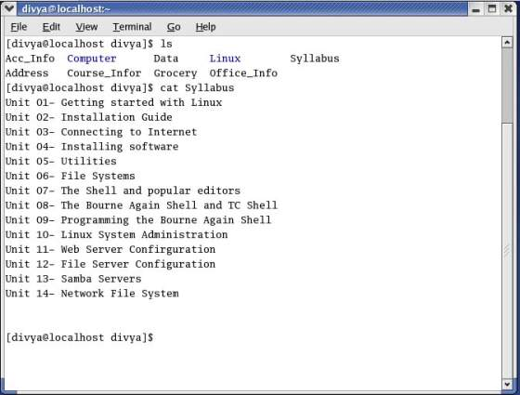
cat utility

Slide 11
cat utility
When you do not give cat an argument (that is, when you give the command cat followed immediately by RETURN), cat takes its input from standard input.
Thus, when called without an argument, cat copies standard input to standard output, one line at a time.

Slide 12
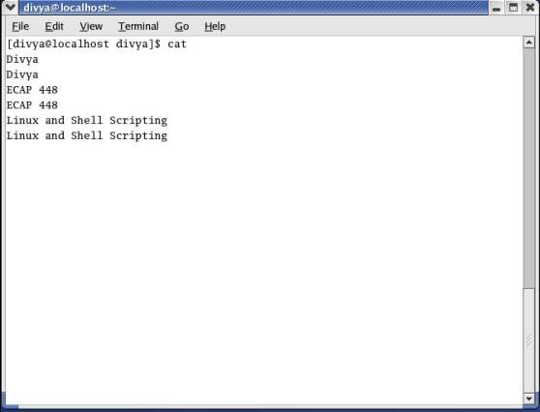
cat utility

Slide 13
cat utility
Because the shell associates cat’s standard input with the keyboard and cat’s standard output with the screen, when you type a line of text cat copies the text from standard input (the keyboard) to standard output (the screen).

Slide 14
Cat utility
The cat utility keeps copying text until you enter CONTROL-D on a line by itself.
Pressing CONTROL-D sends an EOF (end of file) signal to cat to indicate that it has reached the end of standard input and there is no more text for it to copy.
The cat utility then finishes execution and returns control to the shell, which displays a prompt.

Slide 15
Redirection
The term redirection encompasses the various ways you can cause the shell to alter where standard input of a command comes from and where standard output goes to.
By default the shell associates standard input and standard output of a command with the keyboard and the screen.

Slide 16
Redirection
You can cause the shell to redirect standard input or standard output of any command by associating the input or output with a command or file other than the device file representing the keyboard and the screen.

Slide 17
Redirecting Standard Output
The redirect output symbol (>) instructs the shell to redirect the output of a command to the specified file instead of to the screen.

Slide 18
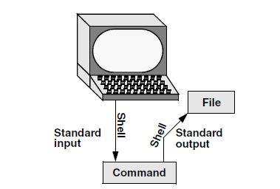
Redirecting Standard Output

Slide 19
Redirecting Standard Output
The format of a command line that redirects output is
command [arguments] > filename
where command is any executable program (such as an application program or a utility), arguments are optional arguments, and filename is the name of the ordinary file the shell redirects the output to.

Slide 20
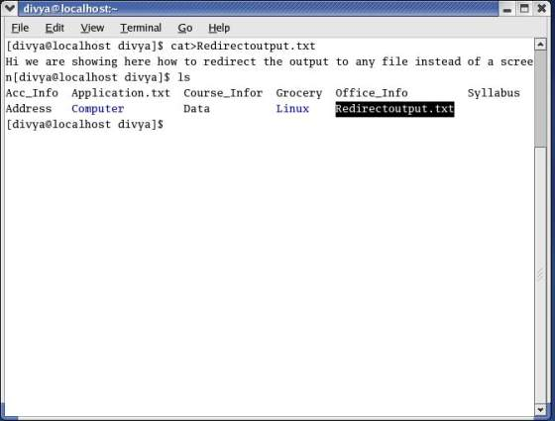
Redirecting Standard Output

Slide 21
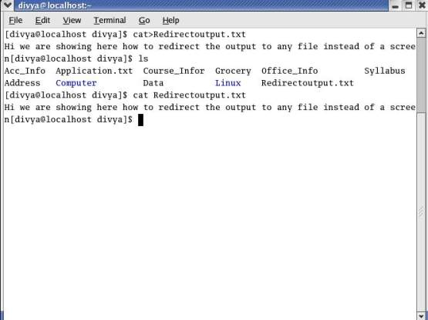
Redirecting Standard Output

Slide 22
Redirecting Standard Output
The redirect output symbol on the command line causes the shell to associate cat’s standard output with the redirectoutput.txt file specified on the command line.

Slide 23
Redirecting Standard Output
Redirecting standard output from cat is a handy way to create a file without using an editor.
The drawback is that once you enter a line and press RETURN, you cannot edit the text.
While you are entering a line, the erase and kill keys work to delete text.
This procedure is useful for creating short, simple files.

Slide 24
Redirecting Standard Output
The cat is used and the redirect output symbol to catenate (join one after the other—the derivation of the name of the cat utility) several files into one larger file.

Slide 25
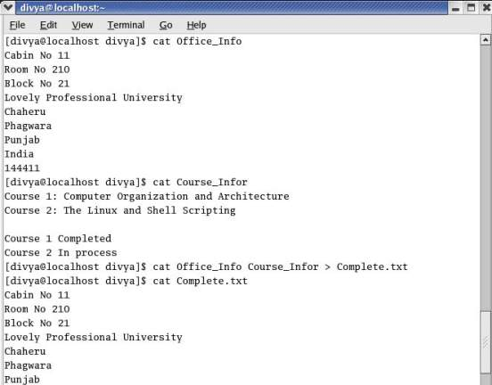
Redirecting Standard Output

Slide 26
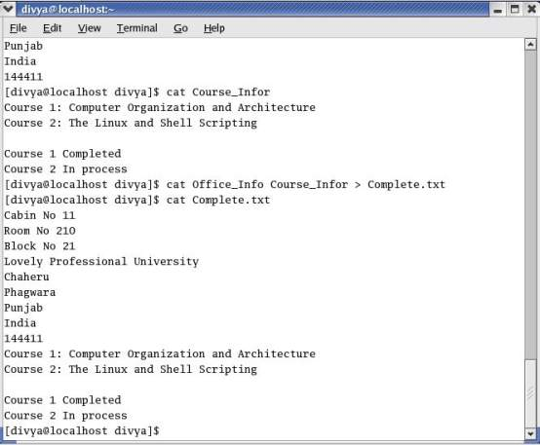
Redirecting Standard Output

Slide 27
Redirecting Standard Input
The redirect input symbol (<) instructs the shell to redirect a command’s input to come from the specified file instead of from the keyboard.

Slide 28
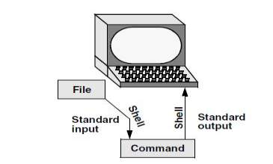
Redirecting Standard Input

Slide 29
Redirecting Standard Input
The format of a command line that redirects input is
command [arguments] < filename
where command is any executable program (such as an application program or a utility), arguments are optional arguments, and filename is the name of the ordinary file the shell redirects the input from.

Slide 30
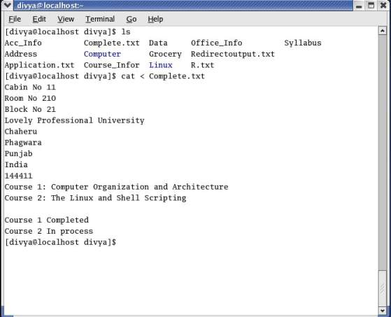
Redirecting Standard Input

Slide 31
noclobber: Avoids Overwriting Files
The shell provides the noclobber feature that prevents overwriting a file using redirection.
Under bash you can enable this feature by setting noclobber using the command set –o noclobber. The same command with +o unsets noclobber.
Under tcsh use set noclobber and unset noclobber.

Slide 32
noclobber: Avoids Overwriting Files
With noclobber set, if you redirect output to an existing file, the shell displays an error message and does not execute the command.

Slide 33
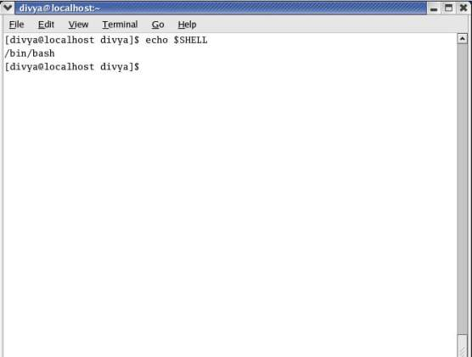
Checking for Shell

Slide 34
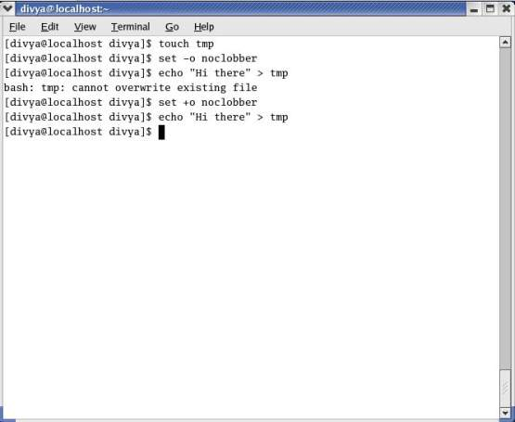
noclobber: Avoids Overwriting Files

Slide 35
Appending Standard Output to a File
The append output symbol (>>) causes the shell to add new information to the end of a file, leaving existing information intact. This symbol provides a convenient way of catenating two files into one.

Slide 36
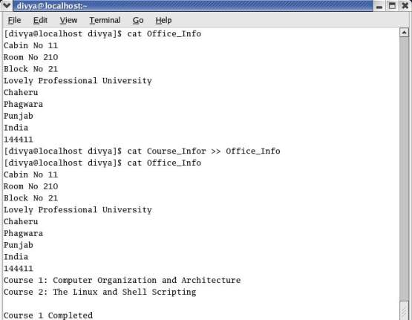
Appending Standard Output to a File

Slide 37
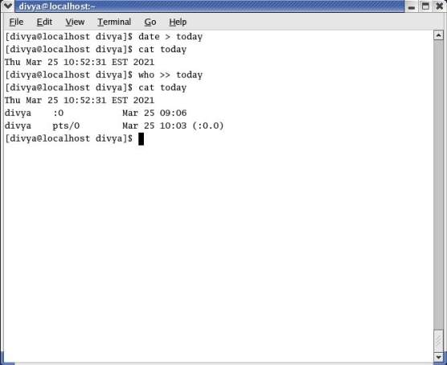
Redirecting and appending output

Slide 38
/dev/null: Making Data Disappear
The /dev/null device is a data sink, commonly referred to as a bit bucket. You can redirect output that you do not want to keep or see to /dev/null and the output will disappear without a trace.

Slide 39
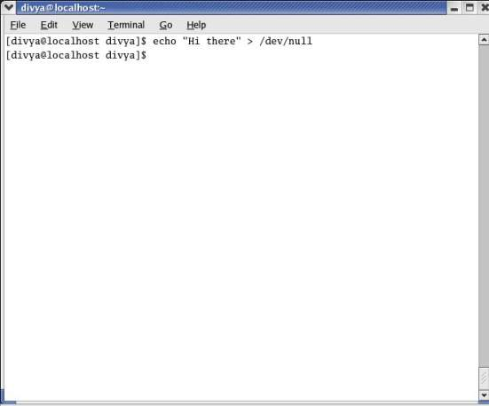
/dev/null: Making Data Disappear

Slide 40
Pipes
The shell uses a pipe to connect standard output of one command to standard input of another command.
A pipe (sometimes referred to as a pipeline) has the same effect as redirecting standard output of one command to a file and then using that file as standard input to another command.
The symbol for a pipe is a vertical bar (|).

Slide 41
Pipes
The syntax of a command line using a pipe is
command_a [arguments] | command_b [arguments]
The preceding command line uses a pipe on a single command line to generate the same result as the following three command lines:
command_a [arguments] > temp
command_b [arguments] < temp
rm temp

Slide 42
Filters
A filter is a command that processes an input stream of data to produce an output stream of data.
A command line that includes a filter uses a pipe to connect standard output of one command to the filter’s standard input.
Another pipe connects the filter’s standard output to standard input of another command. Not all utilities can be used as filters.

Slide 43
Filters
In this example, sort is a filter, taking standard input from standard output of who and using a pipe to redirect standard output to standard input of lpr. This command line sends the sorted output of who to the printer: $ who | sort | lpr

Slide 44
tee: Sends Output in Two Directions
The tee utility copies its standard input both to a file and to standard output.
This utility is aptly named: It takes a single stream of input and sends the output in two directions.

Slide 45
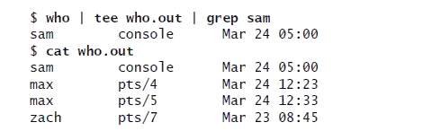
tee: Sends Output in Two Directions

Slide 46
tee: Sends Output in Two Directions
The output of who is sent via a pipe to standard input of tee.
The tee utility saves a copy of standard input in a file named who.out and also sends a copy to standard output.
Standard output of tee goes via a pipe to standard input of grep, which displays only those lines containing the string sam.

