Slide 1
Linux and Shell Scripting

Slide 2
Learning Outcomes
Know how to use vim
Understand the features of vim

Slide 3
What not is vim?
The vim editor is not a text formatting program.
It does not justify margins or provide the output formatting features of a sophisticated word processing system such as OpenOffice.org Writer

Slide 4
What is vim?
It is a sophisticated text editor meant to be used to write code (C, HTML, Java, etc.), short notes, and input to a text formatting system, such as groff or troff.

Slide 5
Using vim
How to start vim,
Enter text,
Move the cursor,
Correct text,
Save the file to the disk,
Exit from vim.

Slide 6
Starting vim
Start vim with the following command to create and edit a file named practice:
$ vim practice

Slide 7
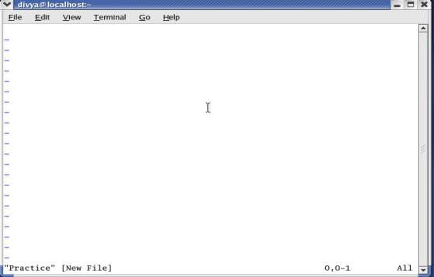
Starting vim
Tildes indicate that the page is blank

Slide 8
Starting vim
If you call vim without specifying a filename on the command line, vim assumes that you are a novice and tells you how to get started.
$ vim

Slide 9
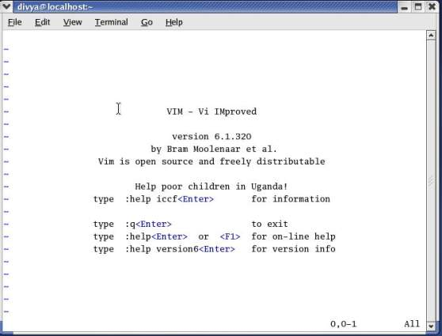
Starting vim

Slide 10

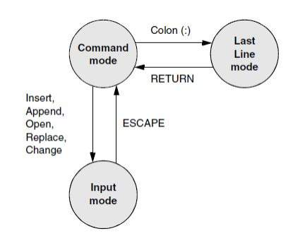
Modes in vim

Slide 11
Modes in vim
Two of vim’s modes of operation are Command mode (also called Normal mode) and Input mode.
While vim is in Command mode, you can give vim commands. For example, you can delete text or exit from vim. You can also command vim to enter Input mode.
In Input mode, vim accepts anything you enter as text and displays it on the screen.

Slide 12
Modes in vim
The colon (:) in the preceding command puts vim into another mode, Last Line mode.
While in this mode, vim keeps the cursor on the bottom line of the screen. When you press RETURN to finish entering the command, vim restores the cursor to its place in the text.

Slide 13
Modes in vim
Press ESCAPE to return vim to Command mode.
By default the vim editor informs you about which mode it is in: It displays INSERT at the lower-left corner of the screen while it is in Insert mode.

Slide 14
Entering Text
When you start vim, you must put it in Input mode before you can enter text.
To put vim in Input mode, press the i (insert before cursor) key or the a (append after cursor) key.

Slide 15
Entering Text
If you are not sure whether vim is in Input mode, press the ESCAPE key; vim returns to Command mode if it is in Input mode or beeps, flashes, or does nothing if it is already in Command mode.
You can put vim back in Input mode by pressing the i or a key again.
While vim is in Input mode, you can enter text by typing on the keyboard. If the text does not appear on the screen as you type, vim is not in Input mode.

Slide 16
Correcting Text
The keys that back up and correct a shell command line serve the same functions when vim is in Input mode.
These keys include the erase, line kill, and word kill keys (usually CONTROL-H, CONTROL-U, and CONTROL-W, respectively).

Slide 17
Moving the Cursor
To delete, insert, and correct text, you need to move the cursor on the screen.
While vim is in Command mode, you can use the RETURN key, the SPACE bar, and the ARROW keys to move the cursor.
You can use the h, j, k, and l (lowercase “l”) keys to move the cursor left, down, up, and right, respectively.

Slide 18
Deleting Text
Deleting a single character: x
Deleting a word: dw
Deleting a line of text: dd

Slide 19
Undoing Mistakes
Give the command u (Undo) immediately after the command you want to undo.
If you give the u command again, vim will undo the command you gave before the one it just undid. You can use this technique to back up over many of your actions.

Slide 20
Undoing Mistakes
If you undo a command you did not mean to undo, give a Redo command: CONTROL-R or :redo (followed by a RETURN).
As with the Undo command, you can give the Redo command many times in a row.

Slide 21
Entering Additional Text
When you want to insert new text within existing text, move the cursor so it is on the character that follows the new text you plan to enter.
Then give the i (Insert) command to put vim in Input mode, enter the new text, and press ESCAPE to return vim to Command mode.
Alternatively, you can position the cursor on the character that precedes the new text and use the a (Append) command.

Slide 22
Entering Additional Text
To enter one or more lines, position the cursor on the line above where you want the new text to go.
Give the command o (Open).
The vim editor opens a blank line below the line the cursor was on, puts the cursor on the new, empty line, and enters Input mode.

Slide 23
Entering Additional Text
Enter the new text, ending each line with a RETURN. When you are finished entering text, press ESCAPE to return vim to Command mode.
The O command works in the same way as the o command, except it opens a blank line above the current line.

Slide 24
Correcting Text
To correct text, use dd, dw, or x to remove the incorrect text. Then use i, a, o, or O to insert the correct text.

Slide 25
Example
To change the word pressing to hitting in, you might use the ARROW keys to move the cursor until it is on top of the p in pressing.
Then give the command dw to delete the word pressing. Put vim in Input mode by giving an i command, enter the word hitting followed by a SPACE, and press ESCAPE.

Slide 26
Example
The word is changed and vim is in Command mode, waiting for another command.
A shorthand for the two commands dw followed by the i command is cw (Change word). The cw command puts vim into Input mode.

Slide 27
Ending the Editing Session
While you are editing, vim keeps the edited text in an area named the Work buffer.
Use the ZZ command (you must use uppercase Zs) to write the newly entered text to the disk.
You can exit with :q! if you do not want to save your work.

Slide 28
Introduction to vim Features
Online help,
Modes of operation,
The work buffer,
Emergency procedures,
Other vim features.

Slide 29
Online Help
Give the command :help feature to display information about feature.
As you scroll through the various help texts, you will see words with a bar on either side, such as |tutor|.
These words are active links: Move the cursor on top of an active link and press CONTROL-] to jump to the linked text.

Slide 30
Online Help
Use CONTROL-o (lowercase “o”) to jump back to where you were in the help text. You can also use the active link words in place of feature. For example, you might see the reference |credits|; you could enter :help credits RETURN to read more about credits. Enter :q! to close a help window.

Slide 31
Online Help
You can also give the command :help doc-file-list to view a complete list of the help files.

Slide 32
Terminology
Current character: The character the cursor is on.
Current line: The line the cursor is on.
Status line: The last or bottom line of the screen. This line is reserved for Last Line mode and status information. Text you are editing does not appear on this line.

Slide 33
Modes of Operation
The vim editor is part of the ex editor, which has five modes of operation:
ex Command mode
ex Input mode
vim Command mode
vim Input mode
vim Last Line mode

Slide 34
Modes of Operation
While in Command mode, vim accepts keystrokes as commands, responding to each command as you enter it. It does not display the characters you type in this mode.
While in Input mode, vim accepts and displays keystrokes as text that it eventually puts into the file you are editing.
All commands that start with a colon (:) put vim in Last Line mode. The colon moves the cursor to the status line of the screen, where you enter the rest of the command.

Slide 35
Modes of Operation
When you give a command in Command mode, you do not terminate the command with a RETURN.
In contrast, you must terminate all Last Line mode commands with a RETURN.

Slide 36
Modes of Operation
When an editing session begins, vim is in Command mode.
Several commands, including Insert and Append, put vim in Input mode.
When you press the ESCAPE key, vim always reverts to Command mode.

Slide 37
Modes of Operation
The Change and Replace commands combine the Command and Input modes.
The Change command deletes the text you want to change and puts vim in Input mode so you can insert new text.
The Replace command deletes the character(s) you overwrite and inserts the new one(s) you enter.

Slide 38
The Display
Status Line
The vim editor displays status information on the bottom line of the display area.
This information includes error messages, information about the deletion or addition of blocks of text, and file status information.
In addition, vim displays Last Line mode commands on the status line.

Slide 39
The Display
Redrawing the Screen
Sometimes the screen may become garbled or overwritten.
When vim puts characters on the screen, it sometimes leaves @ on a line instead of deleting the line.

Slide 40
The Display
When output from a program becomes intermixed with the display of the Work buffer, things can get even more confusing. The output does not become part of the Work buffer but affects only the display.
If the screen gets overwritten, press ESCAPE to make sure vim is in Command mode, and press CONTROL-L to redraw (refresh) the screen.

Slide 41
The Display
Tilde (~) Symbol
If the end of the file is displayed on the screen, vim marks lines that would appear past the end of the file with a tilde (~) at the left of the screen.

Slide 42
Correcting Text as You Insert It
While vim is in Input mode, you can use the erase and line kill keys to back up over text so you can correct it.
You can also use CONTROL-W to back up over words.

Slide 43
Work Buffer
The vim editor does all its work in the Work buffer.
At the beginning of an editing session, vim reads the file you are editing from the disk into the Work buffer.
During the editing session, it makes all changes to this copy of the file but does not change the file on the disk until you write the contents of the Work buffer back to the disk.

Slide 44
Work Buffer
Normally when you end an editing session, you tell vim to write the contents of the Work buffer, which makes the changes to the text final.

Slide 45
Advantage and Disadvantage of Work Buffer
If you accidentally end an editing session without writing out the contents of the Work buffer, your work is lost.
However, if you unintentionally make some major changes (such as deleting the entire contents of the Work buffer), you can end the editing session without implementing the changes.

Slide 46
Work Buffer
To look at a file but not to change it while you are working with vim, you can use the view utility: $ view filename
Calling the view utility is the same as calling the vim editor with the –R (readonly) option.

Slide 47
Line Length and File Size
The vim editor operates on files of any format.
The total length of the file is limited only by available disk space and memory.

Slide 48
Windows
The vim editor allows you to open, close, and hide multiple windows, each of which allows you to edit a different file.
Give the command :help windows to display a complete list of windows commands.

Slide 49
Abnormal Termination of an Editing Session
You can end an editing session in one of two ways: When you exit from vim, you can save the changes you made during the editing session or you can abandon those changes.
You can use the ZZ or :wq command from Command mode to save the changes and exit from vim.
To end an editing session without writing out the contents of the Work buffer, give the following command: :q!

Slide 50
Abnormal Termination of an Editing Session
Use the :q! command cautiously. When you use this command to end an editing session, vim does not preserve the contents of the Work buffer, so you will lose any work you did since the last time you wrote the Work buffer to disk.
:w filename: Use this to save the file with a name.

Slide 51
Recovering Text After a Crash
The vim editor temporarily stores the file you are working on in a swap file.
If the system crashes while you are editing a file with vim, you can often recover its text from the swap file.
If someone else is editing the file, quit or open the file as a readonly file.
With the –r option, vim displays a list of swap files it has saved (some may be old).

Slide 52
Recovering Text After a Crash
If your work was saved, give the same command followed by a SPACE and the name of the file.
Give the command :w filename immediately to save the salvaged copy of the Work buffer to disk under a name different from the original file; then check the recovered file to make sure it is OK.

