Slide 1
Linux and Shell Scripting

Slide 2
Learning Outcomes
Understand the command mode and input mode

Slide 3
Command Mode
While vim is in Command mode, you can position the cursor over any character on the screen.

Slide 4

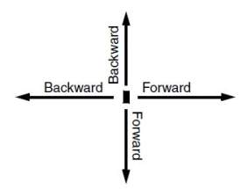
Forward and Backward
Forward means toward the right and bottom of the screen and the end of the file.
Backward means toward the left and top of the screen and the beginning of the file.

Slide 5
Moving the Cursor
When you use a command that moves the cursor forward past the end (right) of a line, the cursor generally moves to the beginning (left) of the next line.
When you move it backward past the beginning of a line, the cursor generally moves to the end of the previous line.

Slide 6
Moving the Cursor
Sometimes a line in the Work buffer may be too long to appear as a single line on the screen.
In such a case vim wraps the current line onto the next line.

Slide 7
Moving the Cursor
You can move the cursor through the text by any Unit of Measure (that is, character, word, line, sentence, paragraph, or screen).
If you precede a cursor-movement command with a number, called a Repeat Factor, the cursor moves that number of units through the text.

Slide 8
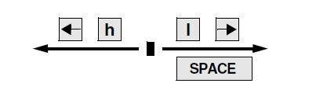
Moving the Cursor by Characters
Forward: Space bar, l and Right Arrow Key
Backward: h and Left Arrow Key

Slide 9
Moving the Cursor by Characters
For example, the command 7 SPACE or 7l moves the cursor seven characters to the right.

Slide 10
Moving the Cursor to a Specific Character
You can move the cursor to the next occurrence of a specified character on the current line by using the Find command.
For example, the following command moves the cursor from its current position to the next occurrence of the character a, if one appears on the same line: fa

Slide 11
Moving the Cursor to a Specific Character
You can also find the previous occurrence by using a capital F. The following command moves the cursor to the position of the closest previous a in the current line: Fa
A semicolon (;) repeats the last Find command.

Slide 12
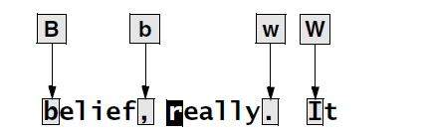
Moving the Cursor by Words
W and w: Moves the cursor forward
B and b: Moves the cursor backwards
E and e: Moves the cursor to the end of the next word.

Slide 13
Moving the Cursor by Words
Groups of punctuation count as words.
The command 15w moves the cursor to the first character of the fifteenth subsequent word.
The W key is similar to the w key but moves the cursor by blank-delimited words, including punctuation, as it skips forward.

Slide 14
Moving the Cursor by Words
The B key moves the cursor backward by blank-delimited words.
E moves it to the end of the next blank-delimited word.

Slide 15
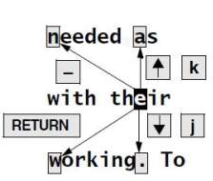
Moving the Cursor by Lines
RETURN: To the beginning of next line.
j/ DOWN Arrow: Down one line to the character just
below the current character.
k and UP Arrow: Up one line to the character just
above the current character.
-: To the end of the next line.
): Forward to the beginning of the next sentence.
}: Forward to the beginning of the next paragraph.
(: Backward to the beginning of current sentence.
{: Backward to the beginning of current paragraph.

Slide 16
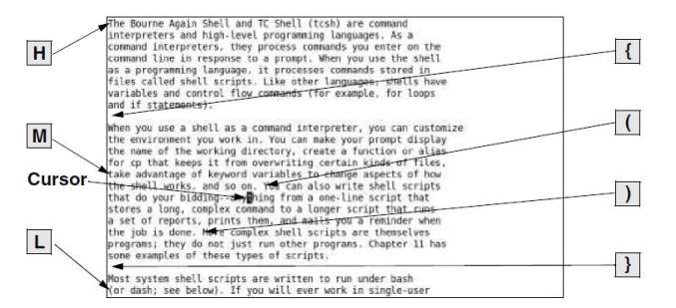
Moving the Cursor Within the Screen
H: To the left end of the top line of the screen
M: To the middle line
L: To the bottom line

Slide 17
Viewing Different Parts of the Work Buffer
The screen displays a portion of the text that is in the Work buffer.
You can display the text preceding or following the text on the screen by scrolling the display.
You can also display a portion of the Work buffer based on a line number.

Slide 18
Viewing Different Parts of the Work Buffer
Press CONTROL-D to scroll the screen down (forward) through the file so that vim displays half a screen of new text.
Use CONTROL-U to scroll the screen up (backward) by the same amount.
If you precede either of these commands with a number, vim scrolls that number of lines each time you press CONTROL-D or CONTROL-U for the rest of the session (unless you again change the number of lines to scroll).

Slide 19
Viewing Different Parts of the Work Buffer
The CONTROL-F (forward) and CONTROL-B (backward) keys display almost a whole screen of new text, leaving a couple of lines from the previous screen for continuity.
On many keyboards you can use the PAGE DOWN and PAGE UP keys in place of CONTROL-F and CONTROL-B, respectively.

Slide 20
Input Mode
The Insert, Append, Open, Change, and Replace commands put vim in Input mode.
While vim is in this mode, you can put new text into the Work buffer.
To return vim to Command mode when you finish entering text, press the ESCAPE key.

Slide 21
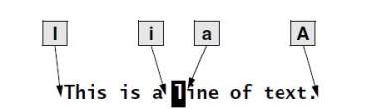
Inserting Text
i: Put vim in the insert mode and places the text before the current character.
I: Places the text at the beginning of the current line.
a: Places the text after the current character.
A: Places the text after the current line.
o: Opens a new line below the current line.
O: Opens a new line above the current line.

Slide 22
Replacing Text
The r and R (Replace) commands cause the new text you enter to overwrite (replace) existing text. The single character you enter following an r command overwrites the current character. After you enter that character, vim returns to Command mode—you do not need to press the ESCAPE key.
The R command causes all subsequent characters to overwrite existing text until you press ESCAPE to return vim to Command mode.

Slide 23
Quoting Special Characters in Input Mode
While you are in Input mode, you can use the Quote command, CONTROL-V, to enter any character into the text, including characters that normally have special meaning to vim.
Among these characters are CONTROL-L (or CONTROL-R), which redraws the screen; CONTROL-W, which backs the cursor up a word to the left; CONTROL-M, which enters a NEWLINE; and ESCAPE, which ends Input mode.

Slide 24
Quoting Special Characters in Input Mode
To insert one of these characters into the text, type CONTROL-V followed by the character. CONTROL-V quotes the single character that follows it.
For example, to insert the sequence ESCAPE[2J into a file you are creating in vim, you would type the character sequence CONTROL-V ESCAPE[2

Slide 25
Command Mode: Deleting and Changing Text
Undoing changes
Deleting characters
Deleting text
Changing text
Replacing text
Changing case

Slide 26
Undoing Changes
The u command (Undo) restores text that you just deleted or changed by mistake.
A single Undo command restores only the most recently deleted text.
With the compatible parameter set, vim can undo only the most recent change.
The U command restores the last line you changed to the way it was before you started changing it, even after several changes.

Slide 27
Deleting Characters
The x command deletes the current character.
You can precede the x command by a Repeat Factor to delete several characters on the current line, starting with the current character.
The X command deletes the character to the left of the cursor.

Slide 28
Deleting Text
The d (Delete) command removes text from the Work buffer.
The amount of text that d removes depends on the Repeat Factor and the Unit of Measure.
After the text is deleted, vim is still in Command mode.

Slide 29
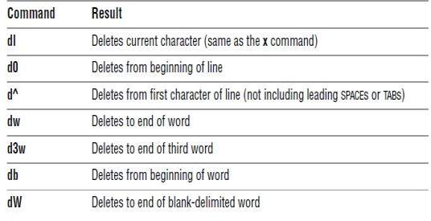
Deleting Text

Slide 30
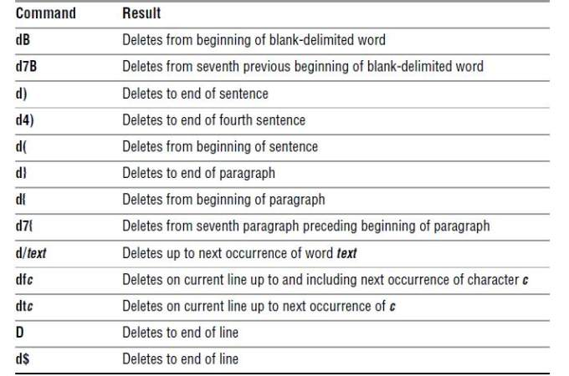
Deleting Text

Slide 31
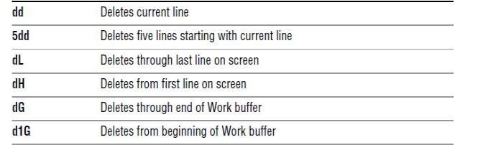
Deleting Text

Slide 32
Changing Text
The c (Change) command replaces existing text with new text.
The new text does not have to occupy the same space as the existing text.
You can change a word to several words, a line to several lines, or a paragraph to a single character.
The C command replaces the text from the cursor position to the end of the line.

Slide 33
Changing Text
The c command deletes the amount of text specified by the Repeat Factor and the Unit of Measure and puts vim in Input mode.
When you finish entering the new text and press ESCAPE, the old word, line, sentence, or paragraph is changed to the new one.
Pressing ESCAPE without entering new text deletes the specified text (that is, it replaces the specified text with nothing).

Slide 34
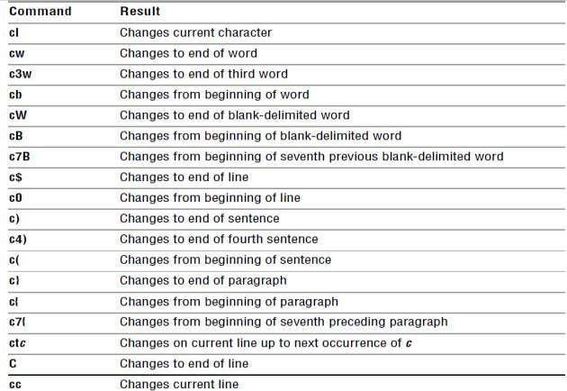
Changing Text

Slide 35
Replacing Text
The s and S (Substitute) commands also replace existing text with new text.
The s command deletes the current character and puts vim into Input mode.
It has the effect of replacing the current character with whatever you type until you press ESCAPE.

Slide 36
Replacing Text
The S command does the same thing as the cc command: It changes the current line.
The s command replaces characters only on the current line.
If you specify a Repeat Factor before an s command and this action would replace more characters than are present on the current line, s changes characters only to the end of the line (same as C).

Slide 37
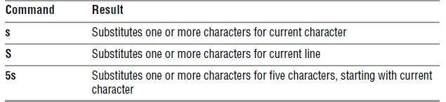
Replacing Text

Slide 38
Changing Case
The tilde (~) character changes the case of the current character from uppercase to lowercase, or vice versa.
You can precede the tilde with a number to specify the number of characters you want the command to affect.
For example, the command 5~ transposes the next five characters starting with the character under the cursor, but will not transpose characters past the end of the current line.

