Slide 1
Linux and Shell Scripting

Slide 2
Learning Outcomes
know the difference between emacs and vim
understand the functionalities in emacs
understand the basic editing commands in emacs

Slide 3
Introduction
Emacs is one of the oldest and most versatile text editors available for Linux and UNIX-based systems.
It’s been around for a long time (more than twenty years for GNU emacs) and is well known for its powerful and rich editing features.
The emacs editor, which is coded in C, contains a complete Lisp interpreter and fully supports the X Window System and mouse interaction.

Slide 4
Introduction
Version 22 has significant internationalization upgrades: an extended UTF-8 internal character set four times bigger than Unicode, along with fonts and keyboard input methods for more than 30 languages.
Also, the user interface is moving in the direction of a WYSIWYG (what you see is what you get) word processor, which makes it easier for beginners to use the editor.

Slide 5
Introduction
You never need to switch emacs between Input and Command modes, emacs is a modeless editor.

Slide 6
emacs Versus vim
Like vim, emacs is a display editor: It displays on the screen the text you are editing and changes the display as you type each command or insert new text.
Unlike vim, emacs does not require you to keep track of whether you are in Command mode or Insert mode: Commands always use CONTROL or other special keys.

Slide 7
emacs Versus vim
The emacs editor inserts ordinary characters into the text you are editing (as opposed to using ordinary characters as commands), another trait of modeless editing. For many people this approach is convenient and natural.

Slide 8
emacs Versus vim
As with vim, you use emacs to edit a file in a work area, or buffer, and have the option of writing this buffer back to the file on the disk when you are finished.
With emacs, however, you can have many work buffers and switch among them without having to write the buffer out and read it back in.

Slide 9
emacs Versus vim
Like vim, emacs has a rich, extensive command set for moving about in the buffer and altering text. This command set is not “cast in concrete”—you can change or customize commands at any time.

Slide 10
emacs Versus vim
Finally, and very unlike vim, emacs allows you to use Lisp to write new commands or override old ones. This feature is called online extensibility,

Slide 11
Getting Started with emacs
Starting emacs
To edit a file named sample using emacs as a text-based editor, enter the following command:
$ emacs -nw -q sample

Slide 12
Getting Started with emacs
–nw option: which must be the first option on the emacs command line, tells emacs not to use its X interface (GUI).
–q option: tells emacs not to read the ~/.emacs startup file. Not reading this file guarantees that emacs will behave in a standard manner and can be useful for beginners or for other users who want to bypass a .emacs file.

Slide 13
Getting Started with emacs
$ emacs -nw -q sample
This command starts emacs, reads the file named sample into a buffer, and displays its contents on the screen or window.

Slide 14
Getting Started with emacs
If no file has this name, emacs displays a blank screen with (New File) at the bottom.

Slide 15
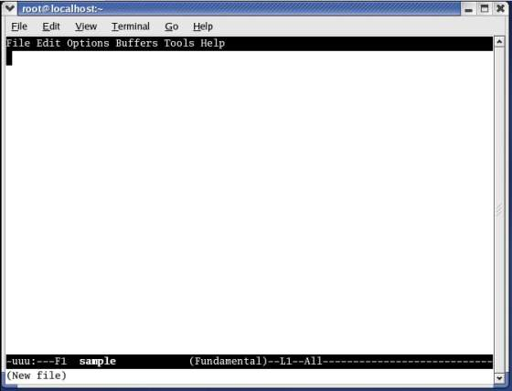
Getting Started with emacs

Slide 16
Getting Started with emacs
If the file exists, emacs displays the file and a different message.

Slide 17
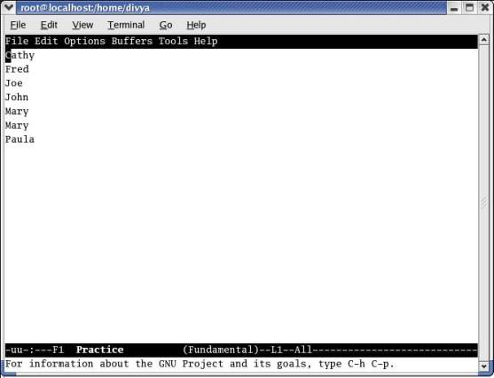
Getting Started with emacs

Slide 18
Getting Started with emacs
If you start emacs without naming a file on the command line, it displays a welcome screen that includes usage information and a list of basic commands.

Slide 19
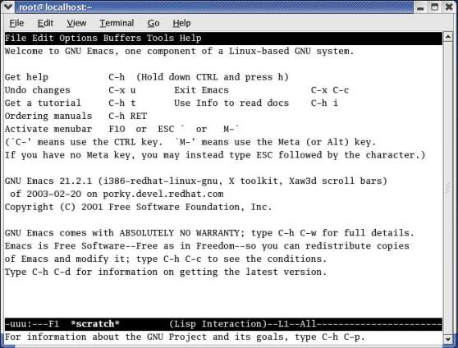
Getting Started with emacs

Slide 20
Getting Started with emacs

Slide 21
Getting Started with emacs
Initially, emacs displays a single window.
At the top of the window is a reverse-video menubar that you can access using a mouse or keyboard.
From the keyboard, F10, META-‘ (back tick), or META-x tmm-menubar RETURN displays the Menubar Completion List window.

Slide 22
Getting Started with emacs
At the bottom of the emacs window is a reverse-video titlebar called the Mode Line.
At a minimum, the Mode Line shows which buffer the window is viewing, whether the buffer has been changed, which major and minor modes are in effect, and how far down the buffer the window is positioned.

Slide 23
Getting Started with emacs
When multiple windows appear on the screen, one Mode Line appears in each window.
At the bottom of the screen, emacs leaves a single line open.
This Echo Area and Minibuffer line (they coexist on one line) is used for messages and special one-line commands.

Slide 24
Getting Started with emacs
If you make an error while you are typing in the Minibuffer, emacs displays the error message in the Echo Area. The error message overwrites the command you were typing, but emacs restores the command in a few seconds.

Slide 25
Getting Started with emacs
A cursor is either in the window or in the Minibuffer.
All input and nearly all editing take place at the cursor.
As you type ordinary characters, emacs inserts them at the cursor position.
If characters are under the cursor or to its right, they are pushed to the right as you type, so no characters are lost.

Slide 26
Getting Started with emacs
Exiting
The command to exit from emacs is CONTROL-X CONTROL-C.
If you want to cancel a half-typed command or stop a running command before it is done, press CONTROL-G.
The emacs editor displays Quit in the Echo Area and waits for another command.

Slide 27
Getting Started with emacs
Inserting Text
Typing an ordinary (printing) character pushes the cursor and any characters to the right of the cursor one position to the right and inserts the new character in the space opened by moving the characters.

Slide 28
Getting Started with emacs
Deleting Characters
Depending on the keyboard and the emacs startup file, different keys may delete characters in different ways.
CONTROL-D typically deletes the character under the cursor, as do DELETE and DEL.
BACKSPACE typically deletes the character to the left of the cursor.

Slide 29
Getting Started with emacs
Moving the Cursor
You can position the cursor over any character in the emacs window and move the window so it displays any portion of the buffer.
You can move the cursor forward or backward through the text various textual units—for example, characters, words, sentences, lines, and paragraphs.

Slide 30


Getting Started with emacs
Moving the Cursor by Characters
Control – B / Left Arrow Key: Moves the cursor backward one character.
Control – F / Right Arrow Key: Moves the cursor forward one character.

Slide 31
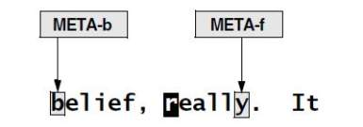
Getting Started with emacs
Moving the Cursor by Words
META-f: Moves the cursor forward one word. To invoke this command, hold
down the META or ALT key while you press f. If the keyboard you are using does not have either of these keys, press ESCAPE, release it, and then press f.
META-b: Moves the cursor backward one word, leaving the cursor on the first letter of the word it started on.

Slide 32
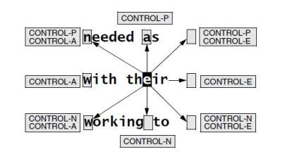
Getting Started with emacs
Moving the Cursor by Lines
CONTROL-A: Moves the cursor to the beginning of the line it is on;
CONTROL-E: Moves it to the end.
UP ARROW key or CONTROL-P: Moves the cursor up one line to the position directly above where the cursor started;
DOWN ARROW key or CONTROL-N: Moves it down.

Slide 33
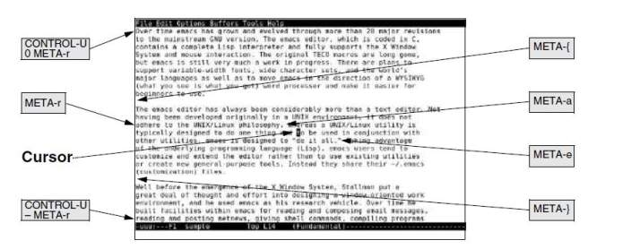
Getting Started with emacs
Moving the Cursor by Sentences, Paragraphs, and Window Position

Slide 34
Getting Started with emacs
META-a moves the cursor to the beginning of the sentence the cursor is on; META-e moves the cursor to the end.
META-{ moves the cursor to the beginning of the paragraph the cursor is on; META-} moves it to the end.
Pressing META-r moves the cursor to the beginning of the middle line of the window.

Slide 35
Getting Started with emacs
The command CONTROL-U 0 META-r moves the cursor to the beginning of the top line (line zero) in the window.
The command CONTROL-U– (minus sign) moves the cursor to the beginning of the last line of the window

Slide 36
Getting Started with emacs
Editing at the Cursor Position
Entering text requires no commands once you position the cursor in the window at the location you want to enter text. When you type text, emacs displays that text at the position of the cursor. Any text under or to the right of the cursor is pushed to the right.

Slide 37
Getting Started with emacs
Editing at the Cursor Position
Pressing BACKSPACE removes characters to the left of the cursor. The cursor and the remainder of the text on this line both move to the left each time you press BACKSPACE. To join a line with the line above it, position the cursor on the first character of the second line and press BACKSPACE. Press CONTROL-D to delete the character under the cursor.

Slide 38
Getting Started with emacs
Saving and Retrieving the Buffer
No matter what changes you make to a buffer during an emacs session, the associated file does not change until you save the buffer.
If you leave emacs without saving the buffer (emacs allows you to do so if you are persistent), the file is not changed and emacs discards the work you did during the session.

Slide 39
Getting Started with emacs
Saving and Retrieving the Buffer
The command CONTROL-X CONTROL-S saves the current buffer in its associated file.
The emacs editor confirms a successful save by displaying an appropriate message in the Echo Area.

Slide 40
The emacs GUI
Full mouse support was introduced in version 19.
The emacs editor is still evolving toward full internationalization, accessibility, and a simplified user experience that appeals to the widest possible audience.
New features include a colorful menubar and toolbar, mixed text and graphics, tooltips, drag and drop editing, and new GUIs for browsing directories and selecting fonts.

Slide 41
Basic Editing Commands
Command functions in emacs usually involve two or three keys.
The most common is the Ctrl key, followed by the Alt or Esc key. In emacs literature, Ctrl is shown in short form as “C”.
So if you see something like C-x C-c, it means “press the Ctrl key and x together, then press Ctrl and c”.
Similarly, if you see C-h t, it means “press Ctrl and h together, then release both keys and press t”.

Slide 42
Basic Editing Commands
Alt and Esc keys are referred to as “meta” key in emacs lingo.
So if you see a notation like M-x, it means “press Alt/Esc/Option/Edit key and x together”.
The Enter key is shown as RET (short for “Return”) and The Esc key is often shown as E.

Slide 43
Basic Editing Commands
Marking Text Regions
To mark a text region (similar to selecting text in popular word processors), follow these steps:
1) Move the cursor to the position where you would like the selection to start Press C-Space (Ctrl + Space Bar) or C-@ to set a mark. The mini buffer will show a status message of Mark set.
2) Move the cursor to the position where you want the region to end.

Slide 44
Basic Editing Commands
Marking Text Regions
To mark a text region (similar to selecting text in popular word processors), follow these steps:
3) The text will be highlighted up to the point where your cursor is now located.
4) If you want to “un-mark” the highlighted text, press C-Space or C-@ twice The mini buffer will show a status message of Mark deactivated.

Slide 45
Basic Editing Commands
Cut, Copy & Paste
Once you have the text region marked, you can copy or cut the text and paste it elsewhere.
For copying the text, press E-w
For cutting the text, press C-w

Slide 46
Basic Editing Commands
Cut, Copy & Paste
Move your cursor to the position where the text needs to be pasted.
Press C-y (y stands for “yank” - you are yanking the text from one position to another). The contents will be pasted here.

Slide 47
Basic Editing Commands
Deleting Text
For deleting, Backspace and Delete keys work just the way you would expect them to work.
For deleting a whole word, move the cursor at the beginning of a word and press M-d. For deleting multiple words, hold the meta key down and keep pressing d. Words will start deleting one by one.

Slide 48
Basic Editing Commands
Deleting Text
For deleting a whole line, position the cursor where you want it to be and press C-k. This would delete the text right up to the end of the line on screen.
For deleting a sentence, press M-k

Slide 49
Basic Editing Commands
Undo & Redo
Undoing the last operation is simple. Press C-x u. You can keep repeating this to go backwards. Another key combination is C-/ (Ctrl + /) or C-_ (Ctrl + _).
For redoing your last undo, press C-g, followed by C-_ (that’s Ctrl + Shift+ Underscore). Another way to do the same thing would be to press C-x C-u again (Undoing the Undo).

Slide 50
Basic Editing Commands
Search & Replace
There are two search directions in emacs: forward and backward. In forward search, the word you specify will be searched forward from the current cursor position. For backward search, it’s the other way round.
Press C-s for forward search
Press C-r for backward search

Slide 51
Basic Editing Commands
For replacing text, follow these steps:
Press M-% (that’s Alt + Shift + %). The mini buffer shows the prompt for the text to be searched (Query replace:).
Type the text and press Enter
The mini buffer displays a message like (Query replace <search_word> with:)
Type the replacing text and press Enter.

Slide 52
Basic Editing Commands
For replacing text, follow these steps:
For each match emacs finds, it will ask whether you would like to make a replacement (Query replacing <search_word> with <replace_word>: (C-h for help)). You can take any of the following actions:
Press y to replace the current match found.
Press n to skip to the next match.

Slide 53
Basic Editing Commands
For replacing text, follow these steps:
Press q to exit without any replacements (basically escaping).
Press ! to do a global replace without any prompts. (emacs will show a message likereplaced n occurrences)

Slide 54
Basic Editing Commands
Left, Right and Centre Alignment
For justifying a selected text region, follow these steps:
Create a text region to highlight the text you wish to justify
Press M-x. The mini buffer will await a response
Start typing set-justifiction- and press Tab.

Slide 55
Basic Editing Commands
Left, Right and Centre Alignment
You will be given completion options likeset-justification-center, set-justification-left, set-justification-right,set-justification-none and set-justification-full
Complete the justification command (for example set-justification-right) and press Enter.
The selected text will be justified.

Slide 56
Basic Editing Commands
Converting Case
Capitalizing a word after the cursor | M-c (c for Capitalize)
Converting a word to lower case | M-l (l for Lower case)
Converting a word to upper case | M-u (u for Upper case)

Slide 57
Basic Editing Commands
Converting Case
Converting a paragraph to upper case | Block select, then C-x C-u
Converting a paragraph to lower case | Block select, then C-x C-l

